Slide 1
Genetic Algorithms for Game Programming
Steve Gargolinski
steve.gargolinski@gmail.com
sgargolinski@maddocsoftware.com

Slide 2
The Basic Idea
We’re going to develop techniques based on the principals of evolutionary biology in order to find solutions to problems.

Slide 3
First, Some Biology
How we survive as a species
  Reproduction
DNA
  Chromosomes
    Genes
      Nucleotides: Thymine, Adenine, Cytosine, Guanine
Genome = chromosomes + all other hereditary information

Slide 4
How We Evolve
Natural Selection
  Strong members of a population survive to reproduce, passing on their ‘strong’ traits
  Crossover
    Some from parent A, some from parent B
  Mutation
    A strange flipped gene that cannot be traced back to a parent

Slide 5
Biology -> Genetic Algorithm
Gene = smallest atom of data
  Usually binary, so 0 or 1
Genome = string of genes
  0111010010010101
Genome Pool = set of genomes
  Represents our population

Slide 6
The Basic Idea
Start with a completely random genome pool
  Each of these decomposes to a (potential) solution to our problem.
Gradually evolve our way to a solution

Slide 7
Fitness/Strength Heuristic
Turns a binary string into a single floating point value based on how close to our desired result it is.
  Maps back to how well an organism can survive in an environment.
  0.0f = terrible
  1.0f = absolute solution

Slide 8
A Basic Genetic Algorithm
Start with a random genome pool of n members.
Run strength heuristic on each random genome in the pool.
‘Randomly’ crossbreed strong members of the population until you have n new genomes.
Introduce some mutation.
Repeat until the strength heuristic returns a value within our threshold.

Slide 9
Simple Crossover
Parents
Children

Slide 10
Genome Selection
We now know how to crossover, but which genomes do we select?
  Simplest way is random selection
  A better way is to weigh selection based on relative strength
    Roulette Wheel Selection

Slide 11
Pathfinding Example (1)
A* is probably “better”, yeah?
  Definitely better
Example:
  2D grid
  Arbitrary number of boundaries
  1 start point
  1 finish point

Slide 12
Pathfinding Example (2)
Break down binary string into movements across a 2D grid.
  00 = up
  01 = right
  10 = down
  11 = left

Slide 13
Pathfinding Example (3)
Heuristic function:
  Simulate binary string movement beginning at start point.
  Measure distance from finish (simple, Pythagorean)
  Fitness score = 1 – (distance / max possible distance)

Slide 14
Pathfinding Example (4)
Genome A: 01 10 01 10 01 00 01 00
01 = Right
10 = Down
01 = Right (Bump)
10 = Down
01 = Right
00 = Up (Bump)
01 = Right
00 = Up
Fitness = 1 - (2 / 24)
start
finish

Slide 15
Pathfinding Example (5)
Genome B: 00 01 10 10 11 10 01 01
00 = Up
01 = Right
10 = Down
10 = Down
11 = Left
10 = Down
01 = Right
01 = Right
Fitness = 1 – (2 / 24)
start
finish

Slide 16
Pathfinding Example (6)
This is how we take two genomes and create a new one:
Genome A: 01 10 01 10 01 00 01 00
Genome B: 00 01 10 10 11 10 01 01
Genome C: 01 10 01 10 01 00 01 01
(assumes no mutation for now)

Slide 17
Pathfinding Example (7)
Genome C: 01 10 01 10 01 00 01 01
01 = Right
10 = Down
01 = Right (Bump)
10 = Down
01 = Right
00 = Up (Bump)
01 = Right
01 = Right
Fitness = 1 – (0 / 24)
start
finish

Slide 18
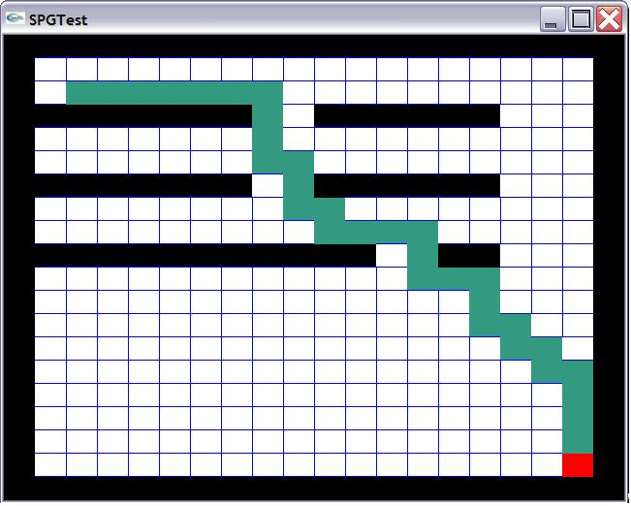
Sample Program
(e-mail me for the source code!)

Slide 19
Things We Can Tweak
Mutation rate
  0.01 is a reasonable starting value
Crossover rate
  0.7 or so
Chromosome length
  Varies a lot based on specific problem
Population size
  Try maybe 150-250

Slide 20
How This is Used in Games
Computationally expensive, becoming easier to deal with as hardware speeds up
Most of the time is run offline with the results used in a ‘black box’ fashion in the actual game.
Can be used to tune priorities, behaviors, parameters, etc.

Slide 21
How This Is Used in Games (2)
Some games run it in real time
  Black and White
Quake 3 bot AI
  Used to optimize the fuzzy logic controller AI.
  I am:
    45% in favor of grabbing that rocket launcher
    62% in favor of picking up the red armor
    89% in favor of the Quad Damage
  Check out the source code (GPL)

Slide 22
Genetic Algorithms Are Cool
Totally generic if you do it right – All you NEED to override is the heuristic/fitness function.
  Algorithm is separate from problem representation.
Can find solutions to problems in very strange solution spaces.

Slide 23
Genetic Algorithms Are Cool (2)
Can result in organic strategies
  If you run in real time and seed genomes with values based on character knowledge, intuition, etc.
Much processing can be done offline and incorporated later.

Slide 24
Things to Watch Out For
Easy to lose good members of the population
Tweaks/optimizations are most likely going to be very problem specific.

Slide 25
Things to Watch Out For (2)
Population can converge on similar chromosomes
  Removes the benefit of the crossover
  Mutation might not be enough to find a solution
    This could lead to an infinite loop

Slide 26
Improvements
First, remember the things I mentioned we could tweak earlier?
  In real-time applications, figure out optimal parameters offline.
We can improve basically each step of the original algorithm.

Slide 27
Different Types of Crossover
Multipoint
Parents
Children

Slide 28
More Mutation
Displacement Mutation
  Grab a random string from parent A
  Insert at a random location in parent B
Insertion Mutation
  Much like displacement mutation, except only move a single gene
  This one is very effective.
Inversion Mutation
  Pick a random string, reverse it
Displaced Inversion Mutation

Slide 29
More Chromosome Selection Techniques
Elitism
  Select a small group of the strongest to move on
Steady State Selection
  Cut out the weakest members
Fitness Proportionate Selection
  Roulette Wheel Selection (original technique)

Slide 30
Scaling Techniques
Instead of using the raw fitness score, run it through a function first.
Rank Scaling
  Order results by fitness, rescore based on rank.
  Prevents quick convergence.
  Can get too slow
Sigma Scaling
  Attempt to balance between wild variation of the early generations and the similar members of later generations.

Slide 31
Things I Wished I Had Known Before Getting My Job
Also, things I was glad that I did know.
And things I wished I had known better.

Slide 32
The Most Important Thing I Can Tell You
Make sure that you leave college with a decent project to show off
  If you’re lucky, get it done through a job
  If not, work on a game or a mod or a tech demo – something!

Slide 33
General Stuff
Always program assignments/solutions to the most general case possible
  Extend from there towards the solution you are looking for.
Program to interfaces

Slide 34
General Stuff (2)
Learn where others have already solved your problems.
  Read “Head First Design Patterns”
  Look for cases to apply these in games
Be consistent in your coding style
  Read “Pragmatic Programmer” and “Code Complete”

Slide 35
Implementation Specific
Standard Template Library
  Know the situations to use each type of container
3D Stuff
  Both OpenGL and D3D implementations
  Pay attention in linear algebra

Slide 36
C++
Know when to use pointers and when to use references
  Also const pointers, const references
Know when things should be virtual
Read “Effective C++” and “More Effective C++” by Scott Meyers

Slide 37
C++ (2)
Learn how to optimize code
  VTune - Hopefully you have an Intel processor
  CodeAnalyst is useless
Programmers are notoriously wrong about this sort of thing.

Slide 38
Misc
Pay attention to time.
Remember that it’s just a (really cool) job.

Slide 39
References
AI Techniques For Game Programming by Mat Buckland
AI Game Engine Programming by Brian Schwab

