Slide 1
DATA SCIENCE
CAPSTONE

Slide 2
The problem

Slide 3
FROM KENDALL, MIAMI, FL TO MANHATTAN N.Y.
A friend of mine will move from Kendall in Miami, FL to Manhattan, New York. He ask to me to compare his actually neighborhood(FL) to others
In New York to find a similar place to rent.
Also he wants:
-To be near a subway station
-Pay less than USD 7000

Slide 4
DATA
- Kendall geolocation
- Kendall Venues
- Manhattan venues
- Manhattan place for rent(less than USD 7000)
- Manhattan subway stations locations

Slide 5
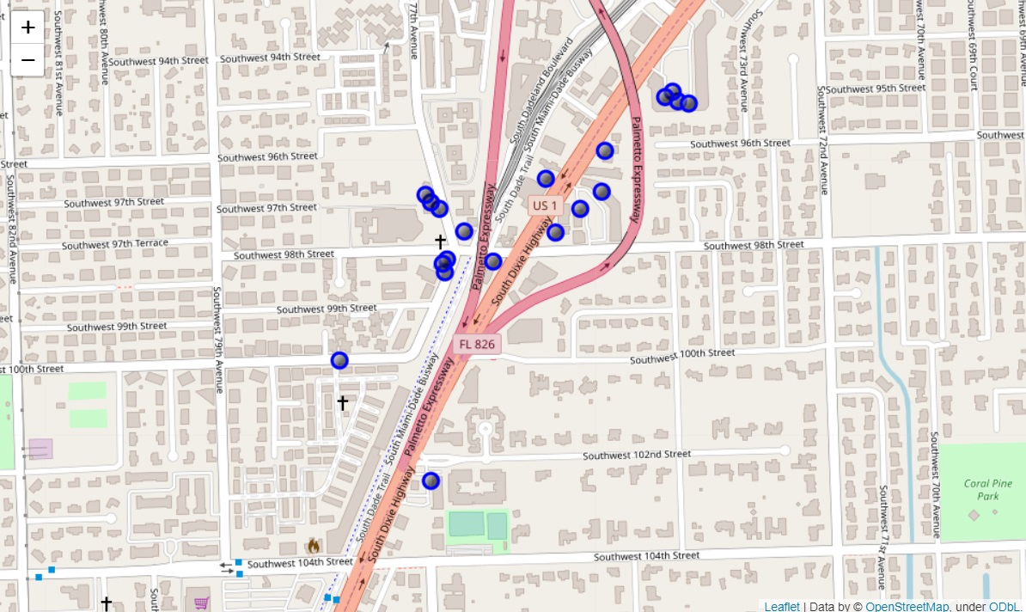
KENDALL VENUES MAP

Slide 6
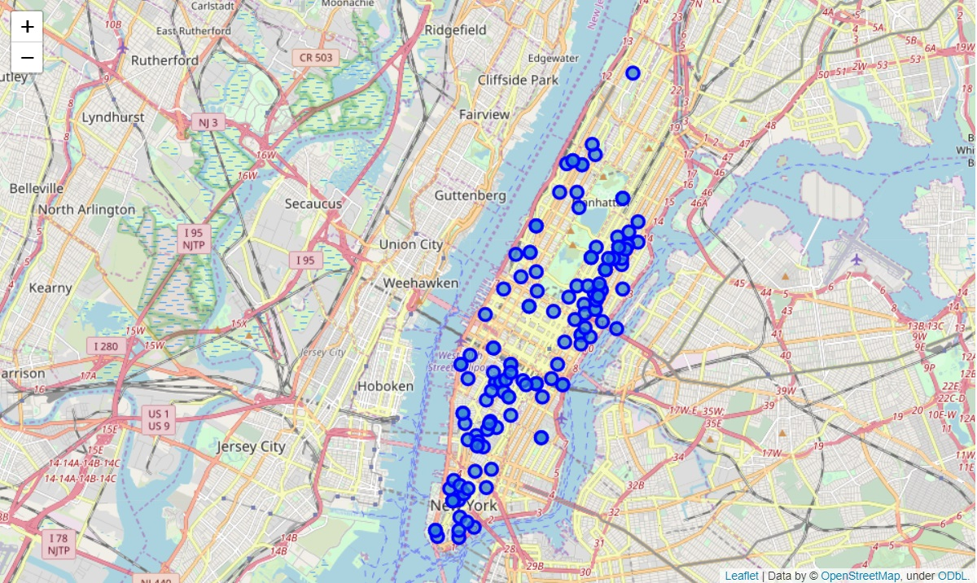
Apartments for rent in manhattan

Slide 7
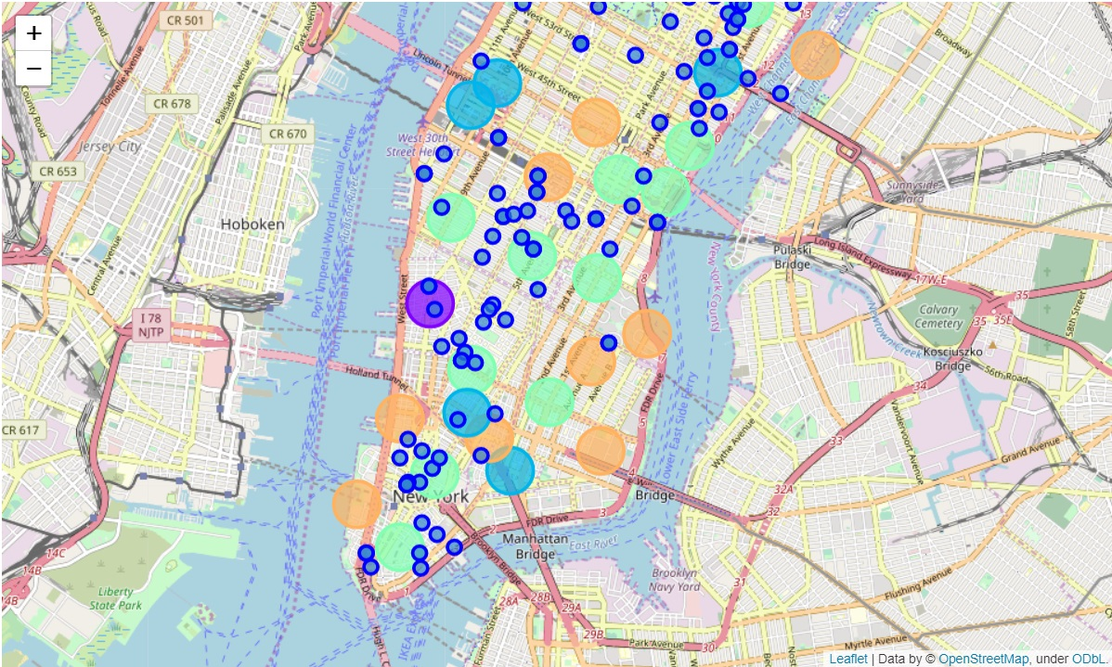
Manhattan apartments for rent cluster

Slide 8
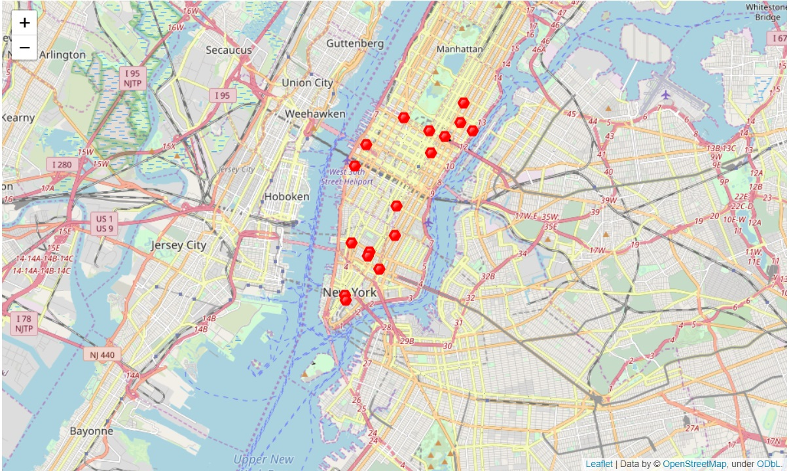
Subways station in manhattan

Slide 9
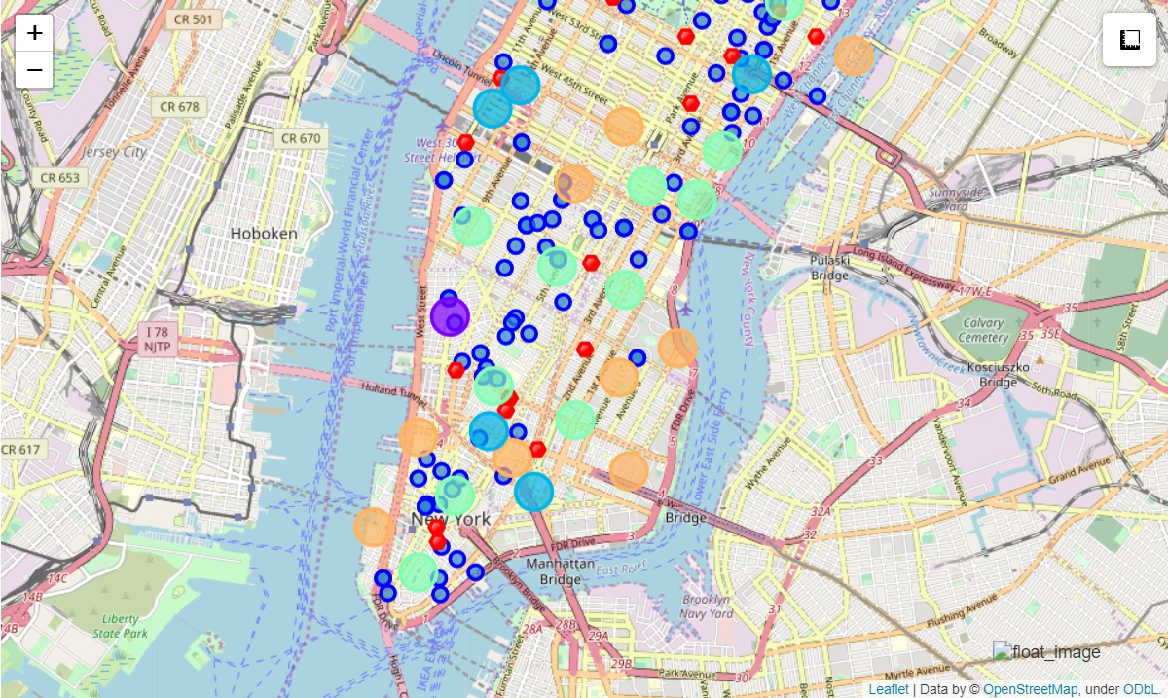
Map containing all data: -Subway stations -Apartments for rent -Venues

Slide 10
SOLUTION
Using the data there are 2 sites
1)305 East 63rd Street in the Sutton Place Neighborhood
2)19 Dutch Street in the Financial District Neighborhood

Slide 11
Solution
Based in Kendall apartment, both Manhattan apartments offer more venues!!
Both are the best solution for the initial problem

