Slide 1
Your Presentation Title
Subtitle can go here Date

Slide 2
Setup
Do you have R and R-Studio Installed?
Create a new project
If you have/use GIT, you can clone the repo, if not, we will get it in a second.
https://github.com/jrgroves/Rticulate
If not, you can use the POSIT cloud which students can log into free and create a project so that they can use the R-Studio interface.
Go To: https://posit.cloud/
Create an account (using any email)
Choose a New R Studio Project from the upper left corner.

Slide 3
Setup
Open a new script in RStudio
Type the above code in the console to ensure you have the needed packages installed.
> install.packages(“tidyverse”)
> install.packages(“sf”)
> install.packages(“usethis”)

Slide 4

Our Mission
Visualize the percentage change in the number of UFO sightings per person in the continental U.S. between 1990 and 2010.

Slide 5

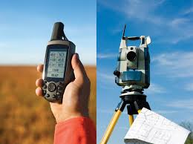
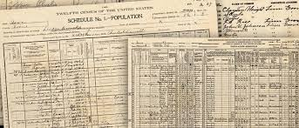
A quick detour
Getting the data you need can be the most complicated part of a project. There are several ways to accomplish this task
Original Collection. This may be going out and measuring something or collecting information or may simply be the transfer of archival data from print to digital formats.

Slide 6
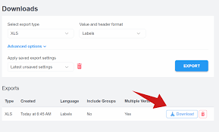
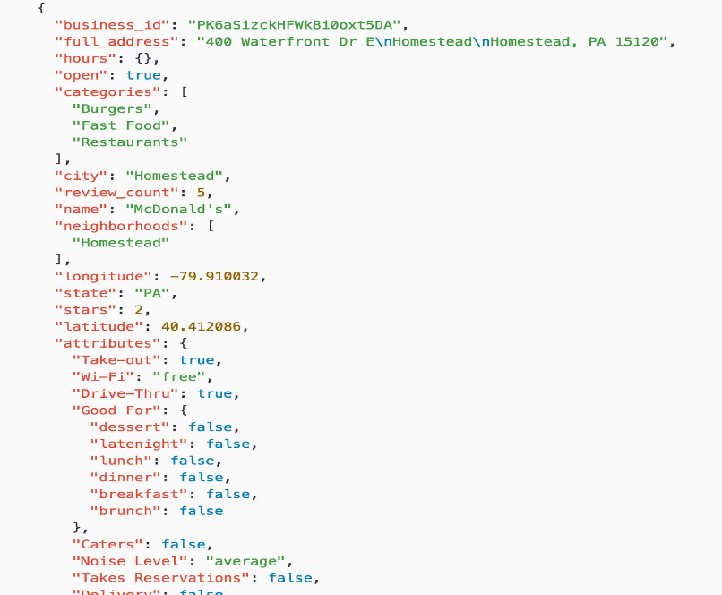
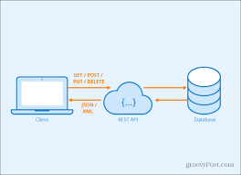
A quick detour
Downloads: This can include data from a primary source such as Redfin or Zillow for housing data, from an API source such as a government or industry database/website, or from cloud storage such as OneDrive or GitHub.

Slide 7
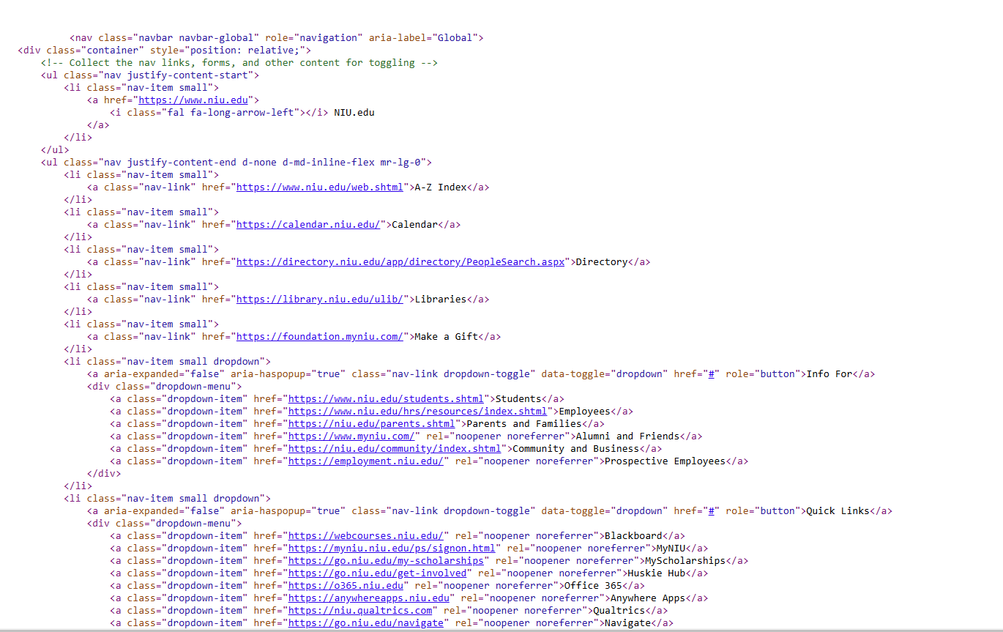
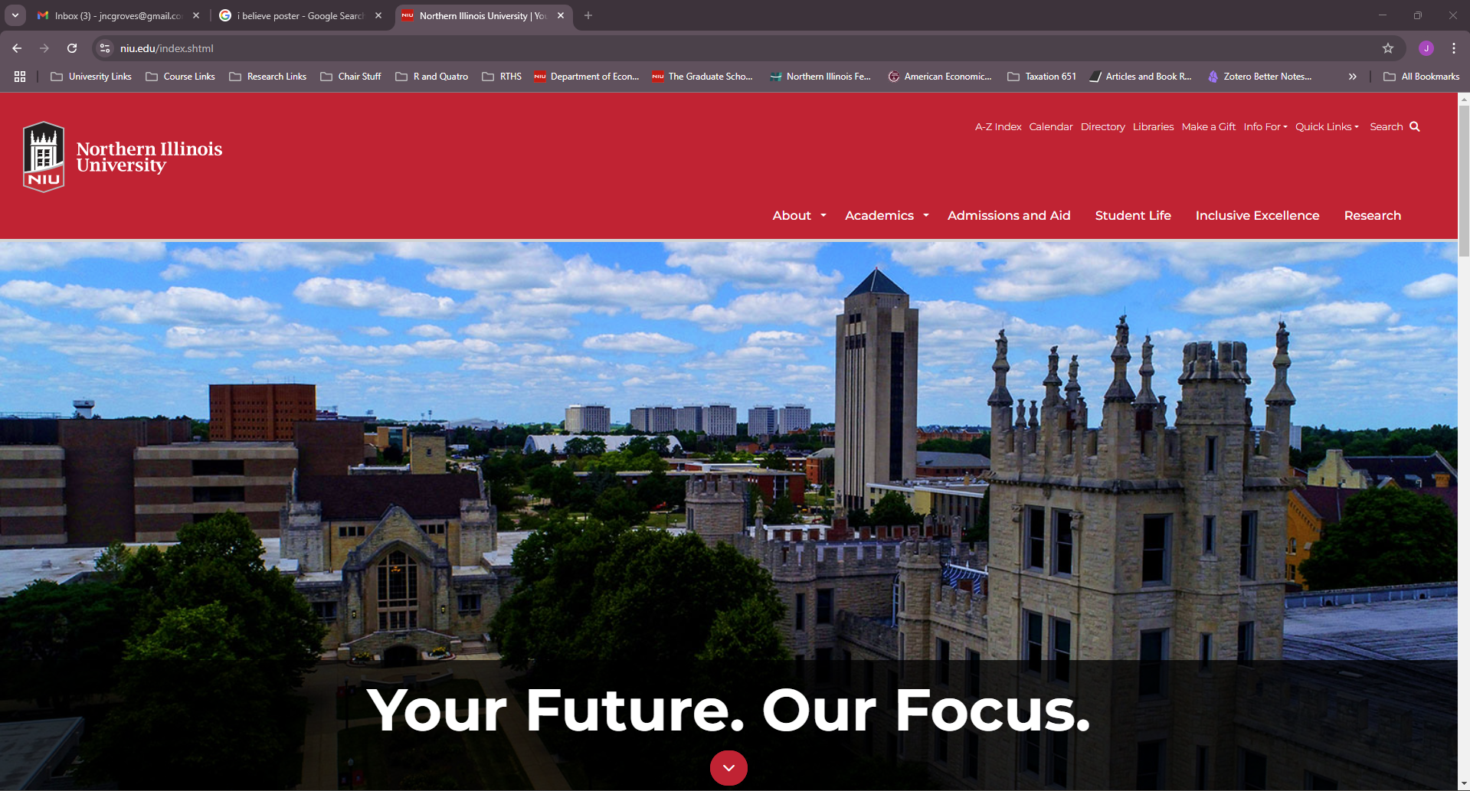
A quick detour
Scrape It: Web-scaping is the process of exploiting the fact that websites, as pretty as they might be, are still just a code written on a system according to a language.

Slide 8
Our Data
We get our data from three primary sources. For time saving, it is already going to be in the reop or zip file you download.
UFO Sightings: National UFO Reporting Center (https://nuforc.org/) and Kraggle (https://www.kaggle.com/datasets/NUFORC/ufo-sightings)
USA Map: U.S. Census Bureau (https://census.gov) Tiger Line Files (via Census API)
Population Data: IPUMS NHGIS (via IMPUS API) (https://www.ipums.org/projects/ipums-nhgis)

Slide 9
Our Data
We get our data from three primary sources. For time saving, it is already going to be in the reop or zip file you download.
UFO Sightings: National UFO Reporting Center (https://nuforc.org/) and Kraggle (https://www.kaggle.com/datasets/NUFORC/ufo-sightings)
USA Map: U.S. Census Bureau (https://census.gov) Tiger Line Files (via Census API)
Population Data: IPUMS NHGIS (via IMPUS API) (https://www.ipums.org/projects/ipums-nhgis)

