Slide 1
Part One - Me Talk Pretty!
How to Effectively Communicate Science to Broad Audiences
(…so basically anyone)
(… and with a focus on social media and blogging).
Dr. Joshua R. Herr
UNL Department of Plant Pathology &
Center for Plant Science Innovation
April 1st, 2022

Slide 2
Three steps for effective communication
Step 1: Tell the people what you are going to tell them
Step 2: Tell the people the information you want to tell them in a clear and organized way
Step 3: Tell the people what you just told them and verify that they understood

Slide 3
Outline
To be an effective communicator you must:
  Be professional
  Be knowledgeable
  Know (and refine or practice) your presentation
  Know your audience
  Respect your audience
  Use effective examples to demonstrate your points – images are the best
  Be factual rather than opinionated
  Monitor the audience responses and adjust

Slide 4
Professionalism
Professionalism can mean many things, but you should show pride in your presence. If you look unprepared – the audience will feel that you are unprepared
Speak clearly and confidently
Don’t abuse your pointing device
Don’t do annoying things – fiddle with an object, for example

Slide 5
Know your area well
Be sure you have a clear understanding of the topic area – shouldn’t be a problem for you!
Do additional research based on your audience so you are prepared for potential questions or to really connect with their interests
If appropriate, bring support materials with you

Slide 6
Presentation Foundations
Be prepared to start on time
Then start and finish on time
Have quality presentation materials (i.e. avoid typos or sloppy work)
Remember to project and don’t talk too fast or slow
Smile and be positive – I like to be the host
Try to avoid being apologetic – “Sorry for a bad presentation” or “I am not really sure what to say…”

Slide 7
Know Your Audience (and where they are coming from)
If you have a technically advanced audience, feel free to use technical terms in moderation
Try to avoid “talking down” and use great care in your word usage to match the knowledge level and experience of your audience:
  Undergraduate presenting to high school
  Graduate to an undergraduate
  Professor to public, etc.

Slide 8
Know Your Audience (and where they are coming from)
I would avoid jargon and abbreviations and/or acronyms unless you absolutely can’t; if you must, clearly define the words and limit them.
  Not good - “The AFLCIO met with the FDA at the OBER convention to deal with SSRI and ANA related to the IABME just before the AIMBE event”
  Clearer, but maybe worse – “The American Federation of Labor and Congress of Industrial Organizations met with the Food and Drug Administration at the Office of Biological and Environmental Research convention to deal with Secure Storage and Retrieval of Information and Active Network Abstraction related to the International Association of Biomedical Engineers just before the American Institute for Medical and Biological Engineers event”

Slide 9
Jargon is the most common presentation downfall for speaking to the public
Even scientists from different fields often struggle with technical terms from one field to another
  e.g. biology terms compared with those used in physics and chemistry
If scientists struggle to understand – imagine how hard it is for the general public!

Slide 10


Slide 11
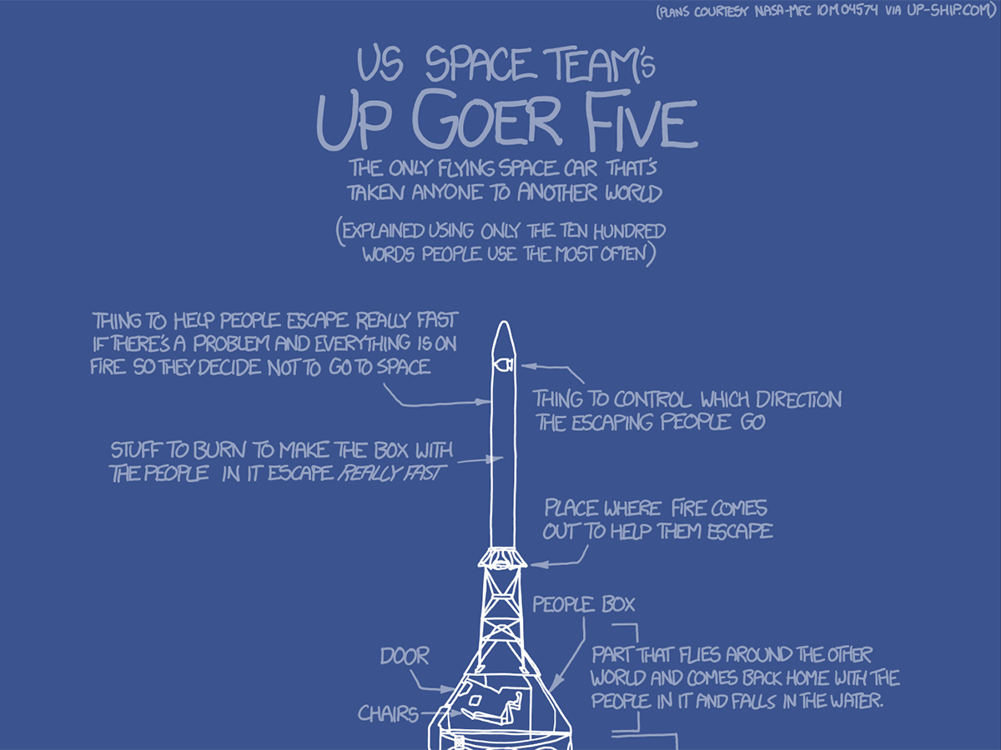

Slide 12
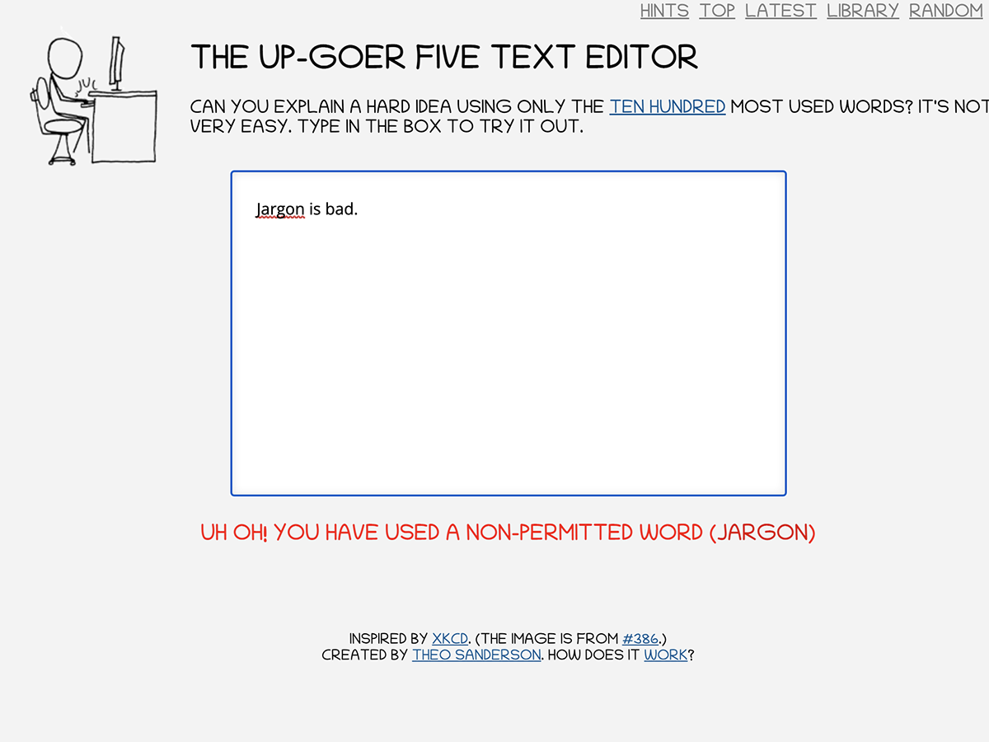

Slide 13
Respect your audience
Never argue with your audience
Jokes can be great, but don’t joke about the audience or use inappropriate jokes
Be very careful about discussing issues of race, sex, and religion – they are complicated areas
Avoid absolute statements on issues that are not factual

Slide 14
Use illustrations over words
Demonstrate your points by example – good images will be easier to digest and remember
Always make sure your illustrations are well suited to your point
Be succinct and clear when you use illustrations
(I’m breaking this rule right now)
More on images and illustrations at the end of the presentation today!

Slide 15
Be factual rather than opinionated
Try to link your story with the big picture – very important for general public
Try to excite the listener into defining questions of interest to them
Encourage the audience to ask questions – be clear on when you want the audience to interact with you
Distinguish ideas from facts – it’s great to have theories, but support those with facts.

Slide 16
Monitor the Audience Response
Are the audience paying attention?
Are you looking at confused blank faces?
Are people responding – nodding heads, smiling, etc?
Are they taking notes or “playing” on their cell phones?
I try to interact with the audience to keep them engaged in particular with public talks – i.e. ask questions expecting a response or call on specific people.

Slide 17
Some additional things to consider when talking to the public
Communicating with public audiences is not the same as giving a lecture colleagues or students
Public audiences most likely will not be taking notes or underlining your handouts
Public audiences may be timid to ask questions
Think and talk in themes or the big picture not minutiae and/or use a lot of analogies
Use active verbs & vivid nouns.

Slide 18
Responding to Audience Questions
Repeat the question so that all the audience all hear it – this confirms with the questioner that you are answering their specific question and gives you time to think of an answer
Never argue with a questioner – under any circumstances
If you disagree with an assertion, never say “you are wrong”, etc., – always answer in a diplomatic way - “You make a good point, let me give you an alternative perspective” or “That is interesting, but the facts support otherwise…”

Slide 19
Concluding your presentation
Remember to repeat what you told the audience – this is your conclusion and reinforces the main ”take-home” messages – especially true when talking to the general public
Always acknowledge your colleagues, friends, family or support group that allowed you to be where you are (some people start off by doing this)
Finally, thank the audience for their attention

Slide 20
Summary
To be an effective communicator you must:
  Be professional
  Be knowledgeable
  Know (and refine or practice) your presentation
  Know your audience
  Respect your audience
  Use effective examples to demonstrate your points – images are the best
  Be factual rather than opinionated
  Monitor the audience responses and adjust

Slide 21
Thank you for your attention!
Questions?

