Slide 1
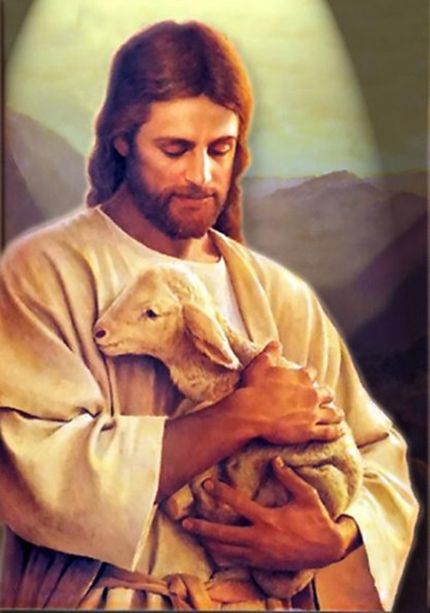
The Story of Jesus
By: Evan Anderson

Slide 2
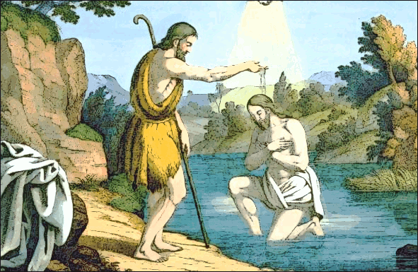
The Baptism of Jesus
John the Baptist baptized Jesus in the Jordan River.

Slide 3
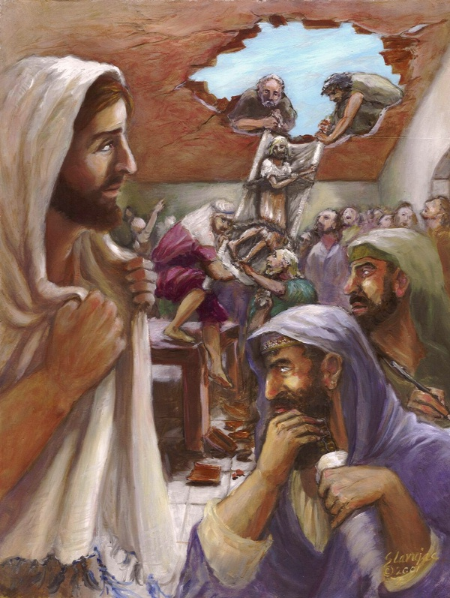
Jesus Heals a Crippled Man
Four men lowered their friend through a hole in the roof and Jesus healed him.

Slide 4
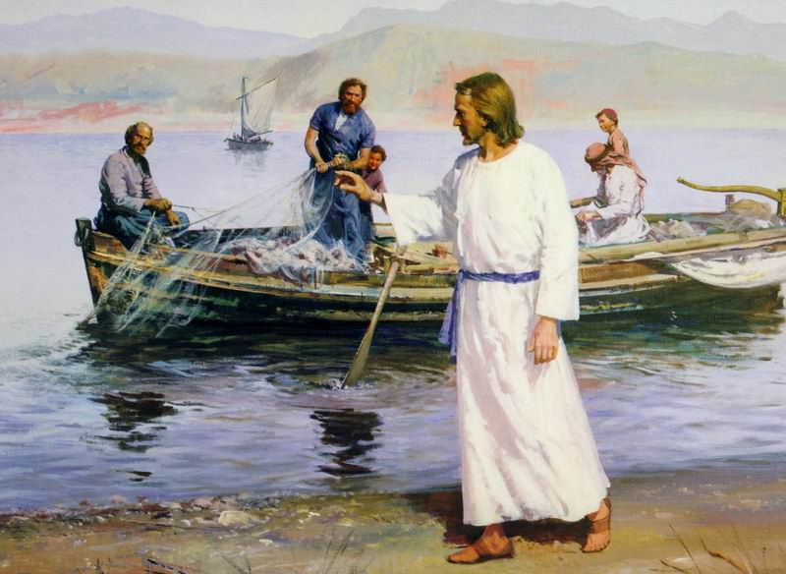
Jesus Chooses His Twelve Apostles
Simon Peter, James, John, Andrew, Philip, Bartholomew, Matthew, Thomas, James the son of Alphaeus, Thaddaeus, Simon, Judas who betrayed Jesus.

Slide 5
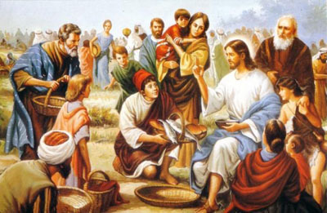
Jesus Feeds Five Thousand
He got 5 loaves of bread and 2 fish. He blessed them and fed the crowd.

Slide 6
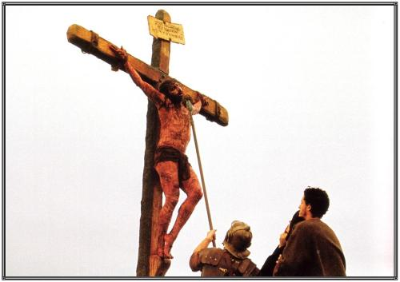
The Death of Jesus
One of them ran and grabbed a sponge. After he had soaked it in wine, and held it up to Jesus. Jesus was dying.

Slide 7
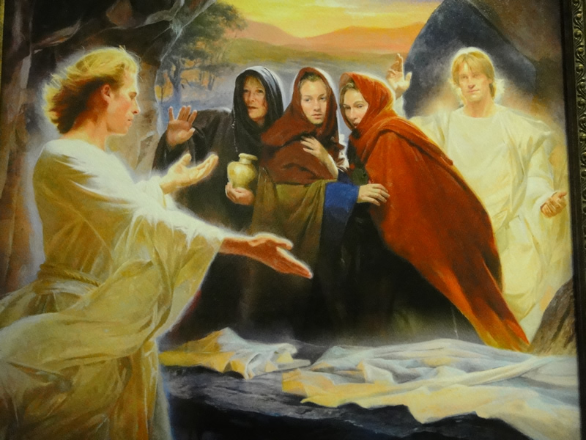
Jesus Is Alive
The angel told the women that Jesus is alive.

