Slide 1
Flow control in R
Lecture 3
BIOF529

Slide 2
Flow Control
Conditional Statement
if()...else
ifelse()
switch()
Determine which set of expressions to run depending on whether or not a condition is TRUE
Do something to each element in a data structure depending on whether or not a condition is TRUE for that particular element
Evaluate diﬀerent expressions depending on a given value
Loop Statement
for()
while()
repeat
break
next
Loop for a ﬁxed number of iterations
Loop until a condition is FALSE
Repeat until iterations are halted with a call to break
Break out of a loop
Stop processing the current iteration and advance the looping
index

Slide 3
if()...else
The condition needs to evaluate to a single logical value.
Brackets { } are not necessary if you only have one expression and/or the
if()...else statement are on one line.
To avoid a syntax error, you should NOT have a newline between the
closing bracket of the if statement and the else statement
if(condition) expression if TRUE
if(condition) {
expressions if TRUE
}
if(condition)expression if TRUE else expression if FALSE
if(condition) {
expressions if TRUE
} else {
expressions if FALSE
}

Slide 4
Common conditions in if-statements
if (x==5)
if (x==5 & y==7)
if (x>=5)
if (x==5 | y>=17)
if (x %in% c(1,2,3,5))
if (!found)
if (!is.na(x) & y==3)

Slide 5
Conditions
Conditions in an if-statement are based on Boolean operators
== Boolean equals (don’t use =)
!= not equals
>=, <=, >, < greater and less than
| or (comparing single element)
& and (comparing single element)

Slide 6
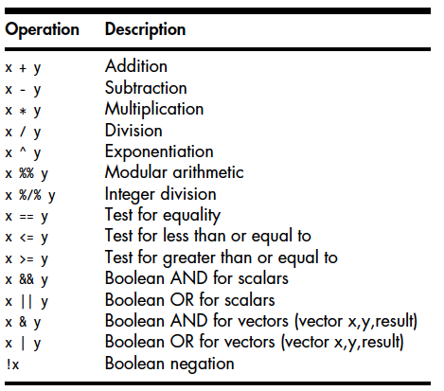
Arithmetic and Boolean Operators

Slide 7

Example - if()...else
Calculate the median of a random sample X1 ...Xn,
where X(1) ...X(n) denote order statistics.
x <- c(5,4,2,8,9,10)
n <- length(x)
sort.x <- sort(x)
if(n%%2==0) {
median <- (sort.x[n/2]+sort.x[1+n/2])/2
} else median <- sort.x[(n+1)/2]
median

Slide 8
Example - if()...else
plotxy <- function(x, y) {
if (length(x) == length(y)) {
plot(x,y)
}
else {
print("Lengths of x and y are different")
}
}
> plotxy(x=1:5, y=5:1)
> plotxy(x=1:5, y=4:1)
[1] "Lengths of x and y are different"

Slide 9
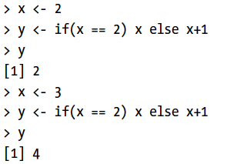
If – else as a function call
v <- if (cond) expression1 else expression2
Example)

Slide 10
ifelse()
ifelse() returns a value with the same structure as test which is ﬁlled
with elements selected from either yes or no depending on whether the
element of test is TRUE or FALSE.
ifelse(test, yes, no)
> x <- seq(0,2,len=6)
[1] 0.0 0.4 0.8 1.2 1.6 2.0
> ifelse(x <= 1, "small", "big")
[1] "small" "small" "small" "big" "big" "big”
> y <- matrix(1:8, nrow=2)
[,1] [,2] [,3] [,4]
[1,] 1 3 5 7
[2,] 2 4 6 8
> ifelse(y>3 & y <7, 1, 0)
[,1] [,2] [,3] [,4]
[1,] 0 0 1 0
[2,] 0 1 1 0

Slide 11
Complicated if-then-else statements
sum.bigger <- function(x, y) {
if(length(x) != length(y)) {
print("not equal lengths")
}
else {
if (sum(x) > sum(y)) {
print("x bigger")
}
else {
print("x smaller or equal")
}
}
}
> sum.bigger(x=1:5, y=6:10)
[1] "x smaller or equal"
Calling an if-then-else
statement within an if-then-else statement. Line indentation is critical!

Slide 12
switch()
The switch() function evaluates and returns diﬀerent expressions
depending on the value of EXPR
switch(EXPR, ...)
EXPR needs to be a single character string or a number, not a vector
... is a comma separated list of name=expression or number=expression
If there is an exact match between EXPR and name/number then that
expression is evaluated and returned. If there is no expression, then the
next non-missing expression is used.
If there is no match between EXPR and name/number, the value of the ﬁrst
unnamed expression in ... is returned (unnamed expressions are like a
default).
You do not need to put name in quotes inside switch(), but EXPR will
need quotes.

Slide 13
switch()
Sometimes you might find yourself writing multiple nested if statement
For example, if x==1 then do something, else if x==2 then do something else, else if x==3 then do a third thing, else if x==4 then do a fourth thing...
Instead, use a switch statement
This evaluates the first parameter, and does different things depending on its value
Switch statements are rarely used but very useful when needed

Slide 14
Example - switch()
require(stats)
centre <- function(x, type) {
return(switch(type,
mean = mean(x),
median = median(x),
trimmed = mean(x, trim = .1),
"No function matches") )
}
> x <- rcauchy(10)
> centre(x, "mean")
[1] 0.09228939
> centre(x, "median")
[1] -0.4580926
> centre(x, "unknown")
[1] "No elements match"
This is like writing:
if (type=="mean") {
temp <- mean(x)
}
else {
if (type=="median") {
temp <- median(x)
}
else {
if (type=="trimmed") {
...
return(temp)

Slide 15
for loops
for(var in seq) {
expressions
}
var is the name of the loop variable that changes with each iteration
seq is an expression evaluating to any type of vector
With each iteration var takes on the next value in seq. At the end of the
loop var will equal the last value of seq.
The number of iterations equals the length of seq
The { } are only necessary if there is more than one expression
By default R buﬀers the output created during any loop. To print the
output with each iteration, include flush.console() at the end of the
loop or right click on the console and uncheck: Buﬀered output.
# Calculate 10! using a for loop
f <- 1
for(i in 1:10) {
f <- f*i
cat(i, f, "\n")
}
f
factorial(10)

Slide 16
while loops
while(cond) {
expressions
}
cond is a single logical value that is not NA
The { } are only necessary if there is more than one expression
If you are going to use a while loop, you need to have an indicator variable
i and change its value within each iteration. Otherwise you will have an
inﬁnite loop.
# Calculate 10! using a while loop
i <- 10
f <- 1
while(i>1) {
f <- i*f
i <- i-1
cat(i, f, "\n")
}
f
factorial(10)

Slide 17
repeat loops
repeat {
expressions
if(cond) break
}
The repeat loop does not contain a limit. Therefore it is necessary to
include an if statement with the break command to make sure you do not
have an inﬁnite loop.
# Calculate 10! using a repeat loop
i <- 10
f <- 1
repeat {
f <- i*f
i <- i-1
cat(i, f, "\n")
if(i<1) break
}
f
factorial(10)

Slide 18
Looping through species
Imagine we need to calculate the mean petal and sepal lengths for every species in the iris data set
loop.iris <- function (data=iris) {
for (i in unique(iris$Species)) {
meanSepalLength <-
mean(iris[iris$Species==i,]$Sepal.Length)
meanPetalLength <-
mean(iris[iris$Species==i,]$Petal.Length)
cat(i, meanSepalLength, meanPetalLength, "\n")
}
}
loop.iris()
Pro tip: everything inside the function is indented three spaces, inside the loop by six spaces, allowing reader to easily see which statements are contained within each section of code

Slide 19
In-class exercise 1
Write a function which takes a vector of period p and produces plots of sin(x/p) where p is the period and x ranges from 0 to 2π
Use the call par(mfrow=c(3,3)) to create 9 subplots and run your function for the following values of p: 0.05, 0.1, 0.25, 0.5, 1, 1.5, 2, 2.5, 5
Hint: borrow code from the previous lecture!
If you finish early, try to make the function as general as possible

Slide 20
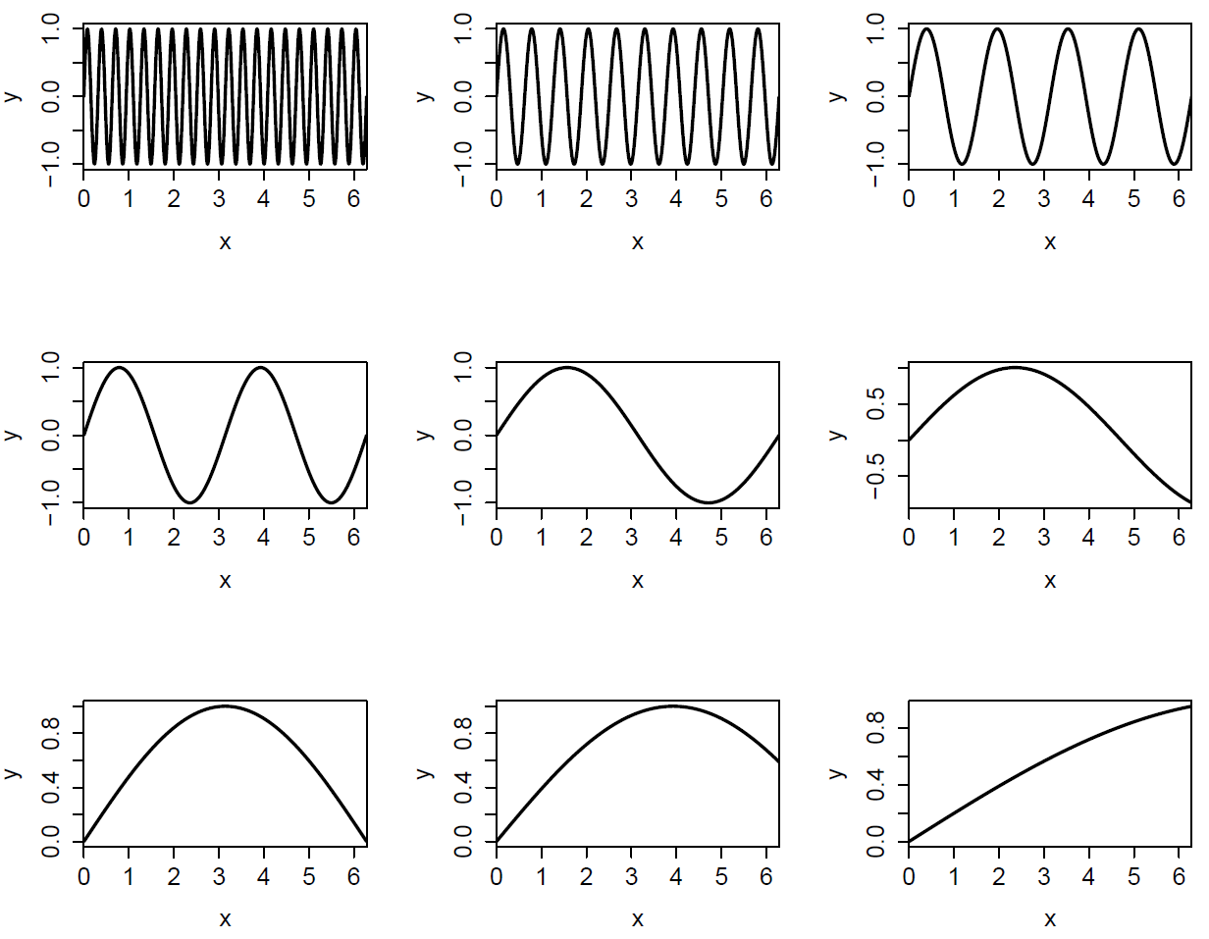

Slide 21
Avoiding Loops
With R it is a good idea to try and avoid including loops in programs.
Code that takes a “whole object” approach versus an iterative approach
will often be faster in R. For example, ifelse() or cumsum().
The apply() family of functions does not reduce the number of function
calls. So using apply() may not necessarily improve eﬃciency. However,
apply() is still a great function for making code more transparent and
compact.
When developing code it may be easier to ﬁrst write an algorithm using a
loop. That’s ﬁne, but try and replace the loop with a more eﬃcient
expression after you have a draft program.
Loops are still useful tools, such as with simulation studies.

Slide 22
Example - Avoiding Loops
Consider an extreme example, suppose we want the sum of 10 million
random standard normal numbers. The sum() function, which uses the
whole vector, is noticeably faster then the for loop, which uses each
element.
z <- rnorm(1E7)
system.time(sum(z))
start <- proc.time()
total=0
for(i in 1:length(z))
total <- total + z[i]
proc.time()-start

Slide 23
In-class exercise 2
Consider the following problem
We have data on age and length for 20 animals ("lect3.csv”)
The number of data points for each animal is not the same
Regress length as a function of age for each animal
Plot the slopes using a histogram
Devise a step-by-step strategy
Read in the data
For each animal
Check if there are two or more data points
If yes, regress length on age for that animal
Store the slope
Plot a histogram of the slopes of each regression

Slide 24
In-class exercise
Hints
Before coding, outline the problem conceptually. How would you do it by hand?
I used a for-loop and an if-statement
To extract the slope from a regression
reg <- lm(y~x)
slope <- coefficients(reg)[2]
Use the hist() function for the histogram
You don’t know how many animals there are or whether there are enough data points to do a regression. How will you handle that?

