Slide 1
Predicting Customer Churn in Telecommunications
Angela Li
Franco Doi
Gautham Nagaraj
Joao Targino
July 22, 2025
Data 607 – Summer 2025

Slide 2
Research Question
Can we accurately predict which customers are likely to churn using classification models?
Customer acquisition is costly — losing customers without warning impacts revenue.
Churn prediction allows companies to act proactively with retention strategies.
Telecommunications has high competition and low switching barriers.
Data-driven retention improves ROI and reduces revenue loss.
Notes:
In this project, we investigated whether we can accurately predict which telecom customers are likely to churn using machine learning classification models.
This is important because acquiring new customers is expensive - often five times more costly than retaining existing ones.
If we can identify customers at risk of leaving, companies can take proactive measures, such as targeted offers or service improvements, to prevent churn.
This is especially relevant in telecommunications, where customers can switch providers easily due to competitive pricing and minimal switching barriers. A well-performing churn prediction model can therefore directly improve return on investment and reduce revenue loss.

Slide 3
Dataset Overview – Telco Customer Churn
Source: Public Kaggle dataset – Telco Customer Churn (~7,043 customers, 50 features)
Numerical: Tenure, Monthly Charges
Categorical: Contract Type, Payment Type, Internet Service
Target Variable: Churn (Yes/No)
Class Imbalance: 26% churned, 74% active customers
Notes:
To address our research question, we used the publicly available Telco Customer Churn dataset from Kaggle.
It contains records for over 7,000 customers from a U.S. telecommunications company, with 50 different features describing each customer.
These features include both numerical variables like tenure, monthly charges,
categorical variables like contract type, payment method, and internet service type.
Our target variable is binary — whether the customer churned or not.
An important characteristic of this dataset is class imbalance: only about a quarter of customers in the data have churned.
This imbalance has implications for how we train and evaluate our models, since accuracy alone could be misleading.

Slide 4
Model Evaluation Metrics
Primary Metrics:
F1 Score: balances precision & recall, useful with class imbalance
Recall: minimizes costly false negatives
Supporting Metrics:
Confusion Matrix – visual breakdown of correct/incorrect predictions
ROC Curve & AUC – measures model’s ability to distinguish churn vs. non-churn
Why Not Accuracy Alone?
Class imbalance means high accuracy could be misleading
Notes:
Because our dataset is imbalanced, we focused on metrics that go beyond simple accuracy.
Our primary decision-making metric was the F1 score, which balances precision and recall, giving us a fair view of overall predictive power.
We also monitored recall closely, since in churn prediction, missing a customer who is about to leave - a false negative - can be very costly for the company.
Supporting metrics like the confusion matrix helped us understand the distribution of errors,
while the ROC curve and AUC quantified how well the model separated churn from non-churn cases.
Accuracy alone wasn’t sufficient - with class imbalance, predicting all customers as “No Churn” would yield 74% accuracy, but the model would fail to identify any at-risk customers.

Slide 5
Preprocessing
Removed non-predictive and highly correlated features (e.g., Customer ID, Churn Score)
Encoded categorical variables as categories (no one-hot needed for boosting models)
Standard scaled numerical features
Used stratified K-Fold cross-validation to handle class imbalance
Notes:
In our preprocessing, we removed columns that were either non-predictive, such as customer IDs, or highly correlated with the target, such as churn score.
This prevented data leakage and reduced noise in the model.
For categorical variables, we used native One hot encoding
Numerical features were standardized to improve performance consistency.
We also applied stratified K-Fold cross-validation to ensure that each fold preserved the dataset’s churn-to-non-churn ratio.

Slide 6
Best Model – LightGBM
Best overall balance of F1 Score, Recall, and AUC
Efficient with mixed feature types and large datasets
Leaf-wise growth captures complex relationships
Optimal Parameters:
learning_rate = 0.05
max_depth = 3
Notes:
Out of all the models tested, LightGBM delivered the best balance between F1 score, recall, and AUC.
Its leaf-wise growth strategy allowed it to capture complex feature interactions more effectively than simpler models.
The optimal settings included a learning rate of 0.05 and a max depth of 3, which helped avoid overfitting while maintaining strong predictive power.

Slide 7
Results & Limitations
Results – LightGBM (Best Model):
F1 Score: 70.1%
Recall: 66.5%
AUC: 90.9%
Best ROC curve performance among all models
Key predictors: Contract type, number of referrals, monthly charges
Limitations:
Class imbalance still impacted recall – some churn cases missed
limited generalizability
Notes:
Using LightGBM, our best model achieved an F1 score of 70.1%, a recall of 66.5%, and an AUC of 90.9%, making it the top performer in distinguishing churn from non-churn cases.
The ROC curve confirmed strong performance, and key predictors included contract type, number of referrals, and monthly charges — all closely tied to customer engagement.
However, there were some limitations.
The class imbalance still reduced recall, meaning some at-risk customers were missed.
The dataset comes from a single telecom provider in one region, so results may not fully generalize to other companies or markets.
Additionally, the dataset is static and lacks temporal behavior patterns, so we can’t predict when churn will happen.

Slide 8
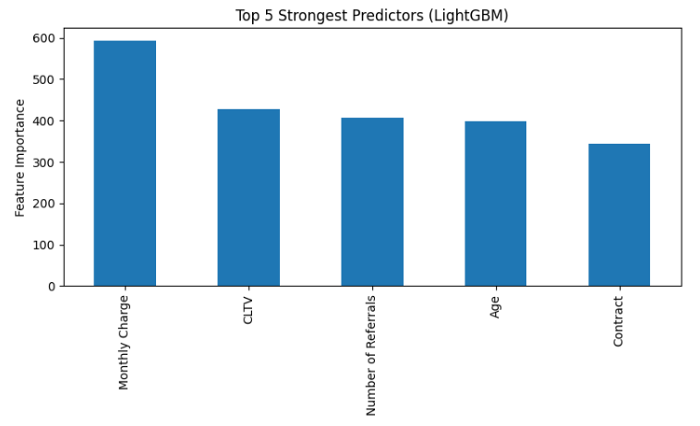
Best Predictors - LightGBM
Understanding the most important predictors for LightGBM

Slide 9
Best Predictors - LightGBM
Looking at some of the important features across churn labels
Why It’s important?
Predictor | Did not Churn | Churned
Monthly Charge | 61.26 | 74.44
Age | 45.34 | 49.73
Number of Referrals | 2.46 | 0.52

Slide 10
Next Steps & Future Work
Include additional features, like customer interaction history

Slide 11
Reference
Jacksoncrow. (2020). Stock Market Dataset [Dataset]. Kaggle. https://www.kaggle.com/datasets/jacksoncrow/stock-market-dataset
Wikipedia contributors. (2024). List of S&P 500 Companies. Wikipedia. https://en.wikipedia.org/wiki/List_of_S%26P_500_companies

