Slide 1

Predicting Data Salaries
Group 4:
Karan, Whitson, Wes, Shreya, Tomas, Jacob
Notes:
KP

Slide 2
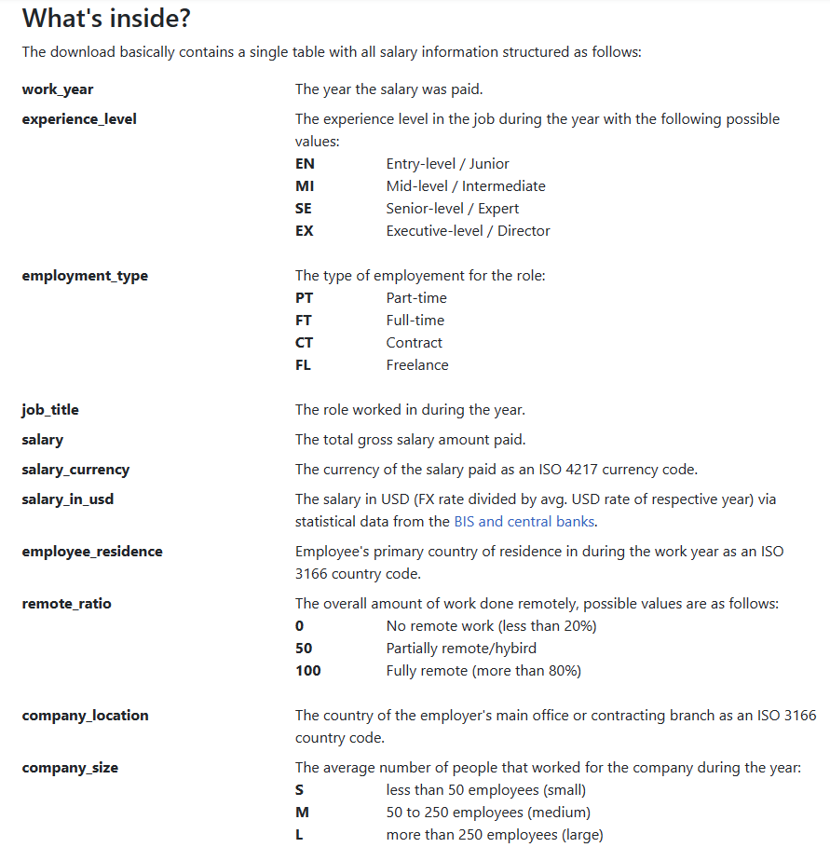
Data
Kaggle
11 Features in Original Data
Predicting Salary in USD
~10,000 rows
Levels of categorical variables are coded
Notes:
KP

Slide 3
Data Cleaning
Variables of Interest | Data Type
Work Year | Numeric
Experience Level | Categorical (4 levels)
Employment Type | Categorical (4 levels)
Job Title | Categorical (93 levels)
Employee Residence | Categorical (25 levels)
Remote Ratio | Numeric
Company Size | Categorical (3 levels)
Years 2022-2023
2022 inflation adjusted
Only US based Companies
Remove Outliers
Helps improve overall model accuracy
Notes:
Shreya
the inflation adjustment is for salary value by 8% of inflation for 2022

Slide 4
Models
Models | RMSE
Linear Regression | ~51000
Decision Tree (Lowest RMSE) | 45,737 (3,863 < Kaggle's best)
XGBoost | 45,738 (3,864 < Kaggle's best)
CatBoost (Best model on Kaggle) | 49,600
Notes:
Shreya (overview of the models)
Model selection is based on the RMSE comparison – We found out that Decision tree gives the lowest RMSE and XGBoost is right behind.
The Kaggle data used CatBoost model which had 49600 RMSE.

Slide 5
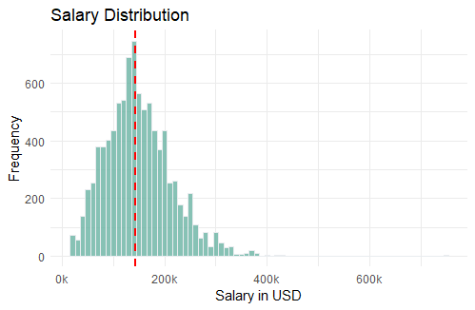
Distribution of Salary
Summary Statistics
Mean | 149,639
Median | 142,200
Max | 750,000
Min | 15,000
Notes:
Tomas: Here we can see the distribution of salary of all job titles. We can see that the mean salary for all jobs is a total of 150k approximately. The median is lower which indicates that the salary distribution is slightly right-skewed, with some higher-income positions pulling the mean higher. You can see the max value being 750,000, which can contribute to this.

Slide 6
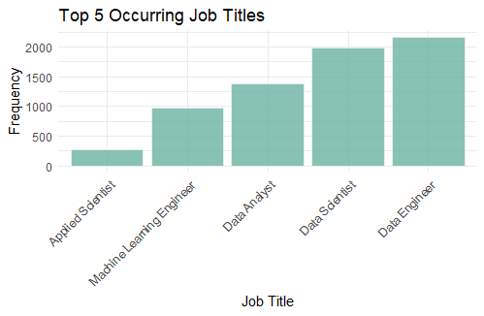
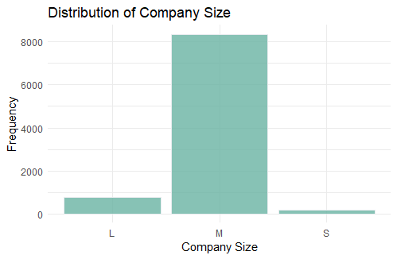
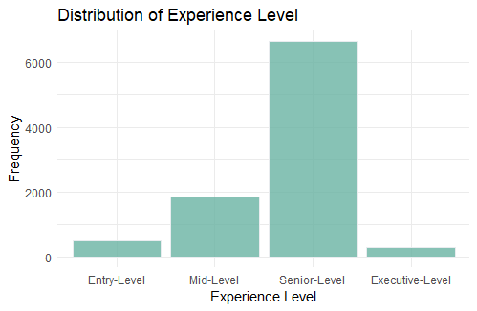
Distribution of Qualitative Variables
Notes:
Tomas: For the distribution of the qualitative variables, we can see that Data analyst, data scientist, and data engineer are the most occuring jobs in our data set. Companies that are medium sized are the ones that appeared the most as well as senior level experience

Slide 7
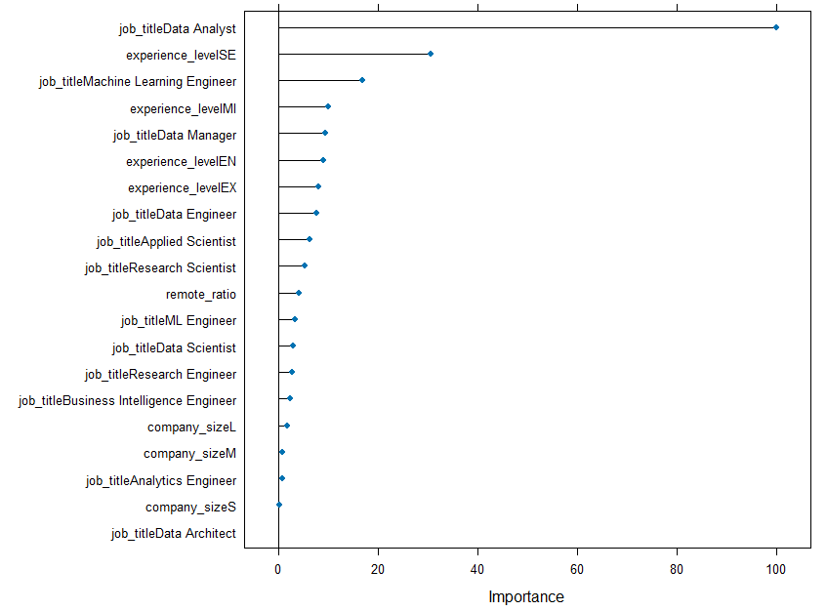
Variable Importance (according to XGBoost)
4 of the top 7 levels include experience.
Remote ratio was not hugely important, and company size seems hardly relevant.
Notes:
Tomas. For relevance of variables, according to XGboost, we concluded that the 4 of the top 7 levels include experience, which makes it a relevant factor to predict salary. VAriables such as remote ratio and company size seems hardly revelant in this situation. Now im going to pass it down to Wes, where he is going to talk about the XGBoost model.

Slide 8
XGBoost
Encoded to deal with categorical variables
Caret Package
Cross Validation using grid search of parameters
RMSE: ~45,738
Beat typical Kaggle model
Notes:
Wes

Slide 9
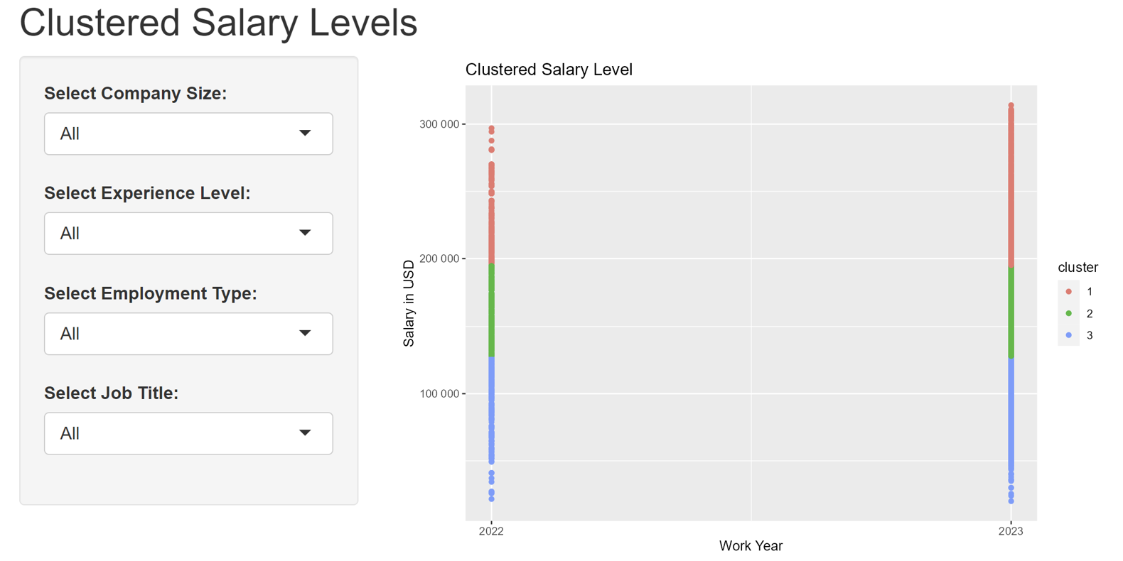
Clustering App
All Data
Notes:
Jacob

Slide 10
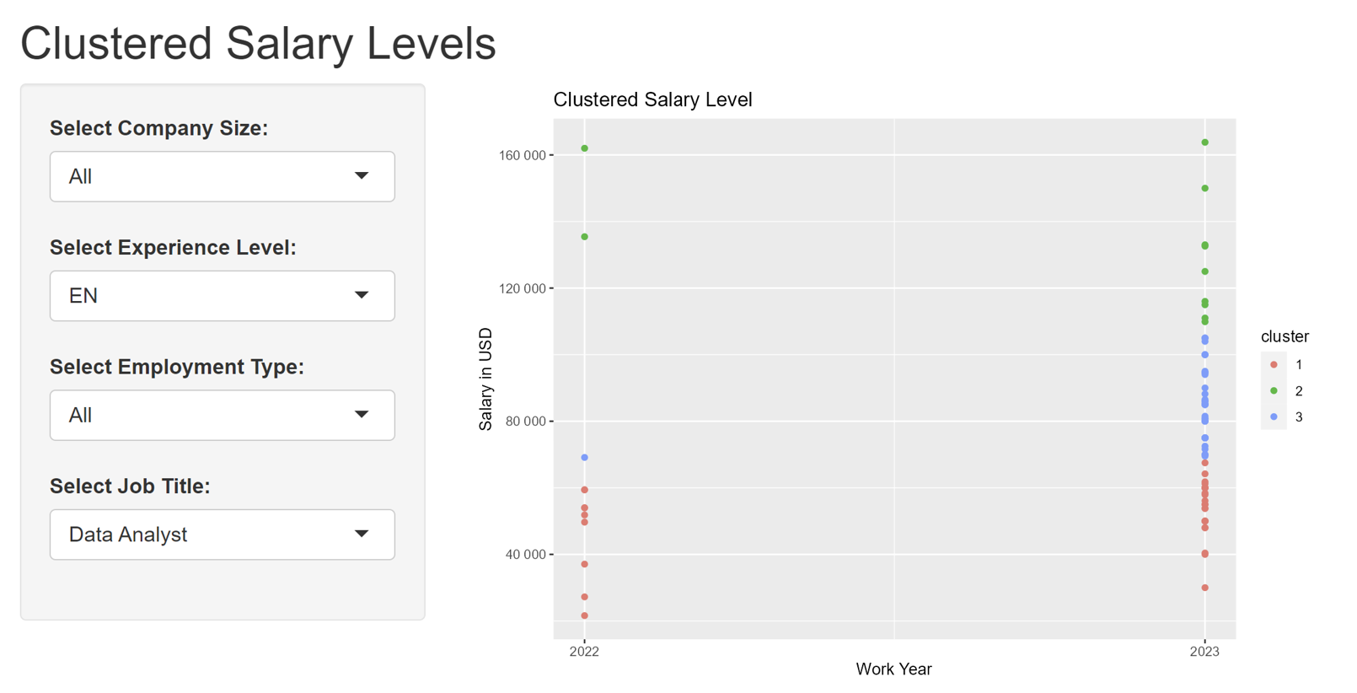
Clustering App
Relevant to us "Analysts"
Notes:
Jacob

Slide 11
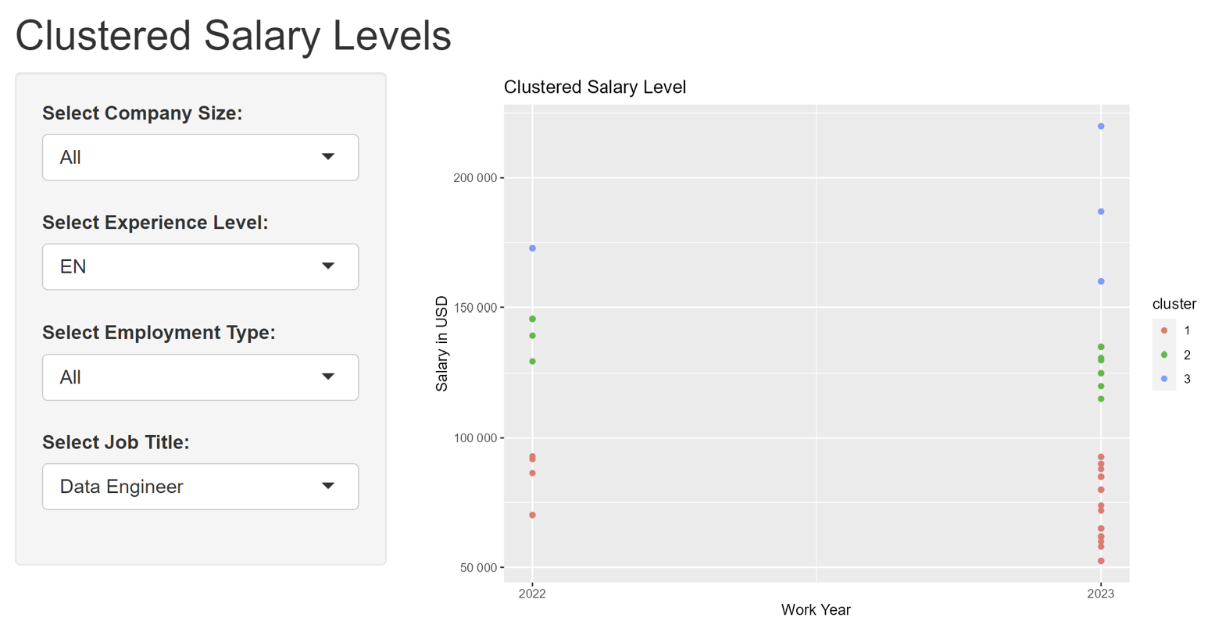
Clustering App
Maybe you'll be an engineer?
Notes:
Jacob

Slide 12
Challenges & Improvements
Limited Data
Only salary info – nothing about school, location, number of past jobs, field of work, etc.
2022-2023 only years with enough data
Notes:
Whitson

Slide 13
Questions?

