Slide 1
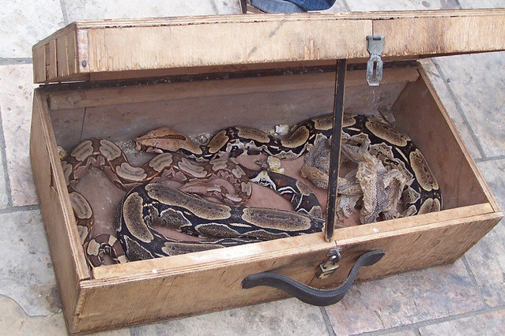
Put your Data in a Box
Josh Reed
Technical Development Lead
Algolux
PyCon Canada 2019

Slide 2
Who am I?
https://twitter.com/jriddycuz
https://github.com/jriddy
8 years working with Python
Built software for: point-of-sale, hardware control, data management, devops tooling
My goal is always to write software so good that it’s forgettable

Slide 3
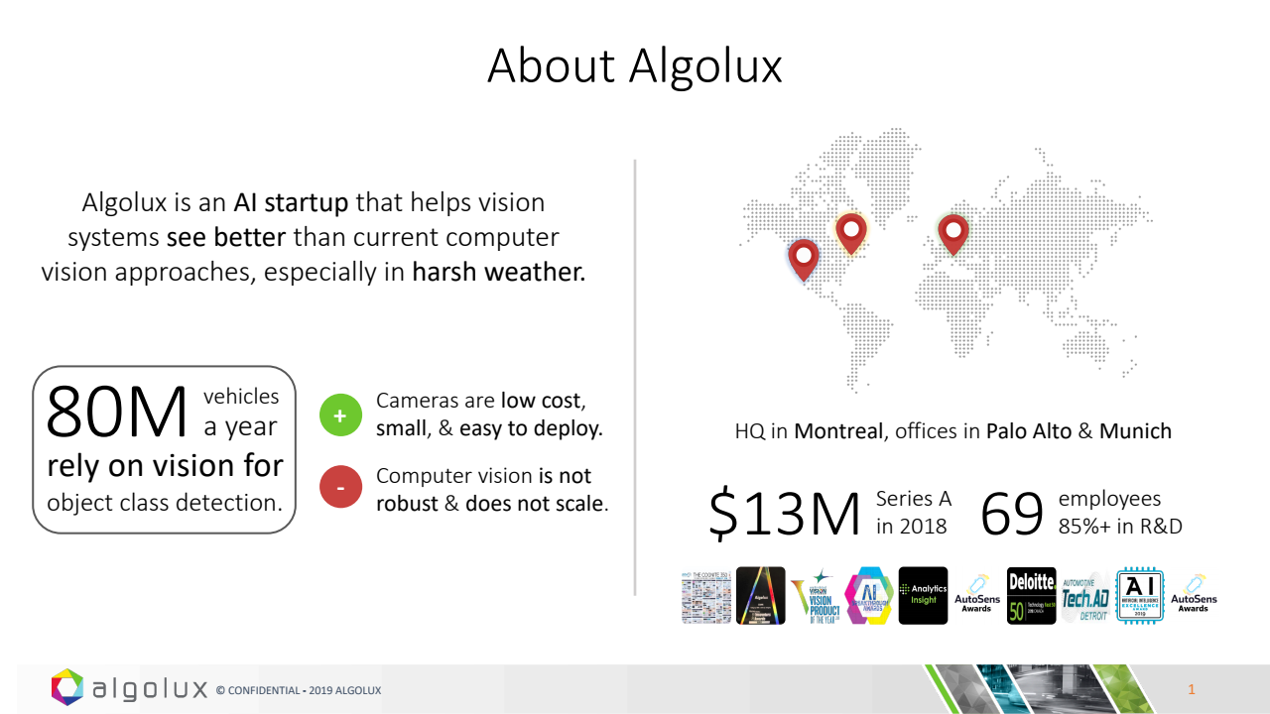

Slide 4




Robust Computer Vision

Slide 5
Data is primary
"Show me your flowchart and conceal your tables, and I shall continue to be mystified. Show me your tables, and I won't usually need your flowchart; it'll be obvious."
Fred Brooks The Mythical Man-Month 1975

Slide 6
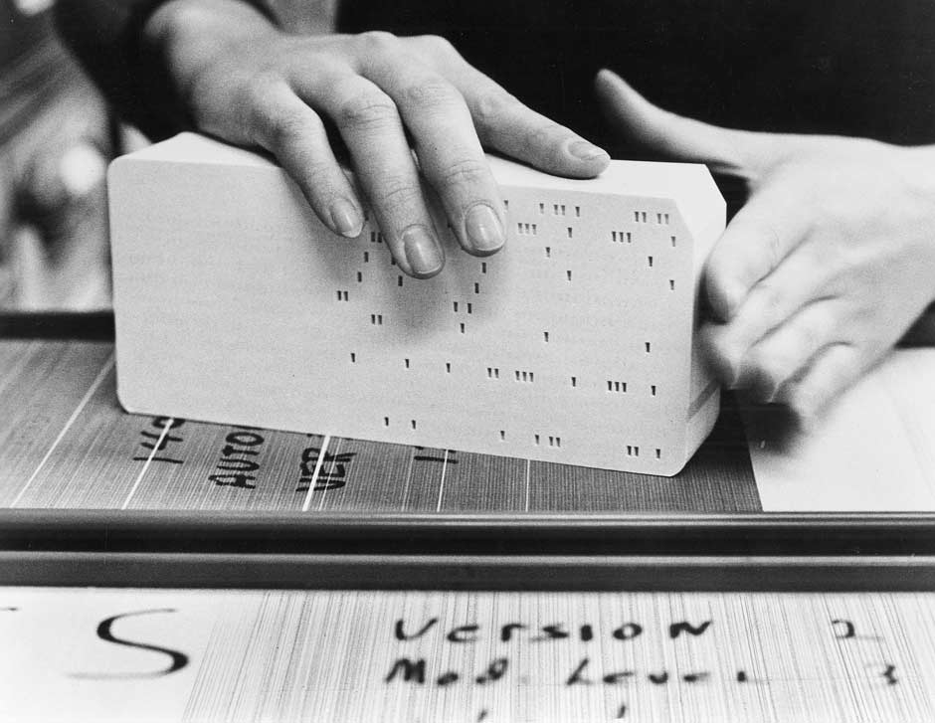
Enterprise development state-of-the-art, 1975

Slide 7
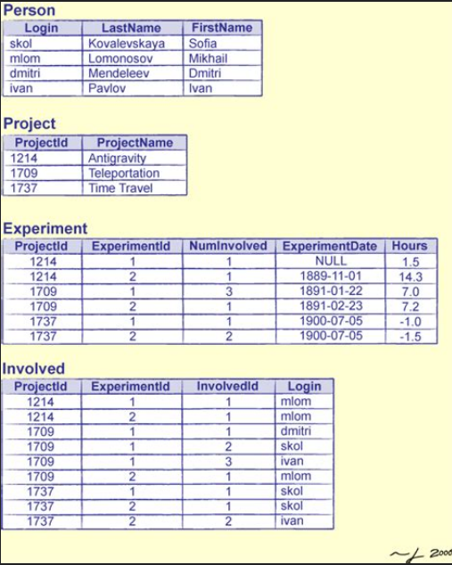
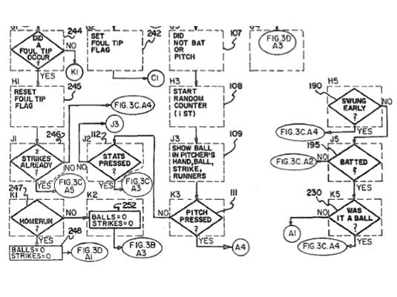
Tools for sanity

Slide 8
Data is primary
"Show me your code and conceal your data structures, and I shall continue to be mystified. Show me your data structures, and I won't usually need your code; it'll be obvious."
Josh Reed PyCon Canada 2019

Slide 9

Easy data structures
Or, how Python spoils us

Slide 10
Don’t take ‘em for granted
() [] {}
Ultra-convenient data structures

Slide 11
(): tuple
Lets you put multiple values anywhere you could put one.
We have no need of a special syntax or feature for things like:
Key-value pair iteration
Enumerating elements in a list
Returning multiple values from a function

Slide 12
Return multiple values
int v1, v2, rc;
rc = func(*v1,*v2);
if (rc != 0) {
// handle error
}
vals = func();
val1 = vals[0];
val2 = vals[1];
val1, val2 = func()

Slide 13

[]: list
Growable
Performance for most tasks is acceptable
How often do you reach for other sequence data structures?

Slide 14
Construct a mutable seq
std::vector<int> a;
a.push_back(1);
a.push_back(4);
a.push_back(7);
a.push_back(12);
a.push_back(20);
a = [1,4,7,12,20]

Slide 15
{}: dict
Quick way to make an arbitrary table
Useful when you don’t know what you’ll be holding
Underpins a large amount of higher-level Python mechanics

Slide 16
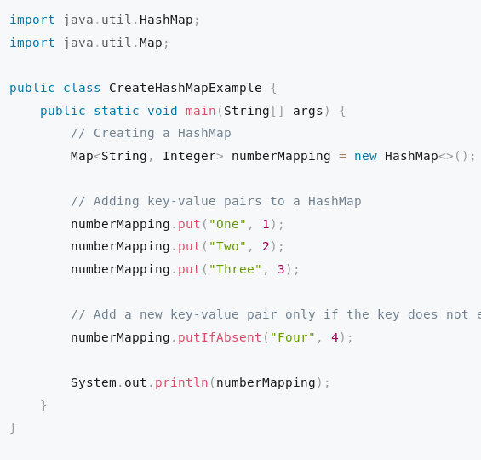
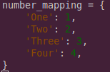
Express key-value pairs

Slide 17

Convenience

Slide 18
Tuple abuse
host, port = split_port(loc_str)
scheme, netloc, path, params, \ query, fragment = urlsplit(url_str)
name, email, phone = \ get_user_info(user_no)

Slide 19
Dict abuse
Extremely general
Well-known names are okay
Complete lack of validation and control is not
Actually python does give us a way to wrap dictionaries with a stricter control on how their data are created, accessed and modified...which we’ll get to
But naked dicts are just bags of data

Slide 20


Bags vs Boxes

Slide 21
Classes!
Classes are the singular way to create special-purpose data structures
They let us define the specifications for the box and exactly how it used
We can mark parts of it as public and other parts as private and expect that people will generally comply
There’s just one thing..

Slide 22
Classes are a pain to write
__init__()

Slide 23

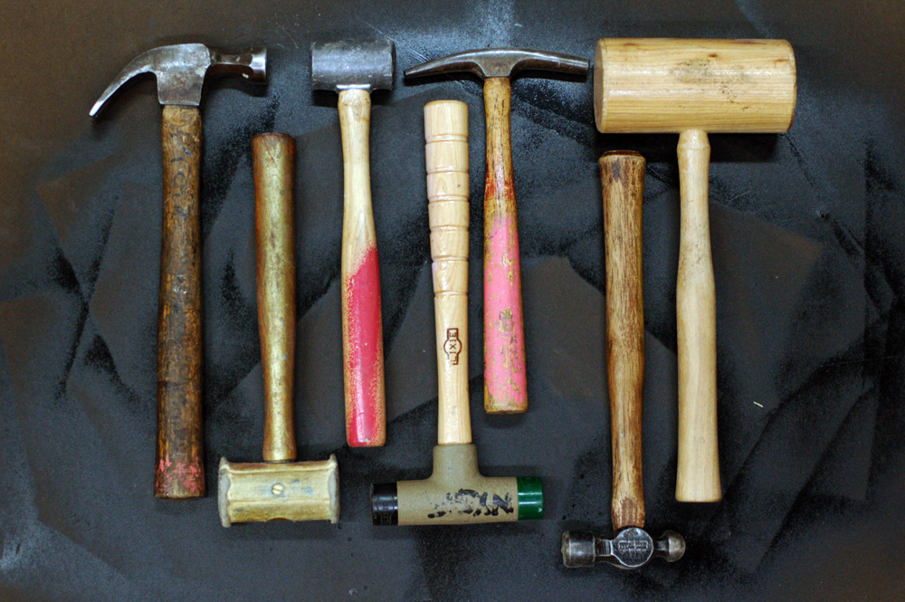
General vs. special purpose

Slide 24
Don’t believe me?
class UserInfo:
def __init__(self, name, phone, email):
self.name = name
self.phone = phone
self.email = email
That’s each name mentioned three times to get less than I could get with just making it a tuple.
Also note that many, many language make this easy.

Slide 25
So what do we do?
Named tuples?
Use something like jsonschema?
How about ORM models?
Serialization frameworks?
All of these options have major downsides
The net effect is that we tend to only write classes for “important” things

Slide 26
Solution: use attrs
@attr.s

Slide 27
Features
You get a plain-old python object (POPO)
...with a bunch of dunder methods defined
...a bunch of opt-in goodies available
...with no extra cost
Yes, it’s mostly just about initialization
But that asserts a subtle influence on everything it touches

Slide 28
Observed benefits
Junior programmers write much better code
Easier to test code
No business logic in __init__()
Decreased coupling between objects
Small classes that do one thing well
“What does this object need to know?” vs ”What does this object need to do?”

Slide 29
Appendix: dataclasses
dataclasses
Inspired by attrs
Available in 3.7 in the stdlib
Useful when you really want to avoid dependencies
attrs
Evolves faster
Available wherever pip is available
Small, well-tested, well-maintained library

