Slide 1
Two Domains and a Neural Network for Musical Instrument Classification
Prepared by: Jessa Rili

Slide 2
Outline
Motivation
Related Literature
The Dataset
Methodology
Feature Extraction
Coefficients of the Amplitude Envelope in the Time-Domain (CATE)
Fast Fourier Transform Coefficients (FFTC)
Mel-Frequency Cepstrum Coefficients (MFCC)
Building the ANN
Results
Conclusion

Slide 3
Outline
Motivation
Related Literature
The Dataset
Methodology
Feature Extraction
Coefficients of the Amplitude Envelope in the Time-Domain (CATE)
Fast Fourier Transform Coefficients (FFTC)
Mel-Frequency Cepstrum Coefficients (MFCC)
Building the ANN
Results
Conclusion

Slide 4
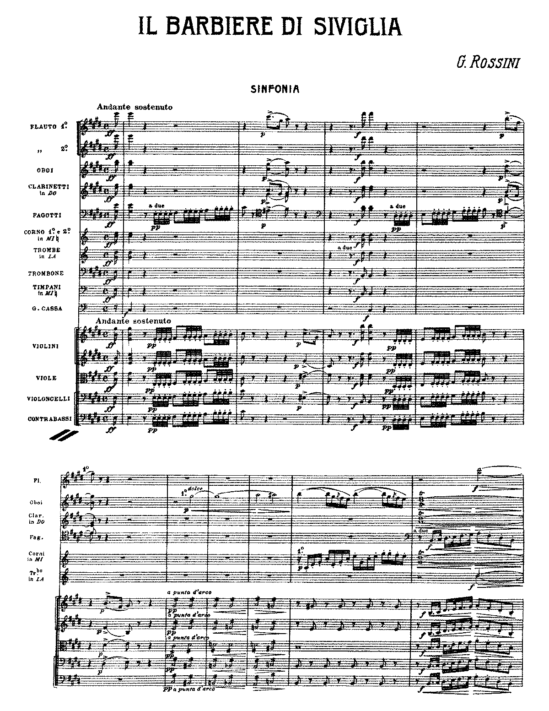
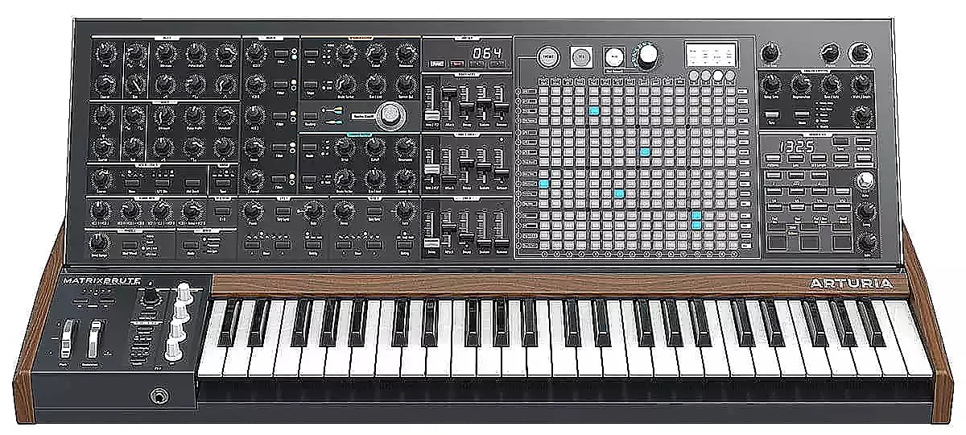
Motivation: Why Classify Musical Instruments?
Working towards automatic music notation
Assessing the quality of music synthesizers
Overture to the Barber Of Seville.MP3
AMN
System

Slide 5
Outline
Motivation
Related Literature
The Dataset
Methodology
Feature Extraction
Coefficients of the Amplitude Envelope in the Time-Domain (CATE)
Fast Fourier Transform Coefficients (FFTC)
Mel-Frequency Cepstrum Coefficients (MFCC)
Building the ANN
Results
Conclusion

Slide 6
Related Literature
*Rizi, Windmark [1]
Dataset used: London Philharmonic Dataset (1244 samples)
Classified musical instruments into eight (8) instrument classes:
banjo, cello, clarinet, english horn, guitar, oboe, trumpet, violin
Features used: various parts of a sample’s frequency spectrum:
whole sample
attack of the sound ; everything but the attack of the sound
initial 100Hz ; latter part of the spectrum
Artificial Neural Networks (ANN) achieved 93.5% accuracy when using the whole sample

Slide 7
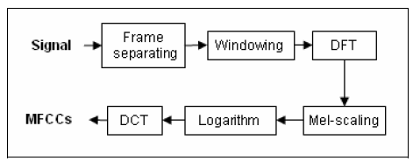
Related Literature
Sarimollaoglu, Bayrak[2] ; Mandel, Ellis[3]
Features used: used Mel-Frequency Cepstral Coefficients (MFCC)
for Musical instrument classification and Music classification, respectively
[2]

Slide 8
Outline
Motivation
Related Literature
The Dataset
Methodology
Feature Extraction
Coefficients of the Amplitude Envelope in the Time-Domain (CATE)
Fast Fourier Transform Coefficients (FFTC)
Mel-Frequency Cepstrum Coefficients (MFCC)
Building the ANN
Results
Conclusion

Slide 9
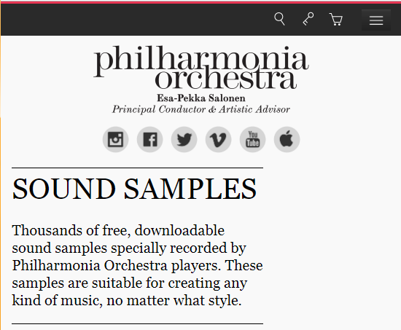

The Dataset
The London Philharmonic Dataset
Sound samples from various instruments (11 pitched, 39 unpitched)
Single notes
Different styles of playing
Different loudness
Short phrases

Slide 10
The Dataset: Filtering
The London Philharmonic Dataset
Sound samples from various instruments (11 pitched, 39 unpitched)
Single notes
Different styles of playing
Different loudness
Short phrases
Choose only single notes with varying loudness
Limit input note range to C4(261.63Hz) to B4(493.88Hz)

Slide 11
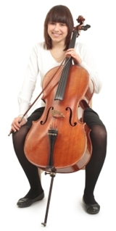
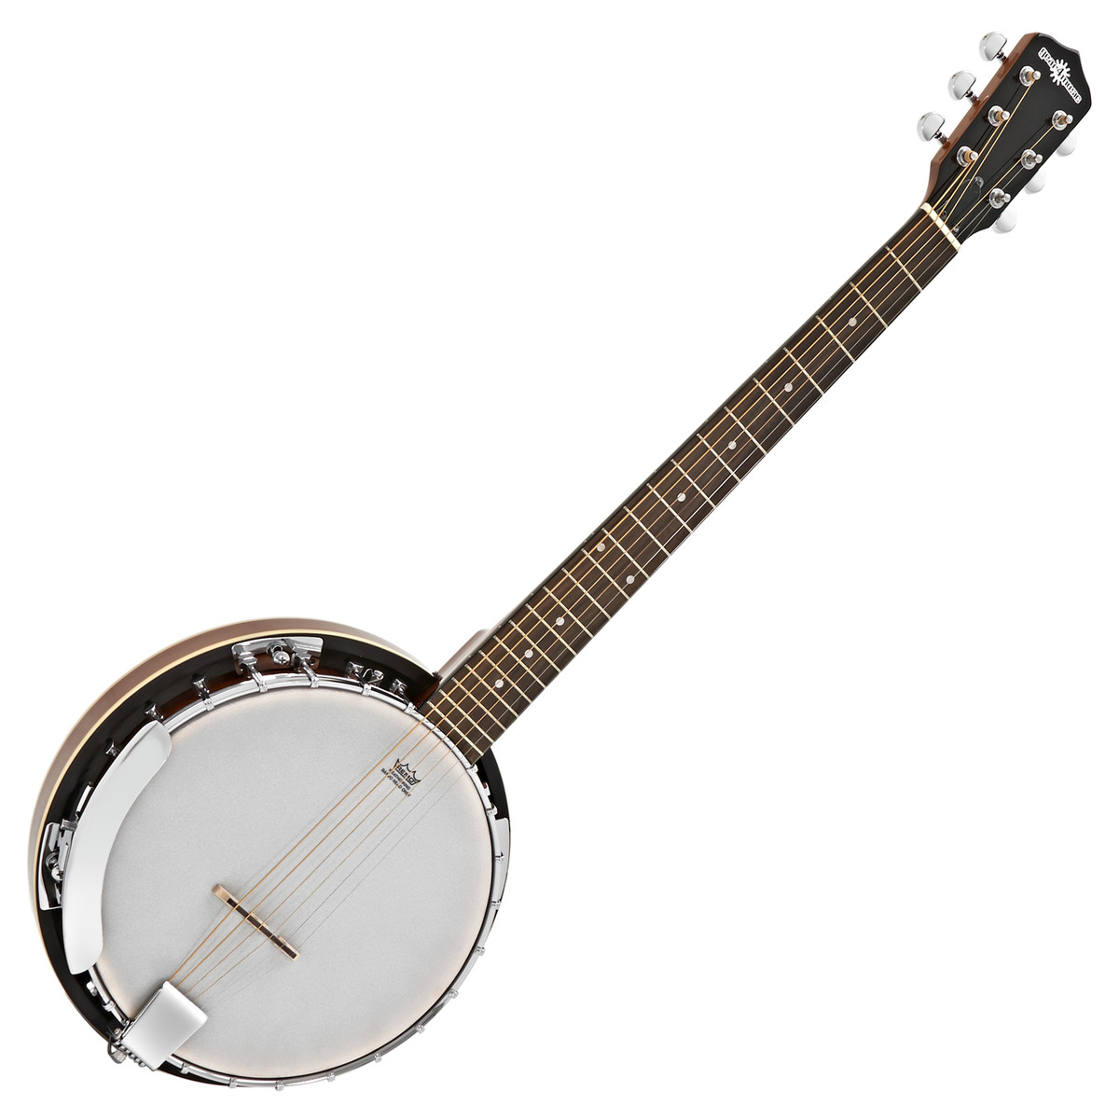
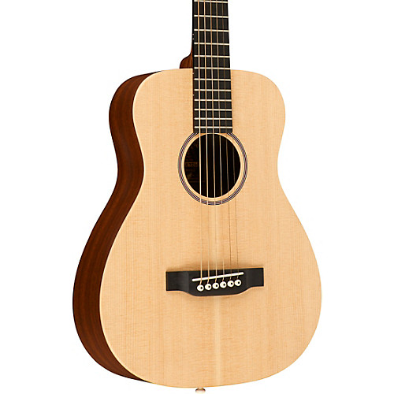
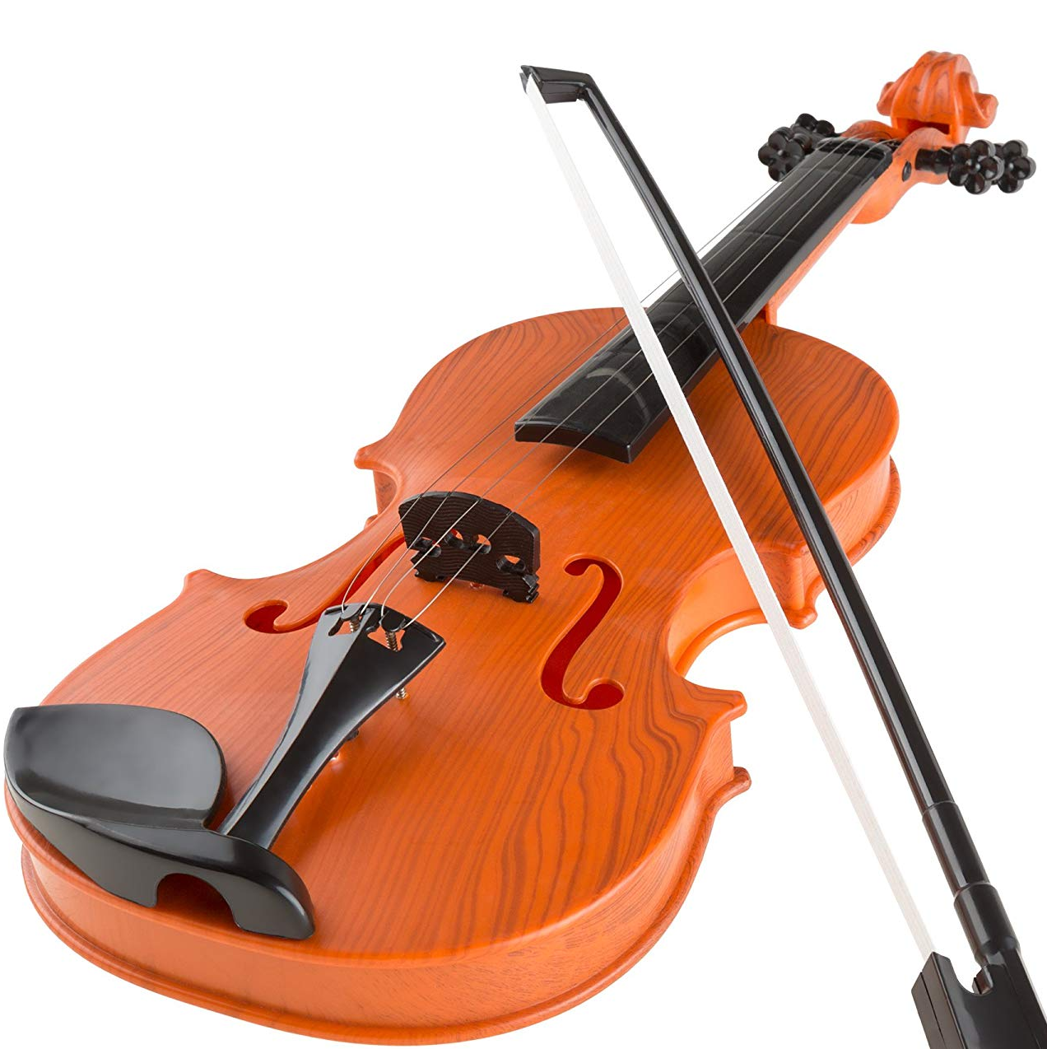
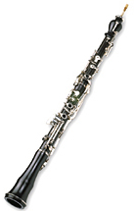
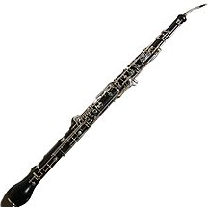
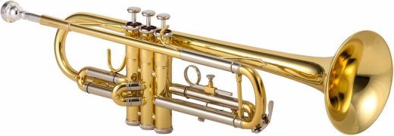
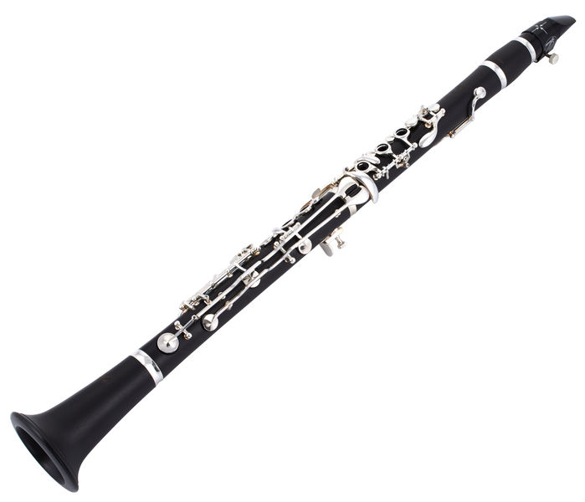
The Dataset: Classes
PLUCKED STRING: Banjo, Guitar | BOWED STRING: Violin, Cello
WOODWIND: Clarinet, Oboe, English Horn | BRASS: Trumpet

Slide 12
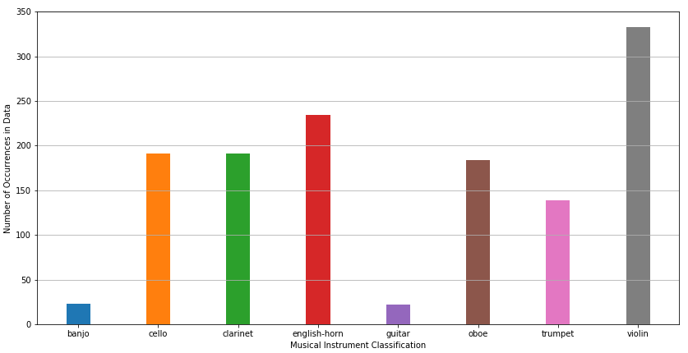
The Dataset: After Filtering
Instrument Class | Number of Samples
Banjo | 23
Cello | 191
Clarinet | 191
English-Horn | 234
Guitar | 22
Oboe | 184
Trumpet | 139
Violin | 333
TOTAL | 1317

Slide 13
Outline
Motivation
Related Literature
The Dataset
Methodology
Feature Extraction
Coefficients of the Amplitude Envelope in the Time-Domain (CATE)
Fast Fourier Transform Coefficients (FFTC)
Mel-Frequency Cepstrum Coefficients (MFCC)
Building the ANN
Results
Conclusion

Slide 14
Feature Extraction
Coefficients of the Amplitude Envelope in the Time-Domain (CATE): 50 float values
Fast Fourier Transform Coefficients (FFTC): 50 float values
Mel-Frequency Cepstrum Coefficients (MFCC): 390 float values
TOTAL # OF FEATURES PER SAMPLE: 490 float values ranging from [-1, 1]

Slide 15
Outline
Motivation
Related Literature
The Dataset
Methodology
Feature Extraction
Coefficients of the Amplitude Envelope in the Time-Domain (CATE)
Fast Fourier Transform Coefficients (FFTC)
Mel-Frequency Cepstrum Coefficients (MFCC)
Building the ANN
Results
Conclusion

Slide 16
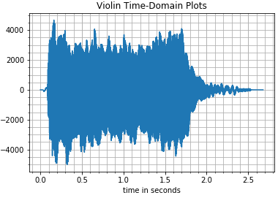
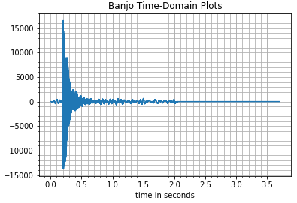
Feature Extraction: Coefficients of the Amplitude Envelope in the Time-domain (CATE)
Background
shape of the positive half of the amplitude envelope could be a good characteristic for instrument identification

Slide 17
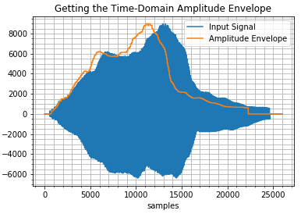
Feature Extraction: Coefficients of the Amplitude Envelope in the Time-domain (CATE)
Take the absolute value of the input signal
Get the shape of the envelope using a Peak-Detection Algorithm
Group adjacent points into n (50) bins
Get the averages per bin
Normalize
50 float values ranging from [0.0, 1.0]

Slide 18
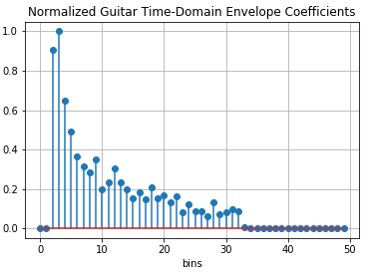
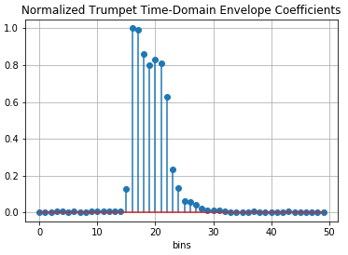
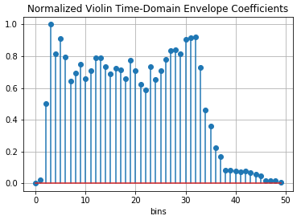
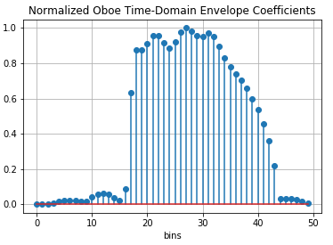
Feature Extraction: Coefficients of the Amplitude Envelope in the Time-domain (CATE)

Slide 19
Outline
Motivation
Related Literature
The Dataset
Methodology
Feature Extraction
Coefficients of the Amplitude Envelope in the Time-Domain (CATE)
Fast Fourier Transform Coefficients (FFTC)
Mel-Frequency Cepstrum Coefficients (MFCC)
Building the ANN
Results
Conclusion

Slide 20
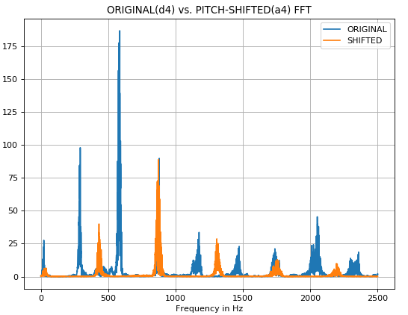
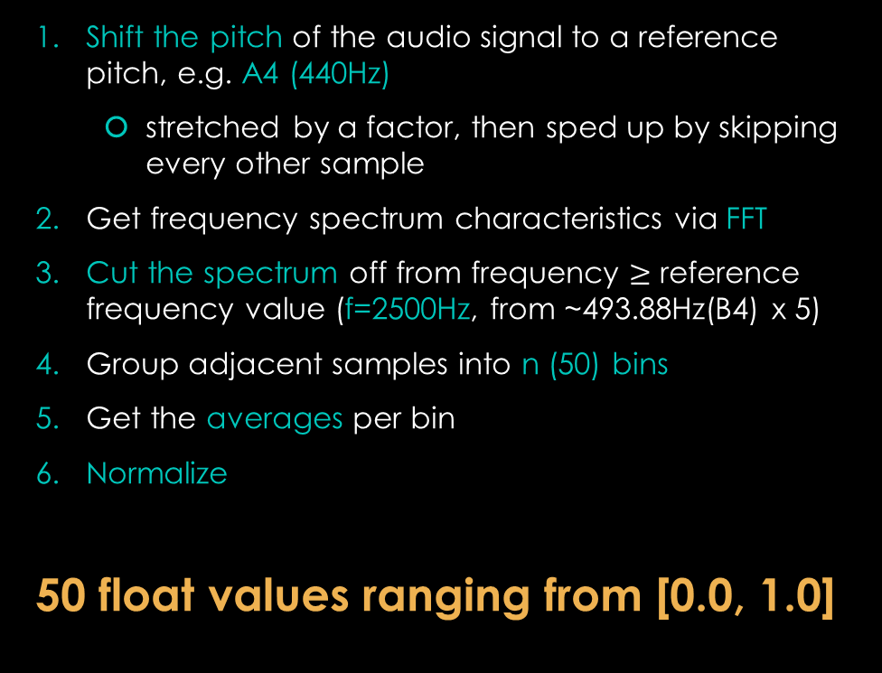
Feature Extraction: Fast Fourier Transform Coefficients (FFTC)
Shift the pitch of the audio signal to a reference pitch, e.g. A4 (440Hz)
stretched by a factor, then sped up by skipping every other sample
Get frequency spectrum characteristics via FFT
Cut the spectrum off from frequency $≥$ reference frequency value (f=2500Hz, from ~493.88Hz(B4) x 5)
Group adjacent samples into n (50) bins
Get the averages per bin
Normalize
50 float values ranging from [0.0, 1.0]

Slide 21
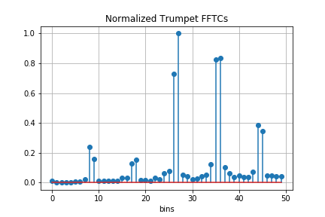
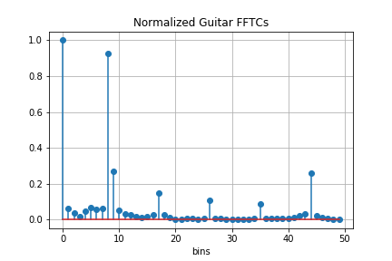
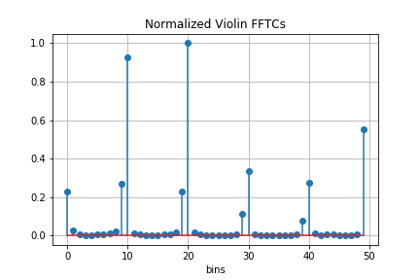
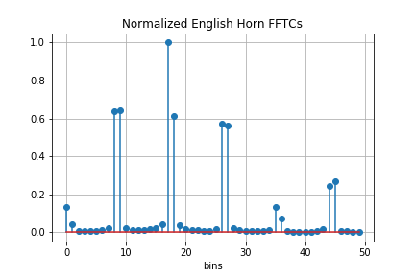
Feature Extraction: Fast Fourier Transform Coefficients (FFTC)

Slide 22
Outline
Motivation
Related Literature
The Dataset
Methodology
Feature Extraction
Coefficients of the Amplitude Envelope in the Time-Domain (CATE)
Fast Fourier Transform Coefficients (FFTC)
Mel-Frequency Cepstrum Coefficients (MFCC)
Building the ANN
Results
Conclusion

Slide 23
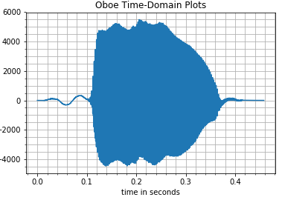
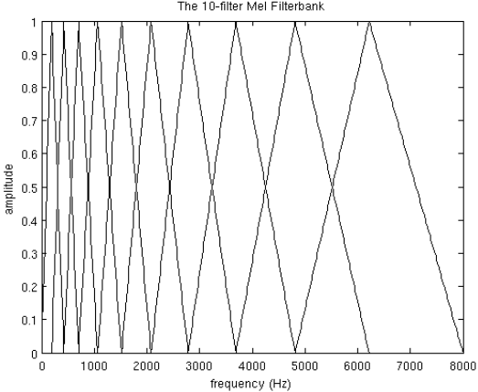
Feature Extraction: Mel-Frequency Cepstrum Coefficients (MFCC)
Background
Commonly-used feature for automatic speech and speaker recognition tasks
Frame signal into 20-40ms frames
One coefficient is computed per Mel-Frequency band for each frame
Mel-Frequency bands: scale of perceptual (logarithmic) scale of pitches judged by listeners to be equal in distance from one another
Coefficient is indicative of amount of spectral energy for each band
http://practicalcryptography.com/miscellaneous/machine-learning/guide-mel-frequency-cepstral-coefficients-mfccs/
Getting the Mel-Frequency bands using the Mel Filterbank

Slide 24
Feature Extraction: Mel-Frequency Cepstrum Coefficients (MFCC)
Compute the MFCCs for the whole input signal
frame size: 20ms
get first 13 MFCC’s
Group adjacent frames into n (30) bins
Get the averages per bin for each of the 13 MFCC
Normalize
30 x 13 = 390 float values ranging from
[-1.0, 1.0]
Getting the Mel-Frequency bands using the Mel Filterbank

Slide 25
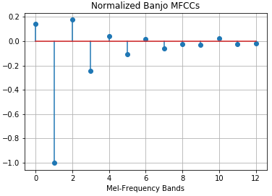
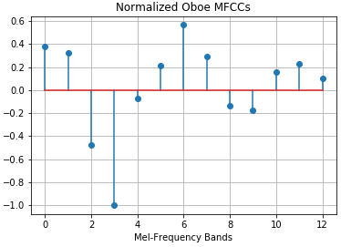
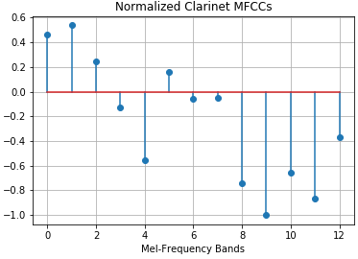
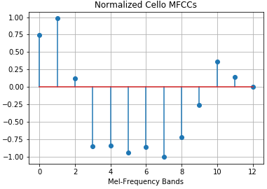
Feature Extraction: Mel-Frequency Cepstrum Coefficients (MFCC)

Slide 26
Outline
Motivation
Related Literature
The Dataset
Methodology
Feature Extraction
Coefficients of the Amplitude Envelope in the Time-Domain (CATE)
Fast Fourier Transform Coefficients (FFTC)
Mel-Frequency Cepstrum Coefficients (MFCC)
Building the ANN
Results
Conclusion

Slide 27
Building the ANN
Using sklearn (MLPClassifier) python library
Tune the hyperparameters via GridSearch (choose settings yielding the highest accuracy)
Parameter | Choices | Final setting
Activation function | identity, logistic, tanh, relU | tanh
Solver for weight optimization | lbfgs, sgd, adam | Adam
Hidden Layer Sizes | (10, 10), (10, 20), (10,30), (20, 10), (20, 20), (20,30), (30, 10), (30, 20), (30,30) | (20, 30)

Slide 28
Outline
Motivation
Related Literature
The Dataset
Methodology
Feature Extraction
Coefficients of the Amplitude Envelope in the Time-Domain (CATE)
Fast Fourier Transform Coefficients (FFTC)
Mel-Frequency Cepstrum Coefficients (MFCC)
Building the ANN
Results
Conclusion

Slide 29
Results: Accuracy
Run Cross Validation with Repeated Stratified K Fold
5 splits, repeated 10 times
Accuracy: 0.9688 ; Standard Deviation: 0.03
Comparison with reference work[1]
3.38% better!
 | Number of runs | Average
Reference work [1] | 10 | 93.5%
This work | 10 | 96.88%

Slide 30
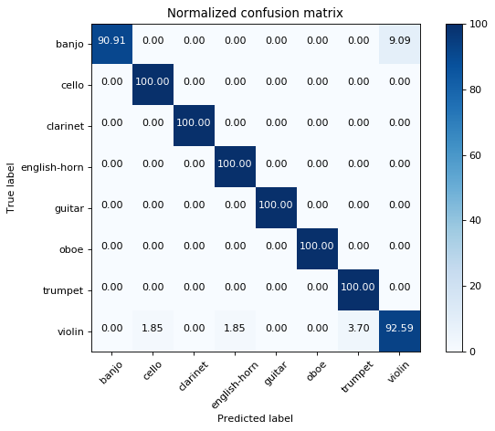
Results: Confusion Matrix
dataset split: 67% (Train), 33% (Test)

Slide 31
Results: Confusion Matrix

Slide 32
Outline
Motivation
Related Literature
The Dataset
Methodology
Feature Extraction
Coefficients of the Amplitude Envelope in the Time-Domain (CATE)
Fast Fourier Transform Coefficients (FFTC)
Mel-Frequency Cepstrum Coefficients (MFCC)
Building the ANN
Results
Conclusion

Slide 33
Conclusion
Features from both the Time Domain (CATE) and the Frequency Domain (FFTC, MFCC) were extracted and utilized together
Yielded 3.38% better average accuracy than a reference work working on the same dataset
Future Work:
Expand the note range of the dataset
Increase number of classifications

Slide 34
Thank you!
GitHub: https://github.com/jrili/rili-intelligent-systems.git

