Slide 1
Project #4: Virtual Memory
Operating Systems (CSE4070) Project
Fall 2021
Prof. Youngjae Kim, Prof. Sungyong Park
TA: Yonghyeon Cho (01)
Jungwook Han (02)
Hongsu Byun (03)

Slide 2
Overview
Reading pintos document is highly recommended especially for this project (pp. 39-49)
Basically, the 'vm' directory contains only 'Makefile's
In project 1, 2 and 3, a program was terminated when a page fault occurs
In this project, you will make the pintos to be more reliable from page faults and to run the programs properly
All code you write will be in new files or in files introduced in earlier projects

Slide 3
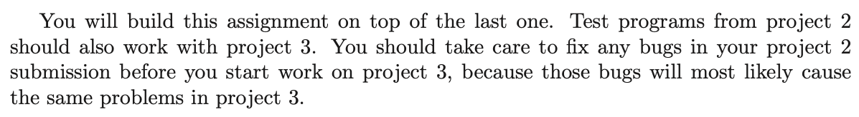
Overview
Use the code implemented in 'User Programs' project.
Refer 2nd paragraph in pg.39.

Slide 4
Project Requirement
Page Table Management
Supplemental page table and page fault handling
Paging to and from (swap) disk
Implement pseudo-LRU policies (second chance)
Stack Growth

Slide 5
Virtual Memory Overview
Physical Memory
Kernel Memory Pool
User Memory Pool
PHY_BASE
Kernel Pages
(Global)
Swap Disk
Max 1GB
Thread A
{…
pagedir
…}
User Pages
(per thread)
3GB
0
switching – process_activate()
Thread B
{…
pagedir
…}
User Stack Growth→
User Pages
(per thread)
3GB
0

Slide 6
Page Table
31
22
21
12
11
0
Page Directory Index
Page Table Index
Page Offset
Page Directory
Page Table
Data Page
1023
1023
PTE
PDE
0
0
1K entries
1K entries
4K data

Slide 7
Page Table Management
기존 Page Table에 필요한 정보 추가
주로 Page fault handling을 위한 정보를 추가
Page Fault handler 구현

Slide 8
Supplemental Page Table
Since the given page table in pintos has limitations, we need to supplement the page table with additional data about each page
You can exploit the functions in userprog/pagedir.c to implement supplemental page table
Page table entry format (flags are defined in threads/pte.h)
31
12
11
9
6
5
2
1
0
Physical Address(20 bits)
AVL
(not used)
D
A
U
W
P
PTE_P | present bit
PTE_W | read(0)/write(1) bit
PTE_U | kernel(0)/user(1) bit
PTE_A | accessed bit
PTE_D | dirty bit
PTE_AVL | not used in pintos

Slide 9
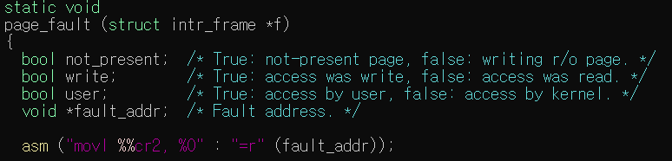
Page Fault Handler
userprog/exception.c의 page_fault()
Page Fault situation
page from a file or swap
Access is invalid
If the page is unmapped, that is, if there’s no data where the page is referenced
If the access is an attempt to write to a read-only page (unprivileged access)
CR2 : register storing faulted address
Some boolean variables in page_fault() will help you
bool not_present; // not present in memory or rights violation
bool write; // write or read fault
bool user; // fault from user or kernel space

Slide 10
Page Fault Handler
Page Fault handling procedures
Processor (CPU) triggers page fault
Control is passed to the kernel, which calls the page fault handler (userprog/exception.c:page_fault())
Get the faulted address from CR2 register
If the memory reference is valid
Obtain a frame to store the page
Fetch the data into the frame, by reading it from the file system or swap, zeroing it, etc.
Point the page table entry for the faulting virtual address to the physical page
If the access is invalid
Any invalid access terminates the process and thereby frees all of its resources

Slide 11
Page Fault Handler: page_fault()
page_fault()
given in userprog/exception.c
Obtain fault_addr
need to be implemented
YES
Is valid
reference?
NO
Growable
region?
NO
Check not present
Get pte
YES
Kill process and
free resources
Call handle_mm_fault
Expand Userstack
Restart process

Slide 12
Page Fault Handler: handle_mm_fault()
handle_mm_fault()
Allocate
frame
Get empty frame
Is there remaining frame?
NO
Page replacement
algorithm
Evict page
YES
Push page
Swap page into frame from disk
Modify page and swap manage tables
Restart process

Slide 13
Paging to and from (swap) disk
Swap disk
Process에 할당해 줄 Physical memory가 부족할 때(User page pool에 free page가 없을 때) disk로 swap-out이 일어남
Swap 할 page의 결정은 page replacement algorithm 사용(LRU, LFU …)
Swap table 작성
swap disk가 현재 사용하고 있는 슬롯과 빈 슬롯 관리
devices/block.c 의 block_read() / block_write() 활용
You may use the BLOCK_SWAP block device for swapping, obtaining the struct block that represents it by calling block_get_role()
BLOCK_SWAP에 대해서는 devices/partition.c, thread/init.c 참조
swap disk 생성
vm/build에서
pintos-mkdisk swap.dsk --swap-size=n --> swap.dsk 라는 이름으로 n MB swap disk 생성
swap.dsk는 pintos의 실행 시 자동으로 hdb1에 attach됨
Pintos 실행 시 argument로 '--swap-size=n ' 을 추가해도 n MB swap disk가 생성됨
swap.dsk는 pintos의 실행 시 자동으로 hda4에 attach됨

Slide 14
Stack Growth
If page faults on an address that "appears" to be a stack access, allocate another stack page
You should impose some absolute limit on stack size, as do most OSes. On many GNU/Linux systems, the default limit is 8 MB.
First stack page can still be loaded at process load time (in order to get arguments, etc.)

Slide 15

Stack Growth (Example 1)
PHYS_BASE-PGSIZE
3GB
0
User Stack Growth→ .........
User Pages
(per thread)
1 Page
(4096B)
PHYS_BASE-PGSIZE*2
Initial stack page
(argument passing)
Code, Data
Segments
0x08048000
(base boundary)
esp = esp-4096 ;allocate stack memory
but the new esp, “esp-4096”, will cause page fault
3GB
0
esp
esp-4096
Newly allocated stack page

Slide 16

Stack Growth (Example 2)
What if user program tries to allocate more than a single PAGE size?
esp = esp-4096*3 ;allocate 3 stack pages
3GB
0x08048000
0
esp
esp-4096*3
Newly allocated stack pages
What about page shrinking?
Do not consider about shrinking
Consider only expanding!

Slide 17
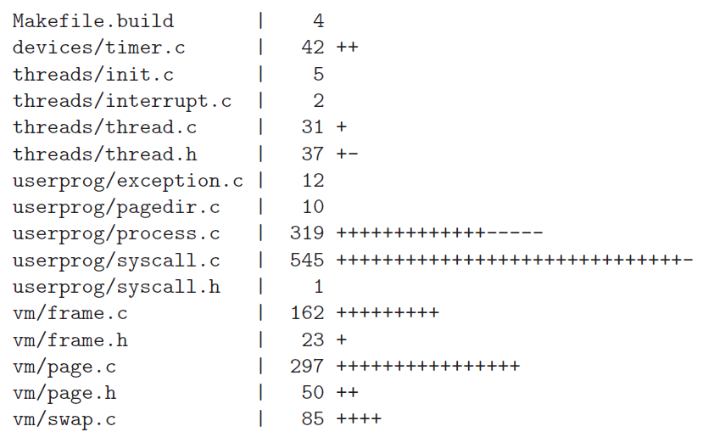
Reference
You can add new files to src/vm/ if it is required.
Newly added files should be written to src/Makefile.build
You can follow this
approach if you want

Slide 18
Evaluation
16 tests will be graded. (Refer to the test case list in the next slide)
Total score is 100 which consists of 80 for test cases and 20 for documentation.
Refer to src/tests/vm/Grading src/tests/vm/Rubric.functionality src/tests/vm/Rubric.robustness to check the points of each test.

Slide 19
Evaluation
Functionality
No. | Test Case | Point
1 | pt-grow-stack | 3
2 | pt-grow-stk-sc | 3
3 | pt-big-stk-obj | 3
4 | pt-grow-pusha | 3
5 | page-linear | 3
6 | page-parallel | 3
7 | page-shuffle | 3
8 | page-merge-seq | 4
9 | page-merge-par | 4
10 | page-merge-mm | 4
11 | page-merge-stk | 4
Total |  | 37
Robustness
No. | Test Case | Point
1 | pt-bad-addr | 2
2 | pt-bad-read | 3
3 | pt-write-code | 2
4 | pt-write-code2 | 3
5 | pt-grow-bad | 4
Total |  | 14

Slide 20
Documentation
Use the document file uploaded on e-class
Documentation accounts for 20% of total score. (Development 80%, Documentation 20%)

Slide 21
Submission
Make 'ID' directory and copy 'src' directory in the pintos directory and the document file ([ID].docx).
Compress 'ID' directory to 'os_prj4_[ID].tar.gz'.
We provide the script 'submit.sh' to make tar.gz file which contains 'src' directory and document file. 학생들의 편의를 위해 pintos 디렉토리 내 submit.sh 스크립트를 제공합니다. 이 스크립트는 src 디렉토리와 document file을 포함한 tar.gz 파일을 생성합니다.
Disclaimer
Any result produced from the 'submit.sh' script is at your own risk.
You must check the contents of the tar.gz file before submission.
'submit.sh' 스크립트로 생성된 결과의 모든 책임은 사용자에게 귀속됩니다.
제출하기 전, tar.gz 파일의 내용물을 반드시 다시 한 번 체크하기 바랍니다.

Slide 22
Submission
Notice – ‘submit.sh’
The ‘submit.sh’ script should be executed on a directory where ‘src’ folder is located.
submit.sh 스크립트는 src 폴더가 위치한 디렉토리에서 실행되어야 합니다.
‘ID’ folder should not be in the directory.
해당 디렉토리에 ‘학번’ 폴더가 없어야 합니다.
‘ID.docx’ file should be located in the directory.
Also, report file with extensions other than ‘docx’ will not be compressed.
해당 디렉토리에 ‘학번.docx’ 파일이 있어야 함께 압축됩니다.
또한 ‘docx’ 이외의 확장자를 가진 보고서 파일은 압축되지 않습니다.
Be sure to backup your code in case of an unexpected situation.
만일의 경우를 대비해 반드시 코드를 백업하여 주세요.

Slide 23
Submission
It is a personal project.
Due date : 2021. 11. 27 23:59
Submission
The form of submission file is as follows:
No hardcopy.
Copy will get a penalty (1st time: 0 Point and downgrading, 2nd time: F grade)
Name of compressed file | Example (ID: 20191111)
os_prj4_[ID].tar.gz | os_prj4_20191111.tar.gz

Slide 24
Submission
Contents
Pintos source codes (Only 'src' directory in pintos directory) 최소한의 용량을 위해 src 디렉토리만 압축파일에 포함합니다.
Document: [ID].docx (e.g. 20191111.docx; Other format is not allowed such as .hwp)
How to submit
Make tar.gz file.
Copy the document file ([ID].docx) to pintos directory.
Execute submit.sh script in the pintos directory and follow the instructions of the script. pintos 디렉토리 내의 submit.sh 스크립트를 실행하고 스크립트의 지시를 따르십시오.
Check that os_prj4_[ID].tar.gz is created.
Decompress os_prj4_[ID].tar.gz and check the contents in it. ($ tar -zxf os_prj4_[ID].tar.gz) (Only [ID].docx and src directory should be contained in the tar.gz file.)
For example, if your ID is 20191111, os_prj4_20191111.tar.gz should be created. To decompress the tar.gz file, execute tar -zxf os_prj4_20191111.tar.gz
Please check the contents of tar.gz file after creating it.
Upload the os_prj4_[ID].tar.gz file to e-class.

