Slide 1
Synthesis of a Forklift Controller

Slide 2
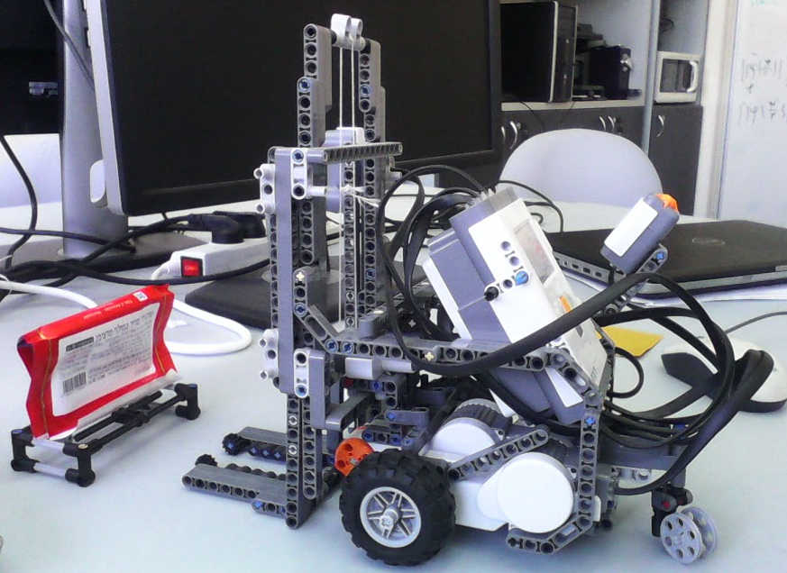
The Forklift

Slide 3
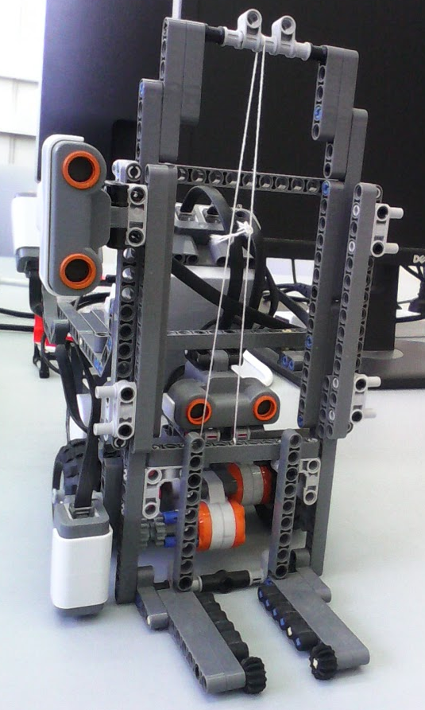
Sensors of Forklift
Two distance sensors
for walls
for cargo and low obstacles
Color sensor to detect station
Emergency off button

Slide 4
Requirements (obligations of forklift)
Do not run into obstacles.
Pay special attention to low obstacles.
Only pick up or drop cargo at stations.
Do not attempt to lift cargo if cargo is lifted.
Always keep on delivering cargo.
Never drop cargo at the station where it was picked up.
Stop moving if emergency off switch is pressed.

Slide 5
Assumptions
The forklift will always be able to eventually find a station with cargo by going forward. The same applies for delivering cargo.
The forklift will always be able to eventually leave a station by going forward or backward.
The forklift can back up or turn to avoid obstacles.
// If the forklift stops at a station it remains there.

Slide 6
C&C Model of Forklift

Slide 7
C&C Model of Forklift
MontiArcAutomaton
ForkLift
«Deploy»
Controller
StationSensor(S1) stationSense
LiftMotor(A) mLift
DistanceSensor(S2, 20) distSense
Motor(B) mLeft
Button(S3) emgOffButton
Motor(C) mRight
DistanceSensor(S4, 9) cargoSense

Slide 8
Controller and Datatypes
Controller
boolean liftAck
«enumeration» Distance
MotorCmd lMot
CLEAR
BLOCKED
boolean atStation
«enumeration» LiftCmd
Distance obstacle
MotorCmd rMot
LIFT DROP NIL
Distance cargo
LiftCmd lift
«enumeration» MotorCmd
boolean emgOff
FWD BWD STOP

Slide 9
Wrappers and Computation
Integration of hardware wrappers and computation parts requires
component definition with no implementation
implementation in Java of
compute() method
optional: constructor, init(), and setup()
framework will do composition

Slide 10
Wrapper: StationSensor
StationSensor(SensorPort sp)
boolean atStation
public StationSensorImpl(SensorPort sp) {
sensor = new ColorSensor(sp);
sensor.setFloodlight(Color.BLUE);
}
public void compute() {
if (sensor.getRawLightValue() < 400) {
sense.setCurrentValue(true);
} else {
sense.setCurrentValue(false);
}
}

Slide 11
Wrapper: DistanceSensor
DistanceSensor(SensorPort sp, int cm)
Distance sense
public DistanceSensorImpl(SensorPort sp, int cm) {
this.cm = cm;
sensor = new UltrasonicSensor(sp);
sensor.continuous();
}
public void init() {compute();};
public void compute() {
if (sensor.getDistance() < cm) {
sense.setCurrentValue(Distance.BLOCKED);
} else {
sense.setCurrentValue(Distance.CLEAR);
}
}

Slide 12
Wrapper: LiftMotor
public LiftMotorImpl(MotorPort mp) {
motor = new NXTRegulatedMotor(mp);
motor.setAcceleration(1000);
motor.resetTachoCount();
}
public void compute() {
if (cmd.getNextValue() != null) {
switch (cmd.getNextValue()) {
case DROP:
motor.rotateTo(0, true);
break;
case LIFT:
motor.rotateTo(600, true);
break;
case NIL:
break;
}
}
LiftMotor(MotorPort mp)
LiftCmd cmd
boolean liftAck
boolean atDonePos = true;
try {
atDonePos = !motor.isMoving() && (motor.getTachoCount() == 0 || motor.getTachoCount() == 600);
} catch (Exception e) {
e.printStackTrace();
}
if (working && atDonePos) {
ack.setCurrentValue(true);
working = false;
} else {
ack.setCurrentValue(false);
}
}

Slide 13
Wrapper: Motor
public MotorImpl(MotorPort mp) {
motor = new NXTRegulatedMotor(mp);
motor.setAcceleration(1000);
motor.resetTachoCount();
}
public void compute() {
if (cmd.getNextValue() != null) {
switch (cmd.getNextValue()) {
case STOP:
motor.stop();
break;
case BWD:
motor.rotate(-180, true);
break;
case FWD:
motor.rotate(180, true);
break;
}
}
}
Motor(MotorPort mp)
MotorCmd cmd

Slide 14
Scheduling Execution
MontiArcAutomaton
ForkLift
«Deploy»
Controller
2
StationSensor(S1) stationSense
LiftMotor(A) mLift
1
3
DistanceSensor(S2, 20) distSense
Motor(B) mLeft
6
7
4
Button(S3) emgOffButton
Motor(C) mRight
8
5
DistanceSensor(S4, 9) cargoSense

Slide 15
Scheduler in CMP Format
<<Deploy>>component ForkLift {
// exception to put it first because it sends data to controller
component LiftMotor(lejos.nxt.Motor.A) mLift;
// sensors
component StationSensor(lejos.nxt.SensorPort.S1) stationSense;
component DistanceSensor(lejos.nxt.SensorPort.S2, 20) distSense;
component Button(lejos.nxt.SensorPort.S3) emgOffButton;
component DistanceSensor(lejos.nxt.SensorPort.S4, 9) cargoSense;
// controller
component Controller controller;
// actuators
component Motor(lejos.nxt.Motor.B) mLeft;
component Motor(lejos.nxt.Motor.C) mRight;
// input from sensors to controller
connect stationSense.sense -> controller.station;
connect distSense.sense -> controller.sense;
connect emgOffButton.pressed -> controller.emgOff;
connect cargoSense.sense -> controller.cargo;
connect mLift.ack -> controller.liftAck;
// output from controller to actuators
connect controller.lift -> mLift.cmd;
connect controller.mLeft -> mLeft.cmd;
connect controller.mRight -> mRight.cmd;
}

Slide 16
Synthesis Specification

Slide 17
“Interface” Definition
VARENV
ext cargo : { CLEAR, BLOCKED };
ext sense : { CLEAR, BLOCKED };
ext station : boolean;
ext emgOff : boolean;
VAR
ext mLeft : { FWD, STOP, BWD, XXX };
ext mRight : { FWD, STOP, BWD, XXX };
ext lift : { LIFT, DROP, NIL, XXX };

Slide 18
Some Abbreviations for Specification
DEFINE
backing := mLeft = BWD & mRight = BWD;
stopping := mLeft = STOP & mRight = STOP;
turning := mLeft = BWD & mRight = FWD;
forwarding := mLeft = FWD & mRight = FWD;
dropping := lift = DROP;
lifting := lift = LIFT;
lowObstacle := (cargo = BLOCKED & station = 0);

Slide 19
Some Guarantees
Do not run into obstacles.
[] ((sense = BLOCKED | lowObstacle) -> ! forwarding);
Only pick up or drop cargo at stations.
[] (!station -> lift = NIL);
Always keep on delivering cargo.
[] <> ((lift = DROP) | emgOff | lowObstacle);

Slide 20
Some Assumptions
The forklift will always be able to eventually leave a station by going forward.
[] ((forwarding) -> <> (!station | stopping));
The forklift will always be able to eventually find a station with cargo by going forward.
[] ((forwarding & !spec_loaded) -> <> ((station & cargo = BLOCKED) | backing | stopping));

Slide 21
Synthesized Controller
state S0, S1, S2, S3, S4, S5, S6[initial], S7, S8, S9, S10, S11;
S0 -> S7 {cargo:CLEAR, sense:CLEAR, station:0, emgOff:0} / {mLeft:FWD, mRight:FWD, lift:NIL};
S0 -> S11 {cargo:BLOCKED, sense:BLOCKED, station:0, emgOff:1} / {mLeft:STOP, mRight:STOP, lift:NIL};
S0 -> S10 {cargo:BLOCKED, sense:CLEAR, station:1, emgOff:1} / {mLeft:STOP, mRight:STOP, lift:NIL};
S0 -> S11 {cargo:CLEAR, sense:CLEAR, station:0, emgOff:1} / {mLeft:STOP, mRight:STOP, lift:NIL};
S0 -> S7 {cargo:CLEAR, sense:BLOCKED, station:0, emgOff:0} / {mLeft:BWD, mRight:FWD, lift:NIL};
S0 -> S7 {cargo:CLEAR, sense:CLEAR, station:1, emgOff:0} / {mLeft:FWD, mRight:FWD, lift:NIL};
S0 -> S11 {cargo:CLEAR, sense:BLOCKED, station:0, emgOff:1} / {mLeft:STOP, mRight:STOP, lift:NIL};
S0 -> S10 {cargo:CLEAR, sense:CLEAR, station:1, emgOff:1} / {mLeft:STOP, mRight:STOP, lift:NIL};
S0 -> S10 {cargo:BLOCKED, sense:BLOCKED, station:1, emgOff:1} / {mLeft:STOP, mRight:STOP, lift:NIL};
S0 -> S7 {cargo:CLEAR, sense:BLOCKED, station:1, emgOff:0} / {mLeft:BWD, mRight:FWD, lift:NIL};
S0 -> S10 {cargo:CLEAR, sense:BLOCKED, station:1, emgOff:1} / {mLeft:STOP, mRight:STOP, lift:NIL};
S0 -> S0 {cargo:BLOCKED, sense:CLEAR, station:0, emgOff:0} / {mLeft:BWD, mRight:BWD, lift:NIL};
S0 -> S7 {cargo:BLOCKED, sense:CLEAR, station:1, emgOff:0} / {mLeft:BWD, mRight:BWD, lift:NIL};
S0 -> S7 {cargo:BLOCKED, sense:BLOCKED, station:1, emgOff:0} / {mLeft:BWD, mRight:BWD, lift:NIL};
S0 -> S11 {cargo:BLOCKED, sense:CLEAR, station:0, emgOff:1} / {mLeft:STOP, mRight:STOP, lift:NIL};
S0 -> S0 {cargo:BLOCKED, sense:BLOCKED, station:0, emgOff:0} / {mLeft:BWD, mRight:BWD, lift:NIL};
S1 -> S1 {cargo:CLEAR, sense:CLEAR, station:0, emgOff:0} / {mLeft:FWD, mRight:FWD, lift:NIL};
S1 -> S6 {cargo:BLOCKED, sense:BLOCKED, station:0, emgOff:1} / {mLeft:STOP, mRight:STOP, lift:NIL};
S1 -> S5 {cargo:BLOCKED, sense:BLOCKED, station:1, emgOff:0} / {mLeft:STOP, mRight:STOP, lift:LIFT};
S1 -> S8 {cargo:BLOCKED, sense:CLEAR, station:1, emgOff:1} / {mLeft:STOP, mRight:STOP, lift:NIL};
S1 -> S6 {cargo:CLEAR, sense:CLEAR, station:0, emgOff:1} / {mLeft:STOP, mRight:STOP, lift:NIL};
S1 -> S1 {cargo:CLEAR, sense:BLOCKED, station:0, emgOff:0} / {mLeft:BWD, mRight:FWD, lift:NIL};
S1 -> S1 {cargo:CLEAR, sense:CLEAR, station:1, emgOff:0} / {mLeft:FWD, mRight:FWD, lift:NIL};
S1 -> S8 {cargo:BLOCKED, sense:BLOCKED, station:1, emgOff:1} / {mLeft:STOP, mRight:STOP, lift:NIL};
S1 -> S6 {cargo:CLEAR, sense:BLOCKED, station:0, emgOff:1} / {mLeft:STOP, mRight:STOP, lift:NIL};
S1 -> S8 {cargo:CLEAR, sense:CLEAR, station:1, emgOff:1} / {mLeft:STOP, mRight:STOP, lift:NIL};
S1 -> S1 {cargo:CLEAR, sense:BLOCKED, station:1, emgOff:0} / {mLeft:BWD, mRight:FWD, lift:NIL};
...

Slide 22
Generated Java Code
switch (this.state) {
case S0:
if (this.cargo.getCurrentValue() != null
&& this.cargo.getCurrentValue() == Distance.CLEAR
&& this.sense.getCurrentValue() != null
&& this.sense.getCurrentValue() == Distance.BLOCKED
&& this.station.getCurrentValue() != null
&& this.station.getCurrentValue() == true
&& this.emgOff.getCurrentValue() != null
&& this.emgOff.getCurrentValue() == false) {
this.state = State.S6;
this.mLeft.setNextValue(MotorCmd.BWD);
this.mRight.setNextValue(MotorCmd.FWD);
this.lift.setNextValue(LiftCmd.NIL);
}
if (this.cargo.getCurrentValue() != null
&& this.cargo.getCurrentValue() == Distance.CLEAR
&& this.sense.getCurrentValue() != null
&& this.sense.getCurrentValue() == Distance.BLOCKED
&& this.station.getCurrentValue() != null
&& this.station.getCurrentValue() == true
&& this.emgOff.getCurrentValue() != null
&& this.emgOff.getCurrentValue() == true) {
this.state = State.S0;
this.mLeft.setNextValue(MotorCmd.STOP);
this.mRight.setNextValue(MotorCmd.STOP);
this.lift.setNextValue(LiftCmd.NIL);
}
...

Slide 23
The Running System

Slide 24
C&C Model of Forklift
MontiArcAutomaton
ForkLift
«Deploy»
Controller
StationSensor(S1) stationSense
LiftMotor(A) mLift
DistanceSensor(S2, 20) distSense
Motor(B) mLeft
Button(S3) emgOffButton
Motor(C) mRight
DistanceSensor(S4, 9) cargoSense

