Slide 1

Fantasy Basketball Researcher
Joshua Rio-Ross
Capstone Demo

Slide 2
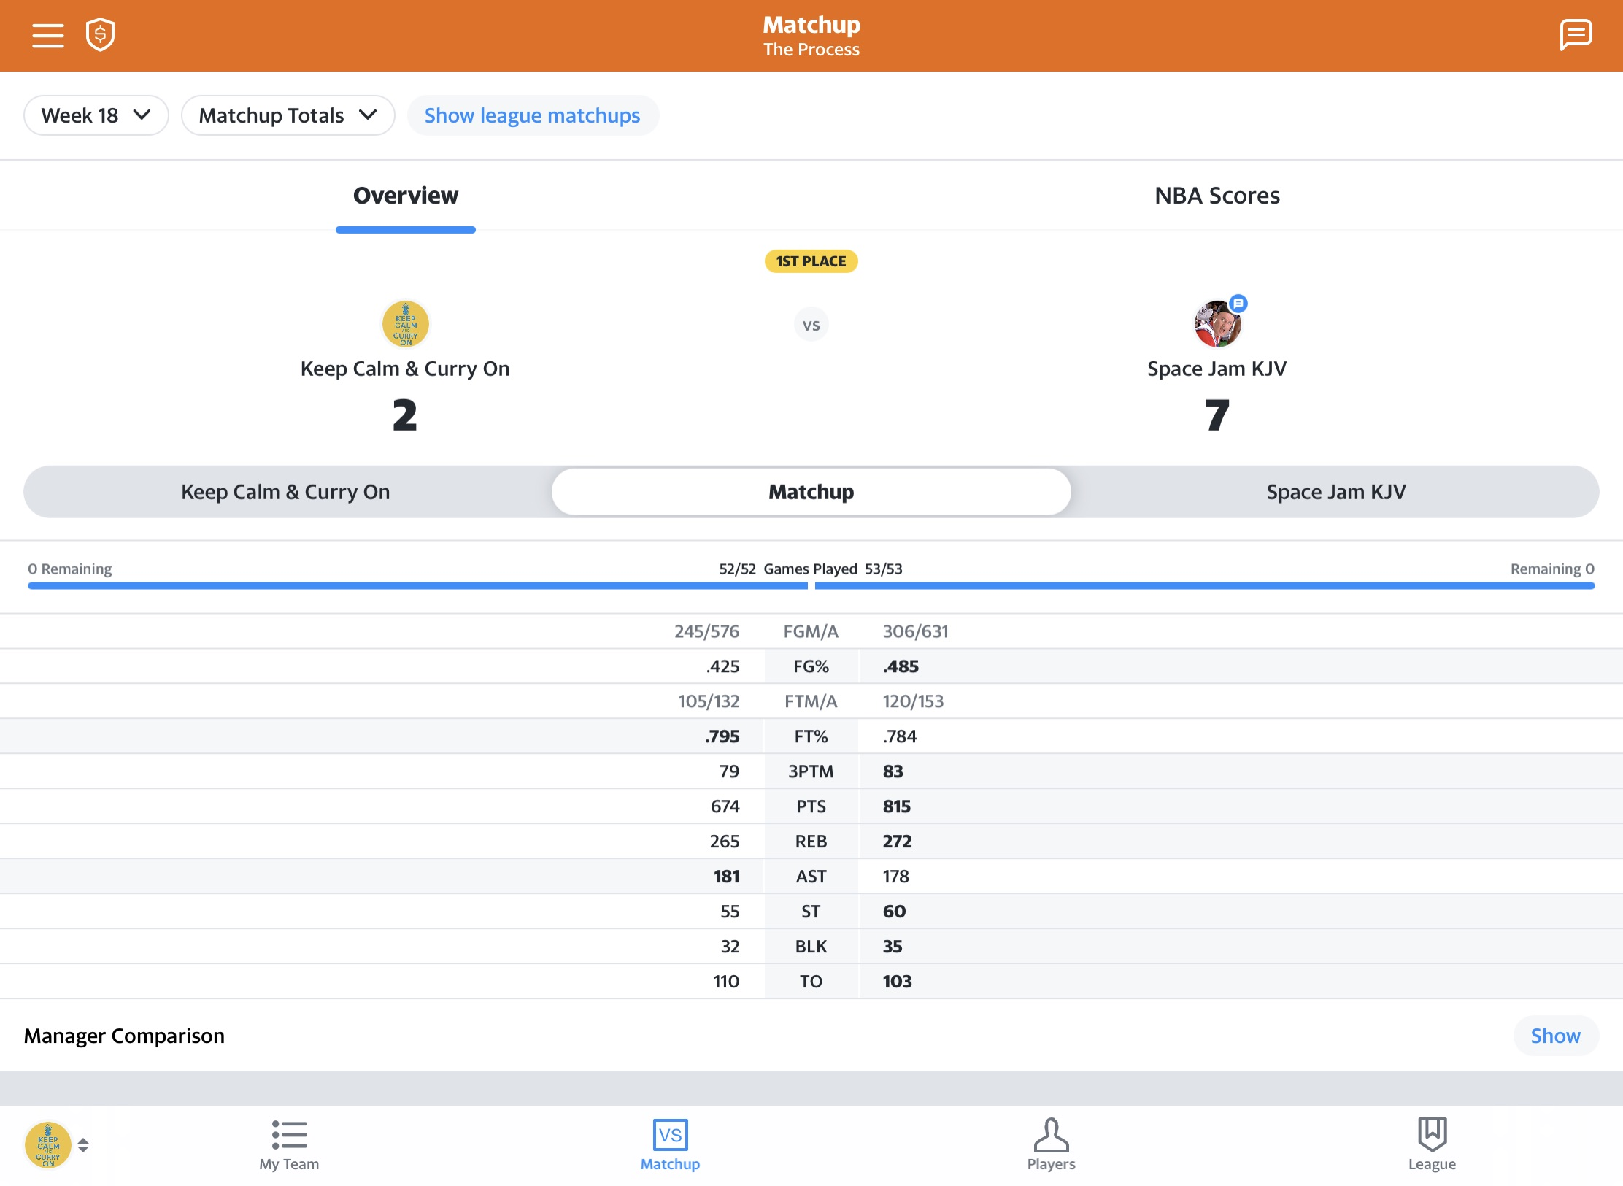
Goal win at least 5 out of 9 categories in each weekly matchup

Slide 3
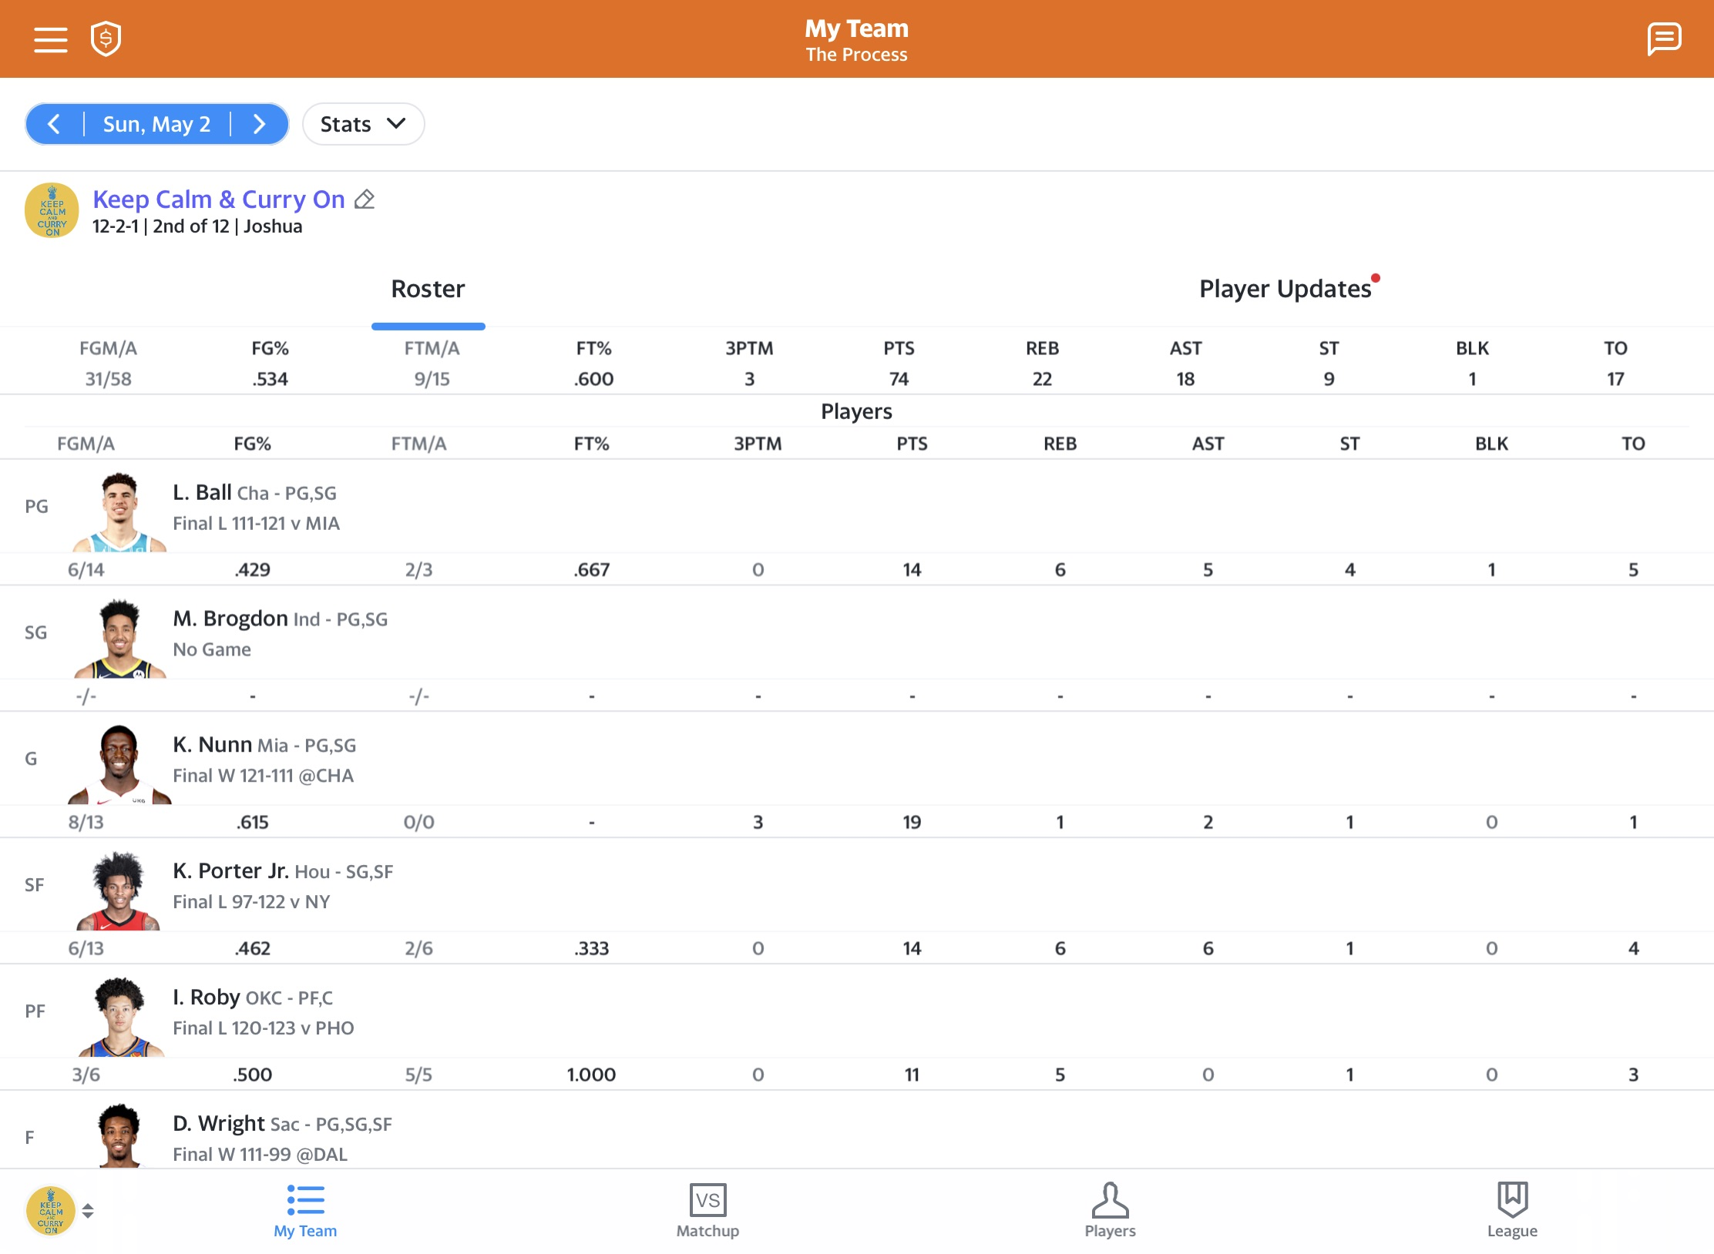
The Process your players accumulate stats in real-life games throughout the matchup week

Slide 4
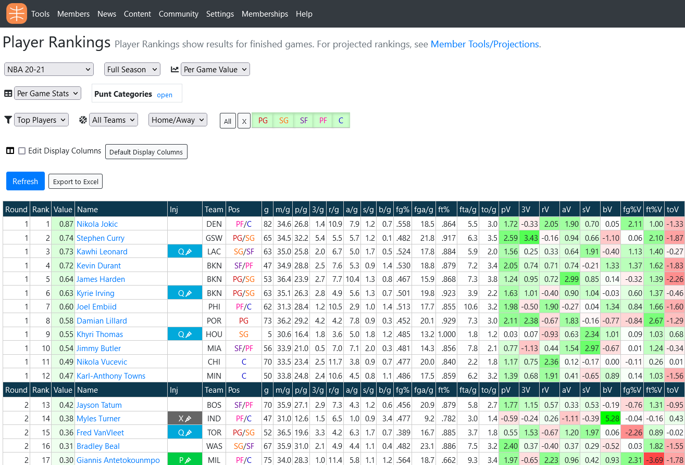
Resources are scarce, and they aren’t pretty

Slide 5
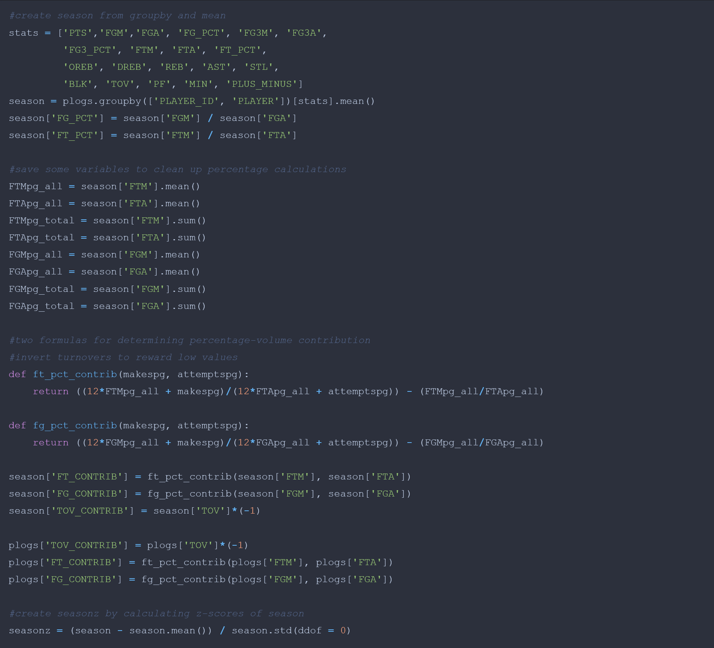
Objectives
Make a user-friendly, graphically insightful dashboard for the fantasy-basketball manager to research player value
Allow for “punting” categories
Create meaningful measures for percent contributions
Determine meaningful normalization
Updateable or bust

