Slide 1

The Country music hall of fame
An $R^{2} Analytics$Webscraping Project

Slide 2
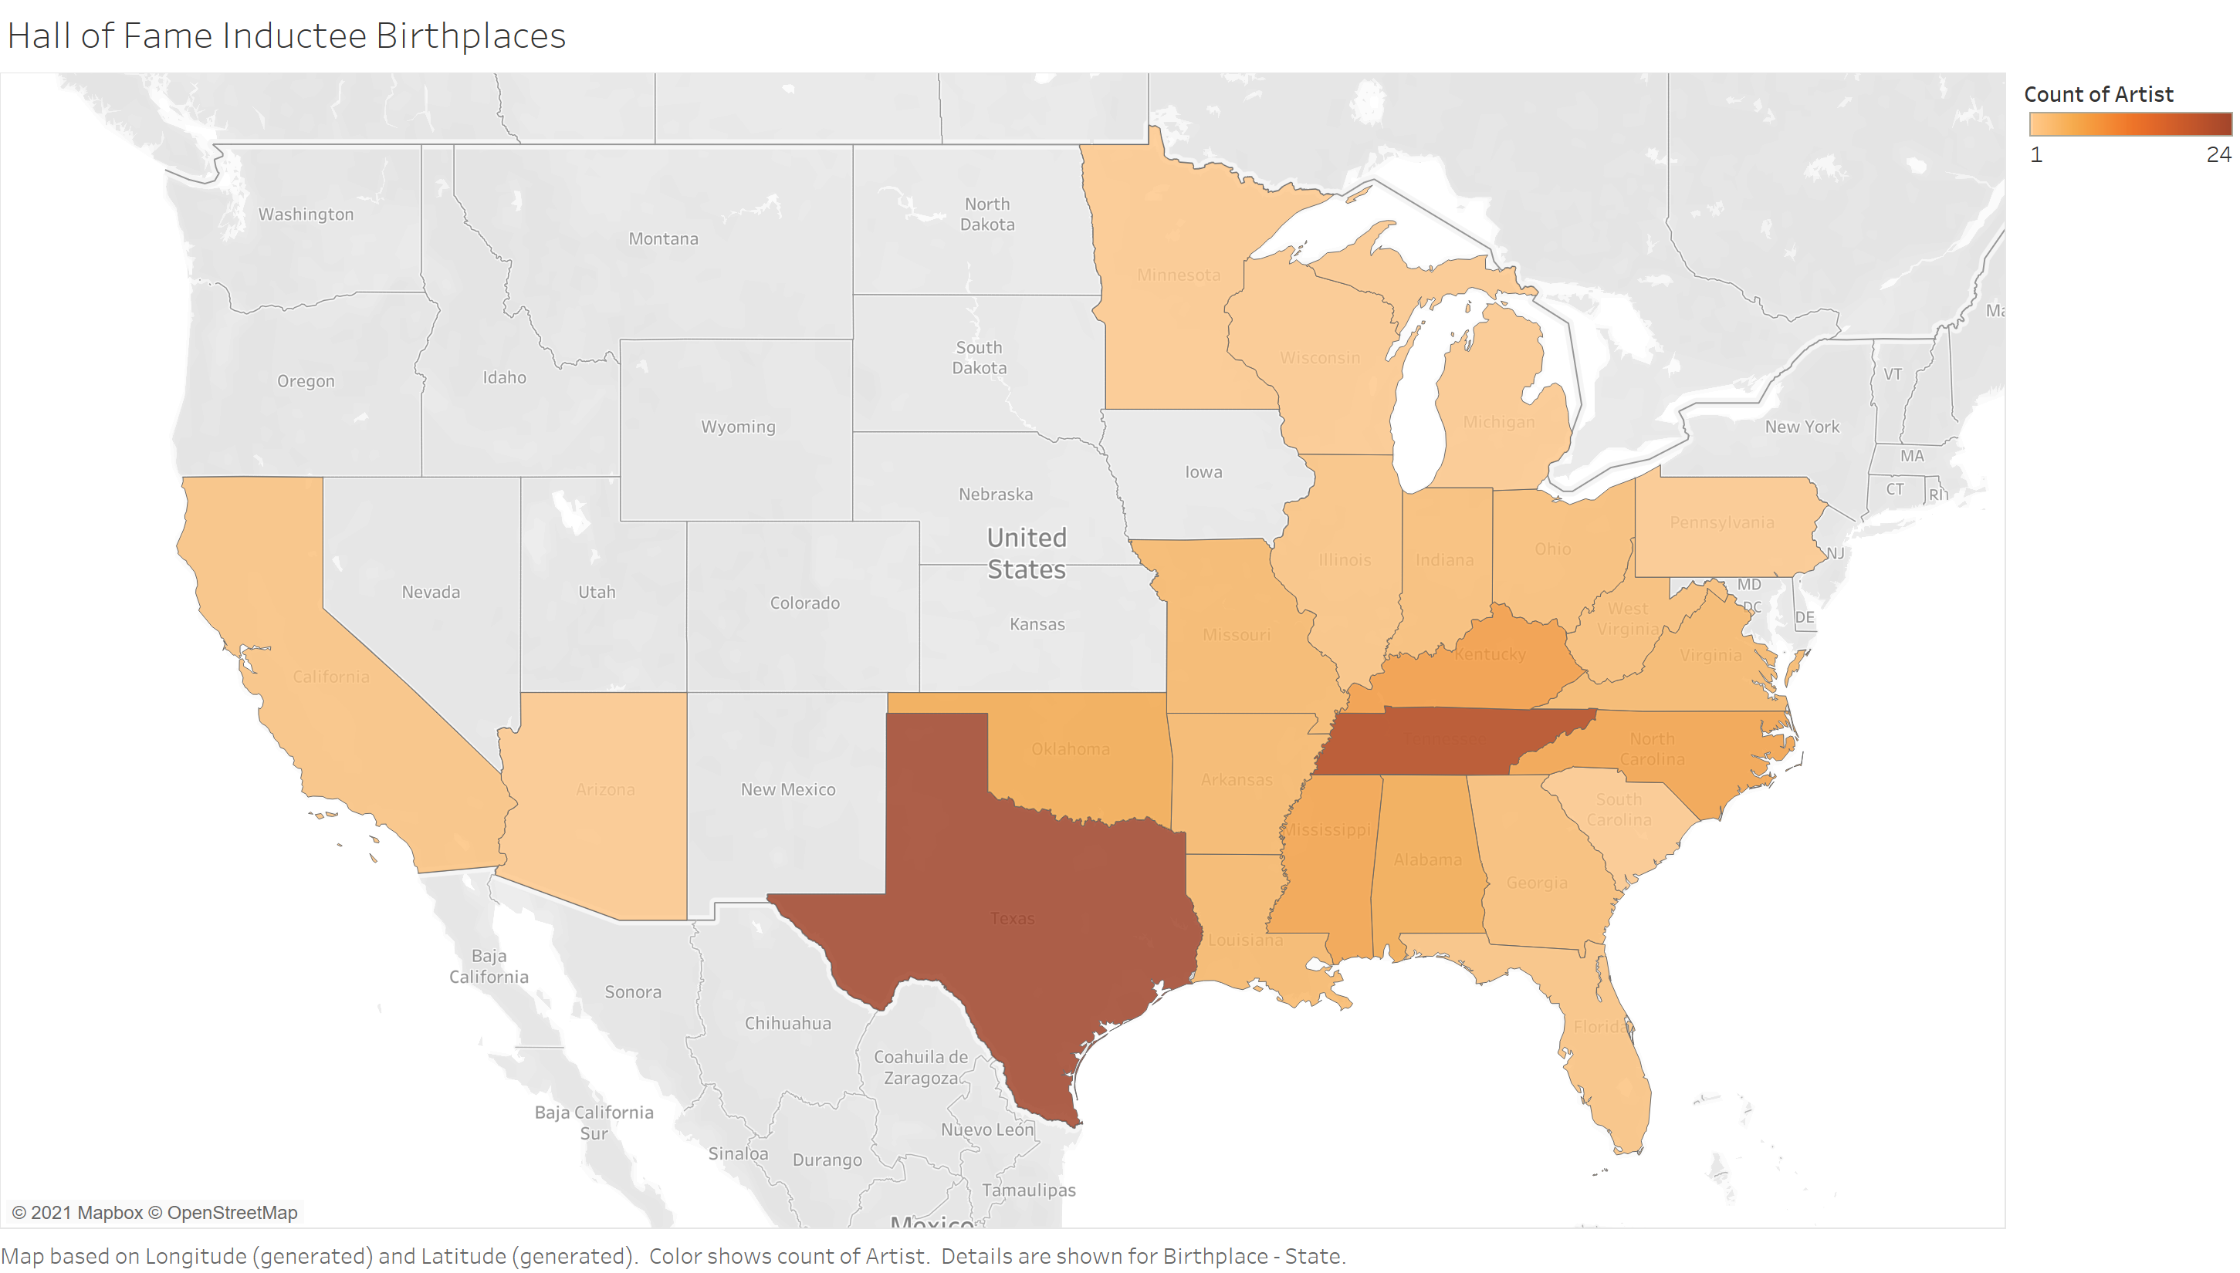
Most Common Hall of Fame Birth States:
Texas: 24
Tennessee: 22

Slide 3

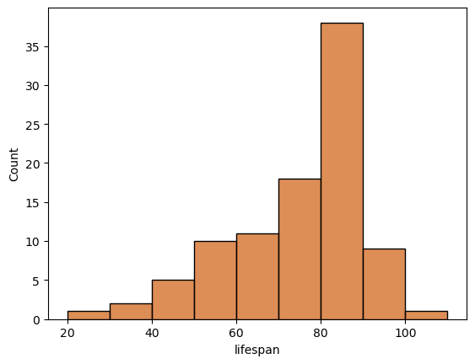

Hall of Fame Inductee Lifespans
Hall of Famers tend to live into their 80s or later.

Slide 4
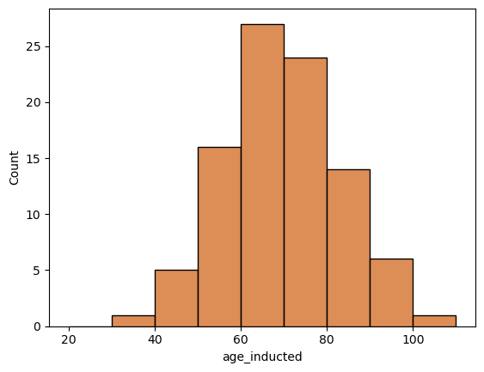
Hall of Fame Inductee Ages
Hall of Famers tend to be inducted after 60.

Slide 5
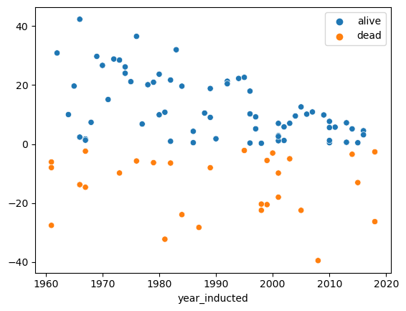
Country artists are being inducted into the Hall of Fame closer and closer to their death.
A change in philosophy, or a conspiracy?

Slide 6
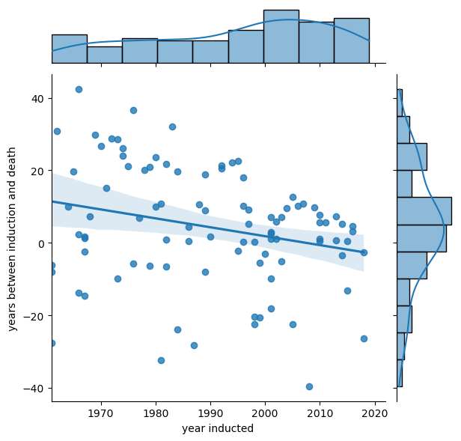
Country artists are being inducted into the Hall of Fame closer and closer to their death.
A change in philosophy, or a conspiracy?
(Similar chart: One color and with a regression line.)

Slide 7
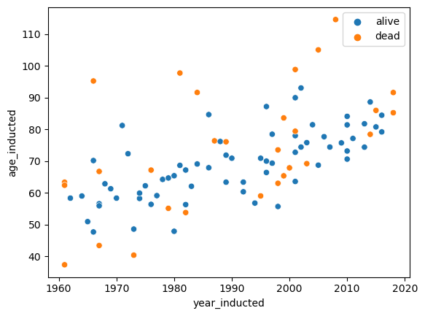
Perhaps not a conspiracy. Living inductees seem to be getting older as time goes on.
Must take more to prove you deserve in.

Slide 8
