Slide 1

Armchair Scouting
Using KeepTradeCut to Track Dynasty Fantasy Football Player Values
Joshua Rio-Ross

Slide 2
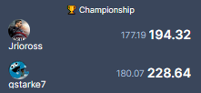
Motivation

Slide 3
The Game
Join a dynasty league
Draft a team, then draft rookies
Players do stuff; you score points
Most points wins weekly H2H

Slide 5
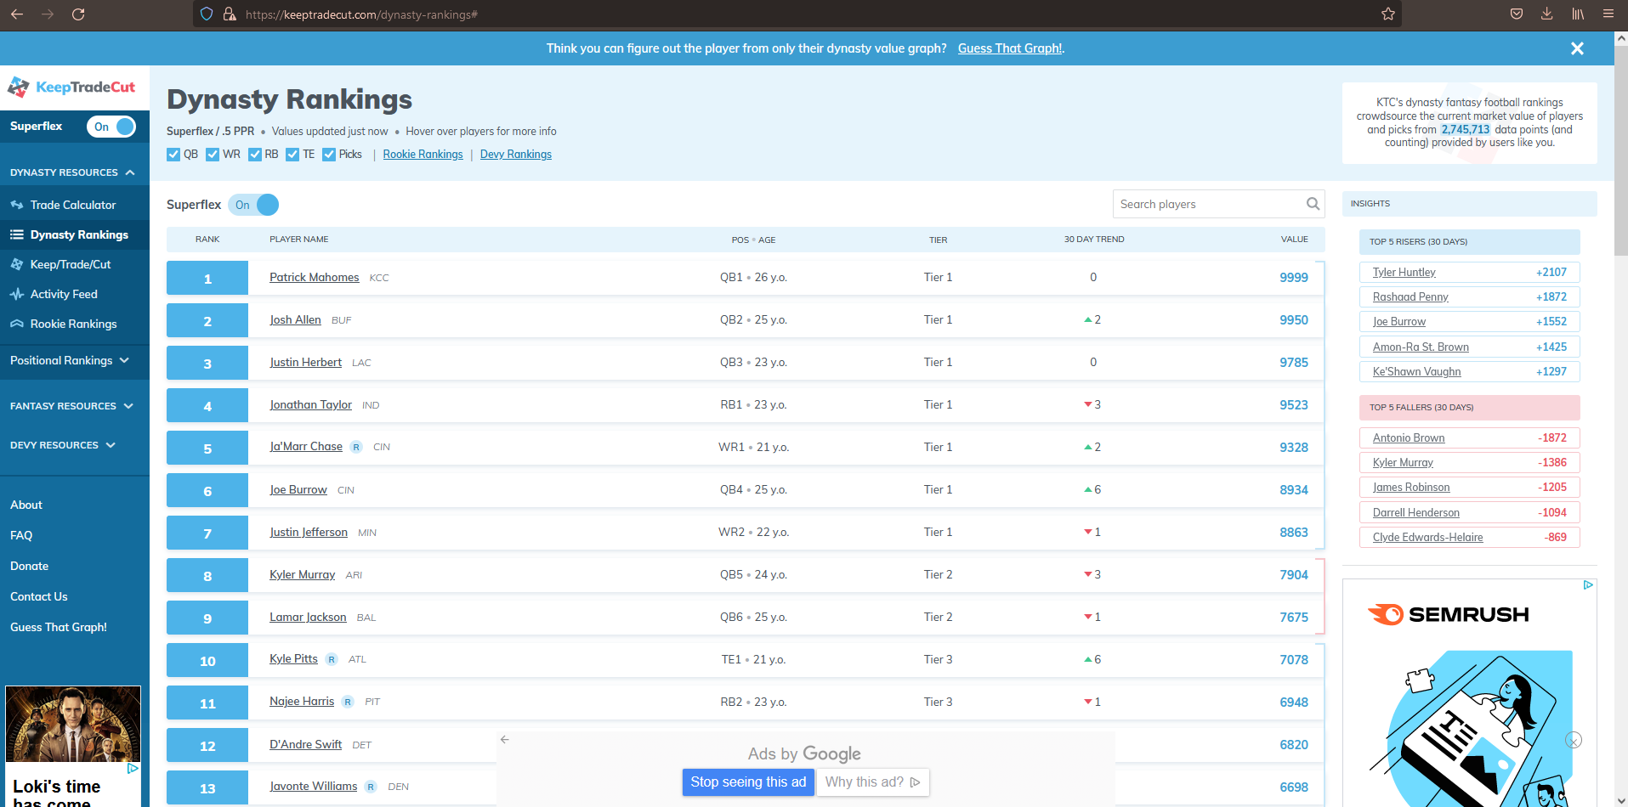

Slide 6
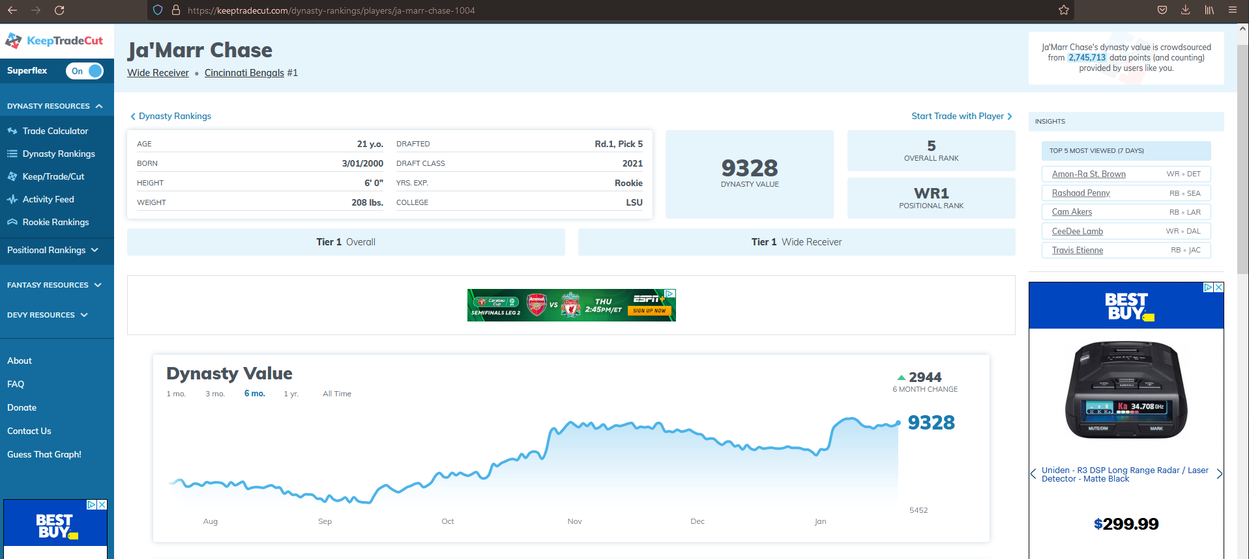

Slide 8
Process
Build KeepTradeCut data pipeline
Gather football data from nflverse
Clean and merge in R
Build Shiny App

Slide 9
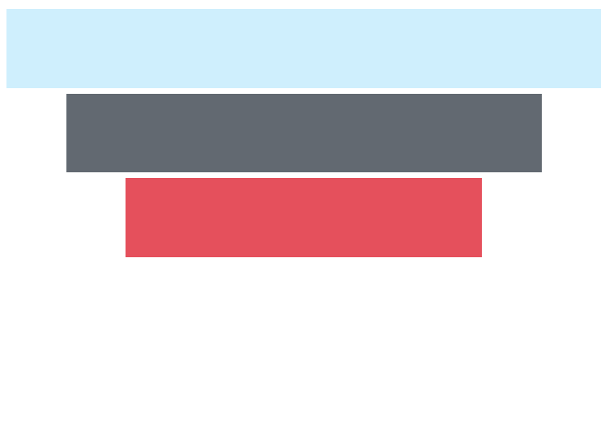
Goal
Find common attributes that correlate with player dynasty values
Compare a player’s dynasty value to those of selected position group
Help you make decisions about your players
Compare two players against each other

Slide 10
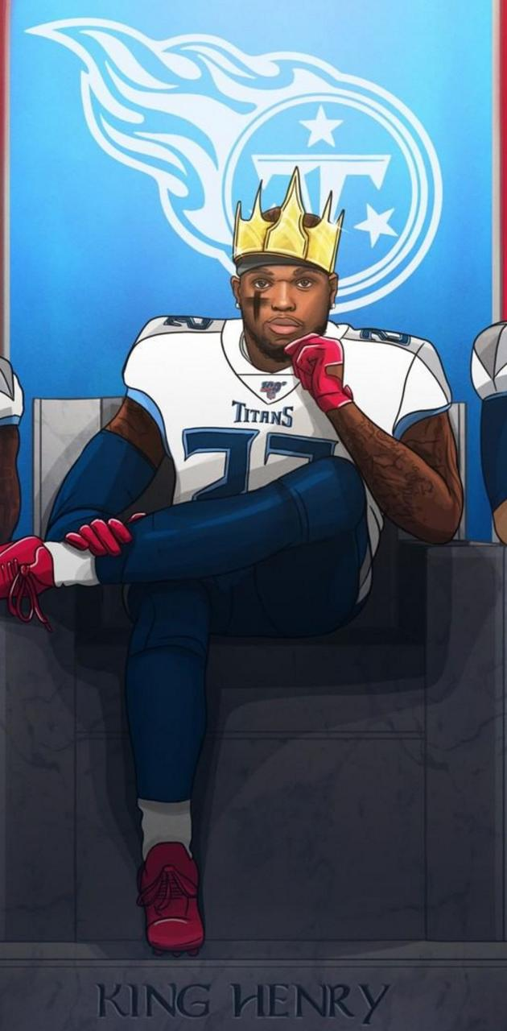
Focus
King (Derrick) Henry

