Slide 1

Armchair Scouting
Using KeepTradeCut to Track Dynasty Fantasy Football Player Values

Slide 2
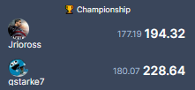
Motivation

Slide 3
The Game
Join a dynasty league
Draft a team, then draft rookies
Players do stuff; you score points
Most points wins weekly H2H

Slide 4
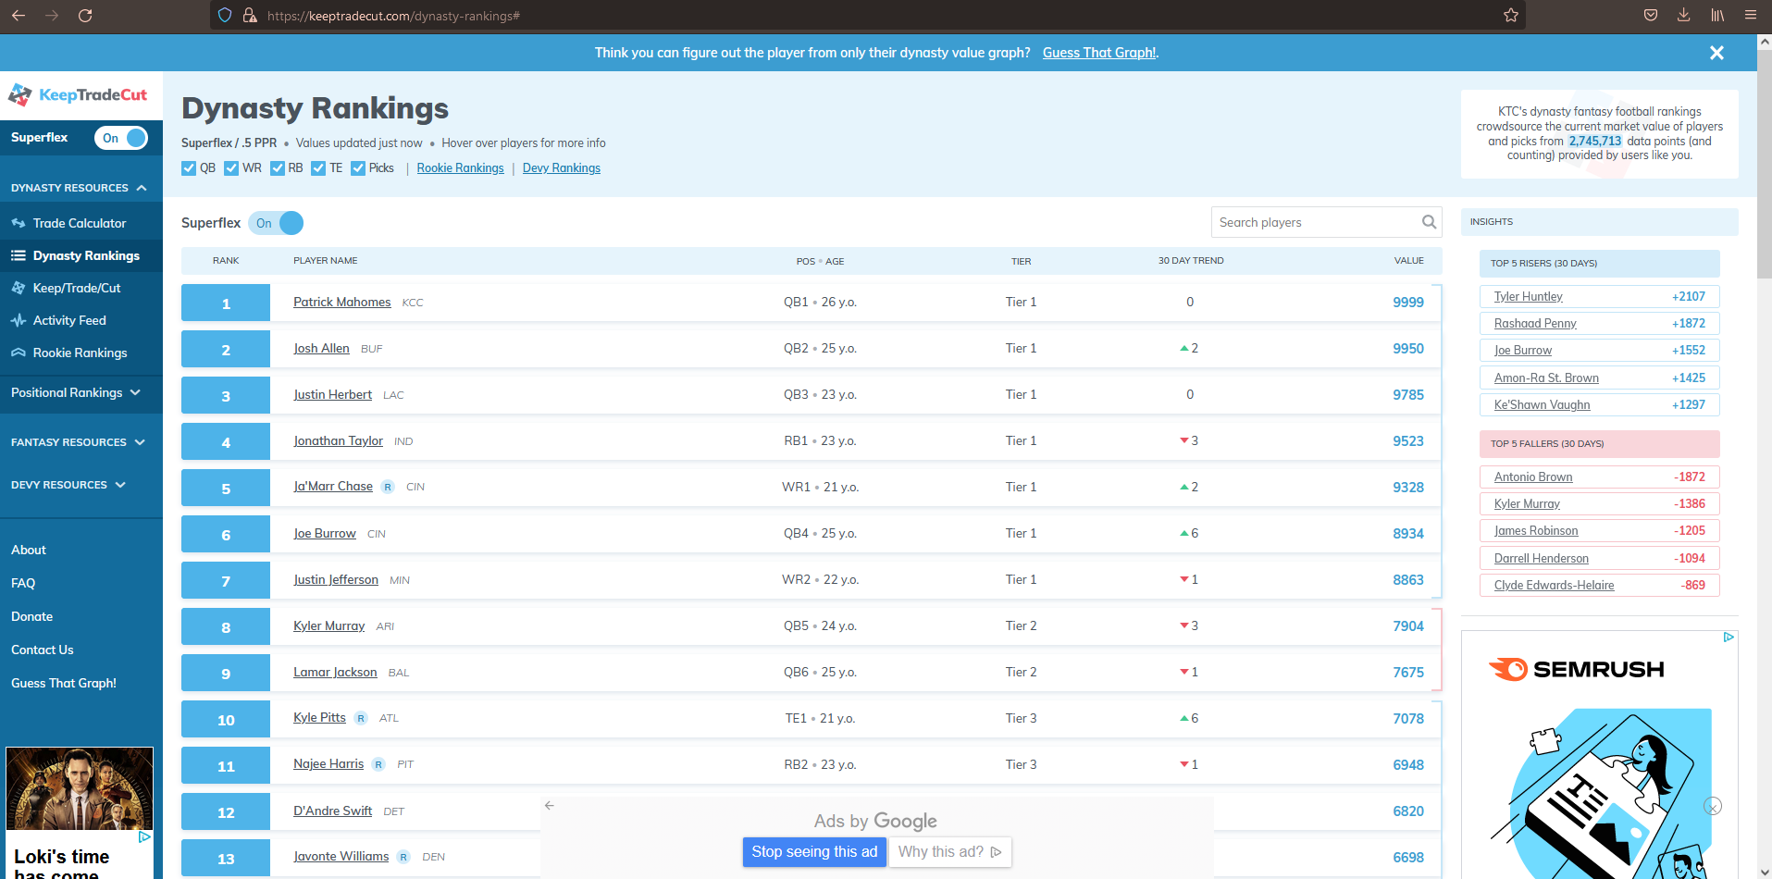

Slide 5
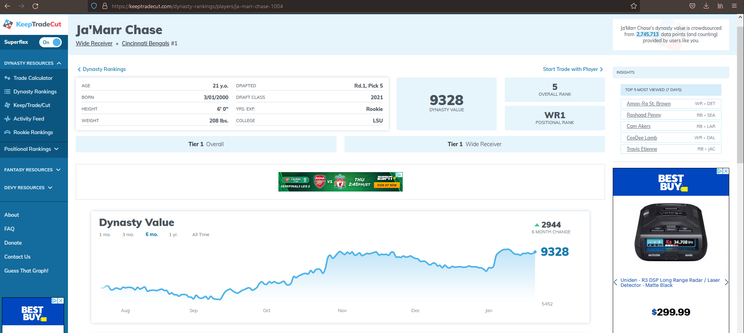

Slide 7
Process
Scrape KeepTradeCut
Gather football data from nflverse
Clean and merge in R
Build the Shiny App

