Slide 1

Semi-Supervised Learning with Active Module for Semantic Segmentation Annotation for Crack Detection
Advanced AI for Smart Cities
Spring 2023
Team Members:
Haolin Wang, Jayda Gabrielle Ritchie, Xiaoyue Zhang
Mentors:
Yichang (James) Tsai, Yung-An Hsieh
Date: 2023.5.5

Slide 2

Contents
Introduction - Background
Needs Assessment & Improvement
Research Problem
Objectives
Proposed Methodology
Evaluation and Discussion
Conclusions and Recommendations
References

Slide 3
Introduction - Background
All supervised learning algorithms for automatic crack detection and classification require large and diverse datasets. In order to make these datasets useful data annotation is required. This process involves labeling features needed for training machine learning models to predict desired output.
In the framework of automatic crack detection, semantic segmentation is the most common and most promising data annotation technique.

Slide 4
Needs Assessment & Improvement
Possible improvements in the automatic crack detection field in terms of improving data annotation techniques include the following:
Methods to reduce overhead cost of data annotation for semantic segmentation annotation used in ML applications - optimizing or even automating the process.
Transfer learning capability for future use on multi-model crack images to improve model generalization and accuracy.
Micro-cracks detection.

Slide 5
Research Problem
Create a robust automatic data annotation tool specialized for crack detection data.
Use semi supervised learning to assign pseudo-labels to unlabeled images
Select the most informative labeled images for training to reduce total number of training images

Slide 6
Research Objectives
Identify images that require more annotation, and identify most informative samples for model training.
Increase the quantity and diversity of finely annotated. segmentation data for algorithms use.
Reduce amount of human effort required in the data annotation process through automation.
Decreases overall time and cost of classifying data for machine learning.
Decreased subjectivity and human error.
Keep the annotated data as robust and reliable as the manually ones while achieving the objectives above.

Slide 7
Proposed Methodology
Experiment Design
Dataset
Data Description
Annotation Method and potential noises/errors
Data Splitting
Model Structure

Slide 8
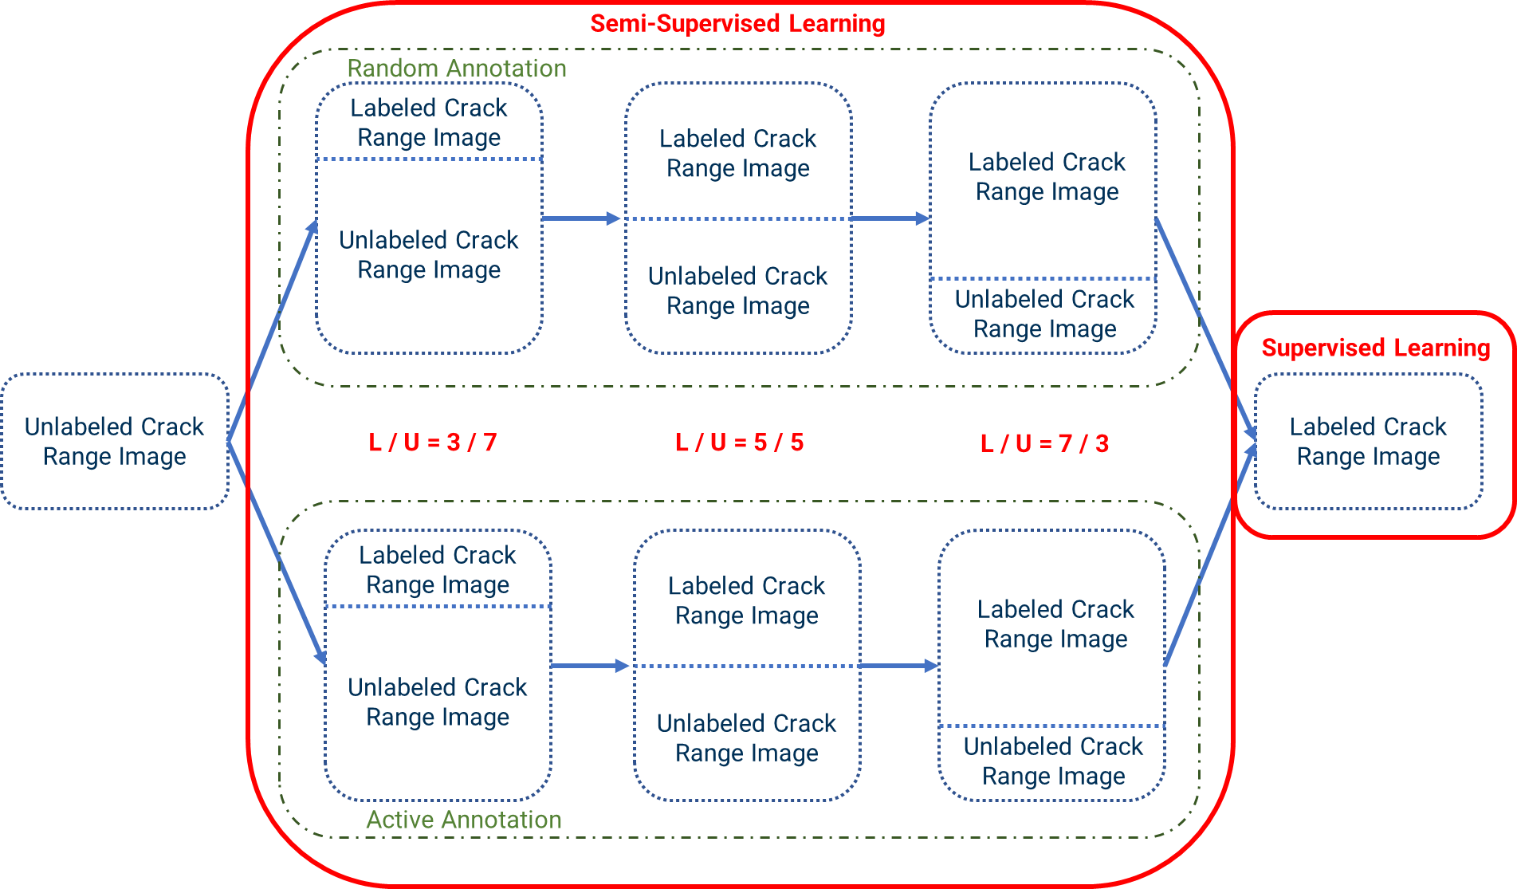
Proposed Methodology - Experiment Design

Slide 9
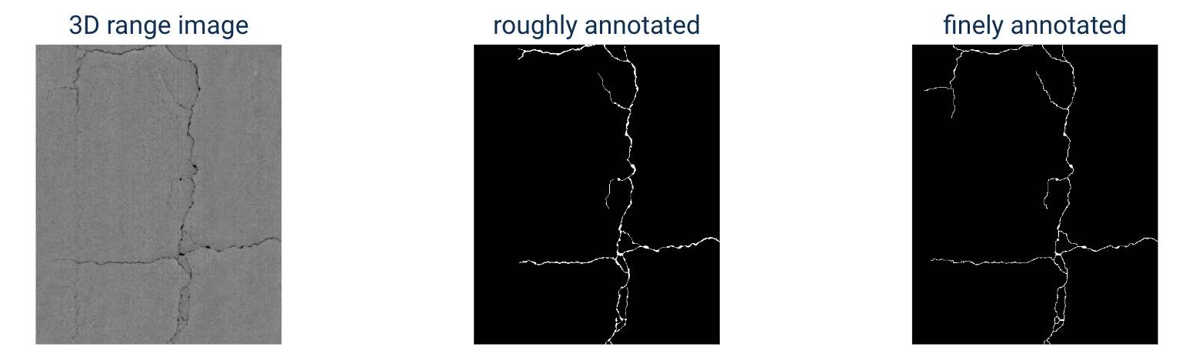
Proposed Methodology - Data Description
The main purpose of this study is to validate proposed pseudo labels generated by automatic annotation framework, and determine the best ratio of Labeled/Unlabeled Data. To do this following dataset used:
A dataset comprised of 1132 + 80 range images with 512x624 pixels with high resolution
Each image is finely annotated and has its corresponding binary segmentation image composed of pixel value of 0 (black, as background) and 255 (white, as crack).

Slide 10
Proposed Methodology - Data Splitting
In order to find the most informative samples and best ratio of labeled/unlabeled data, the 1132 images in dataset is split into multiple labeled/unlabeled sets for semi-supervised learning. These sets are trained using two frameworks presented in this experiment, active semi-supervised learning and semi-supervised learning.
Active Semi-Supervised Learning
0/10 - Unsupervised learning with K-means clustering
3/10 - Active Semi-Supervised learning
5/10 - Active Semi-Supervised learning
7/10 - Active Semi-Supervised learning
10/10 - Used as a baseline with supervised learning to test our model
Semi-Supervised Learning
3/10 - Random Semi-Supervised Learning
5/10 - Random Semi-Supervised learning
7/10 - Random Semi-Supervised learning
10/10 - Used as a baseline with supervised learning to test our model
Notes:
Concretely, we separate reliable and unreliable pixels via the entropy of predictions, push each unreliable pixel to a category-wise queue that consists of negative samples, and manage to train the model with all candidate pixels. Considering the training evolution, where the prediction becomes more and more accurate, we adaptively adjust the threshold for the reliable-unreliable partition.

Slide 11
Proposed Methodology - Data Splitting
Since the purpose of this project is not to optimize the model’s performance but rather to testify a proposed frame’s capability, the data is only splitted as training and testing data, and the 80 images in dataset are set as the testing dataset to evaluate each experiment’s performance.
Notes:
Concretely, we separate reliable and unreliable pixels via the entropy of predictions, push each unreliable pixel to a category-wise queue that consists of negative samples, and manage to train the model with all candidate pixels. Considering the training evolution, where the prediction becomes more and more accurate, we adaptively adjust the threshold for the reliable-unreliable partition.

Slide 12
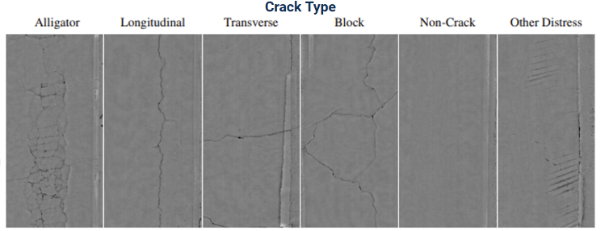
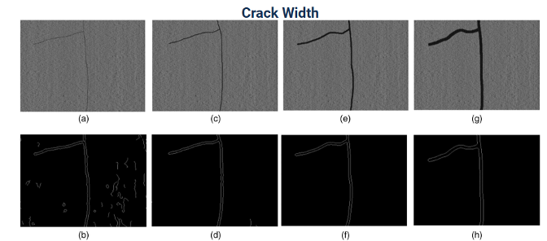
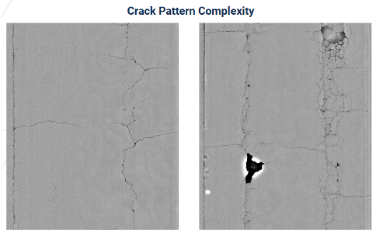
Proposed Methodology - Data Diversity
Dataset diversity:
Cracks with different patterns and complexities were used in dataset
Varying crack widths
Different crack types (longitudinal, transverse and block…)

Slide 13
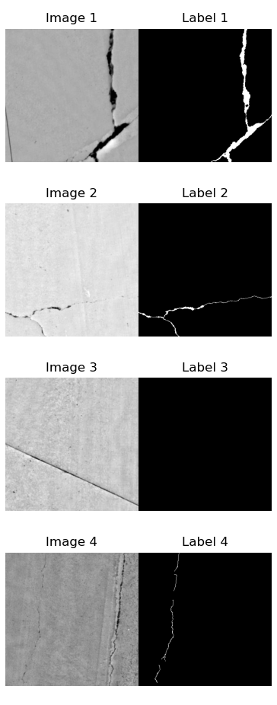
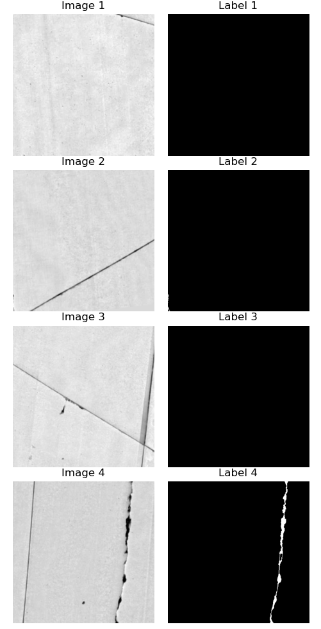
Proposed Methodology - Annotation method
Crack Dataset
Annotation technique:
3D range data was manually annotated to generate the segmentation labels noted in left Figure
Limitations of manual annotation:
More time consuming and expensive process
Possible noises in annotation:
Other distress
Trivial crack

Slide 14
Proposed Methodology - Model
To reduce the total number of manual annotations required to train a model while utilizing all the data collected despite annotation, semi-supervised learning is used.
Semi-supervised learning uses both labeled data and unlabeled data to learn and perform.
Active learning module - experiment will use the idea of active learning to provide the annotation guidance. Aim to identity if implementing active learning will impact the best ratio of labeled/unlabeled data
Semi-supervised learning uses a U- Net model ( Convolutional Neural Network) with ResNet as encoder and deeplabv3_plus as decoder
Notes:
U-Net is a convolutional neural network that was developed for biomedical image segmentation at the Computer Science Department of the University of Freiburg.^{[1]} The network is based on the fully convolutional network^{[2]} and its architecture was modified and extended to work with fewer training images and to yield more precise segmentations. Segmentation of a 512 × 512 image takes less than a second on a modern GPU.

Slide 15
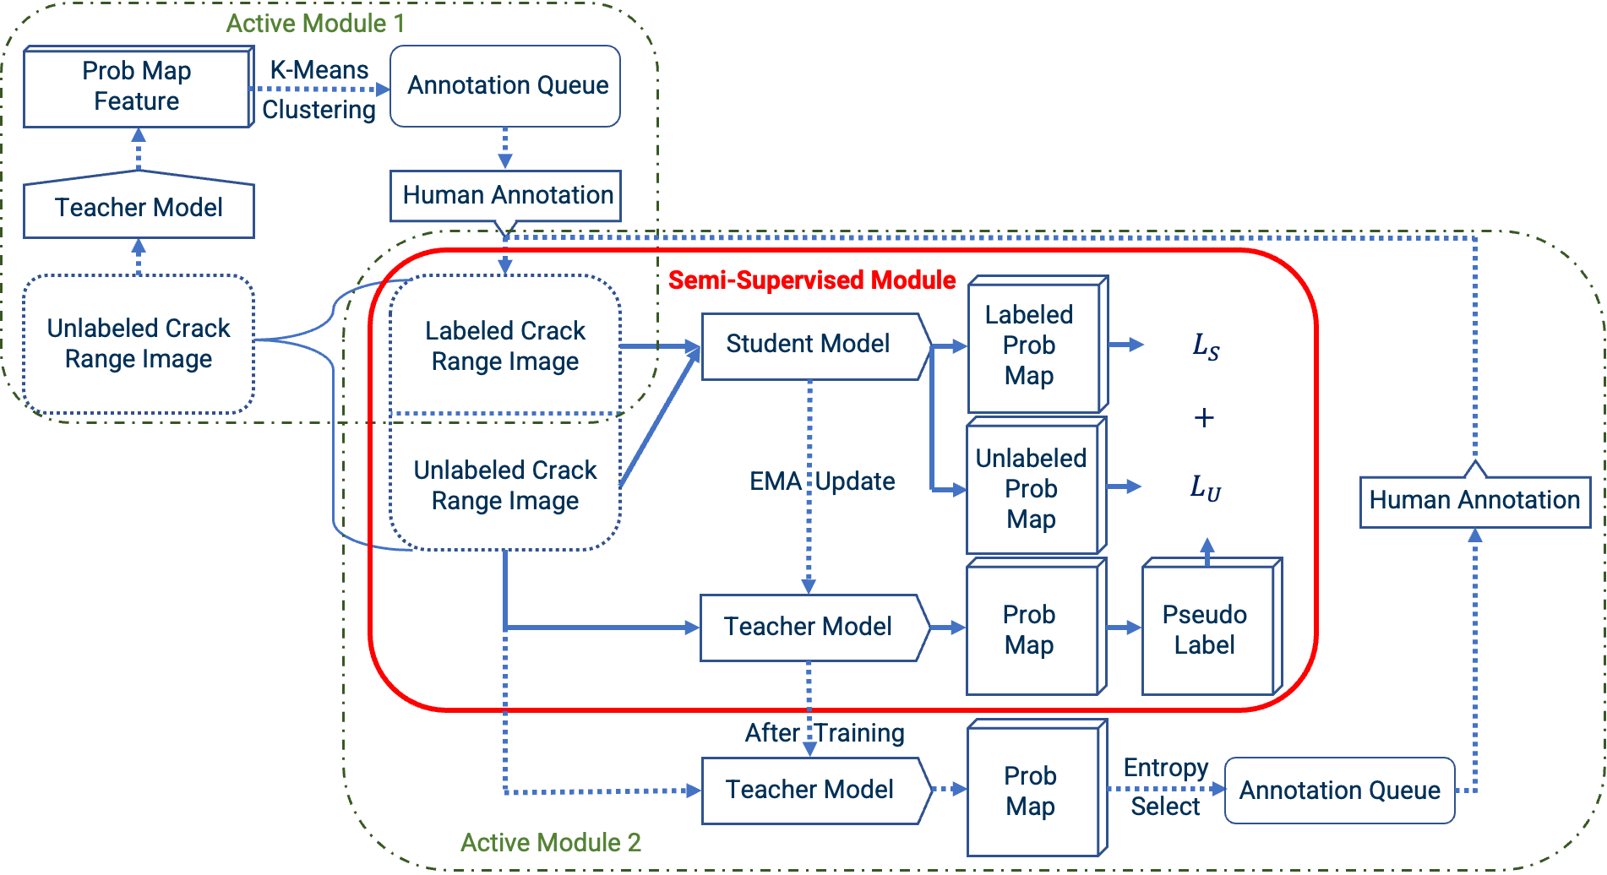
Proposed Methodology - Model
Active module assists with selecting and identifying most informative samples in dataset

Slide 16
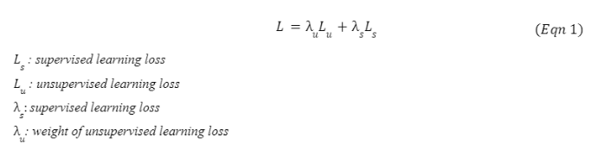
Proposed Methodology - Loss Functions
For all models used except the Fully Supervised (which was the baseline model), the Loss function that was used is composed of Supervised Loss and Unsupervised Loss with the same weight.
Supervised Loss and Unsupervised Loss is a combination of Cross-Entropy Loss and DICE Loss, considering the unbiased ratio between class[0] (pavement background) and class[1] (crack).
DICE Loss addresses data imbalance, and can be used to find similarities between two images
Cross entropy measures difference between two probability distributions for a variable

Slide 17
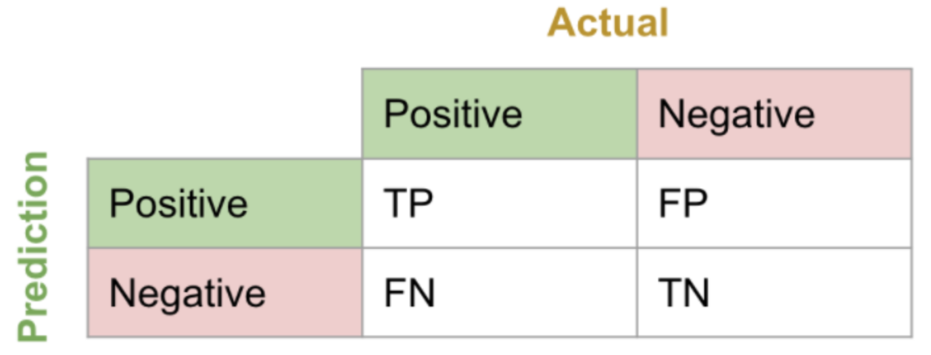
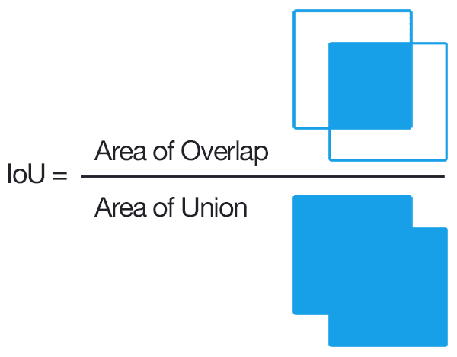
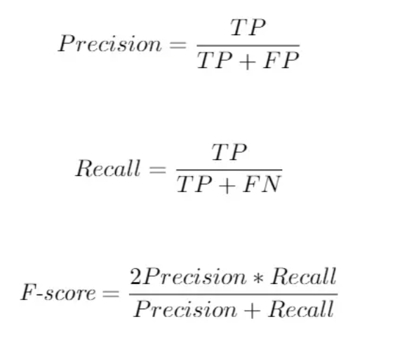
Model Evaluation - Performance Measurement Metrics
The performance of the model is measured on the following metrics:
mIoU
Class[1] (crack) IoU
TP (crack- is crack)
FP (crack- not crack)
FN (noncrack- is crack)
Precision
Recall
F1-Score

Slide 18
Model Evaluation Results
Summary of Evaluation Results
 | Semi-Sup (0.3) | Active-Semi (0.3) | Semi-Sup_ EqualTrain (0.5) | Semi-Sup_ LessTrain (0.5) | Active-Semi (0.5) | Semi-Sup (0.7) | Active-Semi (0.7) | Supervised (1.0)
mIoU | 63.11 | 61.47 | 62.63 | 62.07 | 62.32 | 62.93 | 63.24 | 64.60
Class[1] IoU | 27.40 | 23.91 | 26.38 | 25.23 | 25.93 | 27.07 | 27.62 | 30.20
Precision | 0.4259 | 0.4934 | 0.4403 | 0.4444 | 0.4430 | 0.4281 | 0.4414 | 0.5127
Recall | 0.5028 | 0.3449 | 0.4555 | 0.4212 | 0.5114 | 0.5072 | 0.4945 | 0.4887
F1-Score | 0.4612 | 0.4060 | 0.4478 | 0.4325 | 0.4748 | 0.4643 | 0.4665 | 0.5004
Active Module does not have significant influence on results
More the Annotated Data, better the performance

Slide 19
Error Analysis
Analysis for the various splits include the following:
 | Semi-Sup (0.3) | Active-Semi (0.3) | Semi-Sup_ EqualTrain (0.5) | Semi-Sup_ LessTrain (0.5) | Active-Semi (0.5) | Semi-Sup (0.7) | Active-Semi (0.7) | Supervised (1.0)
TP | 0.2997 | 0.2547 | 0.2885 | 0.2759 | 0.3113 | 0.3023 | 0.3042 | 0.3337
FP | 0.4039 | 0.2615 | 0.3667 | 0.3449 | 0.3913 | 0.4039 | 0.3849 | 0.3172
FN | 0.2964 | 0.4838 | 0.3448 | 0.3792 | 0.2974 | 0.2938 | 0.3110 | 0.3491
Possible reasons for cases of FN/FP:
Model is not sufficiently trained with only 5-7 epochs (1000 iteration) each experiment.
Model may not sufficiently trained on enough diverse dataset.

Slide 20
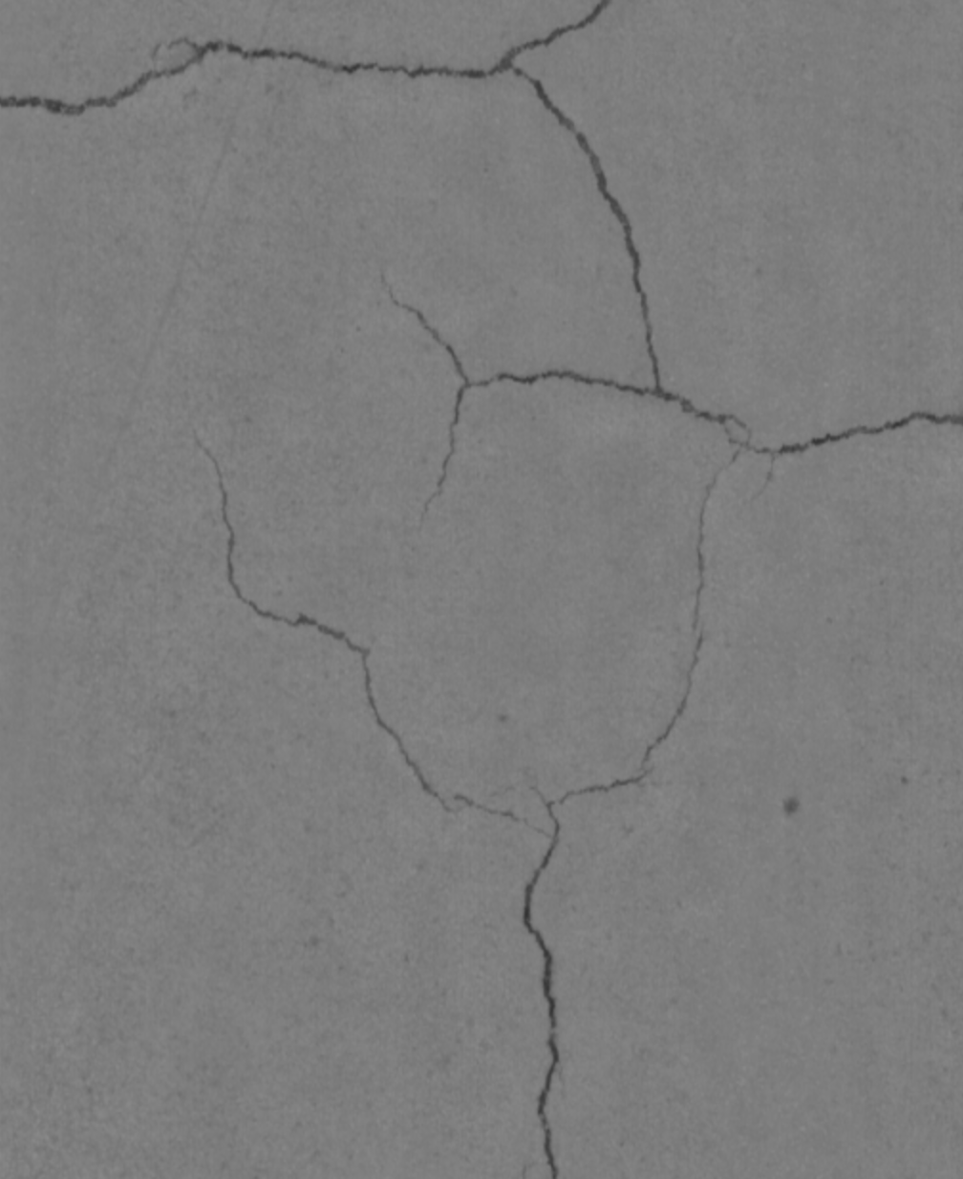
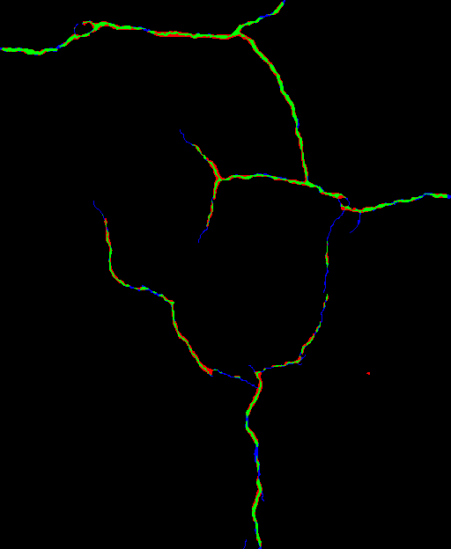
Error Analysis
Result from baseline (1.0 Fully Supervised)
# Green: TP
# Red: FP
# Blue: FN
The trivial crack is hard for the model to detect
Notes:
Concretely, we separate reliable and unreliable pixels via the entropy of predictions, push each unreliable pixel to a category-wise queue that consists of negative samples, and manage to train the model with all candidate pixels. Considering the training evolution, where the prediction becomes more and more accurate, we adaptively adjust the threshold for the reliable-unreliable partition.

Slide 21
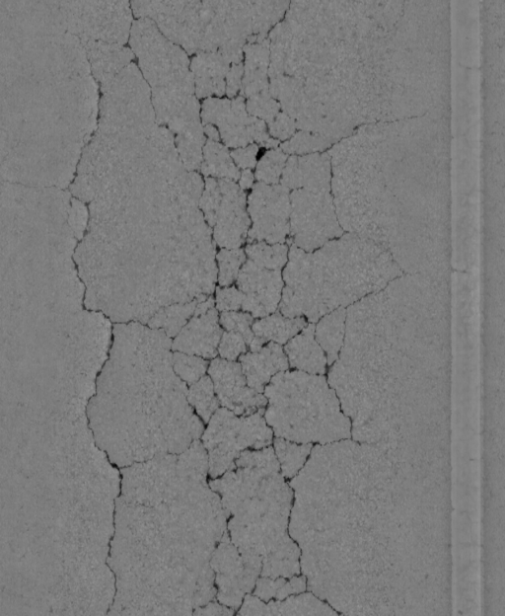
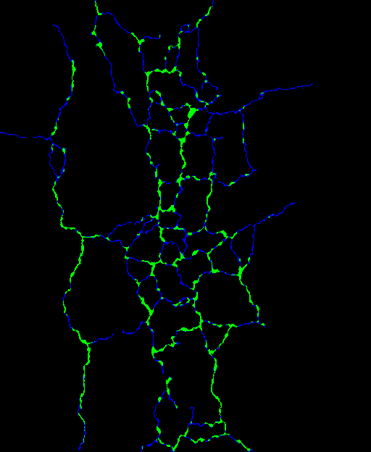
Error Analysis
Result from baseline (1.0 Fully Supervised)
# Green: TP
# Red: FP
# Blue: FN
The model is not sufficiently trained with blocking cracks
The model is not sufficiently trained with transverse cracks
Notes:
Concretely, we separate reliable and unreliable pixels via the entropy of predictions, push each unreliable pixel to a category-wise queue that consists of negative samples, and manage to train the model with all candidate pixels. Considering the training evolution, where the prediction becomes more and more accurate, we adaptively adjust the threshold for the reliable-unreliable partition.

Slide 22
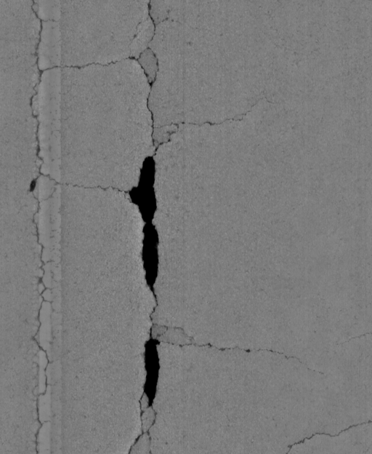
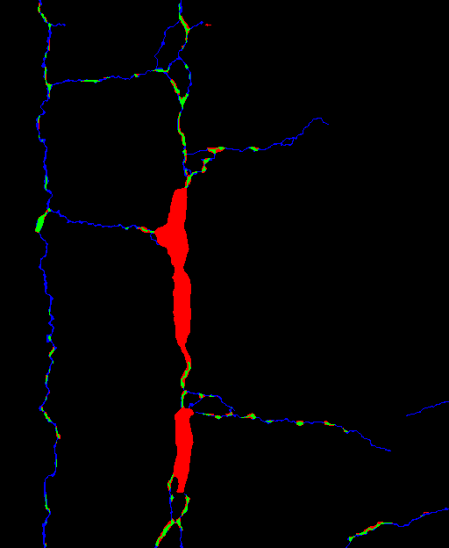
Error Analysis
Result from baseline (1.0 Fully Supervised)
# Green: TP
# Red: FP
# Blue: FN
The model is trained to be more focused on darker parts in images
The model is not sufficiently trained with other types of distress
Notes:
Concretely, we separate reliable and unreliable pixels via the entropy of predictions, push each unreliable pixel to a category-wise queue that consists of negative samples, and manage to train the model with all candidate pixels. Considering the training evolution, where the prediction becomes more and more accurate, we adaptively adjust the threshold for the reliable-unreliable partition.

Slide 23
Conclusions and Recommendations
Conclusions:
The split (labeled : unlabeled) that yields best result used 0.7 split (7 labeled: 3 unlabeled) with the active approach in all semi-supervised experiments.
Under the insufficient training circumstances, the active module has no significant effect on improving the annotation process, or the active criterion is not appropriately chose.
Under the insufficient training circumstances, a higher portion of annotated data can lead to a better performances, regardless other factors.
Recommendations:
Increase the training epochs.
Find other possible criterions for active module.
Find more annotated datasets, to provide a greater training process.

Slide 24
Thank You

Slide 25
Model Evaluation Results
 | Semi-Sup(0.3) | Active-Semi (0.3) | Semi-Sup-EqualTrain(0.5) | Semi-Sup-LessTrain (0.5) | Active-Semi (0.5) | Semi-Sup (0.7) | Active-Semi (0.7) | Supervised(1.0)
mIoU | 63.11 | 61.47 | 62.63 | 62.07 | 62.32 | 62.93 | 63.24 | 64.60
Class[1] IoU | 27.40 | 23.91 | 26.38 | 25.23 | 25.93 | 27.07 | 27.62 | 30.20
Precision | 0.4259 | 0.4934 | 0.4403 | 0.4444 | 0.4430 | 0.4281 | 0.4414 | 0.5127
Recall | 0.5028 | 0.3449 | 0.4555 | 0.4212 | 0.5114 | 0.5072 | 0.4945 | 0.4887
F1-Score | 0.4612 | 0.4060 | 0.4478 | 0.4325 | 0.4748 | 0.4643 | 0.4665 | 0.5004
TP | 0.2997 | 0.2547 | 0.2885 | 0.2759 | 0.3113 | 0.3023 | 0.3042 | 0.3337
FP | 0.4039 | 0.2615 | 0.3667 | 0.3449 | 0.3913 | 0.4039 | 0.3849 | 0.3172
FN | 0.2964 | 0.4838 | 0.3448 | 0.3792 | 0.2974 | 0.2938 | 0.3110 | 0.3491

