Slide 1
Does Netflix have better content than Amazon Prime Video?

Slide 2
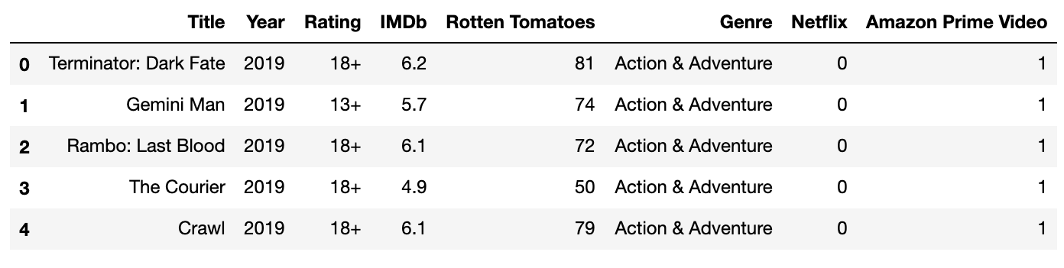
Data
The data was retrieved from Kaggle.

Slide 3
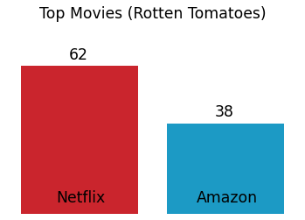
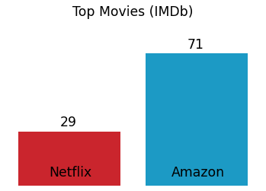
How many top-rated movies are on each platform?

Slide 4
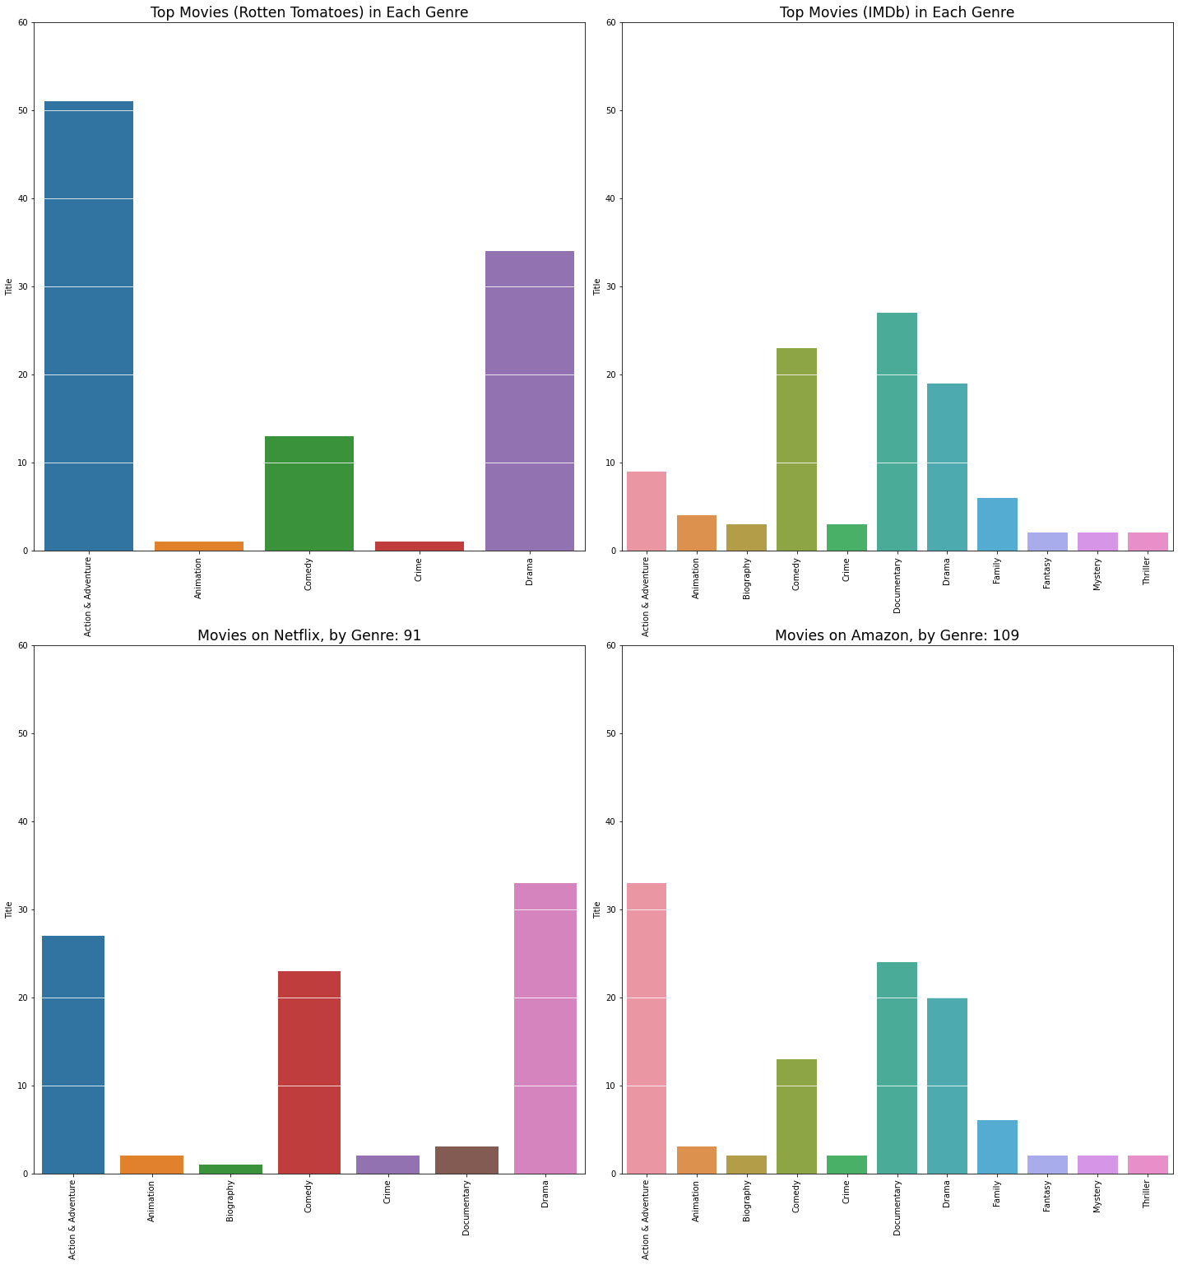
What about movies by genre?

Slide 5
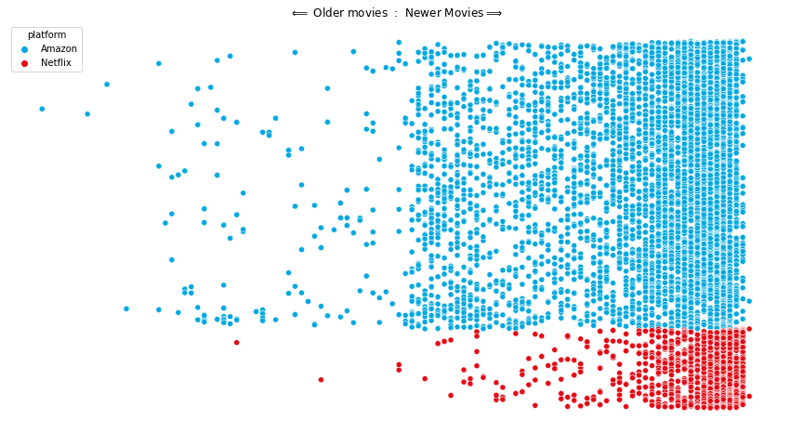
What about classics?

Slide 6
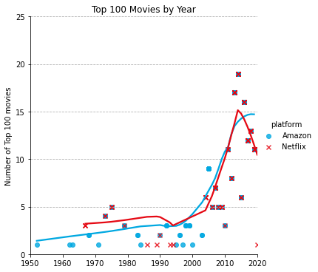
What about GOOD classics?

Slide 7
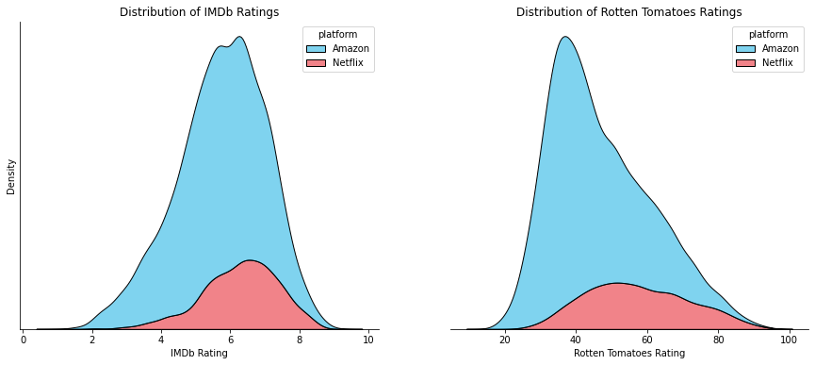
How many movies from with each rating?

Slide 8
Conclusions
Amazon Prime Video has WAY more content than Netflix
Netflix has more high-quality content than Amazon Prime Video
If QUANTITY is more important, Amazon Prime Video is the clear winner
If QUALITY is more important, Netflix outperforms Amazon Prime Video

Slide 9
Thank you!

