Slide 1
Pricing Analysis
For Big Mountain Resort

Slide 2
The State of Pricing at Big Mountain
Big Mountain just put in a new chair lift, raising their operating costs by $1,540,000 this season
Currently, the price of an adult ticket is set by choosing a number slightly above the average for Big Mountain’s market segment.
Can we improve on this system?
How much should Big Mountain be charging?
Can Big Mountain support a price increase that will offset the increase in operating costs?

Slide 3
The pricing model suggests that an adult ticket to ski at Big Mountain should cost $100!

Slide 4

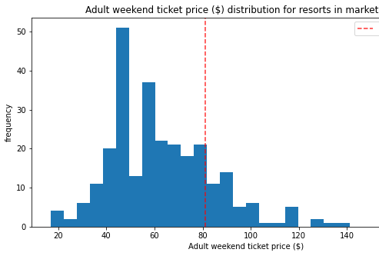
Big Mountain’s Current Price
As you can see, Big Mountain’s current price of $81 is just slightly above the average price of ski resorts nation-wide.
HOWEVER…

Slide 5
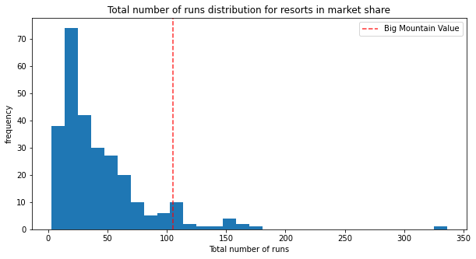
Big Mountain is in the top 7% of resorts in number of runs!

Slide 6
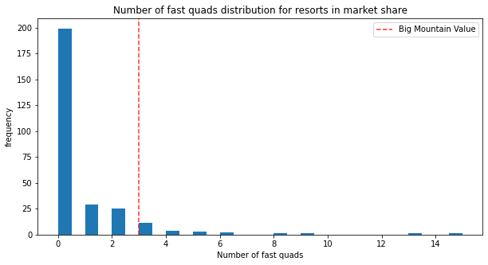
Big Mountain is in the top 5% of resorts in the number of fast Quads!

Slide 7
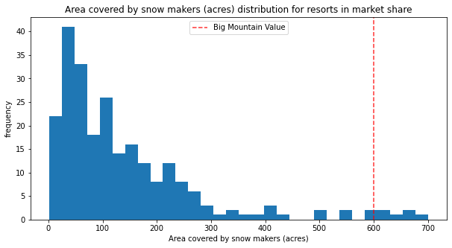
Big Mountain is in the top 3% of resorts in snow-making machine coverage!

Slide 8
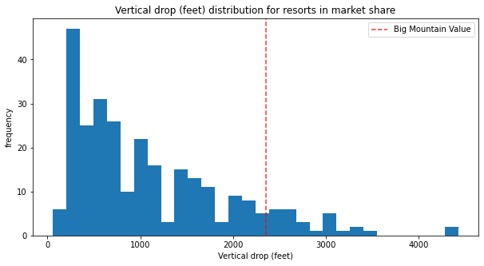
Big Mountain is in the top 11% of resorts by vertical drop!

Slide 9
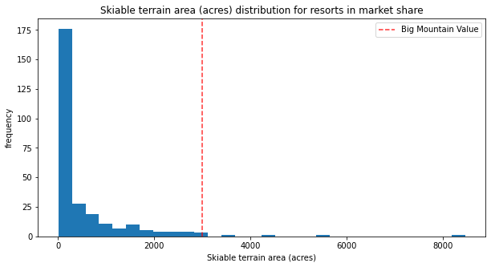
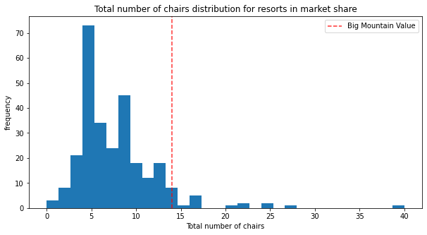
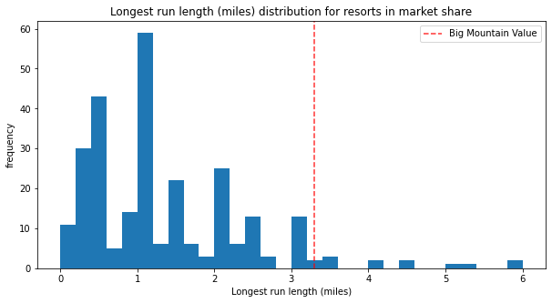
Big Mountain is also a leading resort in other areas!

Slide 10
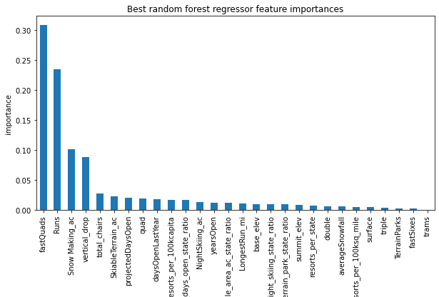
What features determine the price?
Number of Fast Quads has the biggest impact on a resort’s ticket price.
Number of Runs is second.
Area covered by snow-making machines is third, but only half as important as number of runs.
Vertical Drop is the fourth most important feature.
After Vertical Drop, the importance falls significantly.

Slide 11
Scenarios
The best scenarios are the ones that play to Big Mountain’s strengths
increasing the vertical drop, adding another lift, and adding snow-making machines all raise the data-supported price
However, lengthening the longest run and adding more snow-making machines (scenario 4) had no impact on the supported price
 | Scenario 2 | Scenario 3 | Scenario 4
Price Change | $9.02 | $11.26 | $0
Revenue Change | $15,791,667 | $19,708,333 | $0

Slide 12
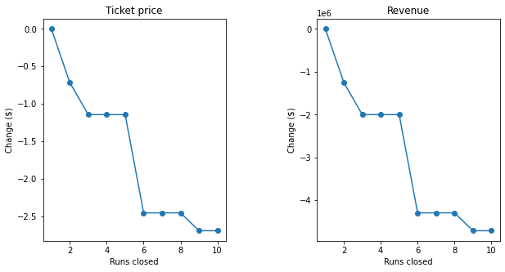
Scenario 1
Closing runs lowers the supported price, but also lowers operating costs.
We do not have the data to tell us if this would have a positive affect on profit!
If closing runs is considered, take advantage of the plateaus in price support.

Slide 13
Recommendations
Big Mountain is among the top resorts nationwide in all 4 of the most important features. It can support a price of $100 per ticket, raising expected revenue by $33,250,000.
However:
The model cannot tell us how a price increase will affect customer behavior.
We do not have the data necessary to optimize the price for maximum profit.
Therefore, we recommend:
Incrementally raise the price to $100 per adult ticket.
For further improvement, add a combination of fast lifts, snow-making machines, and runs while lengthening vertical drop.

Slide 14
Recommendations
Incrementally raise the price to $100 per adult ticket.
For further improvement, add a combination of fast lifts, snow-making machines, and runs while lengthening vertical drop.

