Slide 1
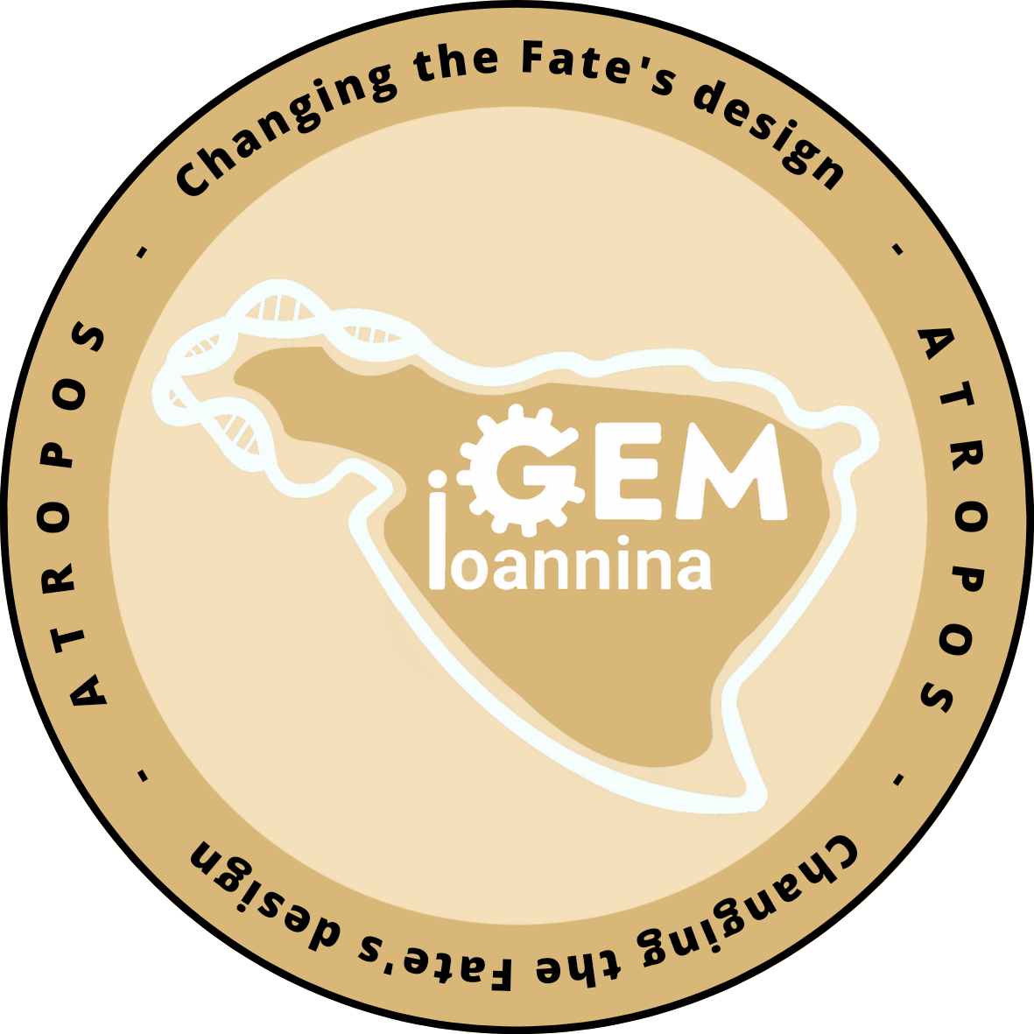


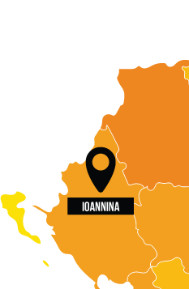

Slide 2

The problem
- Harmful effects of pollution

Slide 3

The problem
- Harmful effects of pollution
- Ioannina has already a high concentration of pollutant materials, co2 and …

Slide 4

The problem
- Harmful effects of pollution
- Ioannina has already a high concentration of pollutant materials, co2 and heavy metals

Slide 5
The problem
- Harmful effects of pollution
- Ioannina has already a high concentration of pollutant materials, co2 and heavy metals
Day after day it appears that we are headed towards a new future for the city of Ioannina...

Slide 6

The problem

Slide 7
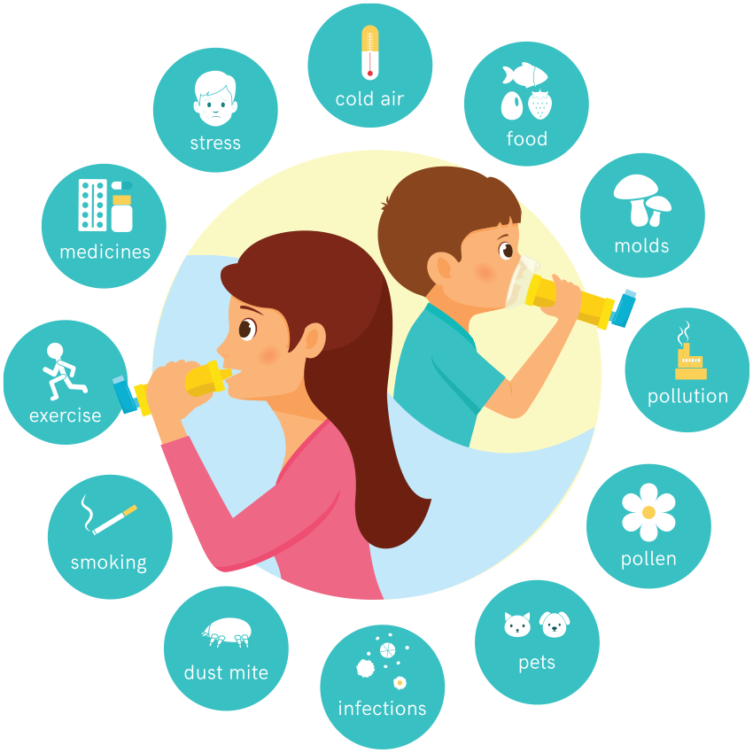
The health impact
- Asthma (Άσθμα)
- COPD (Χ.Α.Π. = Χρόνια Αποφρακτική Πνευμονοπάθεια)
- Cancer (Καρκίνος)
- Dyspnea (Δύσπνοια)
- Cardiovascular Disease (Καρδιαγγειακή νόσος)
- Improper Immune Development (for pregnant women)
- Preterm birth(for pregnant women)

Slide 8
The future impact
-The future Ioannina will be a high danger city for humans , resident’s health will be in high danger
Vulnerable groups such as the elderly will be especially affected
-The special climate of Ioannina makes it even more vulnerable for pollution (Humidity-altitude)
-Less tourists will visit Ioannina which will have a high impact in economy
-The health care system will be significantly challenged

Slide 9
The solution
- How can we minimize the effect of pollution on vulnerable groups while working for a permanent solution?
Notes:
8

Slide 10

The solution
- How can we minimize the effect of pollution on vulnerable groups while working for a permanent solution?
Notes:
9

Slide 11
What is aqIoannina?
- aqIoannina is a multi dimensional project based on a webpage
Notes:
11

Slide 12
What does aqIoannina do?
- aqIoannina collects data from sensors that are located in Ioannina
These sensors measure the quality of air and feed a continuous stream of data into aqIoannina’s Website which visually shows the level of danger
This will help vulnerable groups able to access the website to choose which route is safest and more accessible at any given time
Notes:
11

Slide 13
What does aqIoannina do?
-However, accessibility is important even to those that are less technologically literate
-Enter Thetis
Notes:
12

Slide 14
Phases of implementation
Three phase plan DBTL Cycle
Phase one: Local application and feedback loop
Phase two: Feedback implementation and city expansion
Phase three: Looking outwards
Notes:
13

Slide 15
Business plan
Every good business needs an awesome business plan…
Notes:
14

Slide 16
Thank you for your time
From the team of Aqioannina
Notes:
15

