Slide 1

Random Forest Regression Models for Use in Emergency Response
By, Jared Kinneer

Slide 2
Table of contents
Problem description and project motivation
Explaining Random Forests
Processing the Data
Results
Conclusions
Sources

Slide 3
Problem Motivation
On average there are 6 million car accidents in the U.S., resulting in more than 38,000 people losing their lives annually.
In New York City alone, 48,116 were injured and 238 people died in 2023.
How can we provide better emergency response to these accidents to reduce fatalities and provide quicker care to those injured?

Slide 4
The Goal
Can we create Random Forest models that can predict the number of people injured and killed in a car crash based on data that can be collected at the time of a 911 call?

Slide 5

What are Random Forests?
A random forest is a classifier consisting of a collection of tree-structured classifiers {h(x, $θ_{k}$), k = 1,...} where the {$θ_{k}$} are independent identically distributed random vectors and each tree casts a unit vote for the most popular class at input x.
For regression models the predictor, h(x, $θ_{k}$), results in a numerical value as apposed to a class label.

Slide 6
How are Random Forests Constructed?
Start with training set of size (m*n)
m = number of data points, n is the number of features
For each tree in the forest randomly sample the training data until you have k datapoints
k = m, but it is random sampling with replacement, so some data points may be duplicates
Then for each tree we take f features, f < n.
For each node in the tree the data is split on the best feature from f

Slide 7
More Details for Splitting
The data is split one node at a time using Mean Squared Error (MSE)
MSE(m) = 1/N_{m} ∑_{i} _{∈Dm} (y_{i} – y_{m})²
N_{m} = number of data points at the node
y_{i} = actual result for data point I
y_{m} = mean value for all data points

Slide 8
The Data
The original data set is comprised of 2 million records of car crashes recorded in NYC since 2012.
There are up to 29 features about the accident that are recorded by the police after the accident has been taken care of

Slide 9
Preprocessing Data
Features selected from the original data set
Latitude
Longitude
Zip code
Time
Contributing Factor Vehicle 1
Contributing Factor Vehicle 2
Vehicle Type 1
Vehicle Type 2
Features created by analyzing original data
Number of vehicles involved

Slide 10
One Hot Encoding
Because four of the features selected from the original data set are expressed as strings, we have to add to the feature space before creating the model.
One hot encoding creates a new feature with binary values for all unique values in the original categorical feature.

Slide 11
One Hot Encoding Example
Original Data
One hot encoded
Color
Blue
Red
Green
Color_Blue | Color_Red | Color_Green
1 | 0 | 0
0 | 1 | 0
0 | 0 | 1

Slide 12
Preprocessing Results
After one-hot encoding of the original data which had 9 features, the result was 3409 features.
This led to an incredibly slow run time.
Upon further investigation, the values found in the vehicle type category were not standardized.
This led to features being created for words that were misspelled, nonsense entries, or values that appeared only a handful of times.
To combat this I only one hot encoded data points where the vehicle type 1 and vehicle type 2 were both one of the 40 most common entries in the column.
This new one hot encoded feature space was comprised of 205 features.

Slide 13
Results
After training and testing random forests on a combination of maximum features allowed in a tree, and forest size, I obtained the following results

Slide 14
Training Time
Fatality Predictor
Injury Predictor
Training Times |  | Maximum Features
 |  | 3 | 5 | 10 | 14 | 25 | 100 | 205
Forest Size | 2 | 9.35 | 11.15 | 14.43 | 15.79 | 22.63 | 70.46 | 139.23
 | 10 | 28.5 | 33.65 | 44.27 | 52.45 | 96.40 | 348.08 | 689.38
 | 25 | 63.6 | 72.54 | 95.9 | 127.5 | 210 | 731.07 | 1497.3
 | 100 | 229 | 254.6 | 352.9 | 445.5 | 749.7 | 2911.5 | 5951.8
Training Times |  | Maximum Features
 |  | 3 | 5 | 10 | 14 | 25 | 100 | 205
Forest Size | 2 | 12.9 | 13.65 | 15.62 | 17.75 | 22 | 63.03 | 111.41
 | 10 | 46.7 | 48.18 | 58.92 | 66.29 | 88.51 | 286.77 | 523.70
 | 25 | 110 | 113.4 | 134.9 | 158.9 | 204.1 | 646.13 | 1287.2
 | 100 | 408 | 423.9 | 494.4 | 563.8 | 777.9 | 2556.2 | 5164

Slide 15
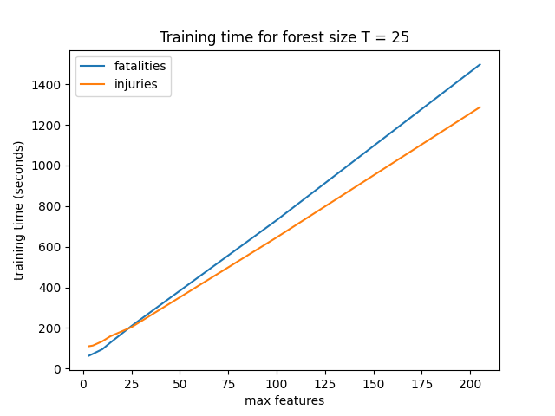
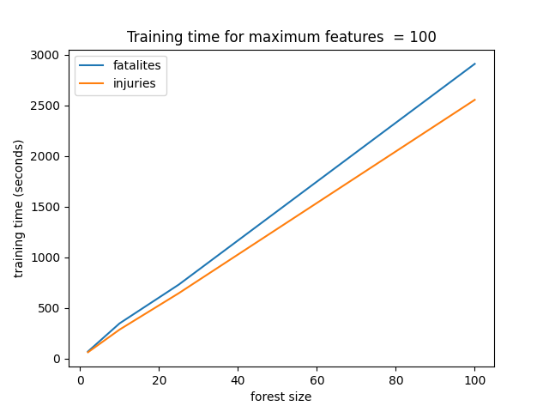
Training Time

Slide 16
Most Important Features
One function of the sklearn library I used to construct the random forests allows you to measure the importance of the features used.
The importance of a feature is a measure of how well the feature splits the data and how well it helps lead to correct predictions across all trees.
These importances are expressed as a percentage so the importance of all features for a random forest equals 1

Slide 17
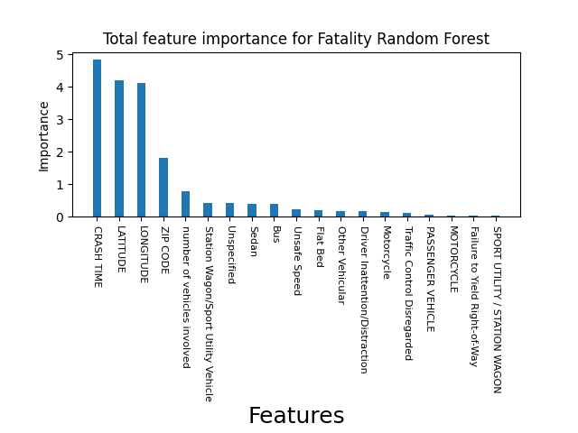
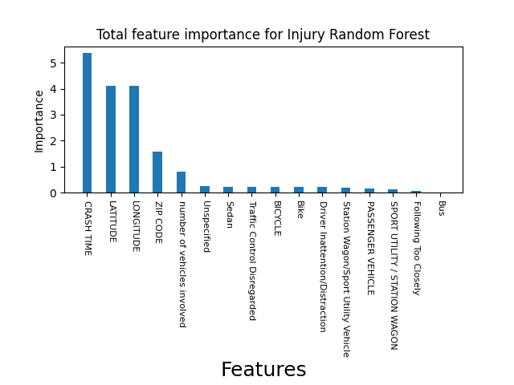
Most Important Features

Slide 18

Mean Absolute Error (MAE)
The mean absolute error of a model is calculated using the following formula:
$$MAE=\frac{1}{N}\sum_{i=0}^{N}{\left|y_{i}−\hat{y_{i}}\right|}$$
N = number of data points
$y_{i}$ = actual output
$\hat{y_{i}}$ = predicted result

Slide 19
MAE
Fatality Predictor
Injury Predictor
MAE |  | Maximum Features
 |  | 3 | 5 | 10 | 14 | 25 | 100 | 205
Forest Size | 2 | 0.001367 | 0.001278 | 0.001395 | 0.001351 | 0.001376 | 0.001466 | 0.001452
 | 10 | 0.001343 | 0.00136 | 0.001356 | 0.001347 | 0.001365 | 0.001407 | 0.001461
 | 25 | 0.001336 | 0.00135 | 0.001354 | 0.001364 | 0.001363 | 0.001443 | 0.001486
 | 100 | 0.001334 | 0.001336 | 0.001353 | 0.001357 | 0.001363 | 0.001426 | 0.001487
MAE |  | Maximum Features
 |  | 3 | 5 | 10 | 14 | 25 | 100 | 205
Forest Size | 2 | 0.411 | 0.410 | 0.410 | 0.408 | 0.407 | 0.415 | 0.419
 | 10 | 0.396 | 0.396 | 0.395 | 0.394 | 0.393 | 0.399 | 0.403
 | 25 | 0.393 | 0.393 | 0.392 | 0.392 | 0.392 | 0.396 | 0.400
 | 100 | 0.392 | 0.392 | 0.391 | 0.391 | 0.391 | 0.395 | 0.399

Slide 20

Accuracy derived from MAE
We can use the mean absolute error to create a measure of the accuracy using this formula
$Accuracy=1−\frac{MAE}{\max\left(y\right)}$
The idea behind this formula is that because the data is in the range 0->y_max, the closer the MAE gets to the maximum value the less accurate the model is.

Slide 21
MAE-Derived Accuracy
Fatality Predictor
Injury Predictor
Accuracy |  | Maximum Features
 |  | 3 | 5 | 10 | 14 | 25 | 100 | 205
Forest Size | 2 | 99.954 | 99.957 | 99.953 | 99.954 | 99.954 | 99.951 | 99.951
 | 10 | 99.955 | 99.954 | 99.954 | 99.955 | 99.954 | 99.953 | 99.951
 | 25 | 99.955 | 99.954 | 99.954 | 99.954 | 99.954 | 99.951 | 99.950
 | 100 | 99.955 | 99.955 | 99.954 | 99.954 | 99.954 | 99.952 | 99.950
Accuracy |  | Maximum Features
 |  | 3 | 5 | 10 | 14 | 25 | 100 | 205
Forest Size | 2 | 98.286 | 98.289 | 98.289 | 98.299 | 98.300 | 98.268 | 98.252
 | 10 | 98.348 | 98.348 | 98.351 | 98.356 | 98.359 | 98.335 | 98.318
 | 25 | 98.358 | 98.358 | 98.362 | 98.365 | 98.366 | 98.347 | 98.329
 | 100 | 98.363 | 98.363 | 98.367 | 98.369 | 98.369 | 98.353 | 98.333

Slide 22


$$R^{2}$$
The $R^{2}$ values show the proportion of the variance between the output variable (fatalities and injuries) and the input variables
So the higher the $R^{2}$ the more correlation the input variables have with the output
$R^{2}$ can be used as a measure of the accuracy of the model.

Slide 23
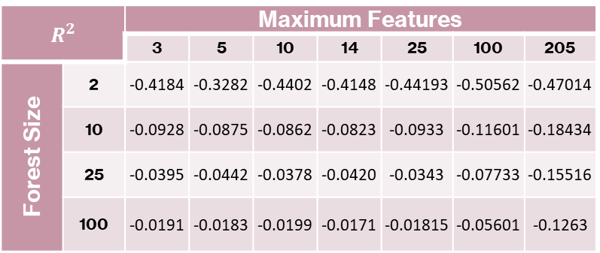

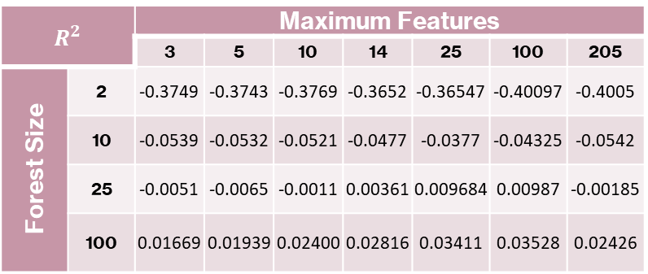
$$R^{2}$$
Fatality Predictor
Injury Predictor
$$R^{2}$$ |  | Maximum Features
 |  | 3 | 5 | 10 | 14 | 25 | 100 | 205
Forest Size | 2 | -0.4184 | -0.3282 | -0.4402 | -0.4148 | -0.44193 | -0.50562 | -0.47014
 | 10 | -0.0928 | -0.0875 | -0.0862 | -0.0823 | -0.0933 | -0.11601 | -0.18434
 | 25 | -0.0395 | -0.0442 | -0.0378 | -0.0420 | -0.0343 | -0.07733 | -0.15516
 | 100 | -0.0191 | -0.0183 | -0.0199 | -0.0171 | -0.01815 | -0.05601 | -0.1263
$$R^{2}$$ |  | Maximum Features
 |  | 3 | 5 | 10 | 14 | 25 | 100 | 205
Forest Size | 2 | -0.3749 | -0.3743 | -0.3769 | -0.3652 | -0.36547 | -0.40097 | -0.4005
 | 10 | -0.0539 | -0.0532 | -0.0521 | -0.0477 | -0.0377 | -0.04325 | -0.0542
 | 25 | -0.0051 | -0.0065 | -0.0011 | 0.00361 | 0.009684 | 0.00987 | -0.00185
 | 100 | 0.01669 | 0.01939 | 0.02400 | 0.02816 | 0.03411 | 0.03528 | 0.02426

Slide 24
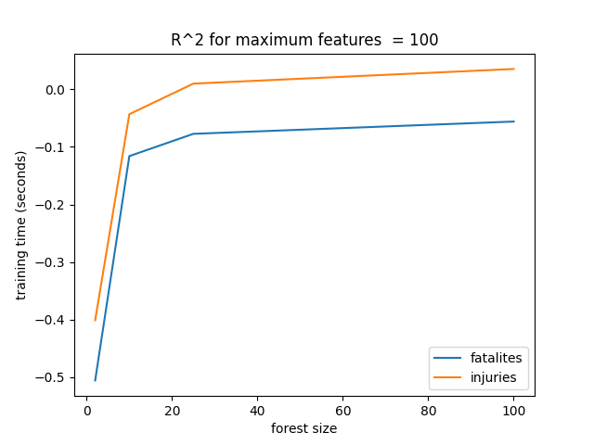
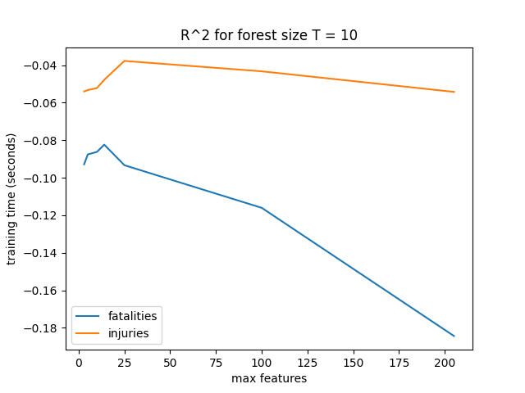

$$R^{2}$$

Slide 25

Conclusions
There is a huge discrepancy between the MAE-derived accuracy and the $R^{2}$ values.
However, we can conclude that the models are accurate because the MAE itself is very low for both models and the spread of the output variable is small.
The low $R^{2}$ values are a result of the features not providing a consistent correlation to the output variable, this can be seen in the earlier graphs

Slide 26
Conclusions
More research is needed to determine the viability of random forests as appropriate models for predicting the number of fatalities and injuries in a given car crash.
Further research should focus on other regression methods such as neural networks, K nearest neighbors, and support vector regression. Another area for further research is using different features.
But for now, this research shows good proof of concept for integrating random forests into emergency response to help first responders allocate resources based on predictions about car crash injuries and fatalities.

Slide 27
Sources
https://www.ddlawtampa.com/resources/car-accident-statistics-you-need-to-know-in-2021/#:~:text=On%20average%2C%20there%20are%20over,losing%20their%20lives%20each%20year.
https://towardsdatascience.com/random-forest-in-python-24d0893d51c0
https://www.stat.berkeley.edu/~breiman/randomforest2001.pdf

