Slide 1
2
1
0
Left-edge use

Slide 2
0
1
2
Right-edge use

Slide 3
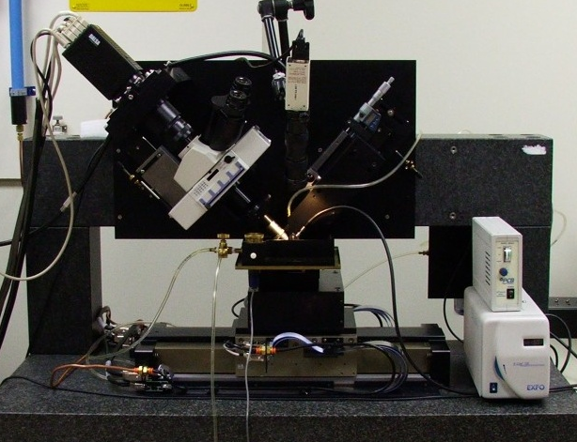
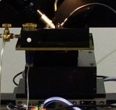
y
x
z

Slide 4
(A)
(B)
4
3
2
1
0

Slide 5
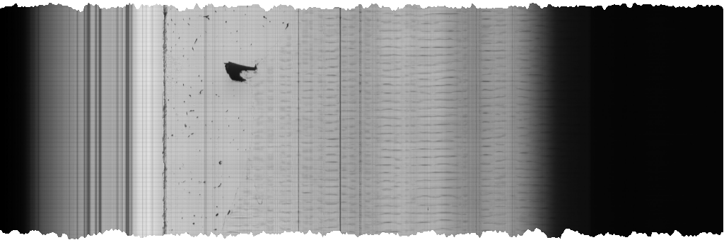

Slide 6
Template image
Gradient

Slide 7
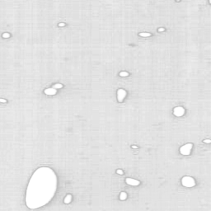
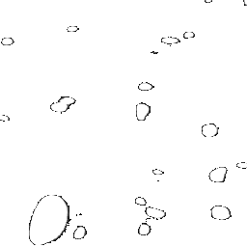
Rationale for a new image process for KESM Brain Atlas
Figure 1. The current image in the KESM brain atlas.
White circular structure is blood vessel. Gray background is supposed to be completely transparent. But due to noisy image background, it is only partially transparent.
Figure 2. The new image.
With proper intensity normalization and noise removal process, the background can be completely transparent.

Slide 8
No Clear Right Edge
The arrow indicates the true right edge. But it is hard to identify it from the automatic tissue area detector.

Slide 9
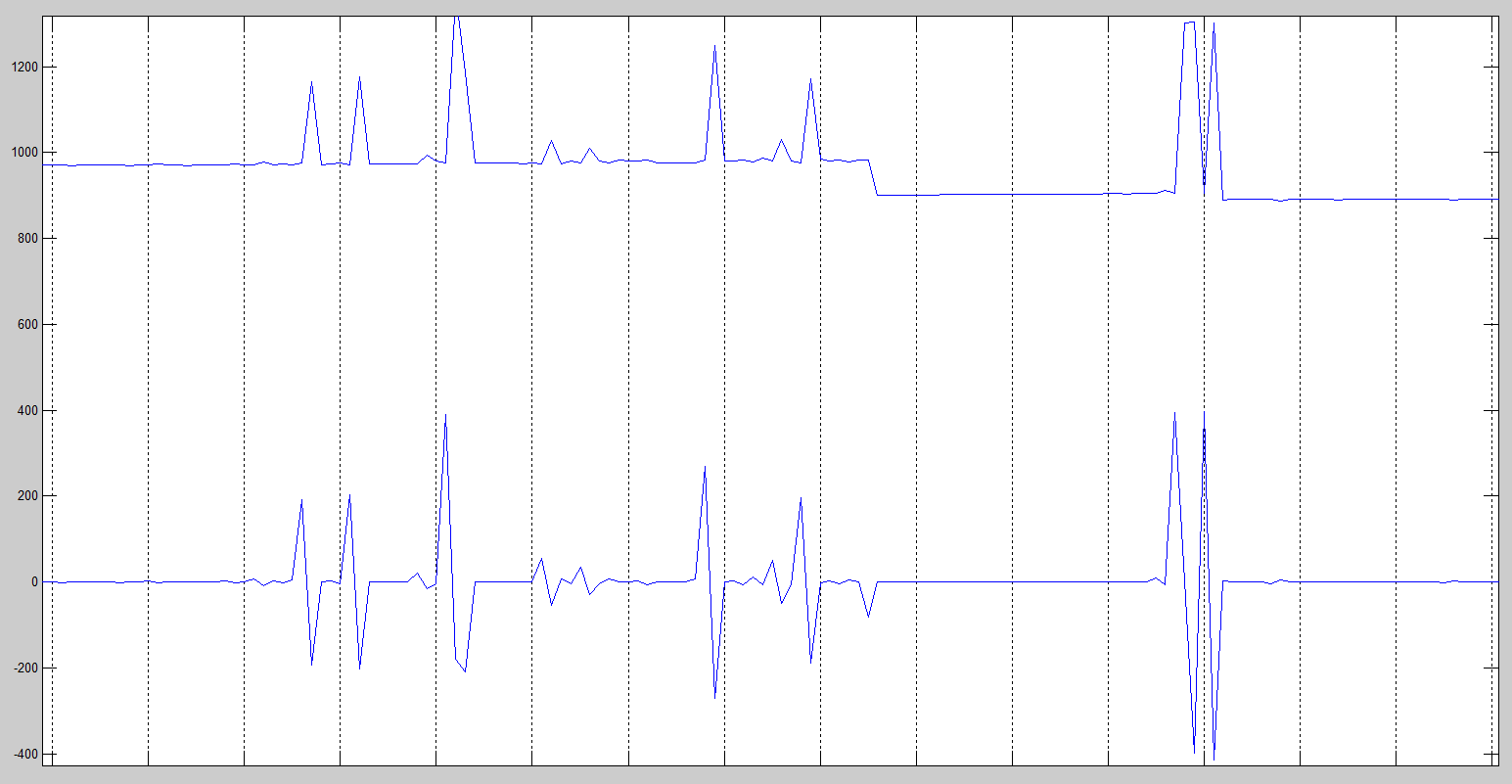
Outliers in Automatic Detection Results
Upper: A partial graph of tissue image start position.
Lower: Corresponding values to the Upper showing differences between start points from two consecutive images.

Slide 10
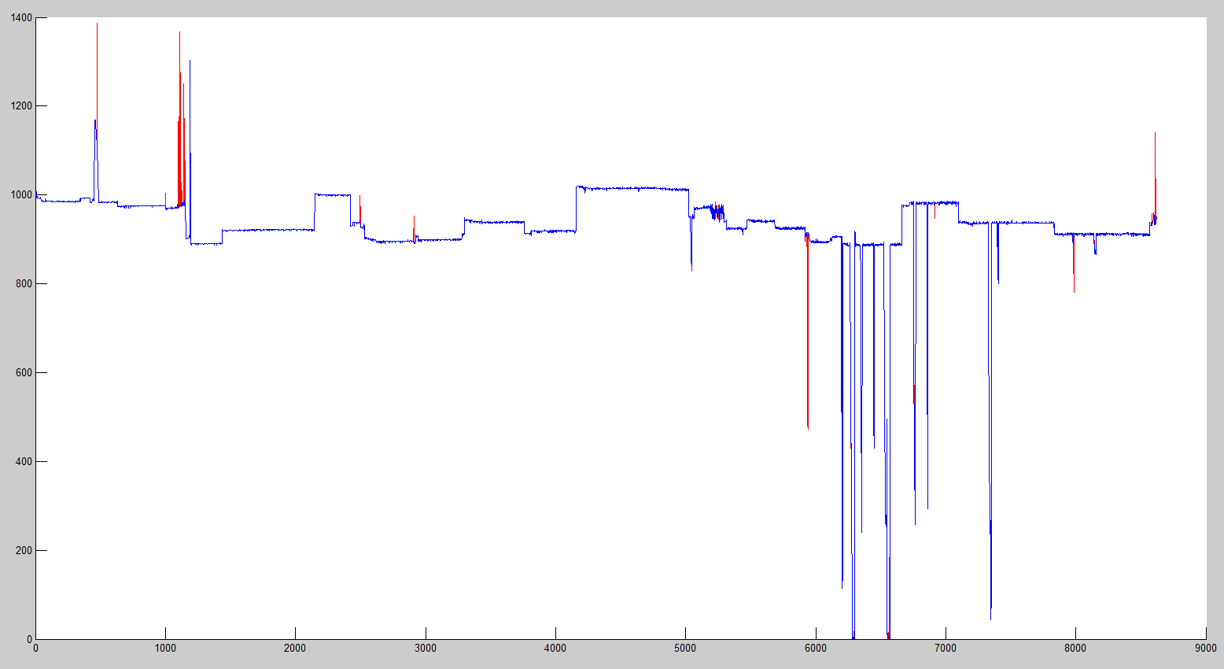
Preliminary Result
Red line: Tissue start positions from Automatic Detection.
Blue line: Outliers are removed.
Purple & narrow arrows indicate new chunks.
** Improvements need to be done to restore the region pointed by a green arrow.

Slide 11
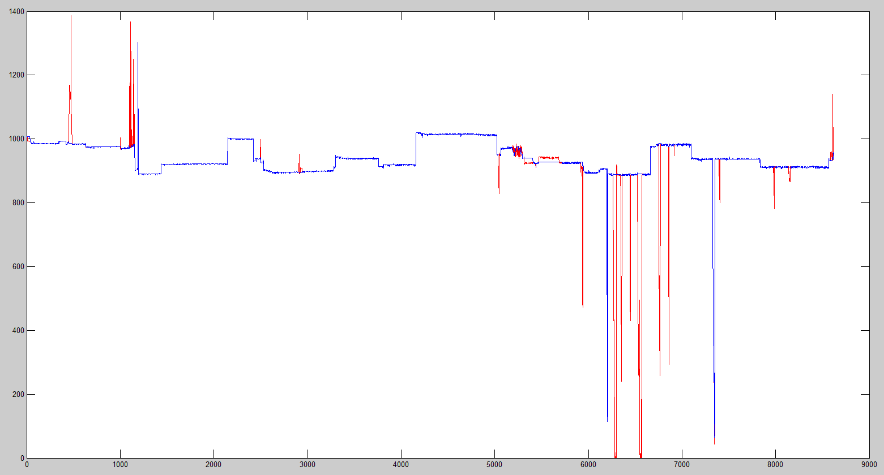
Result
Most bad chunks are successfully removed (green arrow region).

