Slide 1


Right edge
Image n
Image n+1
Undetectable right edge
In Image n+1, the right edge of the tissue ribbon cannot be detected properly due to the severe illumination problem. But the majority of the image contains information. We have to save the image rather than discarding it.

Slide 2
y axis: the starting x point of a tissue area in a raw KESM image in a column.
x axis: image id.
The points are automatically detected based on the right edge of a tissue ribbon.
Outliers (indicated by the arrows) should be adjusted to save more tissue images.
Images in a column are not completed aligned since there were multiple knife cleaning sessions.

Slide 3
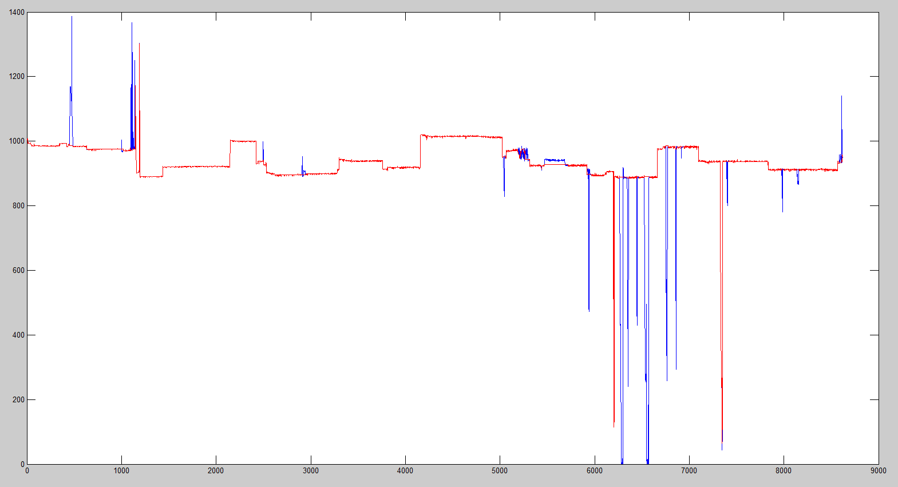
A normal image. The right edge can be detected by the automatic detection.
The right edge cannot be detected. So it is not possible to calculate the staring point.
These images are outliers.
(a) Automatic detection result showing several outlier groups.
(b) After removing outliers. The red solid line shows newly adjusted starting points. Most outliers are removed (green arrows).
Outliers are not actual chunks of images. They should be adjusted based on neighboring images.

Slide 4
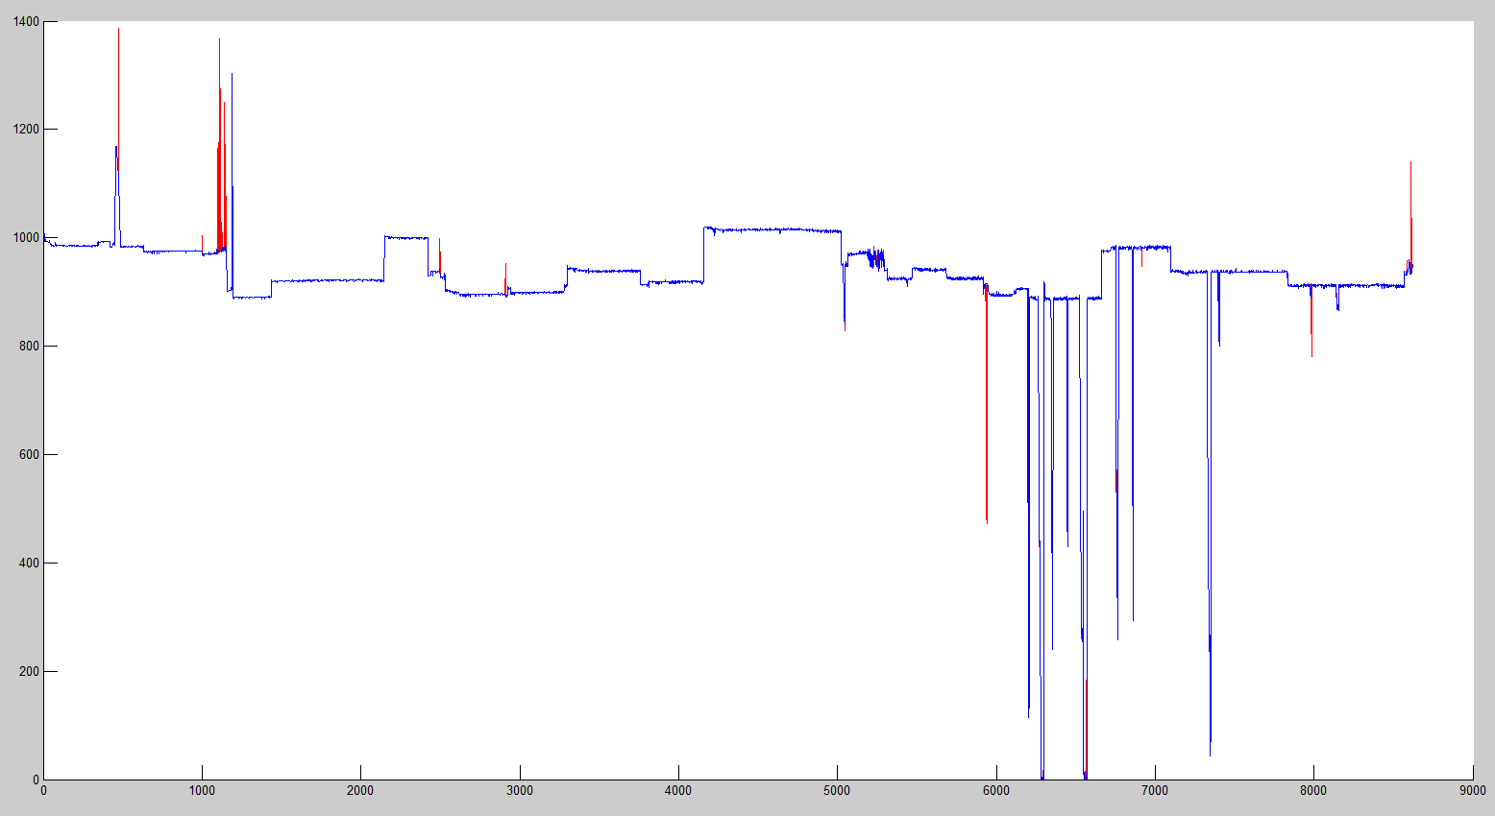
Preliminary Result
Red line: Tissue start positions from Automatic Detection.
Blue line: Outliers are removed.
Purple & narrow arrows indicate new chunks.
** Improvements need to be done to restore the region pointed by a green arrow.

