Slide 1
AUTOMATION REPORT
JORELLE LABANZA

Slide 2
AUTOMATION REPORTS
SYSTEM | ACCOMPLISHMENT | IMPACT
PROMIS | Integration of PROMIS ASSY automation BMR Retirement, PROMIS lite implementation in ASSY Development for iTV ASSY in now in progress TNR WLP PROMIS lite implementation WLP Track in Track Out implementation in progress Closed Tickets (24) | Readiness for ITV, detailed downtime extraction , web-based viewing of downtime TNR History Retrieval Availability For OEE automation computation Faster OEE data extraction
FIRST LEVEL ANALYSIS | Integration of Online FLA Closed Tickets (9) | Easier compilation of FLA, compliance to FLA before endorsement to EE, Easy accessibility and easy inputting on FLA
SPARKS OF BRILLIANCE | Integration of Online Sparks of Brilliance Automation Paperless project for SOB Submission Closed Tickets (6) | SOB automation has decreased processing time of report since we do manual input- from SOB form to excel. It also speed up the routing of approval and decreases recommenders task to manually route form to signatories. Checking of authorized recommenders became easy since only people leaders has the access to the link. Processing time of finance also speed up. Convenient to approvers since it is a “one Click” way of approval Generation of report is also easy. System prompt reminder is convenient for approval of Dept. Heads System is Automated making it Paperless and cost effective
CENTRALIZED REWARD SYSTEM | Integration of Centralized Reward System Automation Reduced Papers for Submission of E-Safety, E-Quality, SOB Awardees with Finance Closed Tickets (3) | Faster Approval and less wasted work time, Cost reduction with papers. Document wise it has less paper to check and file. Much less time consumed because the batching in CRS are generated in an excel file thus checking can be done via formula instead of manually. It consume much lesser time before it can be uploaded to BPI system Notification sent to the awardees is easier after crediting the award
REPORT SYSTEM | Integration of Report System Automation Online log for Load board repairs, Speed loss, Burn in and Action Tracker for Employee’s convenience | Web-based viewing with full details of reports. Real-time email for Action Item Tracking. Excel export of Reports from Report system instead of Manual reporting thru Excel

Slide 3



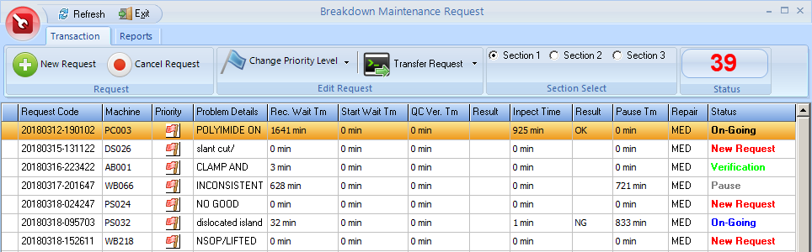
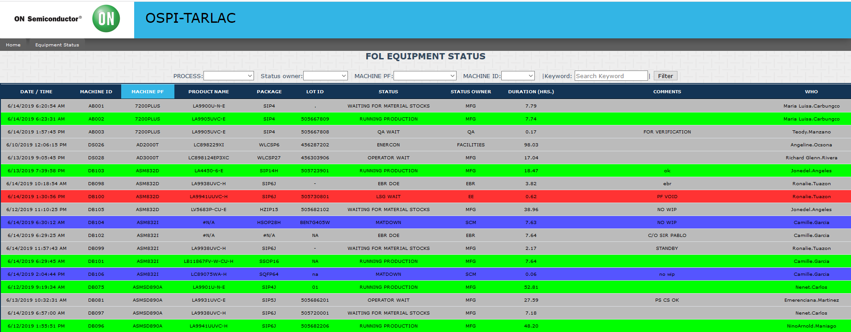
PROMIS
BMR Retirement, PROMIS lite implementation in ASSY
BEFORE
AFTER
PROMIS
Machine Only Updating
Machine updating with easy retrieval of downtime history

Slide 4



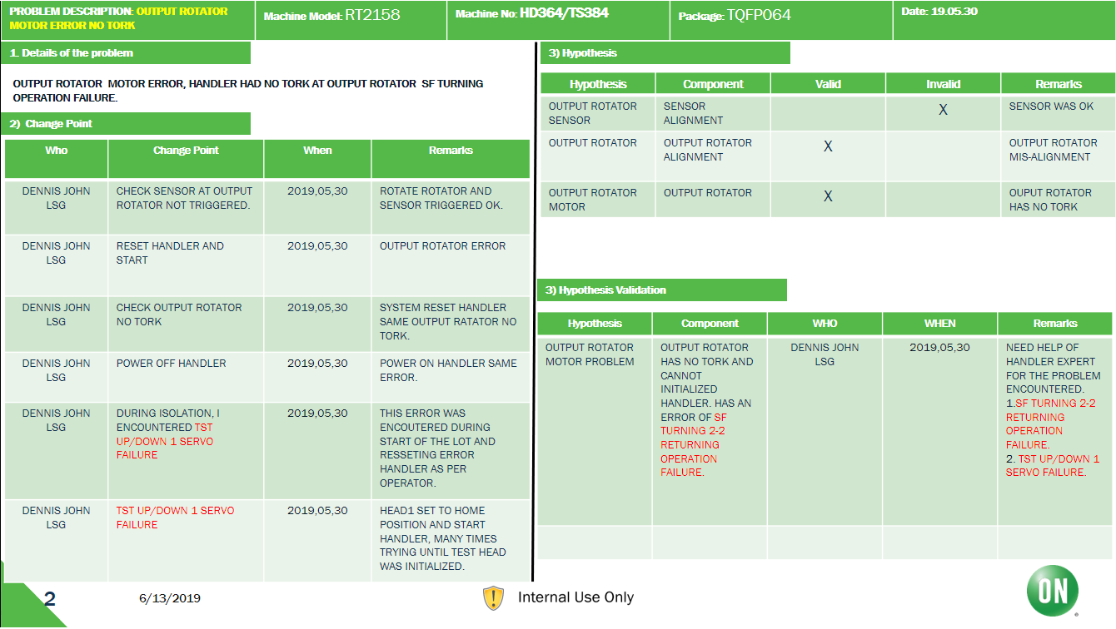
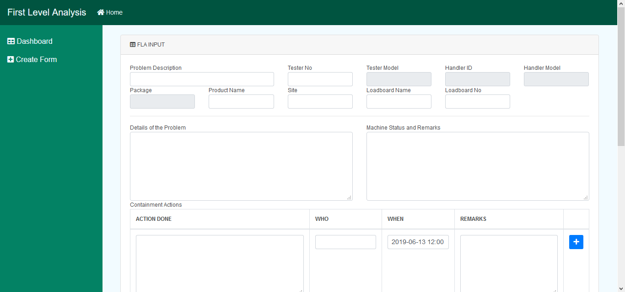
FIRST LEVEL ANALYSIS
Automated First Level Analysis
BEFORE
AFTER
Changes Status but if the condition has met Online FLA will automatically open
Change status to PROMIS
Manual Creation of FLA
PROMIS
ONLINE FLA
First Enhancement:

Slide 5





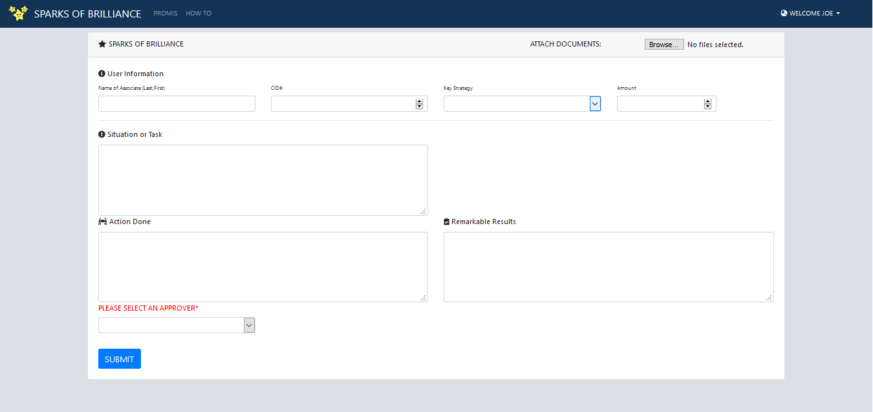
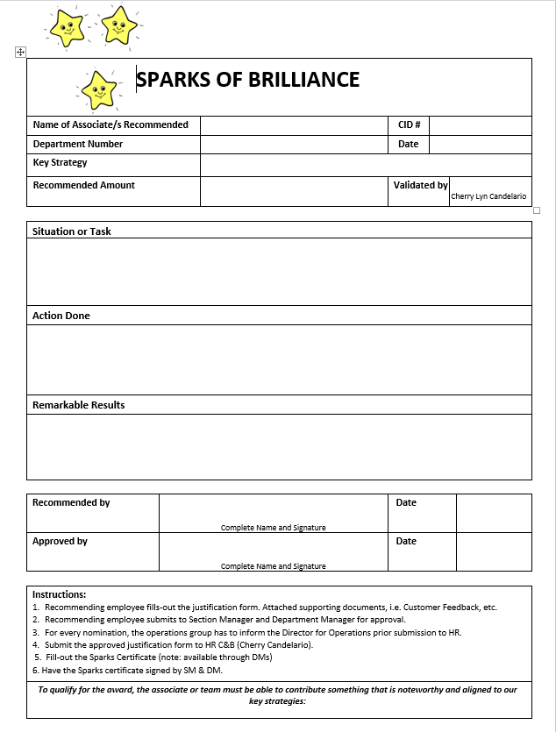

SPARKS OF BRILLIANCE
Paperless project for SOB Submission
BEFORE
AFTER
1. SOB forms takes time to make because it is not automated and must be handwritten.
2. The submitter must go to the approver and it will take a lot of work time and physical energy.
3. After all of the approvals, the submitter must also submit to HR for final approval and must send the form before Tuesday before 12nn cut time
All of the process will be online, Approval will be instant due to auto email upon submission.
You will be notified every process
No more hassle of going to approvers
You can send your form anytime
SOB

Slide 6




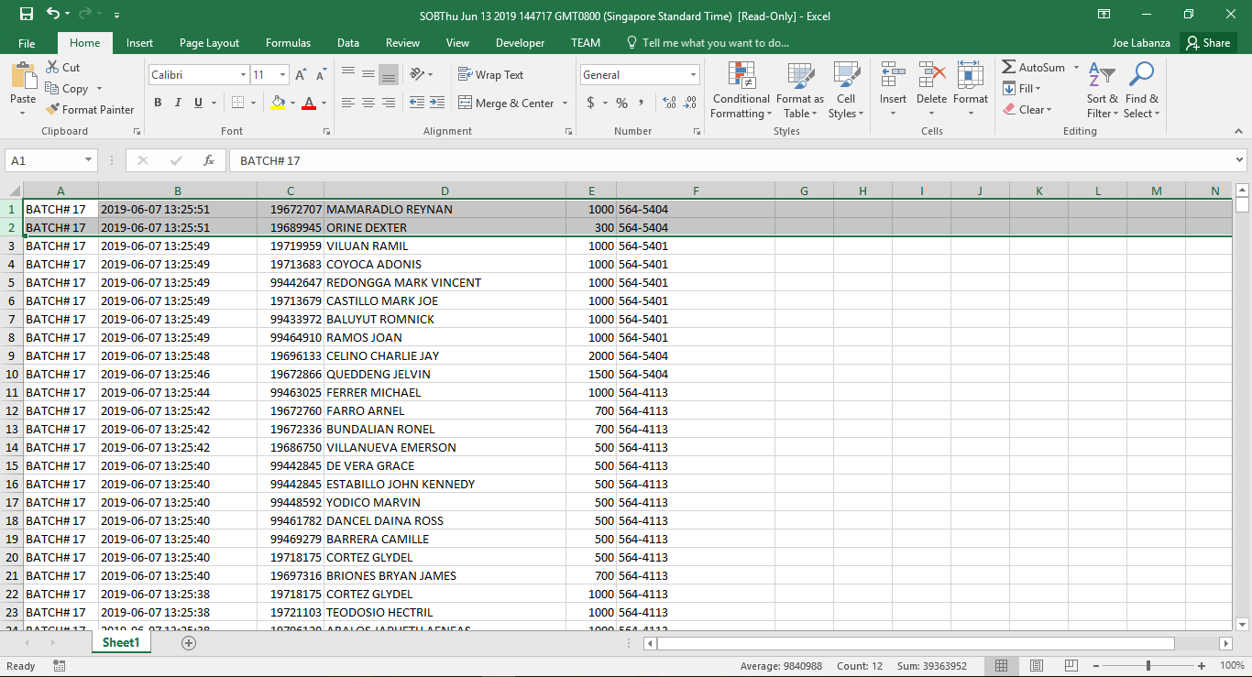


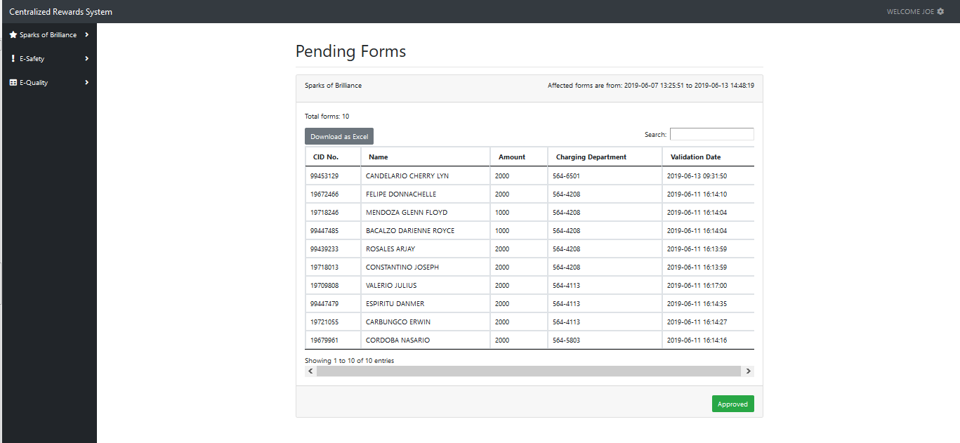
CENTRALIZED REWARD SYSTEM
Reduced Papers for Submission of E-Safety, E-Quality, SOB Awardees with Finance
BEFORE
AFTER
Submitter must list all associates and it will costs a lot of papers due to being compiled and submitted monthly.
Finance will need to double check all list of associates before approval of rewards, Finance time will be wasted.
Finance must email all submitters for the reward information of each associates. This will take a lot of finance time.
CRS system will let the submitters submit every list of awardees with a click of a button.
Finance can also approve the list with a click of a button, and will automatically emailing every submitter.
This will save cost and time.
Impact
E-SAFETY
E-QUALITY
E-SOB
MANUAL CHECKING
MANUAL EMAILING
Document wise it has less paper to check and file.
Much less time consumed because the batching in CRS are generated in an excel file thus checking can be done via formula instead of manually.
It consume much lesser time before it can be uploaded to BPI system
Notification sent to the awardees is easier after crediting the award
E-SAFETY
E-QUALITY
E-SOB

Slide 7





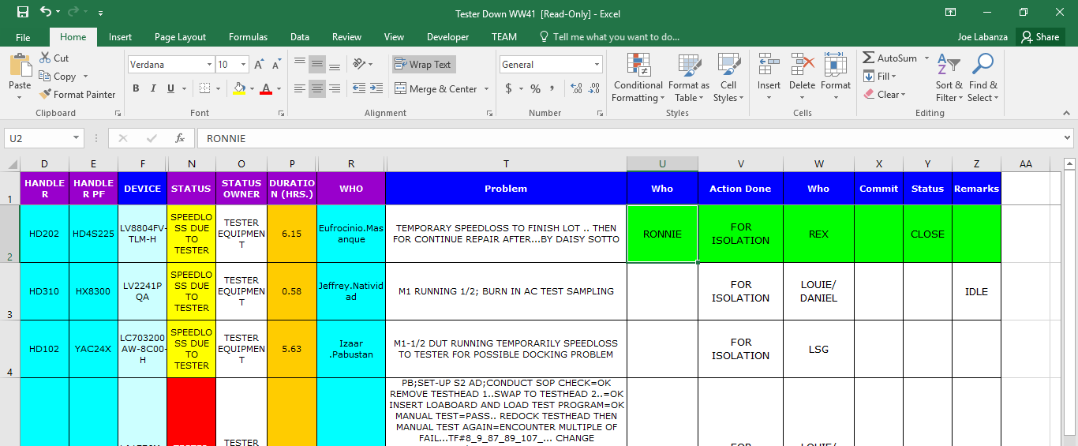
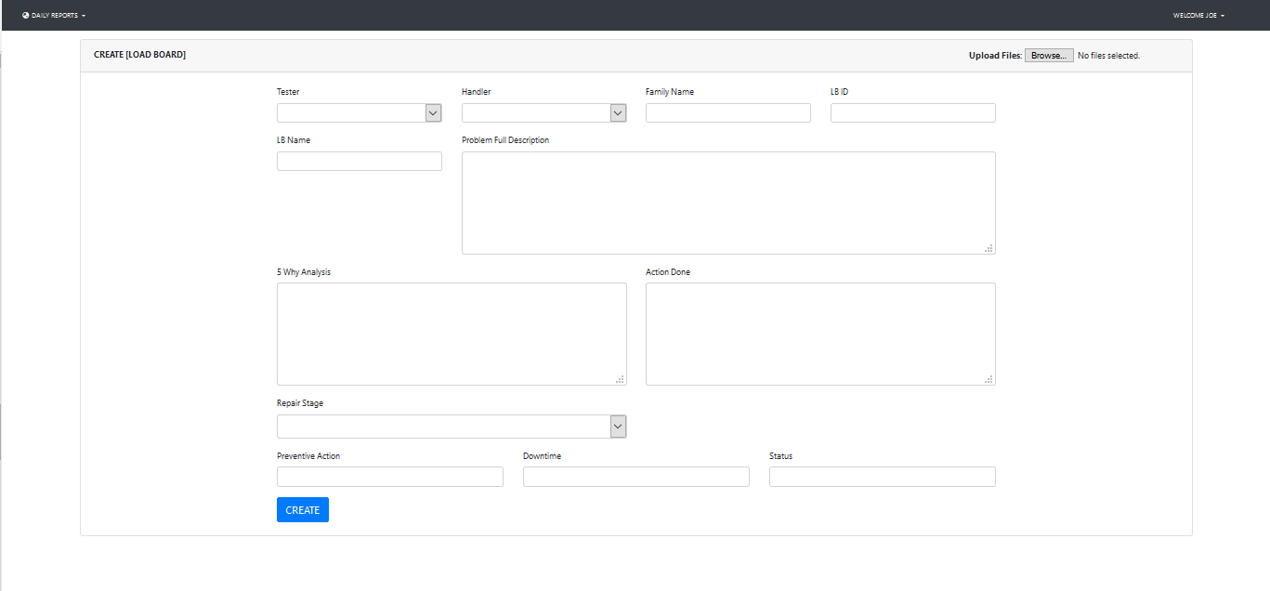
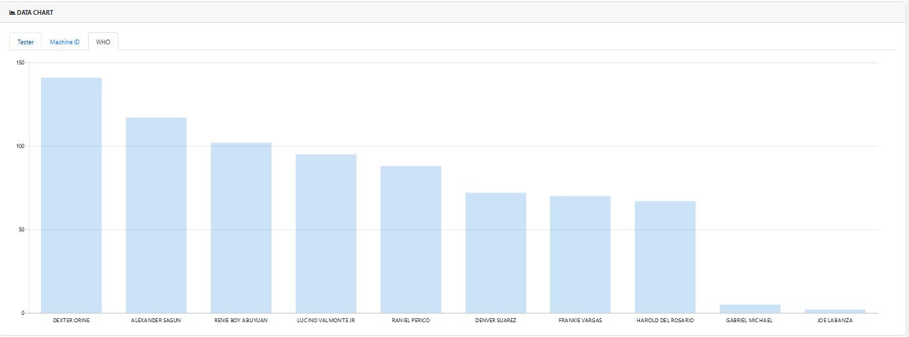
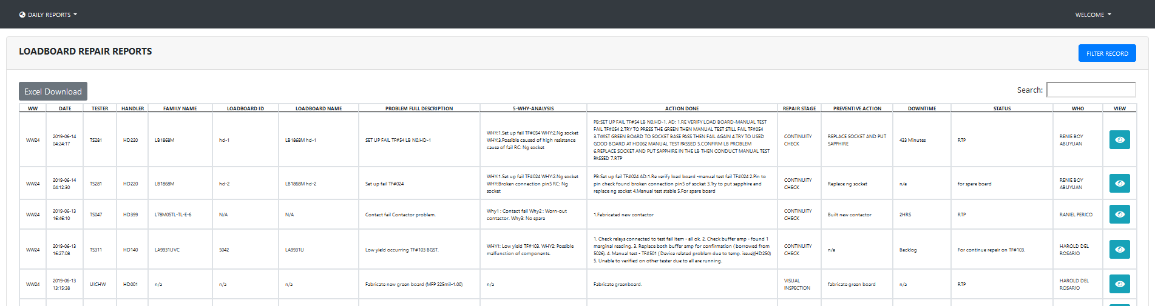
REPORT SYSTEM
Online log for Load board repairs, Speed loss, Burn in and Action Tracker for Employee’s convenience
BEFORE
AFTER
Reports are now detailed and is easily viewable online for convenience, updating and creating the form is now easy.
Reports will always be recorded in a history list instead of an excel file that can cause overwriting issues. Data extraction will be easy.
AI Tracking can monitor employee activities with auto email and activity lists assigned to them without the needing of manual checking for their activities.
Manual Report Inputting
Excel File Overwriting
Manual Monitoring of Employee Activity

Slide 8
ACCOMPLISHED REQUESTS:
PROMIS:
Ticket 341- PROMIS ASSY Filter must also be affected with the current changes with sorting from downtime and duration
Ticket 327- Last Employee Update Retention
Ticket 325- 9 Digit Filtering for PROMIS ASSY
Ticket 313- Inclusion of INTERFACE on PROMIS
Ticket 308 – History Retrieval Column Alignment for PROMIS ASSY
Ticket 307- History Retrieval Column for PROMIS FT
Ticket 294- TF006 requesting to include thru PROMIS under EOL Machine Equipment
Ticket 277- DD006 Additional Machine thru PROMIS
Ticket 271 Manual Deburring (DBR002-DBR003) Additional Machine thru PROMIS
Ticket 269- EOL Additional Machine (MK002) thru PROMIS
Ticket 265- Additional Machine DD009 thru PROMIS at EOL
Ticket 232- Additional Machine for Promis Assy
Ticket 221- Enhancement of the NEW WLP TNR PROMIS updating System
Ticket 220- History Retrieval for PROMIS (TNR)
Ticket 210- Add missing Machine Transaction History
Ticket 209- WLP TNR DB Repoint to Production DB
Ticket 196- PROMIS ASSY Release (BMR Retirement)
Ticket 195- Add user PROMIS ASSY
Ticket 125- Additional Equipment History at PROMIS (EOL)
Ticket 114- Additional User for PROMIS ASSY
Ticket 113- View/Update Status for EOL
Ticket 112- View/Update Status for FOL
Ticket 75- Family Name update in PROMIS ASSY
Ticket 61- TNR Updating Revision

Slide 9
ACCOMPLISHED REQUESTS:
FLA:
Ticket 351- Changing Containment Action column name What to Action Done in FLA.
Ticket 350- Package Auto Populate using PROMIS .
Ticket 349- Handler Model and Handler No. Name Change.
Ticket 348- Renaming Machine to Tester in FLA Form.
Ticket 347- FLA condition for required Attachment before submission.
Ticket 201- FLA Zip file Management
Ticket 199- FLA Dashboard Revision.
Ticket 149- LSG FLA Auto populate.
Ticket 9- FLA integration to PROMIS Update.
SOB:
Ticket 338- SOB Additional User Albert Reyes as Department Head for 564-5511.
Ticket 331- Redirect Approval of E-SOB raised by Johanna Pauline Gadong from Don Bersabal to Daisy Umayam.
Ticket 161- Change Approver.
Ticket 150- Access to E-SOB.
Ticket 46- Update Approver for my E-SOB Application.
Ticket 6- Modify Email Confirmation for Finance CLOSE status.
CRS:
Ticket 314- Recorded date to be reflected in CRS SOB Matrix.
Ticket 141- Include 4 closed E-quality entries in the reward system.
Ticket 243- WW data export from history.

Slide 10
FUTURE PROJECTS
Development
Ticket: 177: Project Management Tracking System for LSI – Final Test
Ticket: 51: Electronic M3

Slide 11
STARS TICKET SUMMARY
PROMIS ASSY and WLP
Enhancement and Support: From January 1 - June 3: 24 Tickets
FLA
Enhancement and Support: From January 1 - June 3: 8 Tickets
Development: FLA Integration to PROMIS Update
Sparks of Brilliance
- Enhancement and Support: From January 1 - June 3: 6 Tickets
Centralized Reward System
- Enhancement and Support: From January 1 – June 3: 2 Tickets

