Slide 1
Comparación de medias de dos grupos

Slide 2
¿Son diferentes?
Respecto a su estructura corporal

Slide 3
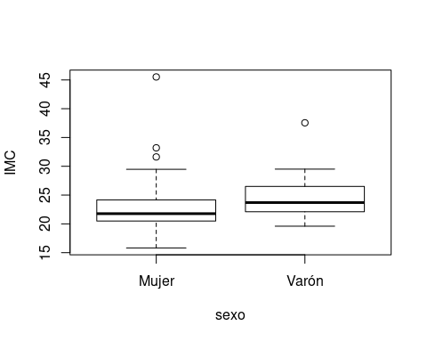

Slide 4
¿Son diferentes? (2)
Con respecto a las características de sus pies

Slide 5
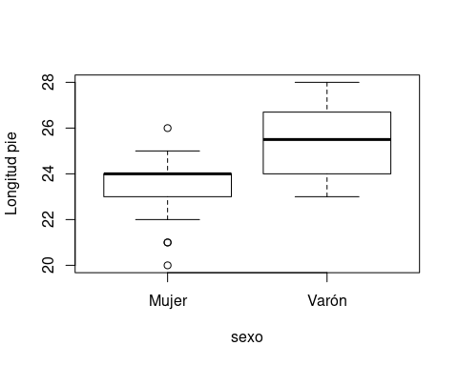

Slide 6
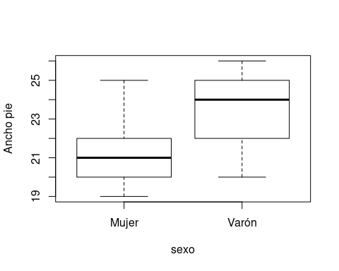
¿Son diferentes? (2)

Slide 7
Hipótesis nula
$$H_{0}:μ_{A}=μ_{B}$$
$$H_{0}:μ_{A}−μ_{B}=0$$

Slide 8
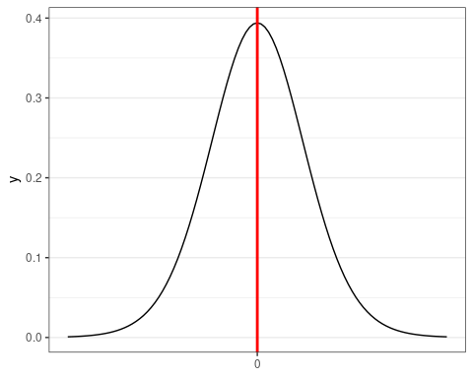

Slide 9
Hipótesis alternativa
$$H_{1}:μ_{A}≠μ_{B}$$
$$H_{1}:μ_{A}−μ_{B}≠0$$

Slide 10
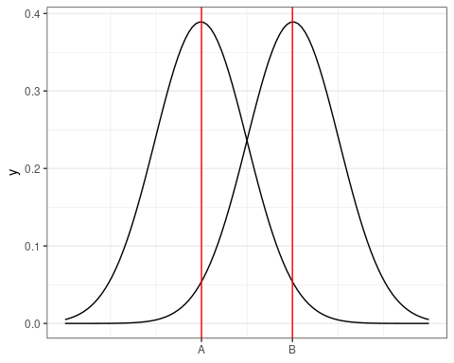

Slide 11
Estadístico del test
$$t_{exp}=\frac{{\overset{‾}{x}}_{A}−{\overset{‾}{x}}_{B}}{E.T.({\overset{‾}{x}}_{A}−{\overset{‾}{x}}_{B})}$$
$$t_{exp}=\frac{{\overset{‾}{x}}_{A}−{\overset{‾}{x}}_{B}}{\sqrt{s_{A}/n_{A}−s_{B}/n_{B}}}$$

Slide 12
Orden de R
t.test(ancho.pie~sexo, alternative='two.sided', conf.level=.95, var.equal=TRUE, data=pies_1920)

Slide 13
Resultado del test bilateral
## ## Two Sample t-test ## ## data: ancho.pie by sexo ## t = -6.1087, df = 51, p-value = 1.385e-07 ## alternative hypothesis: true difference in means is not equal to 0 ## 95 percent confidence interval: ## -3.399480 -1.717736 ## sample estimates: ## mean in group Mujer mean in group Varón ## 21.01282 23.57143

Slide 14
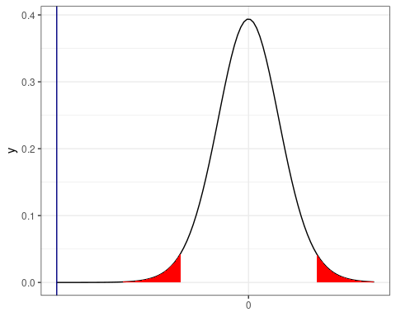

Slide 15
Resultado del test unilateral
## ## Welch Two Sample t-test ## ## data: ancho.pie by sexo ## t = -5.4144, df = 18.915, p-value = 1.613e-05 ## alternative hypothesis: true difference in means is less than 0 ## 95 percent confidence interval: ## -Inf -1.741304 ## sample estimates: ## mean in group Mujer mean in group Varón ## 21.01282 23.57143

Slide 16
