Slide 1
comparamedias_pwp_optica
Juan Ramon Lacalle

Slide 2
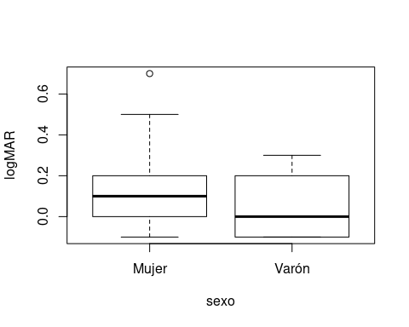
¿Son diferentes?

Slide 3
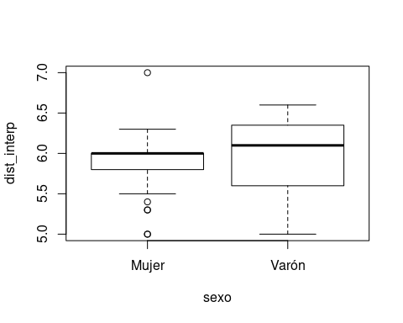
¿Son diferentes? (2)

Slide 4
Hipótesis nula
$$H_{0}:μ_{A}=μ_{B}$$
$$H_{0}:μ_{A}−μ_{B}=0$$

Slide 5
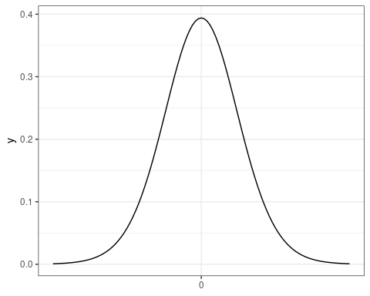

Slide 6
Hipótesis alternativa
$$H_{1}:μ_{A}≠μ_{B}$$
$$H_{1}:μ_{A}−μ_{B}≠0$$

Slide 7
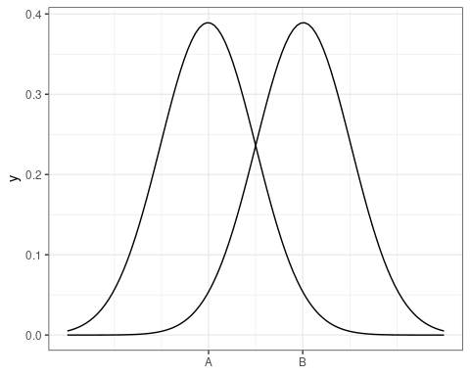

Slide 8
Estadístico del test
$$t_{exp}=\frac{{\overline{x}}_{A}−{\overline{x}}_{B}}{E.T.({\overline{x}}_{A}−{\overline{x}}_{B})}$$
$$t_{exp}=\frac{{\overline{x}}_{A}−{\overline{x}}_{B}}{\sqrt{{\overline{x}}_{A}/n_{A}−{\overline{x}}_{B}/n_{B}}}$$

Slide 9
Orden de R
t.test(logMAR~sexo, alternative='two.sided', conf.level=.95, var.equal=TRUE, data=pies_1920)

Slide 10
Resultado del test bilateral
## ## Two Sample t-test ## ## data: logMAR by sexo ## t = 1.1125, df = 52, p-value = 0.271 ## alternative hypothesis: true difference in means is not equal to 0 ## 95 percent confidence interval: ## -0.05691844 0.19856749 ## sample estimates: ## mean in group Mujer mean in group Varón ## 0.11627907 0.04545455

Slide 11
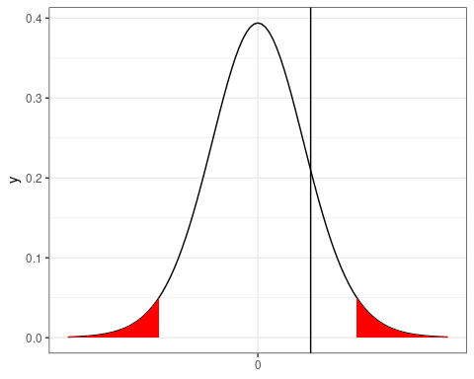

Slide 12
Resultado del test unilateral
## ## Two Sample t-test ## ## data: logMAR by sexo ## t = 1.1125, df = 52, p-value = 0.1355 ## alternative hypothesis: true difference in means is greater than 0 ## 95 percent confidence interval: ## -0.03578605 Inf ## sample estimates: ## mean in group Mujer mean in group Varón ## 0.11627907 0.04545455

Slide 13
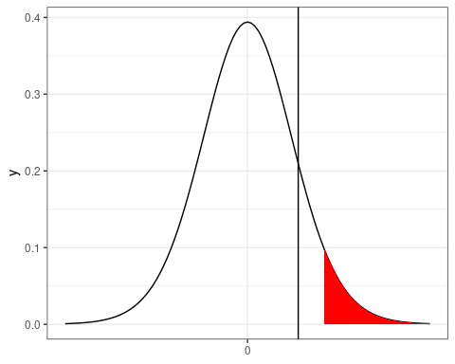

Slide 14
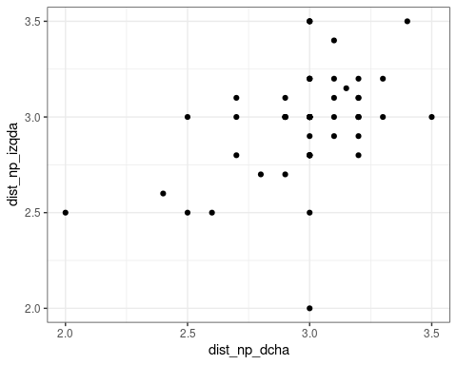
Datos apareados

Slide 15
Datos apareados: Hipótesis
Para cada individuo en el estudio:
$$δ_{i}=x_{A}−x_{B}$$
$$H_{0}:δ=0$$
$$H_{1}:δ≠0$$

Slide 16
Datos apareados: sintaxis
t.test(dist_np_dcha, dist_np_izqda, alternative='two.sided', conf.level=.95, paired=TRUE, data=vision_1920)

Slide 17
Datos apareados: resultados
## ## Paired t-test ## ## data: dist_np_dcha and dist_np_izqda ## t = 0.24292, df = 59, p-value = 0.8089 ## alternative hypothesis: true difference in means is not equal to 0 ## 95 percent confidence interval: ## -0.06030953 0.07697620 ## sample estimates: ## mean of the differences ## 0.008333333

