Slide 1
Possession Across the World
Jonah Landow

Slide 2

Research Topic
How important is controlling the ball to the outcome of a match across top leagues: Premier League, Ligue 1, Serie A, La Liga, Bundesliga, MLS
Stylistically, I expect the correlation to be stronger in leagues such as Serie A and La Liga, while the MLS I expect to have less of an impact considering the physical and counter attacking nature of the league

Slide 3
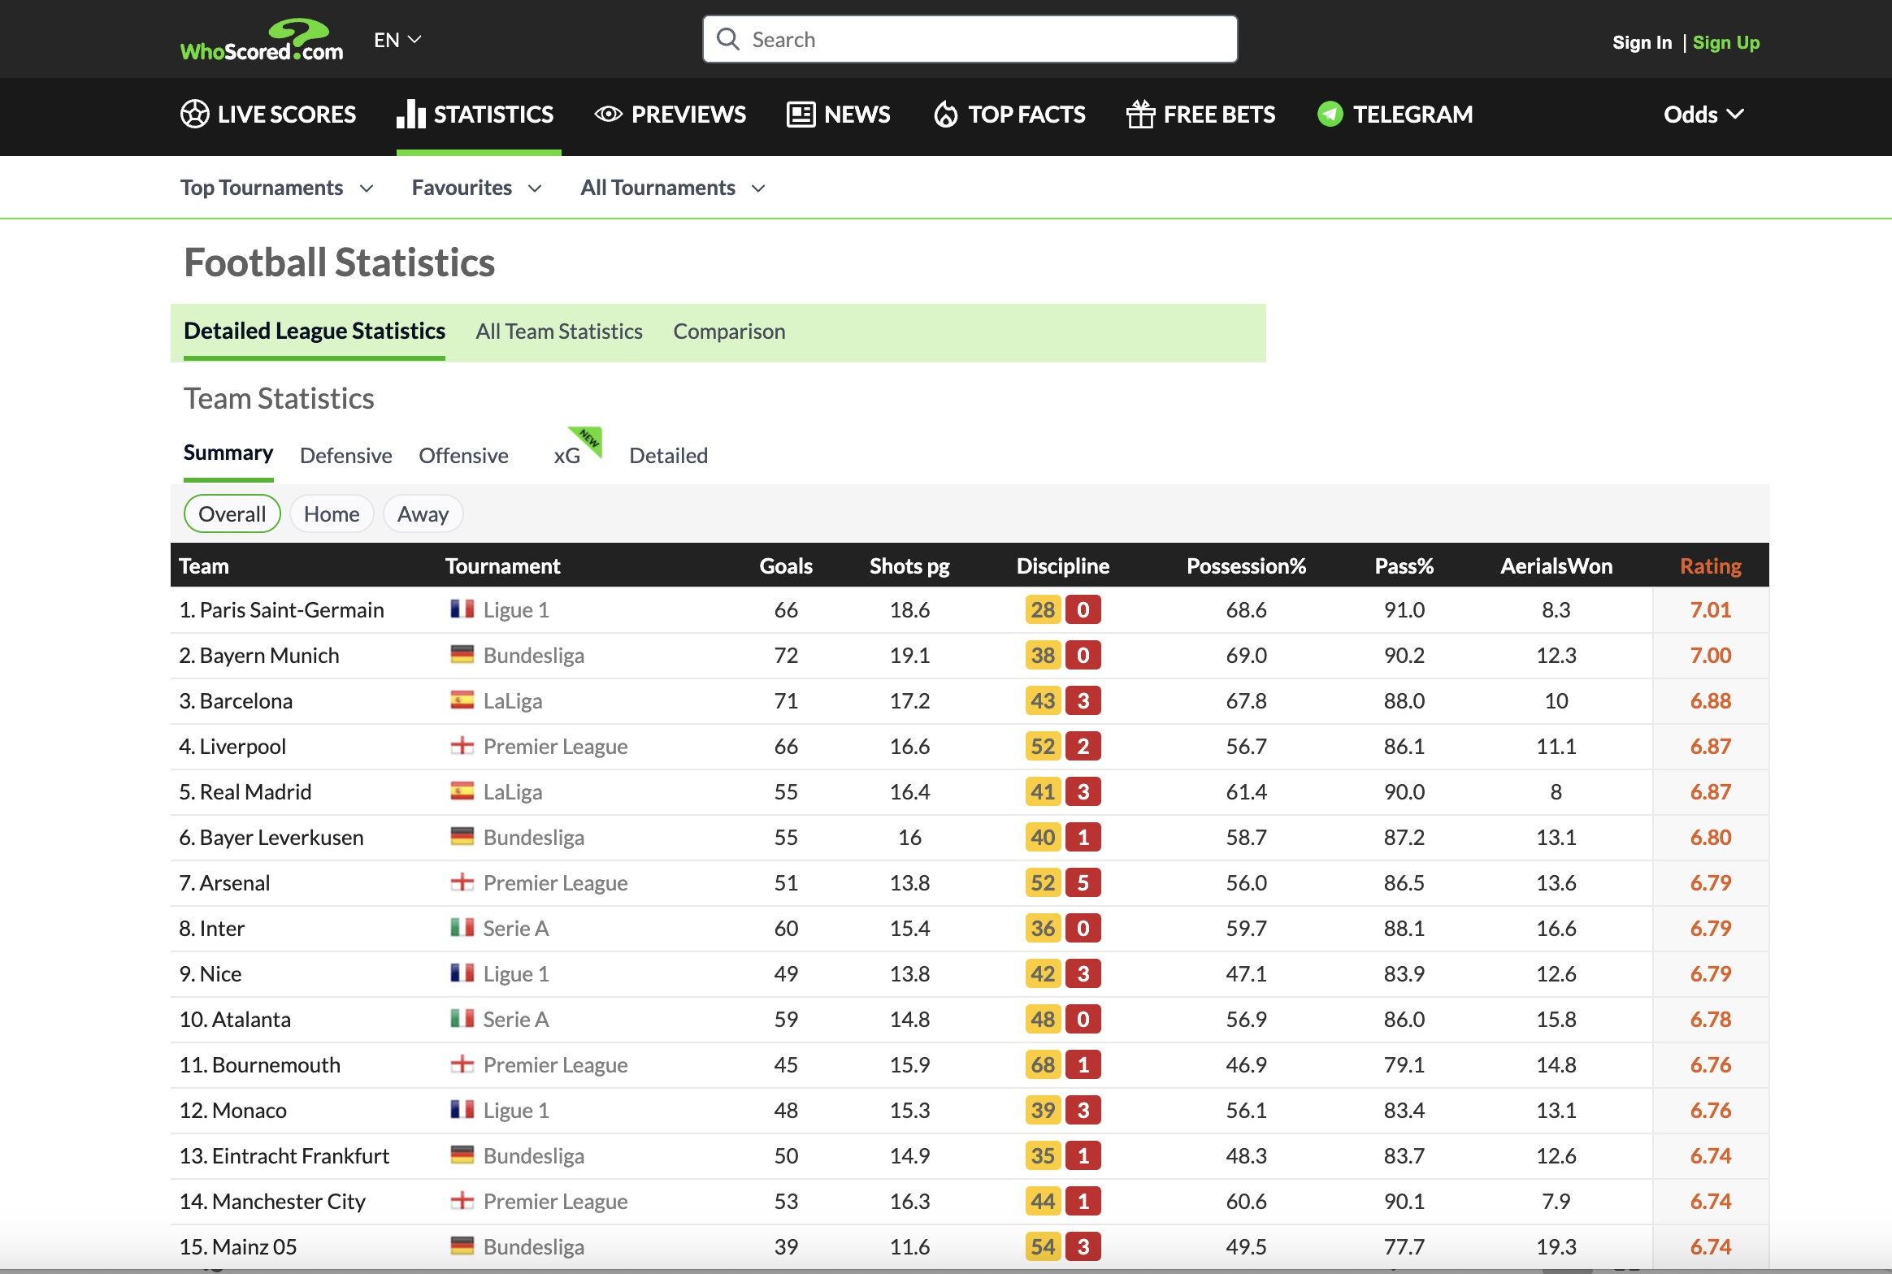
Data Source
Data retrieved from whoscored.com

Slide 4
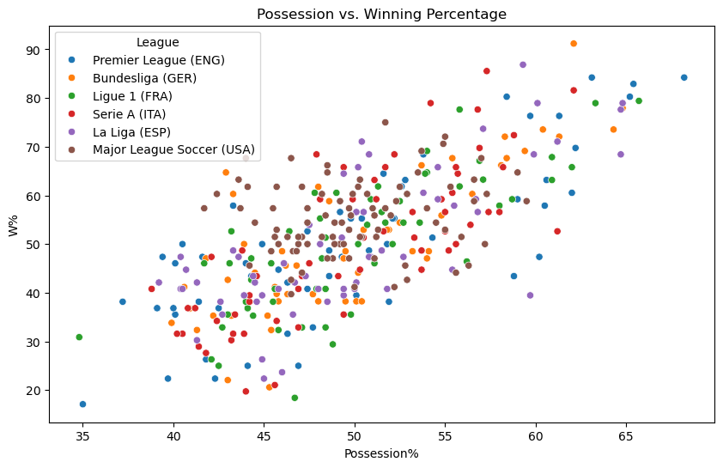
At a glance

Slide 5
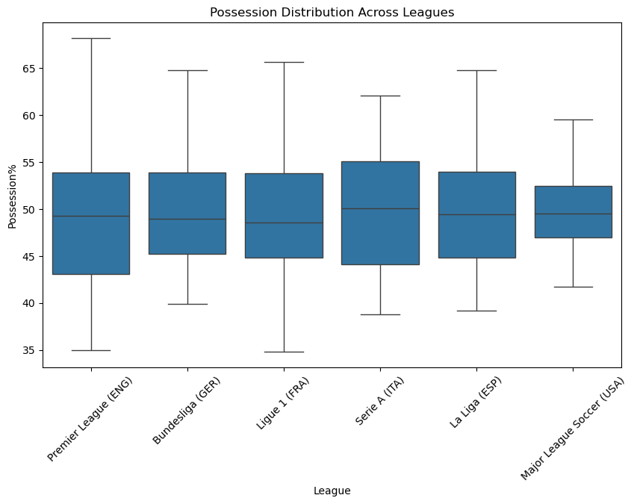

Wide Variety

Slide 6
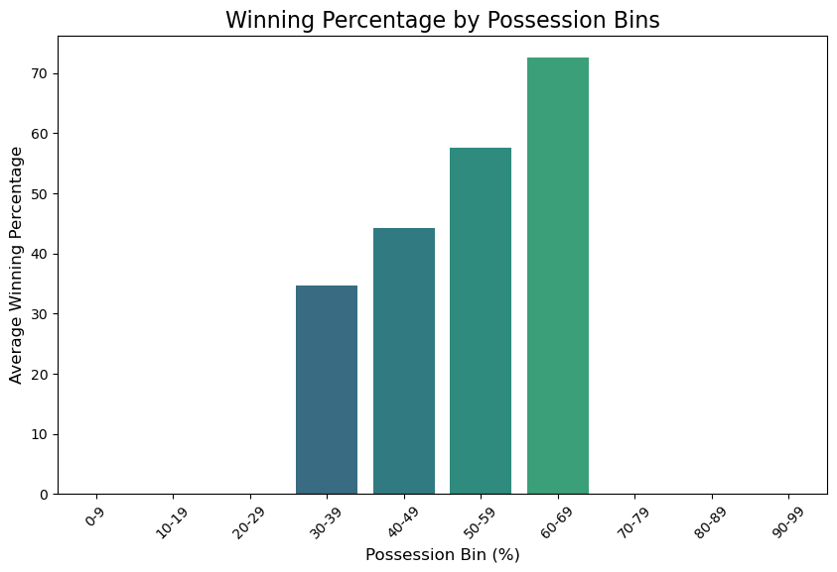
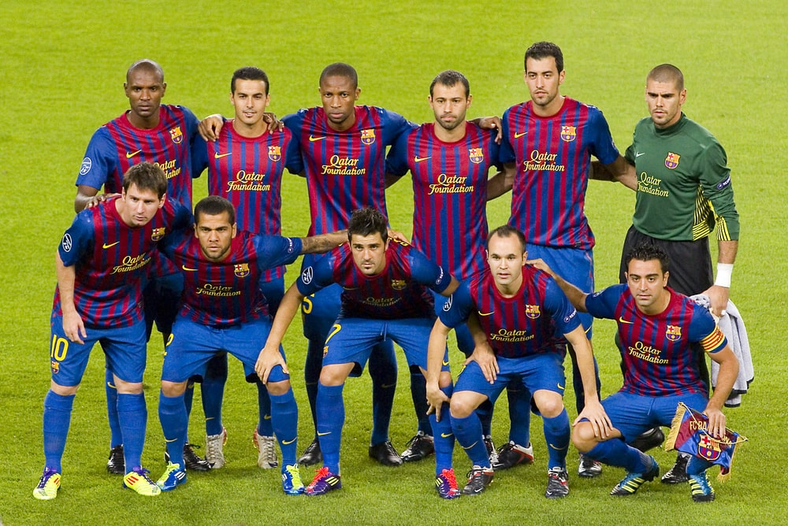
Possession = WINS

Slide 7
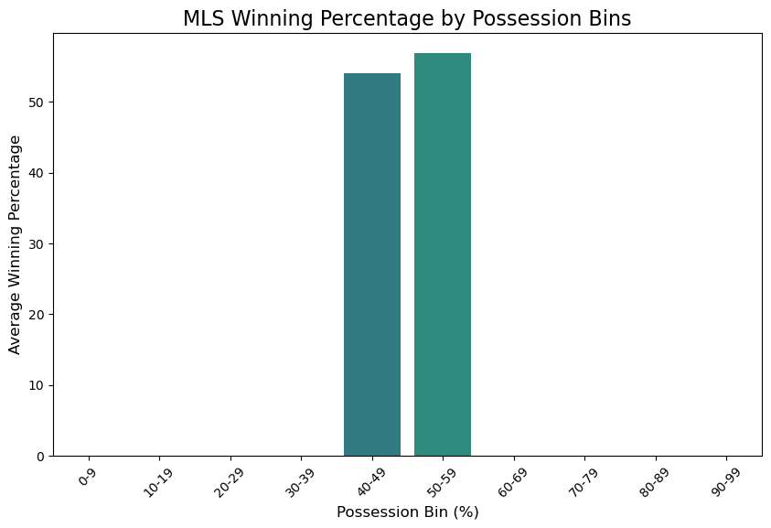
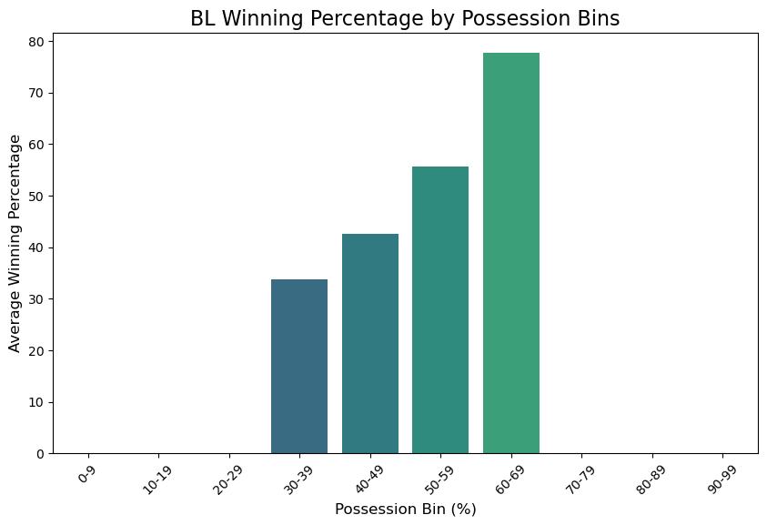
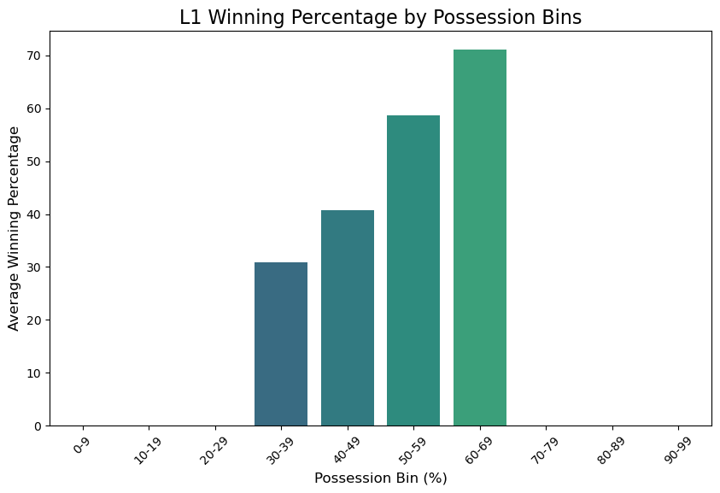
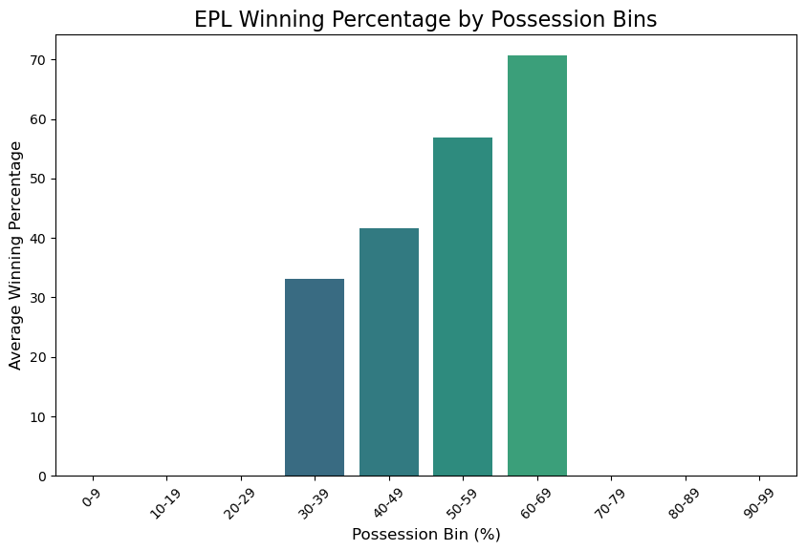
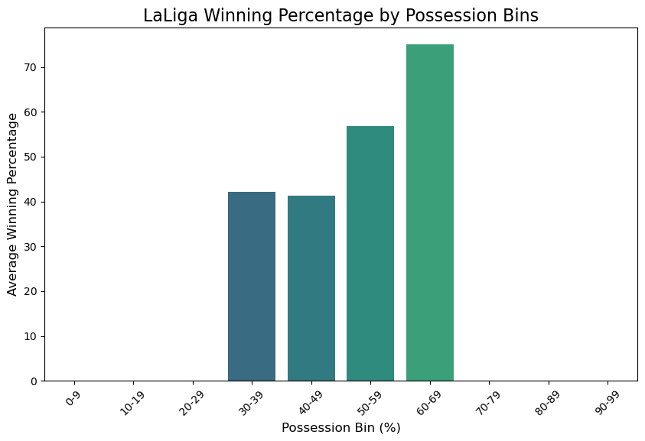
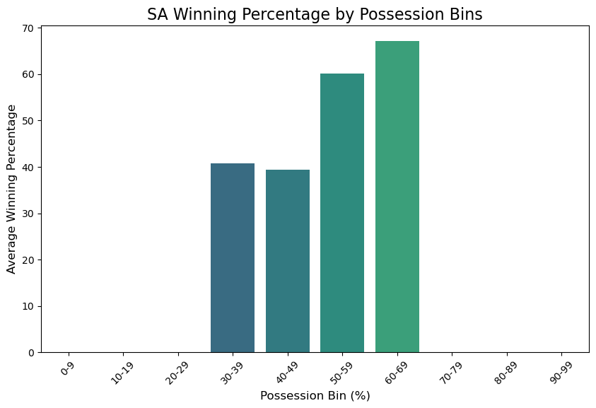
Just how much does it matter in each league

Slide 8
Correlation Heatmaps
Key Findings:
Lowest: MLS - .17 correlation between possession and Winning
Highest: EPL/L1/Bundesliga - .79 correlation between possession and winning

