Slide 1
Automatic DCDT Calibration Device
Chas Bolton

Slide 2
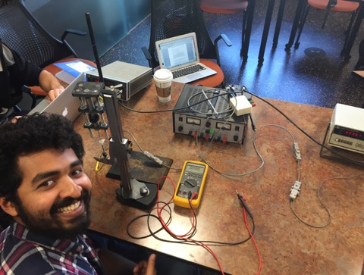
Problem
DCDTs are used in the Rock Mechanics lab for calculating displacements of the horizontal and vertical pistons on the Biax.
We must frequently calibrate the DCDTs to verify we are calculating the correct displacements and to make sure the DCDTs output is linear over a desired range.
Currently calibration is done manually by attaching the outer portion of the DCDT to a ring stand and moving the DCDT core throughout its voltage range.
This process is quite time consuming and could be improved by having a system that automatically moves the DCDT.

Slide 3
Approach
The two main questions to address and solve are: How to hold and move the DCDT?
To hold the DCDT, I designed a holding bracket via 3D printing.
The holding bracket includes a cylindrical holder for the DCDT to fit into
The bracket also includes a set of holes for the linear ball bearings and I-bolts to mount to.

Slide 4
Approach
Moving the DCDT, is done via a stepper motor, driver, belt/pulley system, linear ball-bearings and aluminum rods.
1 pulley is attached the shaft of the motor while the second pulley is attached at the top of the frame via a U-bolt, screw and metal plates.
The belt is looped through the I-bolts attached on the bracket.
DCDT core adapter is mounted at the top to connect the core of the DCDT
Source:https://www.adafruit.com/products/1179

Slide 5
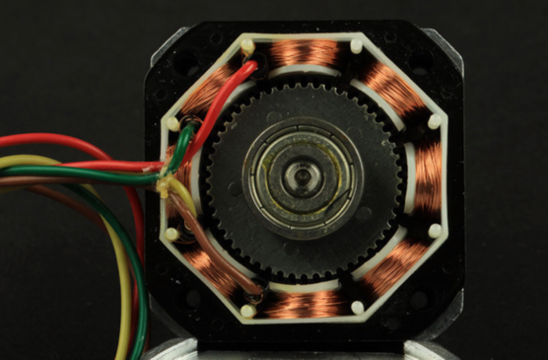
Stepper Motor Basics
A’
B’
The stepper motor is a DC electric motor that moves in discrete steps via digital pulses.
Essential parts of stepper motor consists of a central magnetic gear/rotor surrounded by a series of stators (electromagnet).
Phase= the number of groups/pair of windings. (A&A’=one phase with same polarity, B&B’=second phase with same polarity)
For a hybrid motor, if we apply a voltage to each of the windings we will control the direction of current, and thus, polarity at each stator. At any given time, one set of stators (A or B) will be aligned perfectly with the rotors teeth and the other set of stators will be misaligned. By switching the current direction in winding A it causes the next phase to be aligned perfectly with the rotors teeth, which causes motor to move one step forward
For my motor one revolution corresponds to 400 steps or pulses.
Precision can be increased through half-stepping or micro-stepping.
B
A
A
B’
B
A’

Slide 6
Driver Basics
Arduino sends commands to the driver that determine the direction and the number of steps for the motor to take
Easy Driver is a micro-stepping driver that can move the motor in full, half, quarter or eighth steps. => 400 Steps/Rev * 8= 3200 steps(positions) for 1 revolution
Velocity and torque dependent upon the amount of current supplied to the windings.
Source: https://www.sparkfun.com/products/12779
Power the driver via external power supply
Arduino commands sent to the driver
Driver regulates the current and sends this to the motors coils
Motor moves

Slide 7
Current Operation
Currently I have the stepper motor set to move 1/8th microsteps (1/8th step for each “full” step)
The motor moves 1mm, stops for 5 seconds and moves another 1mm. This process is continued until the motor has moved 30mm. Once the motor has traveled 30 mm the motor switches directions.
All of these parameters can be changed in the code to suit the users preferences and DCDTs “needs”.

Slide 8
Problems Encountered/Future Work
Minor issues with soldering of the pins onto the driver. After the first time of soldering, the voltages coming out of the driver were inconsistent.
Majority of problems I encountered came during the assembly part. Associated with belt, pulley and misalignment of the bracket.
Future work would be aimed at improving the pulley/belt system to mitigate slack problems.
Reduce the size of the frame

Slide 9
DEMO

