Slide 1
Lab-scale Gas Monitor System
Final Project of GEOSCI 597-007
LONG FAN

Slide 2
Outline
1. Background and Problem
2. Lab-scale Gas Monitor System
3. Assembling and Wiring
4. Problem and Discussion

Slide 3
Outline
1. Background and Problem
2. Lab-scale Gas Monitor System
3. Assembling and Wiring
4. Problem and Discussion

Slide 4
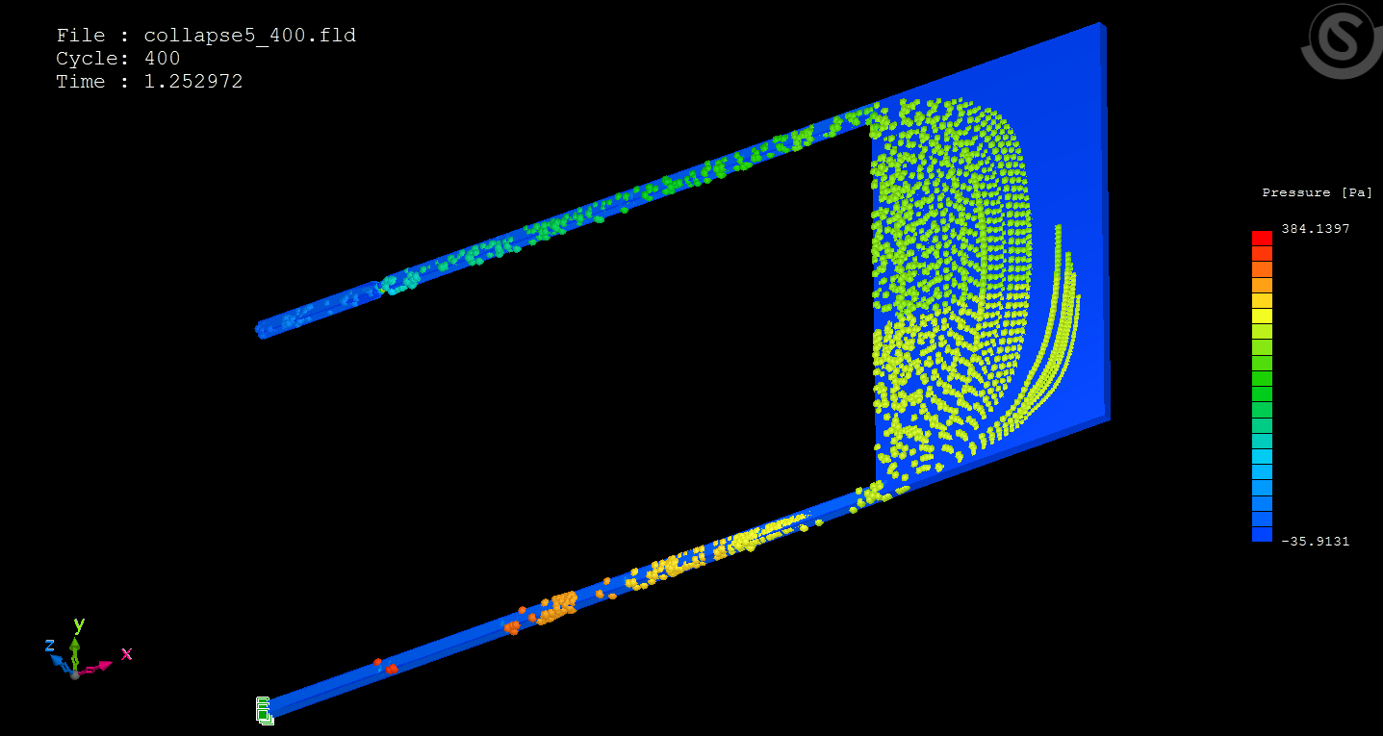
1. Background and Problem

Slide 5
Outline
1. Background and Problem
2. Lab-scale Gas Monitor System
3. Assembling and Wiring
4. Problem and Discussion

Slide 6
2. Lab-Scale Gas Monitor System
Quantity | Item
1 | Sparkfun Redboard
1 | Breadboard
1 | Methane sensor
1 | Gas Sensor Breakout Board
1 | USB Battery Pack
1 | SparkFun USB LiPoly Charger
1 | JST Right-Angle Connector
2 | Display
1 | Potentiometer
2 | LED
2 | 10k Ω resistor
1 | 300 Ω resistor
1 | 3D Printing Bracket

Slide 7
Outline
1. Background and Problem
2. Lab-scale Gas Monitor System
3. Assembling and Wiring
4. Problem and Discussion

Slide 8
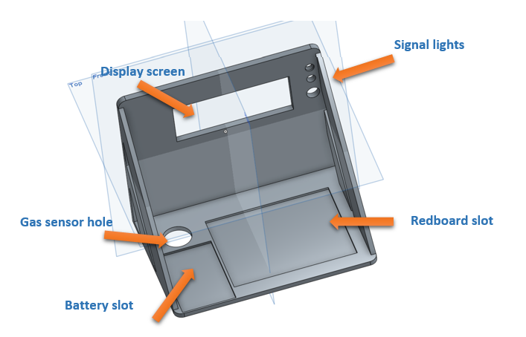
3. Assembling and Wiring
Assempling

Slide 9
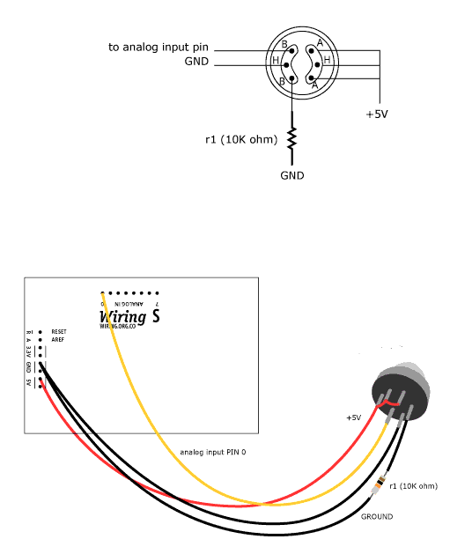
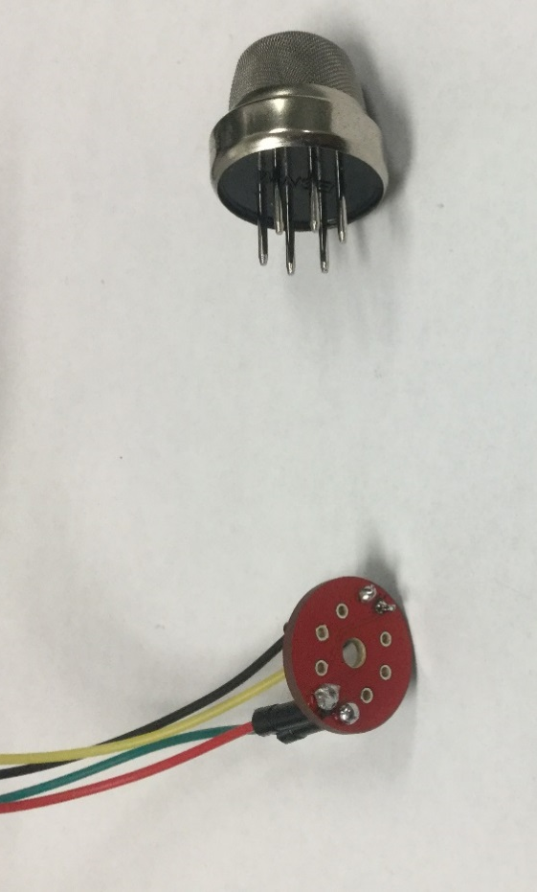
3. Assembling and Wiring
Gas sensor wiring

Slide 10
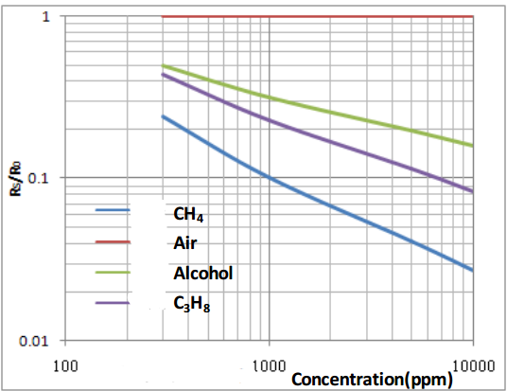
3. Assembling and Wiring
Typical sensitivity curve

Slide 11
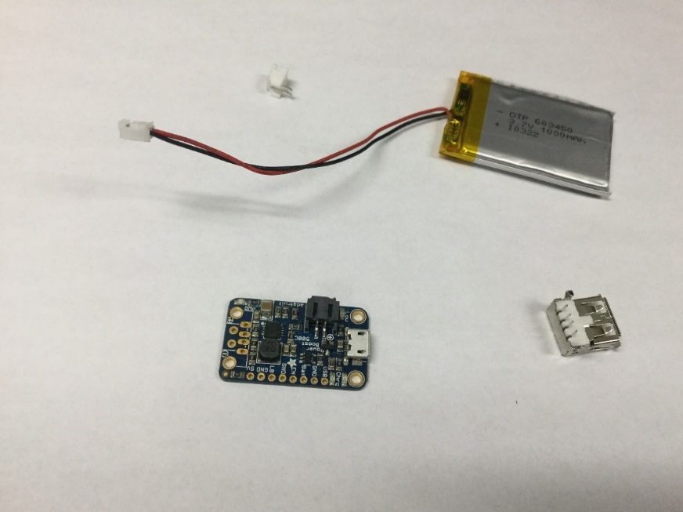
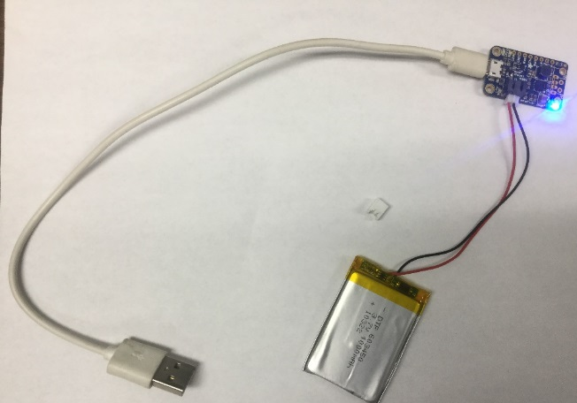
3. Assembling and Wiring
Battery wiring
JST right-angel
connector
USB charger

Slide 12
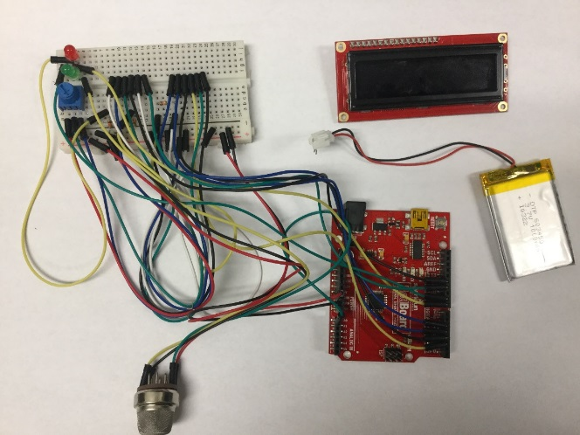
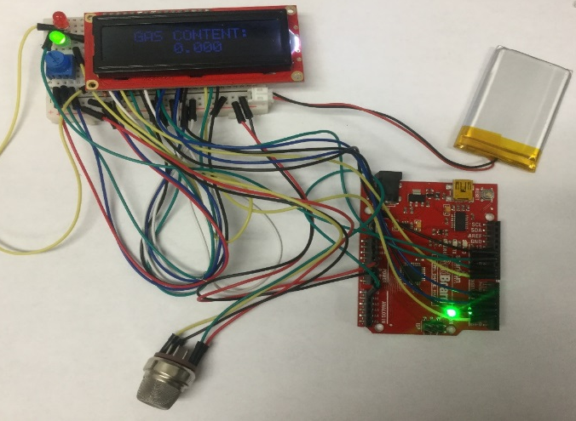
3. Assembling and Wiring
Testing
Physical wiring of all components

Slide 13
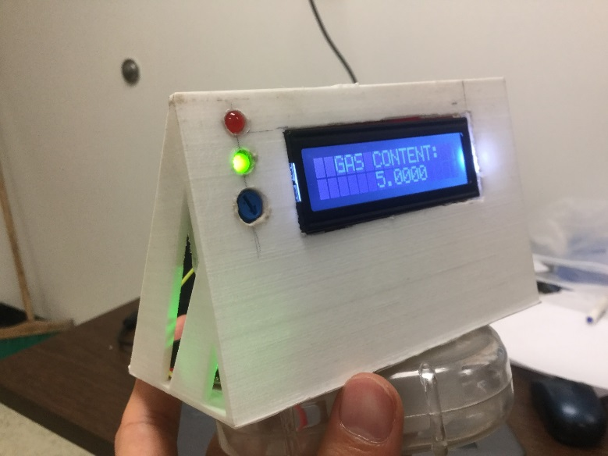
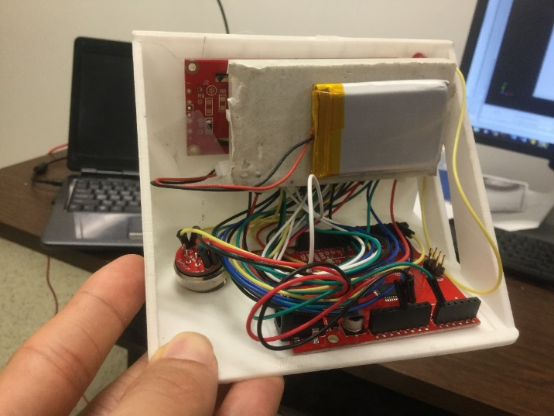
3. Assembling and Wiring
Final project

Slide 14
Outline
1. Background and Problem
2. Lab-scale Gas Monitor System
3. Assembling and Wiring
4. Problem and Discussion

Slide 15
4. Problem and Discussion
Long preheat time of gas sensor

Slide 16
Thank You! Question?

