Slide 1
Syringe Pump for Injecting/Refilling Fluid
GEOSC 597 Project
by
Yi Fang
Department of Energy and Mineral Engineering
Pennsylvania State University
12/06/2016

Slide 2
Project Goal
Build A Syringe Pump
that Can Perform Long-Term Injection

Slide 3
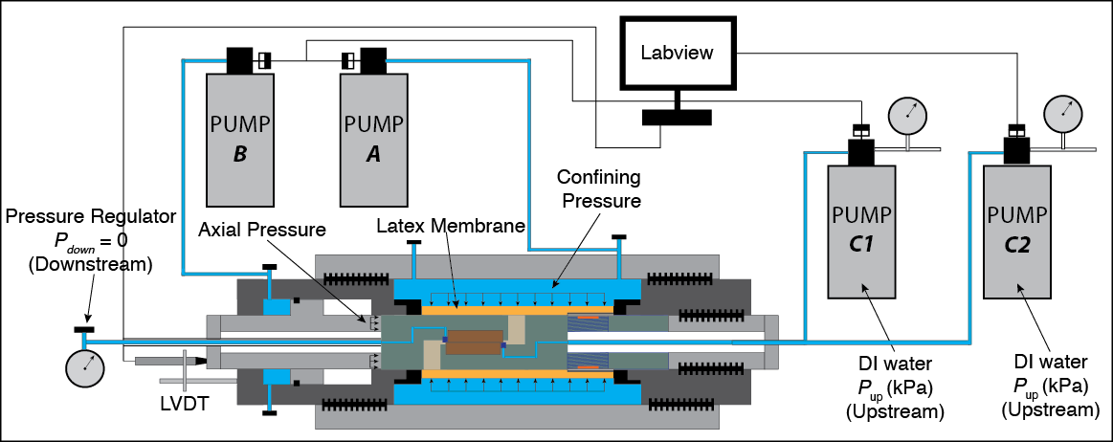
What’s the realistic problem?
Static Hydro-Mechanical Experiment
Long-term injection
Large volume of fluid

Slide 4
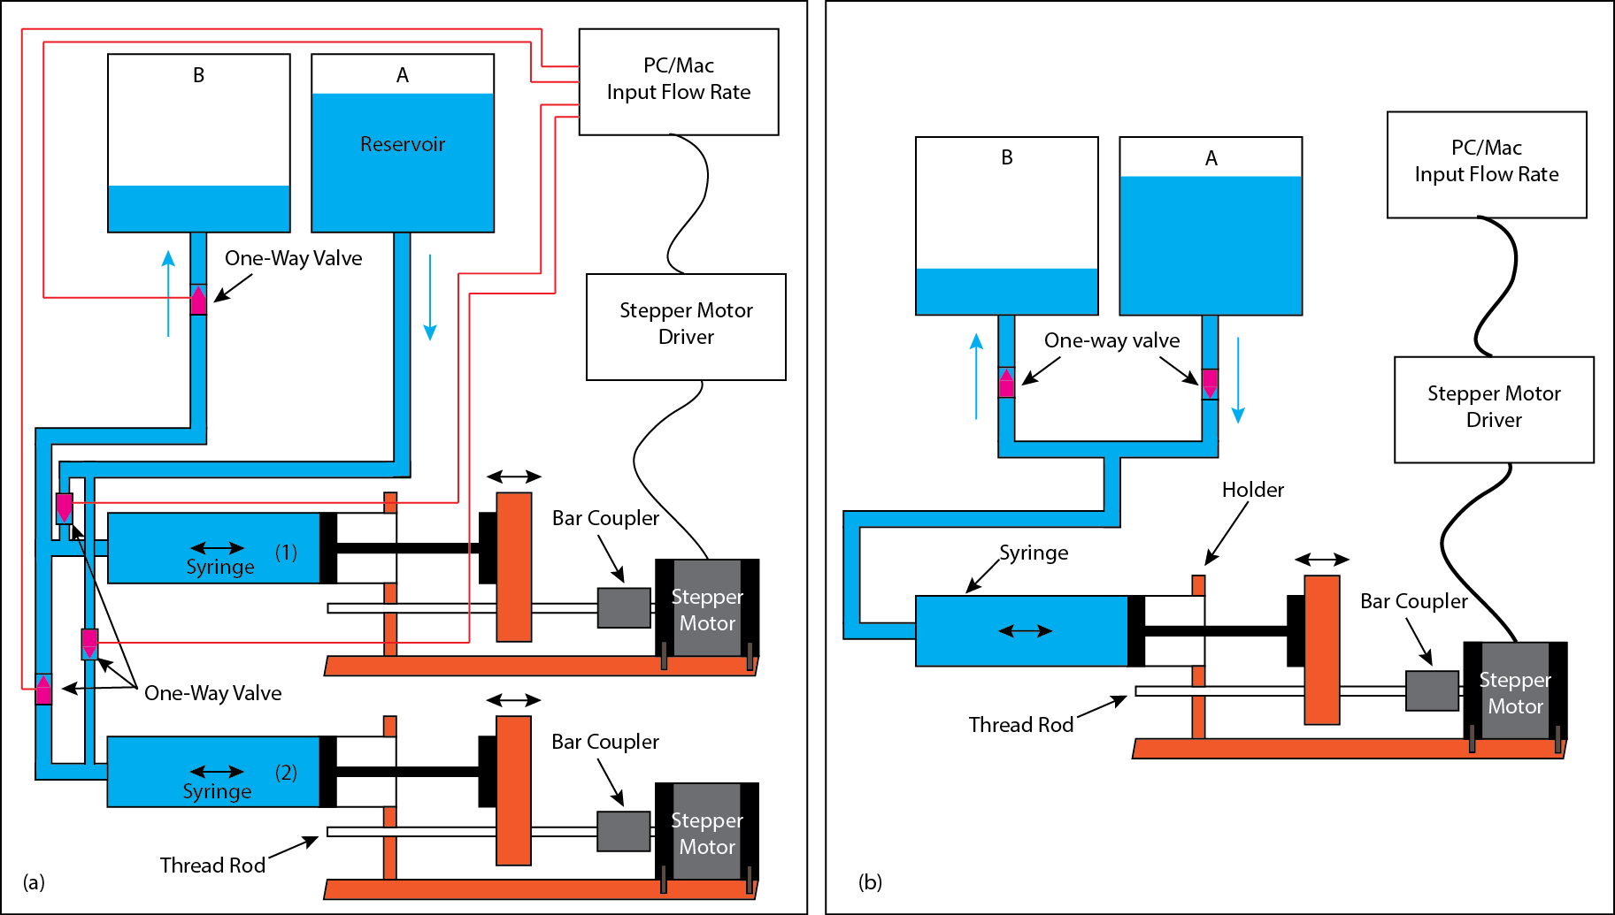
Prototype and Simplification
Left: Prototype/Analogue Solution for Realistic Problem
Large volume of fluid

Slide 5
Three-Step Method
Collect necessary pumping hardware
Assemble the hardware system
Code the control system

Slide 6
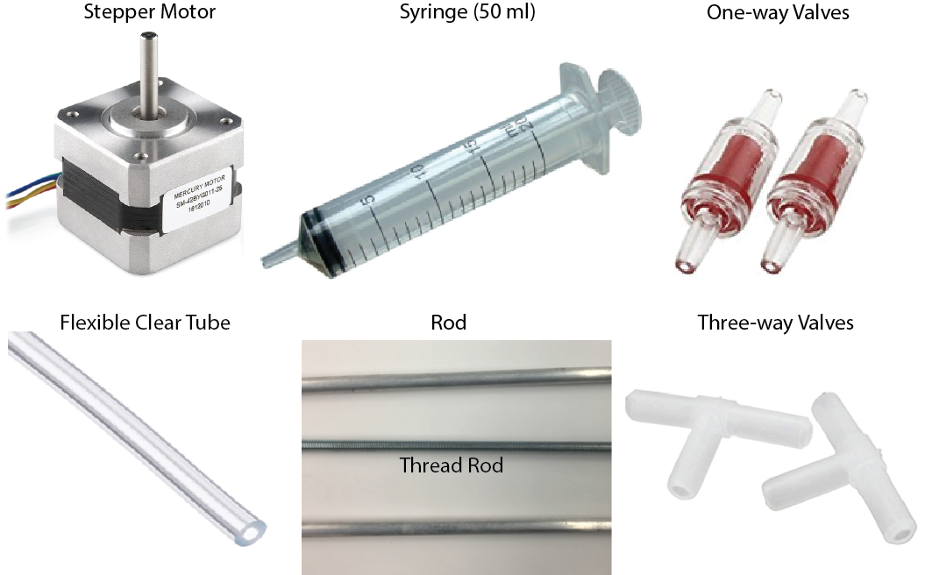
Syringe Pump Hardware Components

Slide 7
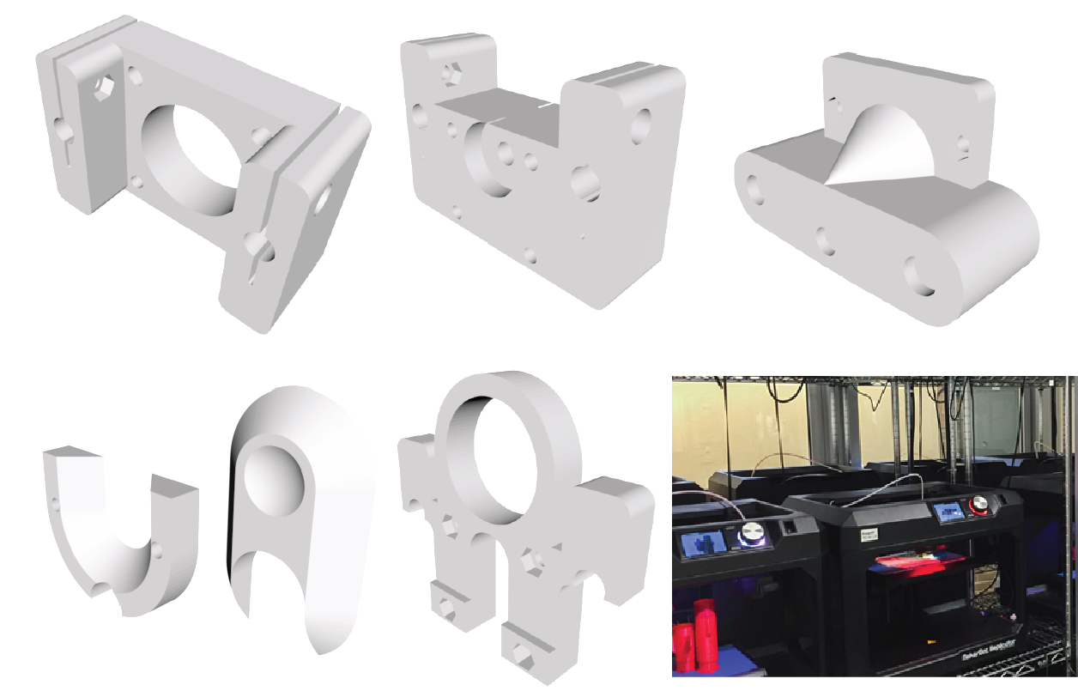
Syringe Pump Structure/Frame Elements

Slide 8
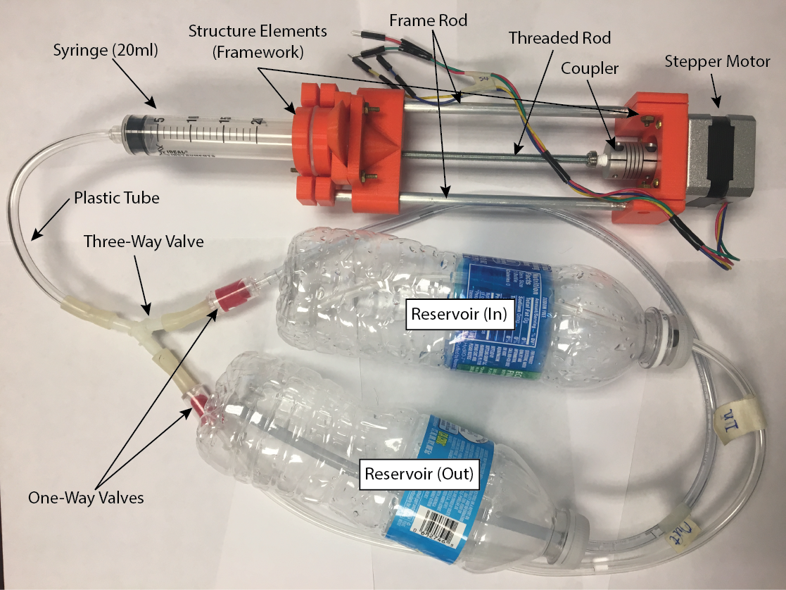
What does it look like after assembled?

Slide 9
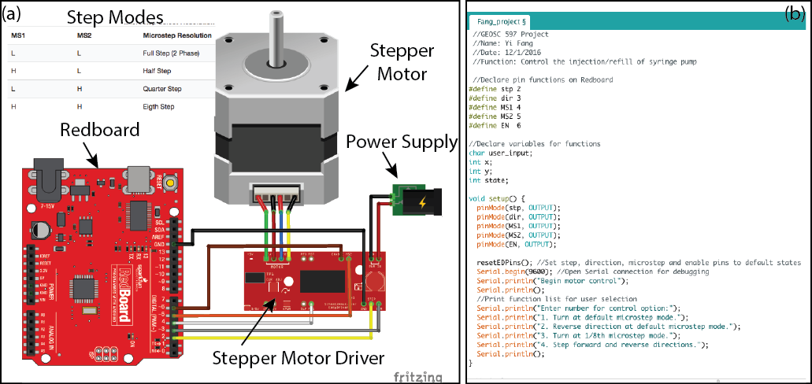
Control System

Slide 10
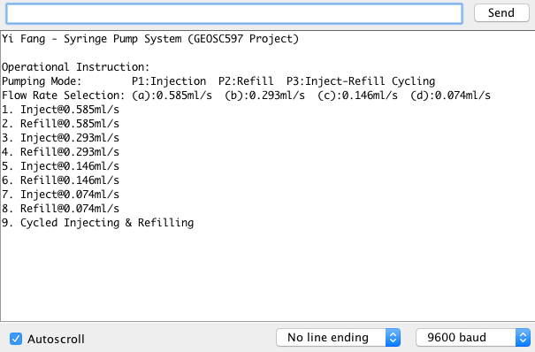
Input Manual

Slide 11
Challenging Issues Encountered
Budget for realistic
Design the size of structure elements
Calibrating the flow rate

Slide 12
Results
Please watch the demonstration!

Slide 13

Thank you for your attention!
Any Questions?

Slide 14
Acknowledgement
Special thanks to John Leeman for ordering the project hardware for me and for his great lectures and guide in the class.
Thanks to Dr. Chris Marone for his kind help throughout the class.

