Slide 1

Arduino Alarm System
Guanglong Hu
GeoSc 597 Final Project
December 6nd, 2016

Slide 2
Why Alarm System?
Experience of burglary
Door is not locked
People broke in the room at 2 am
Violence and crimes against specific ethic group
“Meet the Flockers” by YG
Fatal home invasion in Gwinnett County, Georgia
No AK-47 to protect myself

Slide 3
Schematic of Alarm System
3
6
7
9
10
11
5 V
Piezo Buzzer
GND
Vcc
Trig
Echo
GND

Slide 4
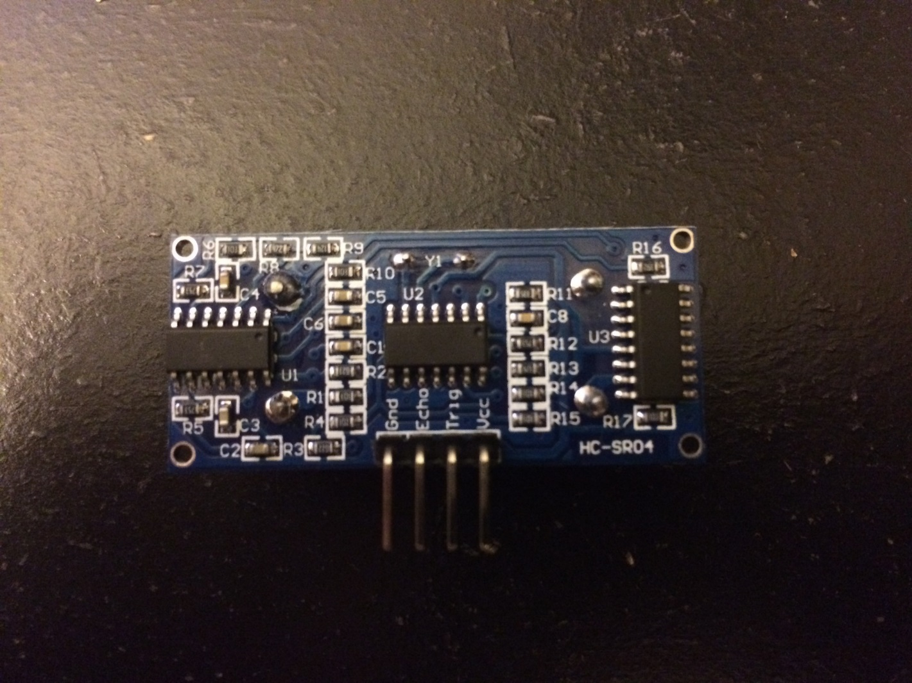
Devices
SR04-Ultrasonic Distance Measurement Sensor
Notes:
GND and Vcc : connect to GND and 5 V, power supply
Trig: make the sensor to send sonar signal
Echo : read the signal back

Slide 5
Devices
Distance Calculation
At 20 degree C, speed of sound = 343.5 m/s = 0.03435 cm/ms
Pace of sound = 1/speed of sound = 1/0.03435 = 29.1 ms/cm
Duration = signal of Echo pin / 2
Distance = Duration / Pace of Sound = Duration/29.1 = [cm]
Code:
int duration, distance;
digitalWrite(trigPin, HIGH);
delay(100);
digitalWrite(trigPin, LOW);
duration = pulseIn(echoPin, HIGH);
distance = (duration/2) / 29.1;

Slide 6
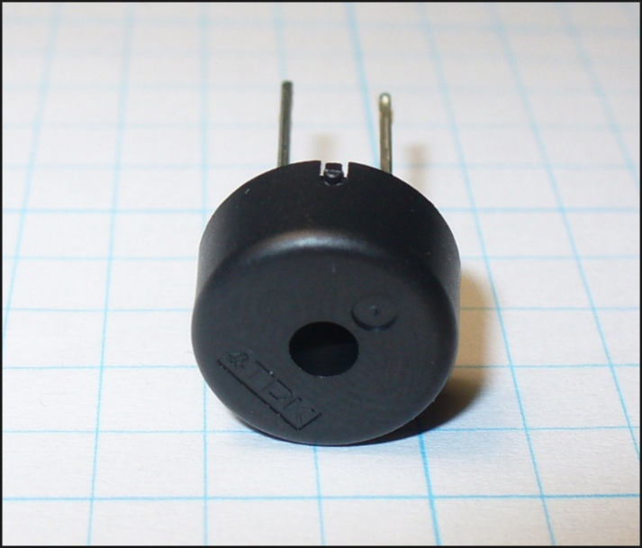
Devices
Piezo Buzzer

Slide 7
State Machine Diagram
Start distance measurement
Send sonar signal, Green light on
Receive signal and calculate distance
Distance < 15 cm
Distance > 15 cm
Buzzer activated, flashing red and blue light

Slide 8
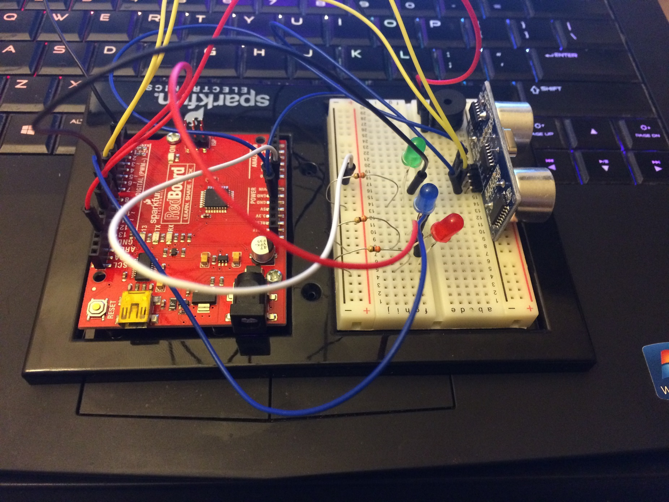
Demonstration

Slide 9
References
http://www.instructables.com/id/Using-a-SR04/
http://www.instructables.com/id/SIMPLE-ARDUINO-ULTRASONIC-SENSOR-DOOR-ALARM-/
http://www.makeuseof.com/tag/how-to-make-a-simple-arduino-alarm-system/

Slide 10
Thank you !
Questions?

