Slide 1
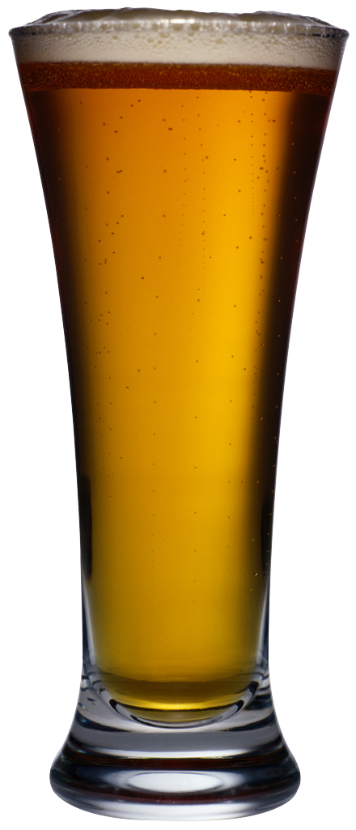
Beer Buddy Pitcher Pourer Shot Spinner
Kerry Ryan
GEOSC597C TGE

Slide 2
Problem?
My jokes are lame.
I have no way to impress my friends.
How can I keep my guests entertained at parties?

Slide 3
Solution
Ways to impress friends:
Science
Beer
3) Science + BEER!

Slide 4
Proposed Plan
Device Requirements:
1) Rotating table to put cup/container under spout
2) Sensor to identify when cup/container is present
3) Valve to control flow of liquid into container

Slide 5
Design Process
State Diagram
Parts List
Assembly
Rework, Revise, Repurpose
Final First Prototype

Slide 6
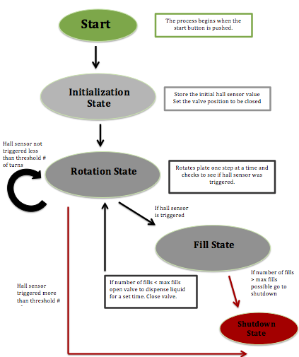

Slide 7
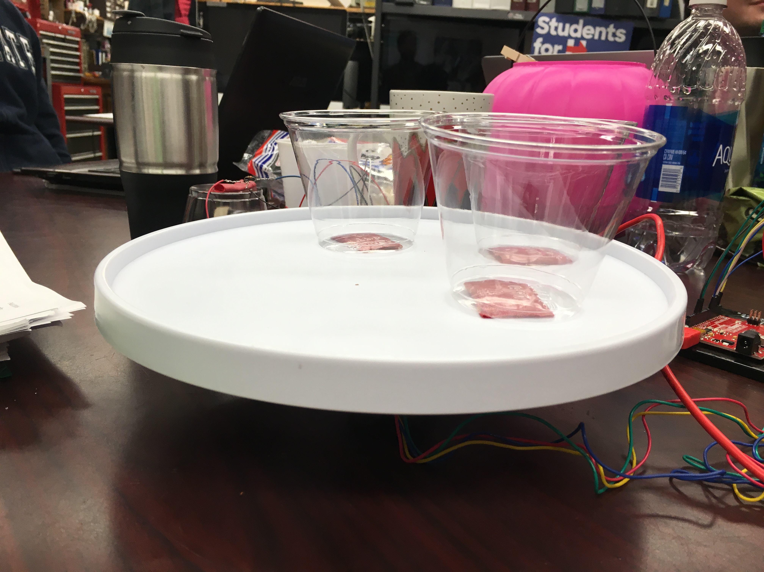
Step 1: Rotating Platform
Lessons Learned: Cheap lazy Susans are cheap for a reason

Slide 8
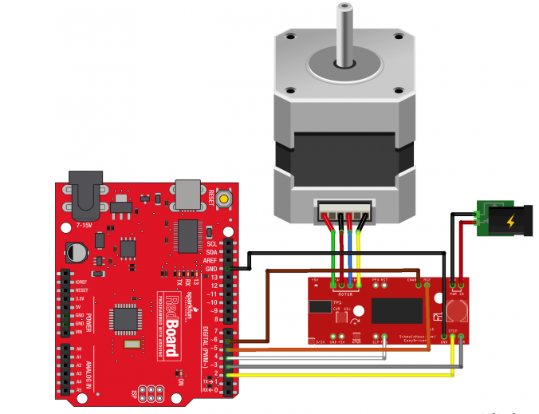
Step 2: Operating the Motor
4 Wire motor
Max 12 V Power
Easy Driver
https://learn.sparkfun.com/tutorials/easy-driver-hook-up-guide?_ga=1.57534690.938360751.1472576888
Notes:
Minimum current requirement. Had to make sure all of the connections were good. There are several different modes you can operate in. I chose to use the step mode.

Slide 9
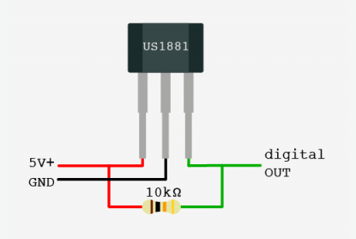
Part 3: Hall Effect Sensor
Output voltage changes with magnetic field
Latch sensor→ once a magnetic field is detected it will stay in that state until a field of opposite polarity is measured
http://bildr.org/2011/04/various-hall-effect-sensors/
Dispenser

Slide 10
Part 4: Dispensing Valve
Basically…. I bought the wrong part
The specs weren’t great and I didn’t really understand how it worked. In order to hook it up I needed a bunch of components I didn’t have.
Modify design plan

Slide 11
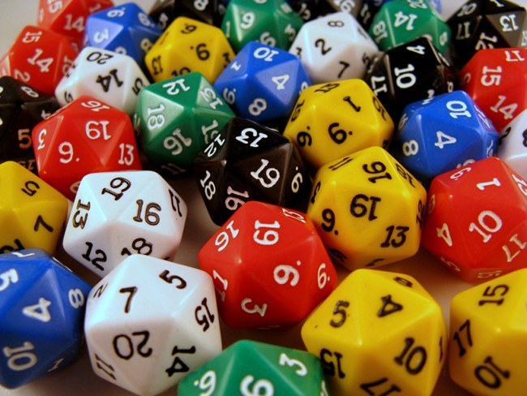
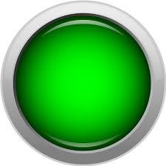
Shot Spinner
Instead of dispensing device→ make it a game
Push the button
Randomly generate 2 numbers
RandomNumdir
0-100
RandomNumturns
1-2000

Slide 12
Shot Spinner
Instead of dispensing device→ make it a game
RandomNumdir < 50
RandomNumdir > 50
Step Forward
Step Backward
Reset
Push the button (again!)

Slide 13
Future Work
Get a much better platform or make one that can support the weight of full glasses
Get dispenser working
Set up multiple types of game play

Slide 14
Thank you!

Slide 15
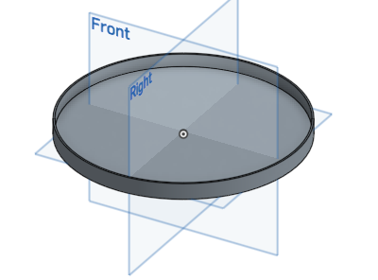
Cup Holder
Circumference: 7.1 in

