Slide 1
3D LASER PROFILOMETER
Srisharan

Slide 2
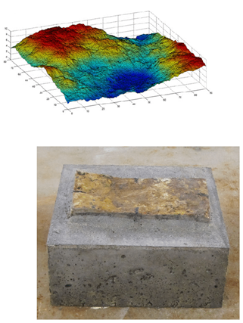
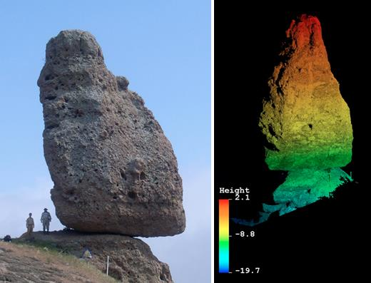
The problem - Rock surface roughness imaging
Source: UNAVCO and Muralha et al. (2014)

Slide 3
Project objective
Create an inexpensive Arduino based laser scanner prototype for rock surface scanning in the Penn State Rock Mechanics lab

Slide 4
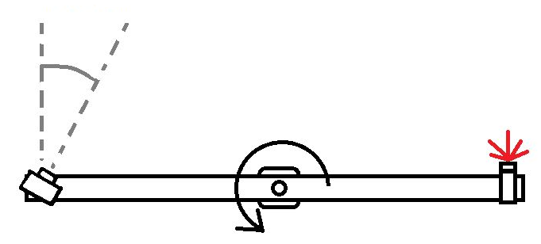
Working principle

Slide 5
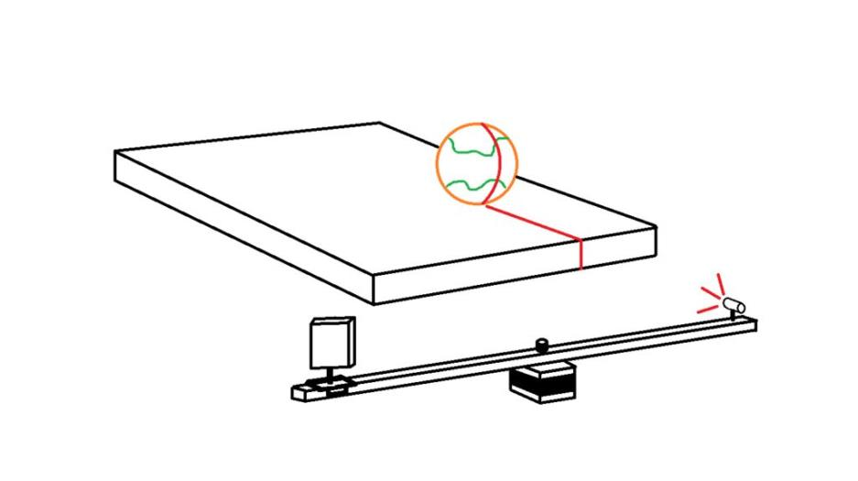
Working principle

Slide 6
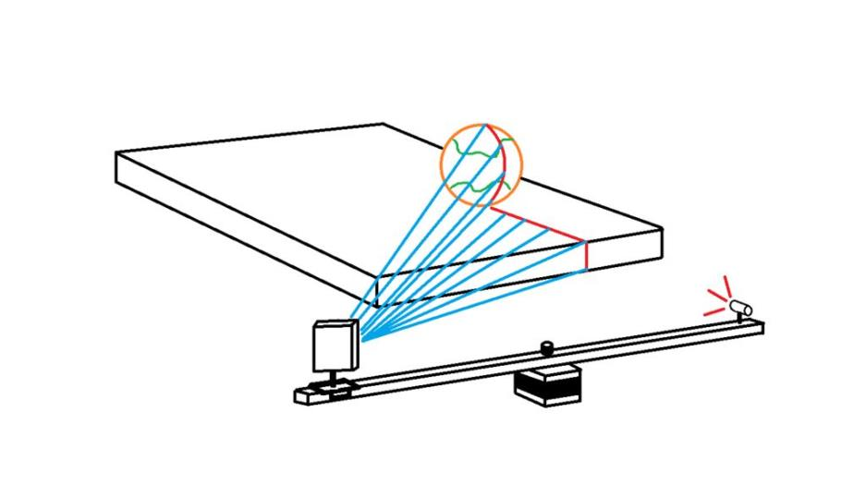
Working principle

Slide 7
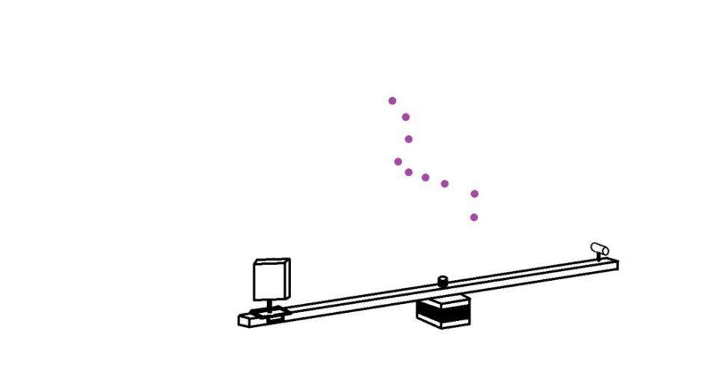
Working principle

Slide 8
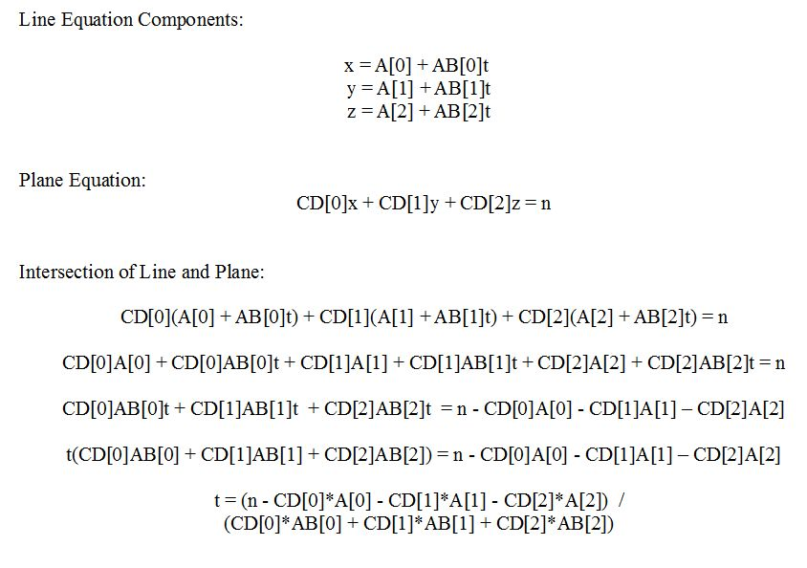
Working principle

Slide 9
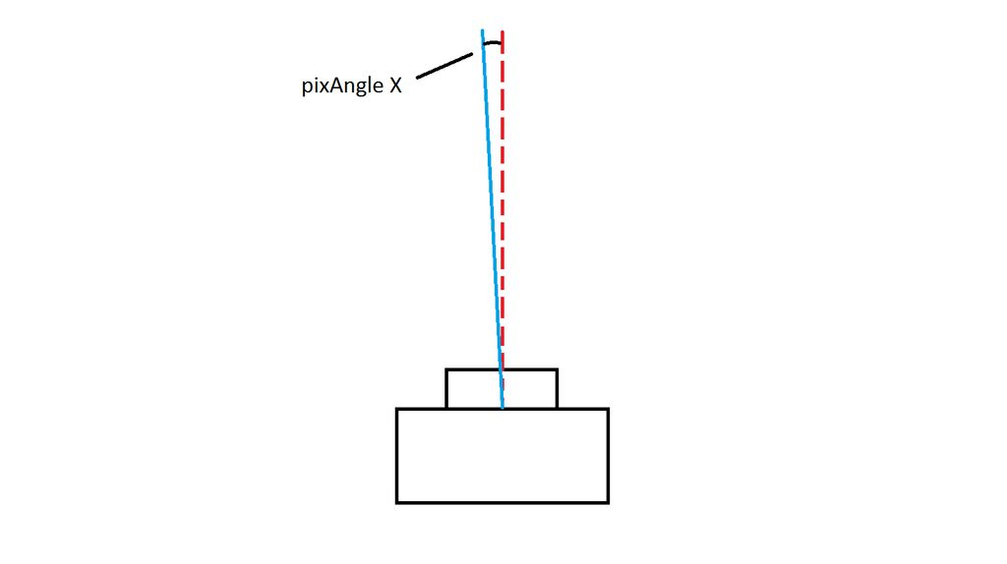
Working principle

Slide 10
List of parts
Sparkfun RedBoard and associated parts (eg. jumper cables, breadboard etc.)
10k potentiometers x 2
Line laser module
Logitech webcam
NEMA 17 stepper motor (200 steps/revolution or 1.8º resolution)
TB6612 Stepper driver
100 uF capacitor
Open source codes – Arduino 1.6.11 and Processing 3.2.1

Slide 11
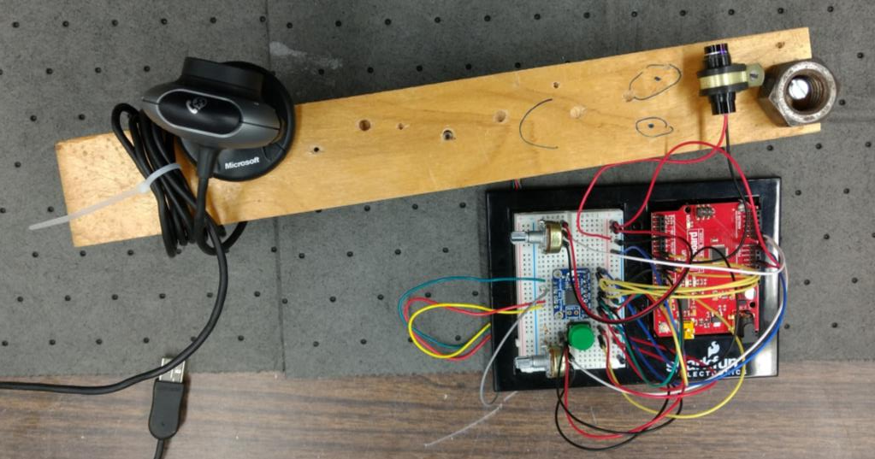
Mechanical build

Slide 12
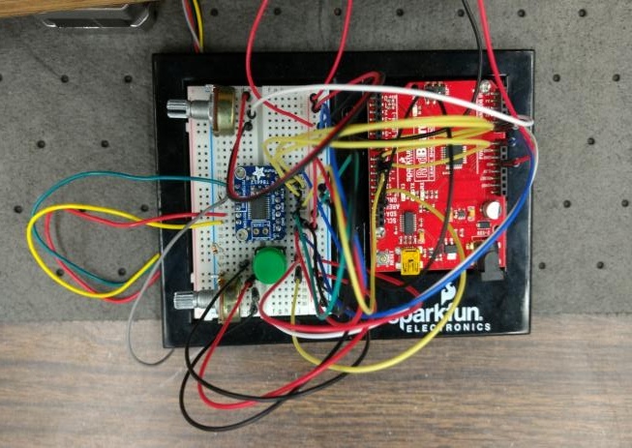
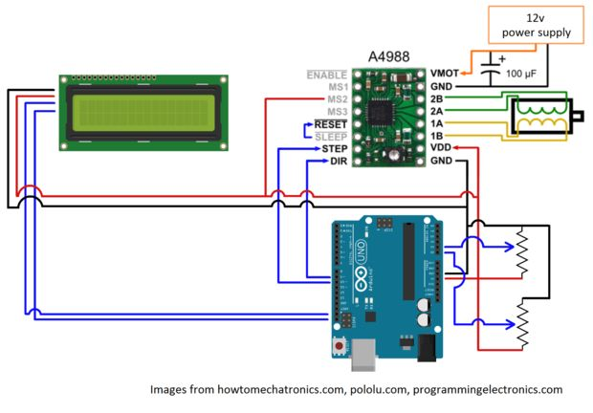
Circuitry

Slide 13
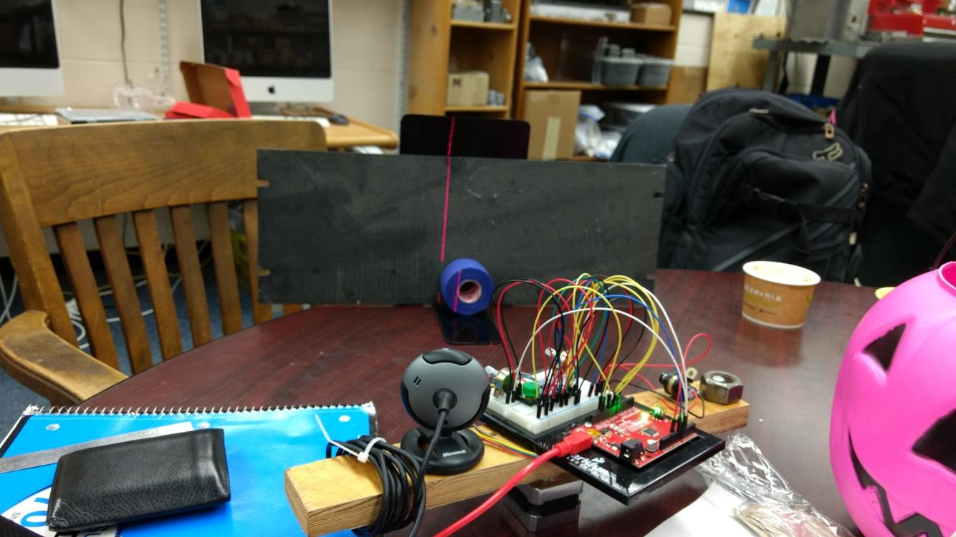
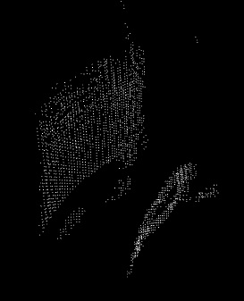
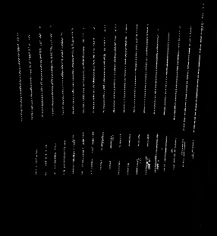

Proof of concept results

Slide 14
Challenges
Environmental reds interacting with poor webcam contrasts
Microstepping and pulse width modulation
Lens curvature distortion

Slide 15
Future work
Better resolution
Mirostepping or using geared DC motor for non-jerky movements
‘Blackbox’ for the setup
Using Python/Matlab for pointcloud instead of Processing

Slide 16
Takeaways
Learnt some fundamentals of electrical circuitry and profilometry
Learnt all about stepper motor drivers
Preemptive vs reactive design considerations

