Slide 1

Funding Rates and Bitcoin Price
Jacob Lindell

Slide 2
Purpose
Determine the relationship between Bitcoin/Ethereum price and funding rates on Bitmex/Binance exchanges
Is there any relationship between Funding rates and cycle tops/bottoms?

Slide 3
Data
BTC price data
Used Historic_Crypto python package (uses Coinbase Pro API)
BTC Funding Rates
BitMex and Binance
Had some trouble: BitMex API does not allow for the acquiring of all of their data for free, and Binance data only went back to beginning of 2020

Slide 4
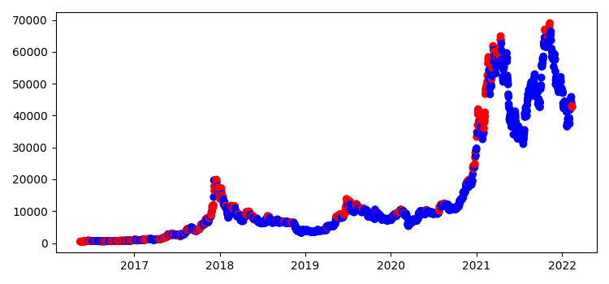
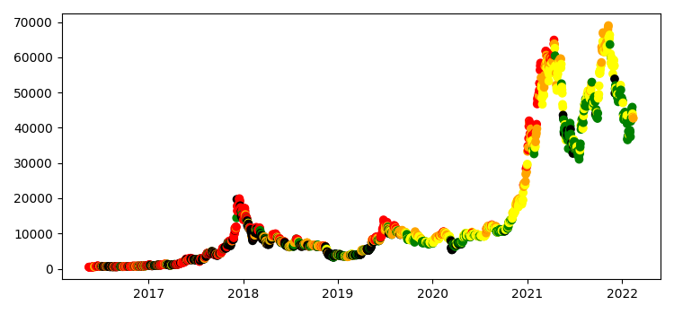
Exploratory Data Analysis
Top chart shows funding rate below mean (blue) and above mean (red)
Bottom chart shows bin color (0=black, 1=green, 2=yellow, 3=orange, 4=red

Slide 5
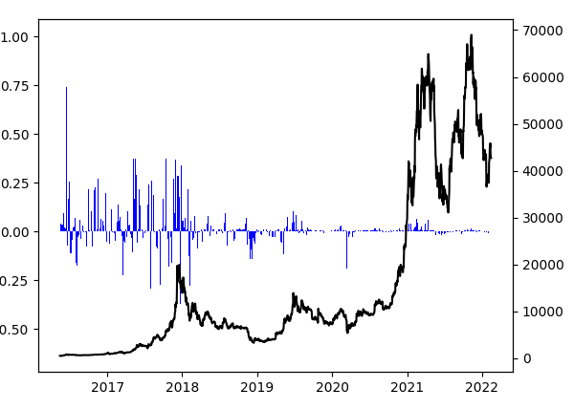
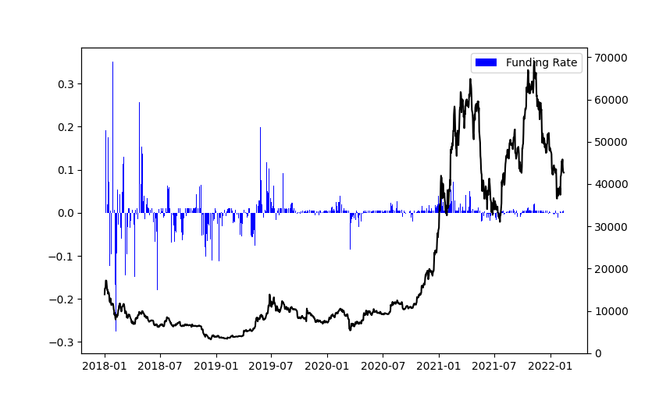
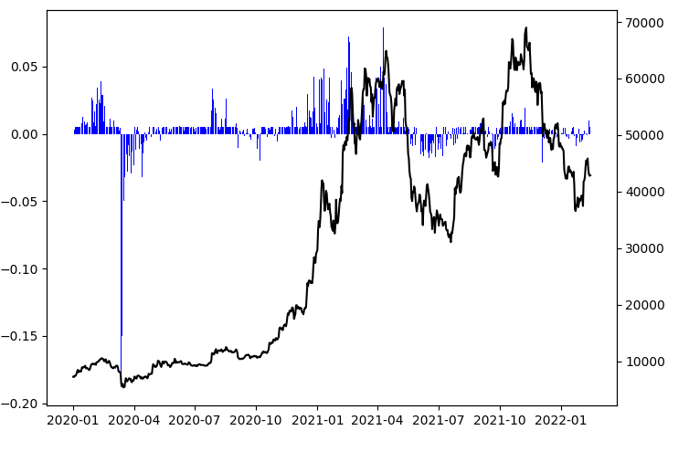
Exploratory Data Analysis cont.
Price with funding rates

Slide 6
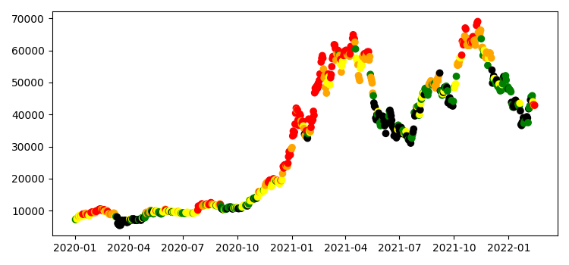
Exploratory Data Analysis cont.
New Old
Price with Funding Rate bin colors

Slide 7
Bin Summaries
 | Funding Rate bin
 | 0 | 1 | 2 | 3 | 4
count | 421 | 420 | 420 | 420 | 421
mean | 5651.99844 | 18599.305 | 24459.8148 | 13955.2719 | 9249.04255
std | 6833.76982 | 16972.2385 | 20085.9094 | 16723.5947 | 14087.9147
min | 551.865 | 581.585 | 607.66 | 558.1025 | 441.2275
25% quartile | 2264.13 | 6433.16438 | 9069.8225 | 6166.68625 | 779.635
50% quartile | 4035.01 | 9161.06 | 11495.2738 | 8187.86875 | 4023.465
75% quartile | 6717.5625 | 36762.8594 | 46852.6969 | 11085.6381 | 10542.6425
max | 49770.8075 | 61497.9075 | 64863.3925 | 67332.3575 | 63184.2325
New Old
 | Funding rate bin
 | 0 | 1 | 2 | 3 | 4
count | 156 | 155 | 164 | 146 | 155
mean | 27505.6486 | 29087.2019 | 21810.8622 | 37191.6635 | 34714.1955
std | 15605.8217 | 17585.0215 | 17580.896 | 21129.0633 | 20473.4806
min | 5041.7675 | 6814.755 | 6833.415 | 7965.5375 | 8480.0525
25% quartile | 8771.54438 | 10368.805 | 9369.5125 | 11667.6806 | 11589.65
50% quartile | 34083.705 | 35032.5625 | 11458.8513 | 47886.5525 | 35406.5575
75% quartile | 39319.9125 | 46030.1775 | 38909.3831 | 56675.7163 | 56835.16
max | 51004.3975 | 61497.9075 | 59252.915 | 64863.3925 | 67332.3575

Slide 8
Tops/Bottoms
Criteria:
Market Tops/Bottoms: highest/lowest price in 500 days
Mid Tops/Bottoms: highest/lowest price in 200 days
Micro Tops/Bottoms: highest/lowest price in 50 days
Market Tops
datetime.date(2017, 9, 2), datetime.date(2017, 12, 17),
datetime.date(2019, 6, 26), datetime.date(2021, 10, 20)
Market Bottoms
datetime.date(2016, 5, 20), datetime.date(2018, 12, 15),
datetime.date(2019, 2, 14), datetime.date(2020, 7, 3)

Slide 9
Tops/Bottoms
Market Tops
datetime.date(2017, 9, 2), datetime.date(2017, 12, 17),
datetime.date(2019, 6, 26), datetime.date(2021, 10, 20)
Other dates with similar funding rates (within 0.0001)
datetime.date(2017, 9, 2): None
datetime.date(2017, 12, 17): datetime.date(2017, 5, 8),
datetime.date(2017, 5, 17), datetime.date(2017, 5, 18), datetime.date(2017, 6, 6), datetime.date(2017, 10, 10), datetime.date(2017, 10, 14), datetime.date(2017, 12, 11), datetime.date(2017, 12, 12), datetime.date(2017, 12, 15), datetime.date(2017, 12, 16),
datetime.date(2019, 6, 26): datetime.date(2016, 6, 15),
datetime.date(2019, 6, 24)
datetime.date(2021, 10, 20): datetime.date(2019, 7, 6),
datetime.date(2020, 8, 2)
Funding rates do not seem necessarily unique to market peaks

Slide 10
Peaks in Funding Rate bins
Mid Market Peak
Bin | Count | Percent
0 | 0 | 0%
1 | 1 | 10%
2 | 0 | 0%
3 | 2 | 20%
4 | 7 | 70%
Small Market Peak
Bin | Count | Percent
0 | 2 | 5%
1 | 3 | 7%
2 | 5 | 12%
3 | 12 | 29%
4 | 20 | 48%
Market Peak
Bin | Count | Percent
0 | 1 | 25%
1 | 0 | 0%
2 | 0 | 0%
3 | 1 | 25%
4 | 2 | 50%
All
Market Peak
Bin | Count | Percent
0 | 0 | 0%
1 | 0 | 0%
2 | 0 | 0%
3 | 0 | 0%
4 | 2 | 100%
Post 2020
Small Market Peak
Bin | Count | Percent
0 | 0 | 0%
1 | 1 | 6%
2 | 2 | 13%
3 | 6 | 38%
4 | 7 | 44%
Mid Market Peak
Bin | Count | Percent
0 | 0 | 0%
1 | 0 | 0%
2 | 0 | 0%
3 | 0 | 0%
4 | 4 | 100%

Slide 11
Peaks in Funding Rate change and Price change bins
TB | FR_chg_bin | Count
Micro | 0 | 4
Micro | 1 | 5
Micro | 2 | 12
Micro | 3 | 7
Micro | 4 | 3
Mid | 0 | 3
Mid | 2 | 2
Mid | 3 | 1
Mid | 4 | 1
Macro | 1 | 1
Macro | 2 | 3
Macro | 3 | 1
TB | Price_chg_bin | Count
Micro | 1 | 1
Micro | 2 | 1
Micro | 3 | 15
Micro | 4 | 14
Mid | 3 | 1
Mid | 4 | 6
Macro | 3 | 1
Macro | 4 | 4
All
Post 2020

Slide 12
Peaks in Funding Rate change and Price change bins cont. (All)
Criteria:
TB = Top or Bottom (options are Micro, Mid, Macro)
Price_chg_bin = binning data of percent change over past 5 days
FR_chg_bin = binning data for change in funding rate over past 5 days
TB | Price_chg_bin | FR_chg_bin | Count
Micro | 1 | 3 | 1
Micro | 2 | 2 | 1
Micro | 3 | 0 | 2
Micro | 3 | 1 | 3
Micro | 3 | 2 | 6
Micro | 3 | 3 | 3
Micro | 3 | 4 | 1
Micro | 4 | 0 | 2
Micro | 4 | 1 | 2
Micro | 4 | 2 | 5
Micro | 4 | 3 | 3
Micro | 4 | 4 | 2
Mid | 3 | 0 | 1
Mid | 4 | 0 | 2
Mid | 4 | 2 | 2
Mid | 4 | 3 | 1
Mid | 4 | 4 | 1
Macro | 3 | 2 | 1
Macro | 4 | 1 | 1
Macro | 4 | 2 | 2
Macro | 4 | 3 | 1

Slide 13
Peaks in Funding Rate change and Price change bins cont. (2)
How to tell if this happens:
TB = What we want to predict (Market cycle top)
FR_chg_bin =
0: -inf% < x < -72%
1: -72% < x < 5.7%
2: 5.7% < x < 74.1%
3: 74.1% < x < 155%
4: 155% < x < inf%
Price_chg_bin =
0: -49.3% < x < -5.15%
1: -5.15 % < x < -0. 8%
2: -0. 8% < x < 2.3%
3: 2.3% < x < 6.89%
4: 6.89% < x < 43.6%

Slide 14
Peaks in Funding Rate change and Price change bins cont. (All)
Criteria:
TB = Top or Bottom (options are Micro, Mid, Macro)
Price_chg_bin = binning data of percent change over past 5 days
FR_chg_bin = binning data for change in funding rate over past 5 days
TB | Price_chg_bin | FR_chg_bin | Count
Micro | 0 | 4 | 1
Micro | 2 | 3 | 1
Micro | 3 | 1 | 2
Micro | 2 | 2
Micro | 4 | 1
Micro | 4 | 0 | 1
Micro | 1 | 1
Micro | 2 | 3
Micro | 3 | 1
Mid | 3 | 3 | 1
Mid | 4 | 3 | 1
Macro | 3 | 2 | 1
Macro | 4 | 3 | 1

Slide 15
Peaks in Funding Rate change and Price change bins cont. (2)
How to tell if this happens:
TB = What we want to predict (Market cycle top)
FR_chg_bin =
0: -inf% < x < -73%
1: -73% < x < 0
2: 0 < x < 40.9%
3: 40.9% < x < 103.3%
4: 103.3% < x < inf%
Price_chg_bin =
0: -49.3% < x < -4.4%
1: -4.4 % < x < -0. 68%
2: -0. 68% < x < 2.83%
3: 2.83% < x < 7.01%
4: 7.01% < x < 21.296%

Slide 16
Peaks in Funding Rate and Price change bins
Looked at just using Funding Rate instead of Funding rate change but did not see any significant benefits

Slide 17
Takeaways and Findings
Seems like there is a correlation between the change in funding rate and tops
Saw same outcomes for ETH so is not in slides (but have if wanted)
There is a connection between funding rate change and price change over 5 days
Using Funding rate bins alone we can get about 50% accuracy on macro cycle tops
Using funding rate percent change, along with price percent change we can get roughly the same

Slide 18
Future Work
Seems like there is a correlation between the change in funding rate and tops/bottoms
Look more at bottoms
Build a screener to determine the funding rate change, price change, and if that will fall into our criteria
Change the 5 day window for price/funding rate change to see if we can get better results
Change the number of bins

