Slide 1

COMPANY DATA ANALYSIS LEFT LANE
Jake Lindell

Slide 2
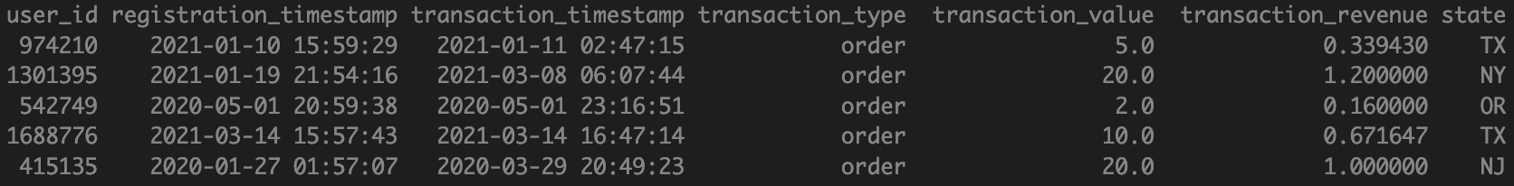
DATA BASICS
Data is a gaming company that allows users to win the prize pool if they are successful in the game
Users can:
Deposit (deposit)
Claim Prizes (Prize claimed)
Interact/compete (Order)

Slide 3
DATA BASICS
Data is a gaming company that allows users to win the prize pool if they are successful in the game
Data keeps track of:
User ID, Timestamp of when user first signed up for the platform (Registration Timestamp), timestamp of the transaction tracked (Transaction Timestamp), type of transaction (deposit, prize claimed, order), revenue earned for that transaction (Transaction Revenue), and the State
Example:
USER ID | REGISTRATION TIMESTAMP | TRANSACTION TIMESTAMP | TRANSACTION TYPE | TRANSACTION VALUE | TRANSACTION REVENUE | STATE
974210 | 1/10/21 15:59 | 1/11/21 2:47 | order | 5 | 0.339429825 | TX
1301395 | 1/19/21 21:54 | 3/8/21 6:07 | order | 20 | 1.2 | NY
542749 | 5/1/20 20:59 | 5/1/20 23:16 | order | 2 | 0.16 | OR
1688776 | 3/14/21 15:57 | 3/14/21 16:47 | order | 10 | 0.671646939 | TX
415135 | 1/27/20 1:57 | 3/29/20 20:49 | order | 20 | 1 | NJ

Slide 4
EXPLORATORY DATA ANALYSIS

Slide 5
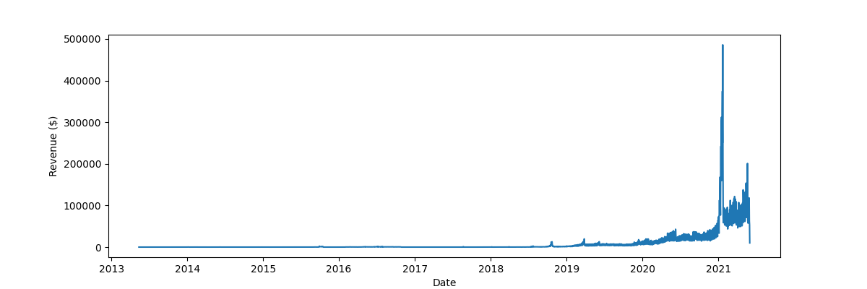
TRANSACTION REVENUE OVER TIME
This chart shows there is great growth over time, but it is hard to see the difference because of how much more data is included after 2021.
* Next chart shows zoomed in

Slide 6
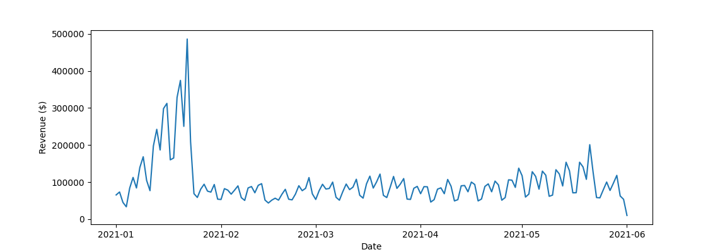
TRANSACTION REVENUE OVER TIME (zoomed in)
This chart shows how big January was for this company. There was a steady up trend until the peak, and then a sharp downtrend followed by consistent participation.
Whatever was occurring during January should be looked at to do again, because it grew the Transaction Revenue drastically

Slide 7
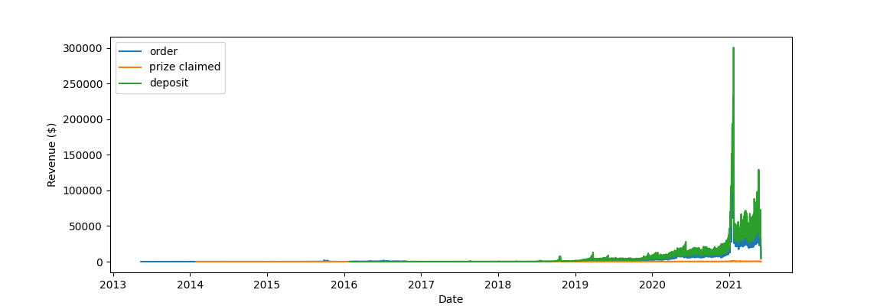
TRANSACTION REVENUE OVER TIME (by type)
This chart shows what the last charts showed, and it seems like Order and Deposit are very correlated (most Orders occur at the same time as a Deposit)
* Next chart shows zoomed in

Slide 8
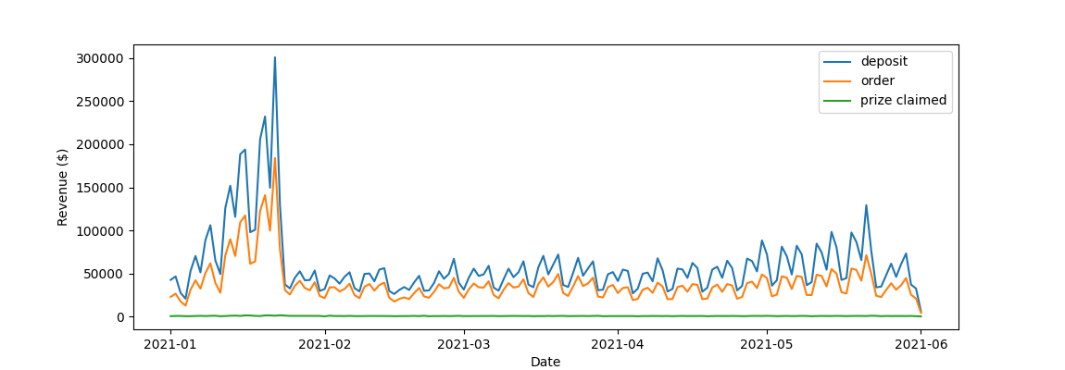
TRANSACTION REVENUE OVER TIME (by type, zoomed in)
This chart shows that Deposit and Order very closely follow each other. It does not seem like users are putting in a big deposit and then playing, they put in smaller deposits consistently

Slide 9
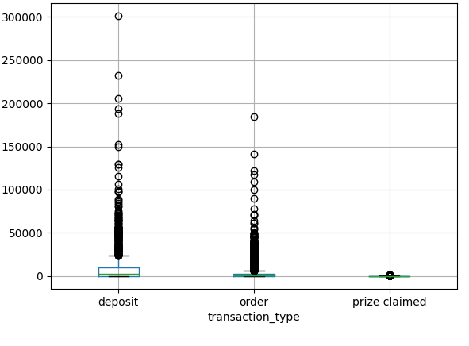
TRANSACTION REVENUE BOX PLOT
This box plot shows the Transaction Revenue (y-axis) for each Transaction Type
Each point is the Transaction Revenue by Date (the dot at 30000 shows there was $30000 in Deposits made on a specific Date)
We can see that when prizes are given out, the prize value is usually much smaller than the Deposits that are made.
The number of Orders (in $) made in a Day is smaller than the number of Deposits (in $) on a given day, indicating more people Deposit and wait to play their entire Deposited amount

Slide 10
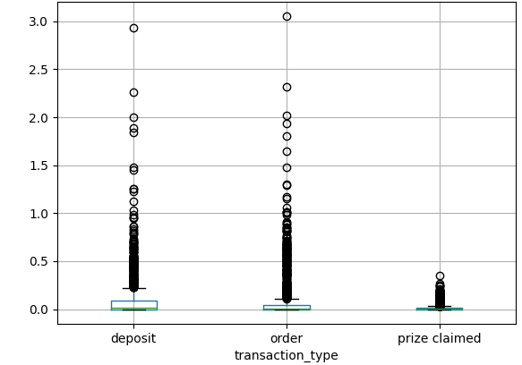
TRANSACTION VALUE BOX PLOT
1e6
Comparing this chart with the previous, we see that there is a much closer Transaction Value between Order and Deposit, and Prize Claimed has a wider range of disparity
This could indicate that our margin of revenue is greater on Deposits than on Orders or Prize Claimed

Slide 11
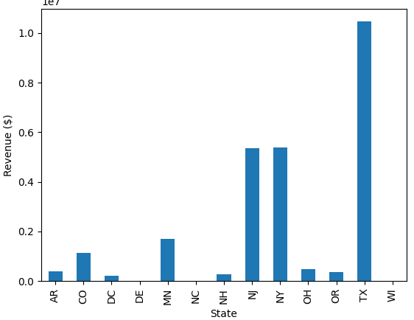
TRANSACTION REVENUE BAR CHART (by state)
This chart shows the Transaction Revenue by State for the entirety of the dataset. As we see, Texas has a lot of the Transaction Revenue
There are 13 States that use this company
The marketing/user traction in Texas, New Jersey, and New York is far superior to the rest of the States
Could be indicative of successful marketing trends

Slide 12
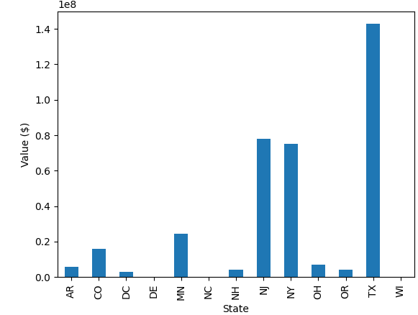
TRANSACTION VALUE BAR CHART (by state)
This chart shows the Transaction Value by State
Can not draw much insights from this that were not seen in the previous chart

Slide 13
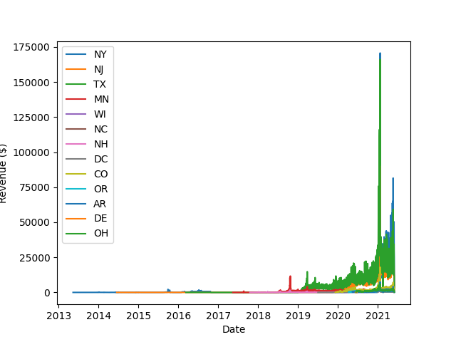
USERS AND TRANSACTION REVENUE (BY STATE)
STATE | USERS
TX | 339579
NJ | 158400
NY | 294274
MN | 39307
CO | 36817
OH | 20352
AR | 19556
NH | 8426
OR | 12975
DC | 5886
DE | 2
NC | 1
WI | 1
STATE | TRANSACTION REVENUE
TX | 10467173.88
NY | 5395739.50
NJ | 5367326.58
MN | 1702432.21
CO | 1145141.44
OH | 493932.91
AR | 391821.86
OR | 357858.441
NH | 265320.86
DC | 214826.42
DE | 5.18
NC | 0
WI | 0
These charts verify what we saw in the previous charts; Texas, New Jersey and New York are the strongest participants for this app
This does help show the breakdown of the rest of the States
94 % of users competed more than once; when users get to the product, they are happy with it and play multiple times

Slide 14
TRANSACTION REVENUE GROWTH (by state)
The interesting things that stand out here are the peak in Minnesota in late 2018 and then peak in mid-2021 where New York had higher Transaction Revenue than Texas

Slide 15
CONCLUSIONS
Whatever the company did for New Jersey, New York, and Texas they should do for the rest of the States
The beginning of 2021 had a big spike in users and participation, but that was short lived. If it was a big marketing campaign or sponsorship, it does not seem to have had lasting results
There is a high rate of re-participation; once users get to the app they play again. This could just be indicative of how the Deposits are lower than the Order value, so they have to play more than once

