Slide 1

RBL BioChem: Dulcis Production
eLeMeNO-P Consulting Team:
Capt Matt Davis
2Lt Jacob Lindell
1Lt Charter Sevier

Slide 2
Agenda
Bottom Line Up Front
Frame the Decision
Evaluation
Deterministic Analysis
Probabilistic Analysis
Appraisal
Value of Clairvoyance
Recommendation

Slide 3

Bottom Line Up Front
Analysis show that purchase EEMRC is an advantageous investment

Slide 4

Purpose
Provide professional insight into RBL Biochem’s
future business decisions in relation to their new
product Dulcis
Conduct analysis to recommend the best
production and marketing strategies to
optimize RBL Biochem’s Net Present Value in
relation to Dulcis

Slide 5
Decision Hierarchy
Taken as given
-Launch of Dulcis
-Packaging size
-USA as targeted market
-Choose PuDont production/licensing agreement
- Determine necessity for additional facility
- Purchase initial demand analysis provided by EEMRC
- Invest in new production process research
Specified by Frame
-Alternative Dulcis production processes
-Selection of appropriate distribution channels
-Expansion to foreign markets
- How appropriate is Dulcis for RBL current product portfolio?
To be Decided Later

Slide 6
Decision Alternatives

Slide 7
Influence Diagram

Slide 8
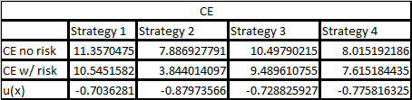
Base NPV Comparison
NPV rank order
Strategy 1
Strategy 3
Strategy 2
Strategy 4

Slide 9
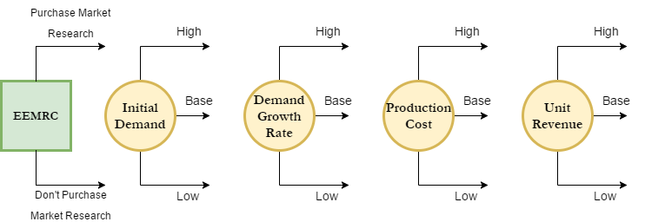
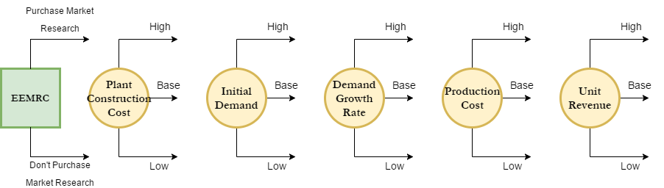
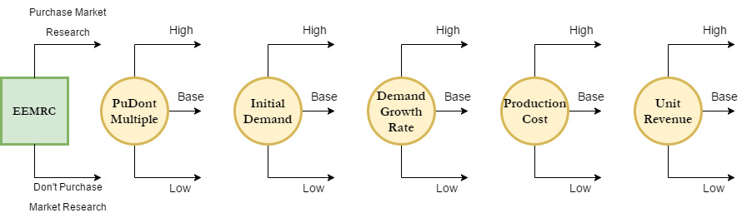
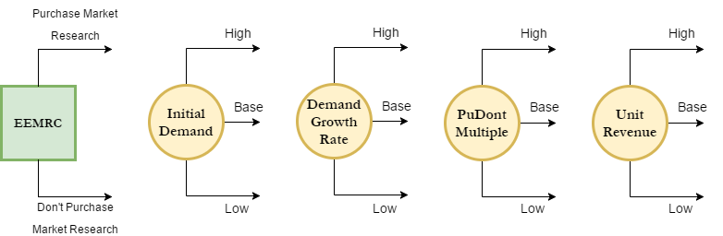
Decision Trees
Strategy 1:
Strategy 2:
Strategy 3:
Strategy 4:

Slide 10
Tornado Diagrams

Slide 11
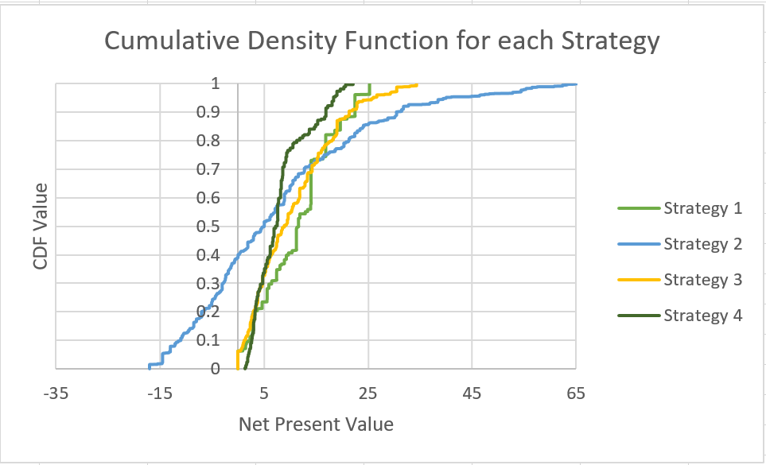
CDF of Net Present Value

Slide 12
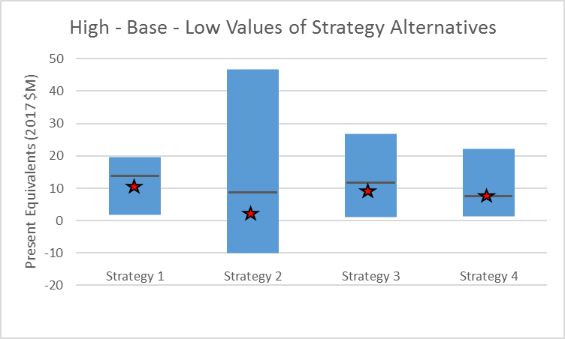
High-Base-Low Comparisons
Certain Equivalents ( ) | 10.5451582 | 3.844014097 | 9.489610755 | 7.615184435
High | 19.66 | 46.69 | 26.73 | 22.08
Base | 14.04 | 8.95 | 11.9 | 7.67
Low | 1.86 | -10 | 0.97 | 1.42

Slide 13
Probabilistic Dominance
Without demand report from EEMRC, scenario 1 still presents the most potential for certain equivalents

Slide 14
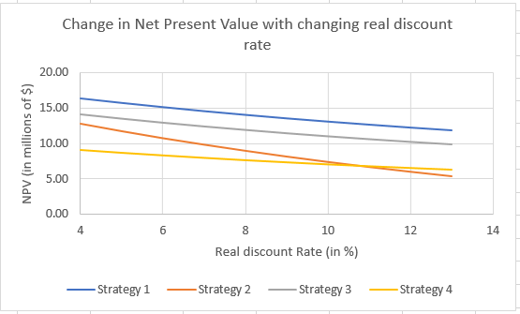
Sensitivity Analysis of change in Real Discount Rate

Slide 15
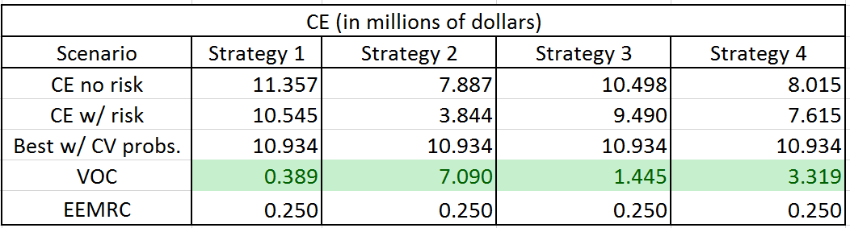
Value of Information
$17.7 M

Slide 16
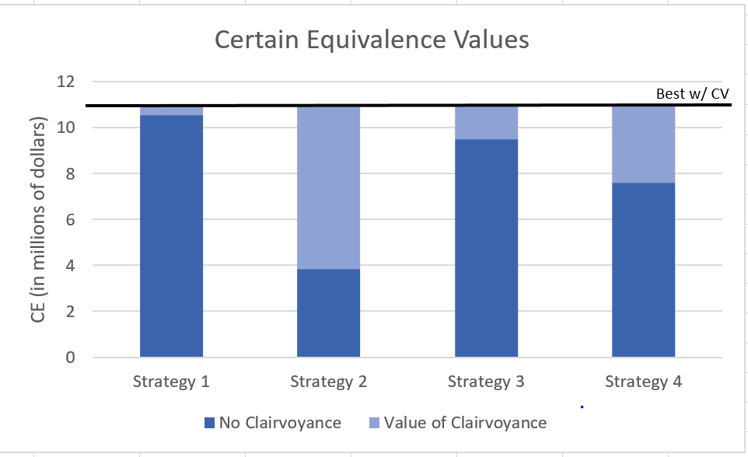

Slide 17
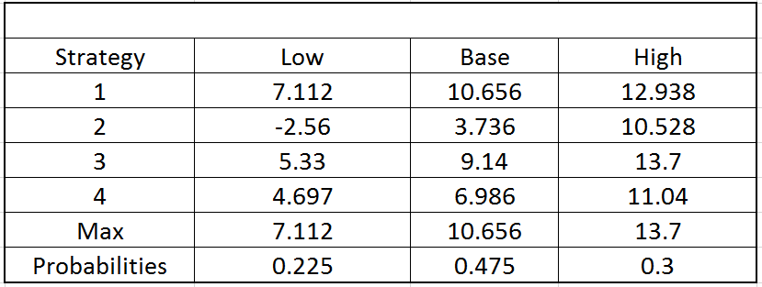
$17.7 M

Slide 18
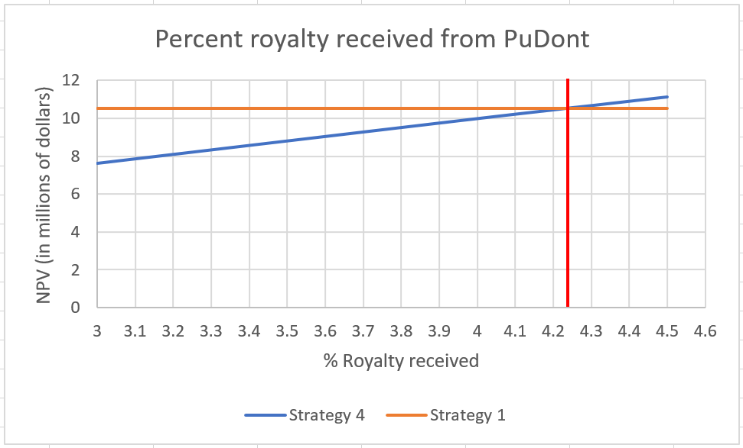
Royalty Analysis
4.25%

Slide 19
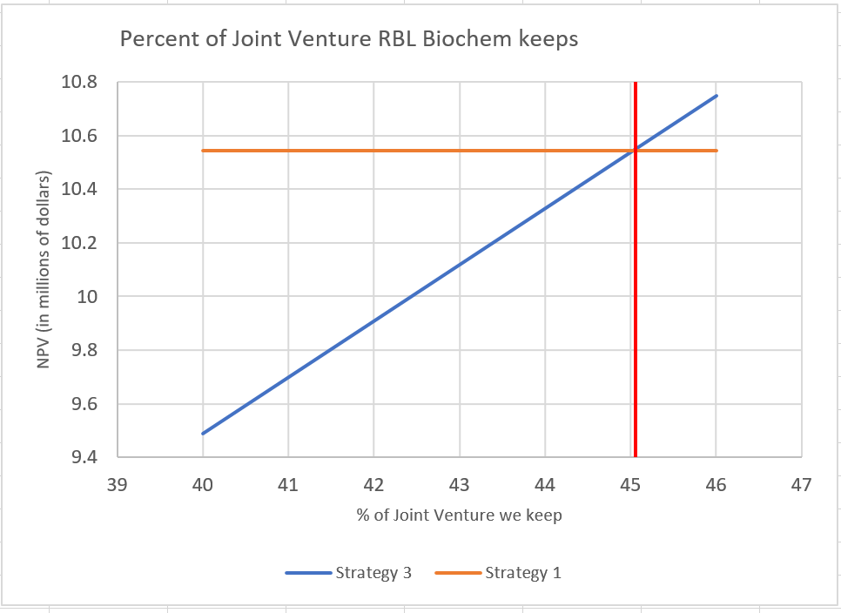
Joint Venture Analysis
45% kept
55% given to PuDont

Slide 20
Recommended Course of Action
RBL Biochem should
Purchase EEMRC insight
Pursue strategy based on initial demand

Slide 21
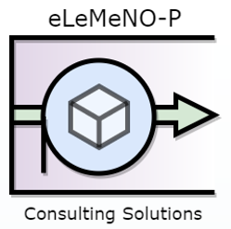
Questions?

