Slide 1

Take me out to (all of) the ball game(s)
2nd Lt. Jacob Lindell
2nd Lt Luke Brantley
22 May 2017

Slide 2

Overview
What we did
Why we did it
How we did it
What it told us
What it told us part 2
How we did it part 2
Problems

Slide 3
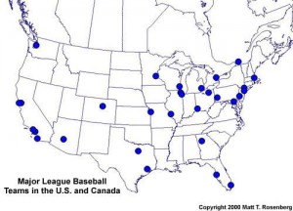
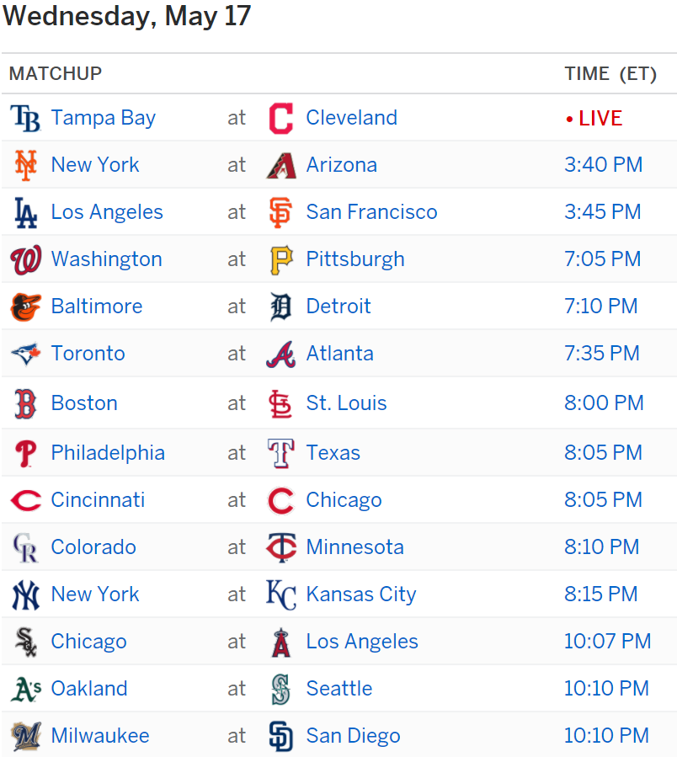
What we did

Slide 4
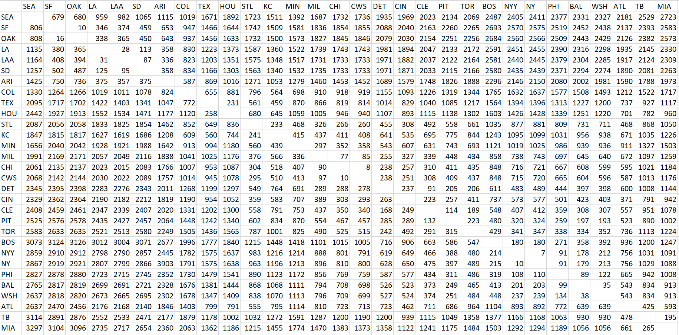
What we used

Slide 5
Assumptions
Can travel in AM on day t and watch game on day t
Can linger and camp out

Slide 6
Parameters and Sets
SETS
N = set of nodes; indexed by I and j, i € {1,…,30}
T = Time; indexed by t, t € {1,…,168}
A = Fully connected (i.e., (i, j) € A ∀ i, j € N)
Parameters
V_{it} = 1 if a game occurs at node I at time t
0 o.w.
d_{ij} = distance from i to j
d_{ii} = 0
DVs
Y_{ijt} = 1 if we go from node i to j on day t
0 o.w.

Slide 7
Parameters and Sets pt. 2

Slide 8
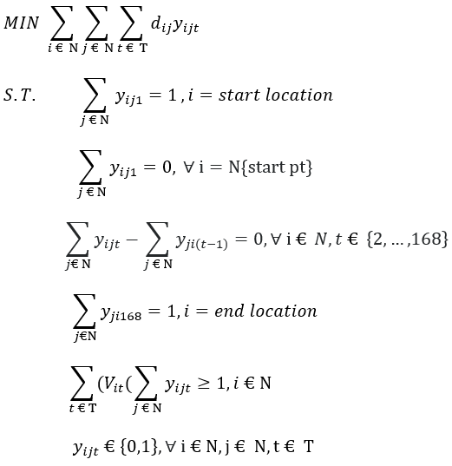
Formulation

Slide 9
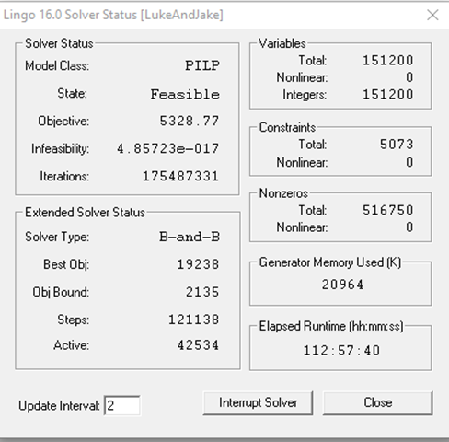
Model

Slide 10
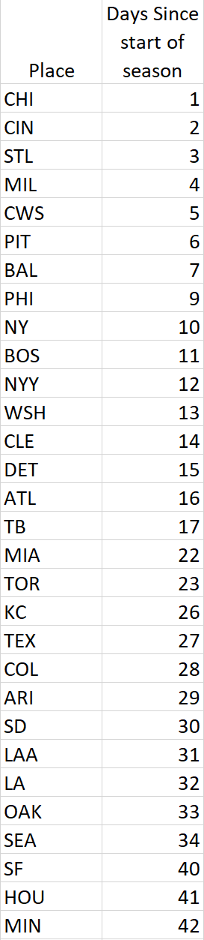
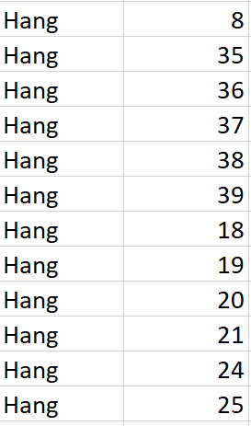
Heuristic
Optimal Value = 12594

Slide 11
Problems Faced
Clean data
LINGO Solver

Slide 12
With more time
Get a solution…
GAMS
Include Time of Day

Slide 13
Questions?

