Slide 1
Self-Attachment Therapy Through VR
Jayanth Munnangi

Slide 2
Problem
17% of UK suffers from mental health problems
Root cause linked to childhood
Self-Attachment Therapy takes a lot of time
Imagine child self as a separate entity

Slide 3
Proposed Solution
Create a way to guide people through it in VR
Reduce time
Makes it easier

Slide 4
My Contributions
VR world
Interactions with child avatar, gestures
Guide through therapy

Slide 5
Self-Attachment Therapy
Self-administrative
Child: anger, sadness, fear
Adult: calm, joy
Embody ideal adult
Comfort themselves

Slide 6
Unity
Cross-platform game engine
Well supported
Supports Oculus Rift, a virtual reality headset
Supports touch controllers

Slide 7
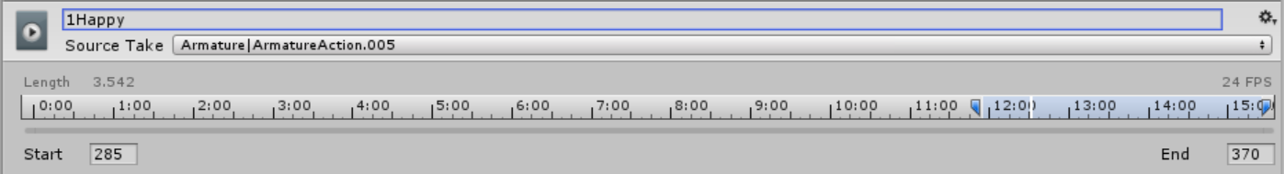
3D child model
“Immersive Self-Attachment Therapy through Personalised Avatar Generation “– Summer Jones
Two hairstyles
Animations attached: Happy, Sad, Dance, Idle.

Slide 8
Stage 1: Introduction
Self-Administered
Might seem silly
Slow progress, needs dedication
A lot of repetition

Slide 9
Stage 2: Connecting with the child
Separate the child and adult self
Two photos of them as children, one happy and one unhappy
Console the unhappy child loudly

Slide 10
Stage 3: Loving the child
Happy song, dance with the child
Claim to adopt and protect the child
Child is happy
Consistently done like a loving parent

Slide 11
Stage 4: Developmental training
Process painful memories in the past
  Imagine traumatic event
  Project onto the child
  Console the child
Process current painful memories
  Picture current emotions
  Project onto the child
  Console the child
Repeat multiple times at the beginning

Slide 12
Stage 4: Developmental training
Create a zest for life
  Rigid face and body like inflexible thinking patterns
  Loosen up and feel happier
Get over negative emotions
  Drowning in negative emotions
  Not true, there is light

Slide 13
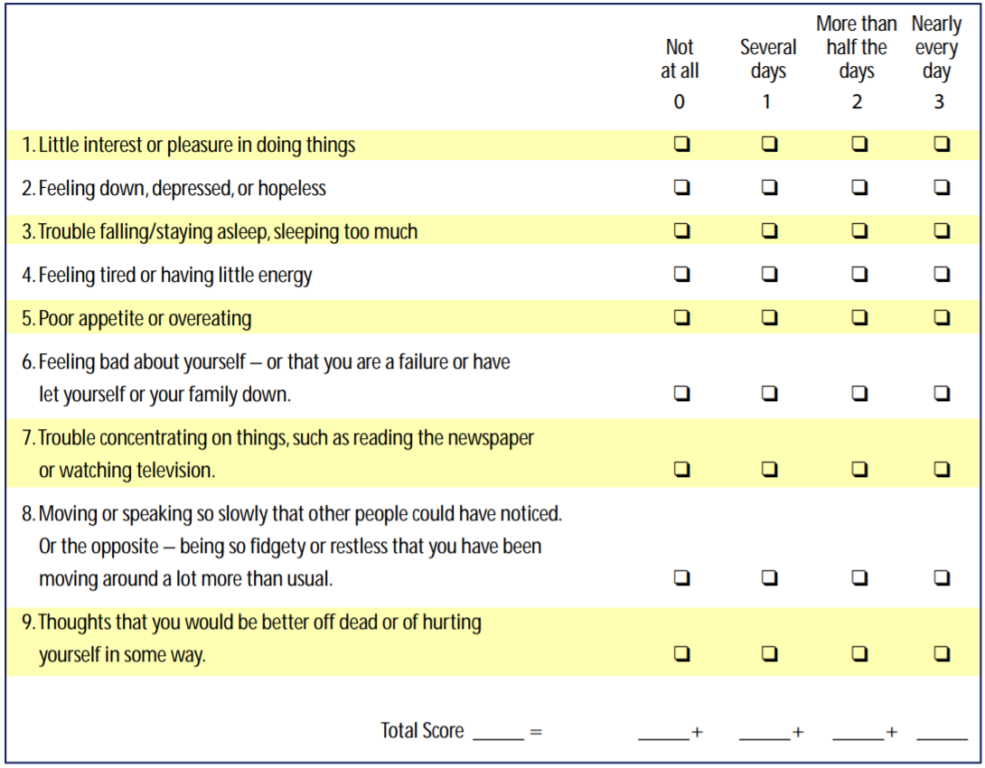
PHQ-9
Self administered version of Prime MD

Slide 14
Evaluation
Objectives met
Good guide through therapy
Not a perfect solution

Slide 15
Future Work
More intricate world
More complex gestures
More customisable

Slide 16
Any questions?

Slide 17
References
http://www.psycho-oncology.info/PHQ9_depression.pdf
https://www.healthline.com/health/depression/facts-statistics-infographic
https://www.doc.ic.ac.uk/research/technicalreports/2017/DTRS17-3.pdf

