Slide 1


Slide 2
Background
The advancement of mobile applications that cater to the need for smooth access and doorstep delivery services resulted in their dominance in the market as well as a consistently growing patronage among mobile users. These mobile applications, like online shopping and food delivery services, greatly help in easing the workload of many users who cannot afford to take time and physically travel to accomplish their everyday tasks.

Slide 3
Background
Similarly, many students and employees at the University of the Philippines Los Baños (UPLB) are currently experiencing a hard time to accomplish multiple errands due to their hectic academic schedules and personal commitments. On the other hand, various students and employees are experiencing difficulties in terms of their budget and financial needs. As a result, they opt to look for freelance labor that could help them augment their budget and gain additional income. These include services such as tutoring, proofreading, transcribing, cleaning, selling, and the likes. Currently, transactions being made by students and employees with their clients do not follow a standard transaction platform.

Slide 4
Statement of the Problem
UPLB students and employees use social media to post errands that need to be done or services that they offer. However, there are multiple online platforms to choose from, such as Facebook, Twitter, and the likes. Since not all students or employees use all platforms, some posted errands may be missed by someone who would have been a good fit. Also, most of the existing crowdsourcing mobile applications are not yet available to the UPLB community and not centered on its contexts and activities. Thus, a dedicated platform for such posts, limited to UPLB students and employees, would streamline this process.

Slide 5
Objectives
The main objective of this study is to design and create a user-friendly errand crowdsourcing mobile application for UPLB students and employees. Moreover, this study specifically aims:
to develop a mobile application for both Android and iOS using Flutter and Firebase; and
to test the mobile application to UPLB students and employees with UP Mail.

Slide 6
Significance
The mobile application to be developed shall serve as an accessible platform for many college students and employees who need help in looking for extra income, as well as those who would like to request for assistance regarding their errands or school and work-related requirements. It will also be mutually beneficial for both parties as it would satisfy the former for its financial needs. At the same time, it would help the latter by making sure that their other tasks are accomplished despite their hectic schedules.

Slide 7
An Errand Crowdsourcing Mobile Application for UPLB Community

Slide 8
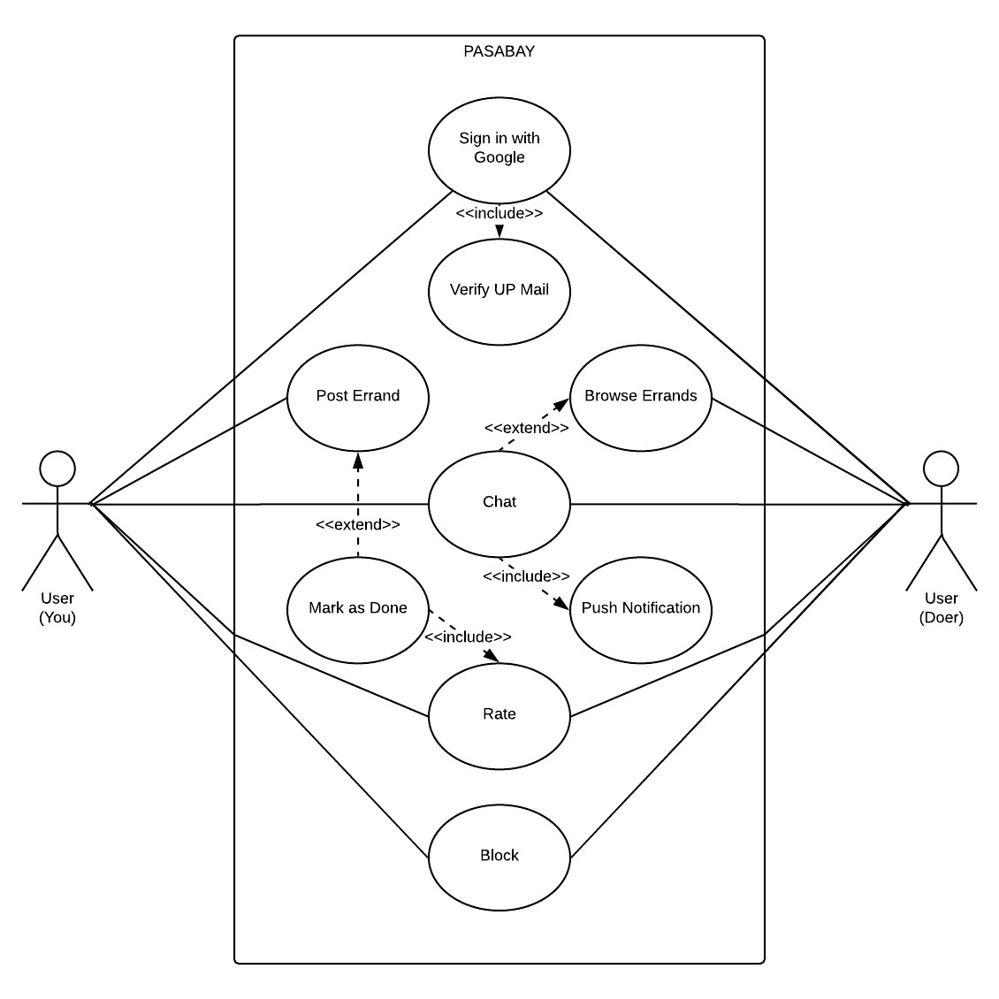
Functionalities
The mobile application requires at least two (2) users. The following are the general functionalities implemented in the app:
Sign in with Google
Post Errand
Browse Errands
Chat
Rate
Block

Slide 9
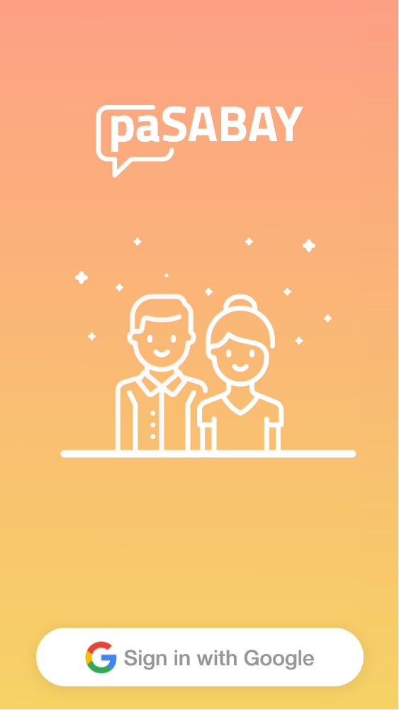
Sign in with Google
This allows users to instantly sign in through the application with the use of their UP Mail account.
Notes:
This allows users to instantly sign in through the application with the use of their UP Mail account. Also, this will serve as a way for the system to verify if they are a bonafide UPLB student or employee, and to eliminate spam user registration.

Slide 10
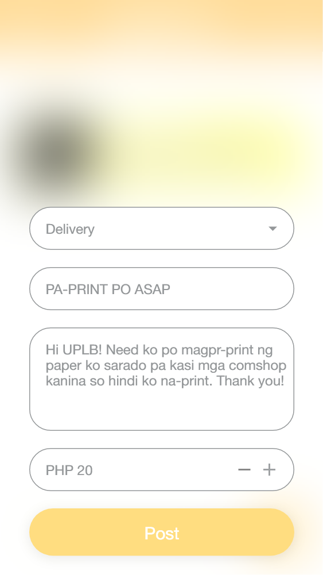
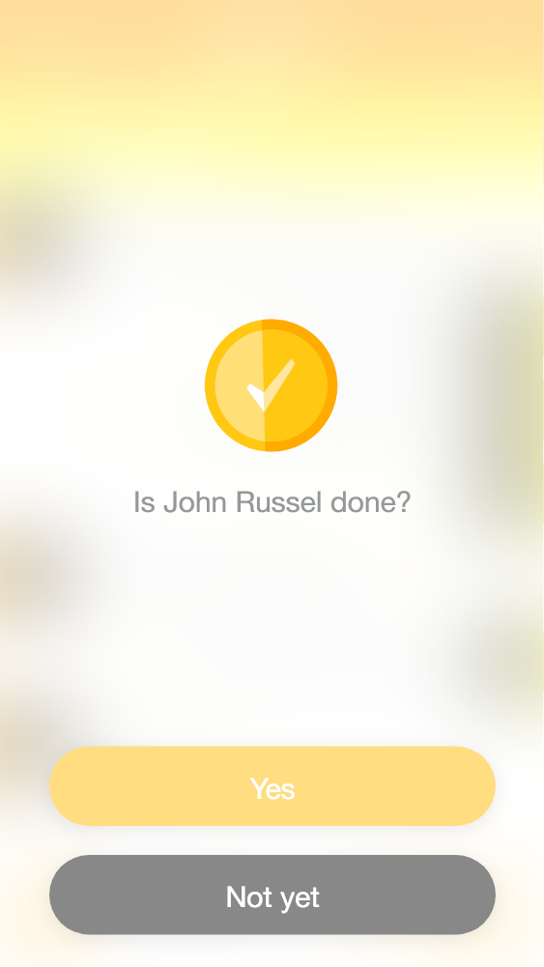
Post Errand
This allows you to post what you need to get done, its description, and how much you are willing to pay for it.
Notes:
This allows you to post what you need to get done, its description, and how much you are willing to pay for it. After an errand is completed, you shall mark it as done so that the system will not display it on the app anymore.

Slide 11
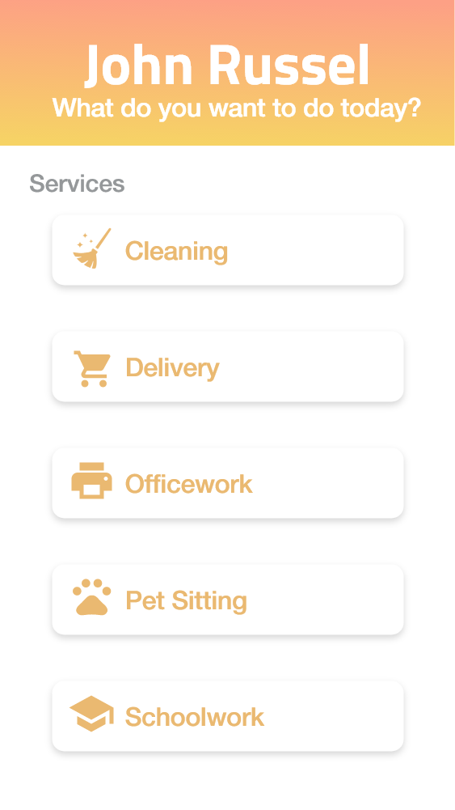
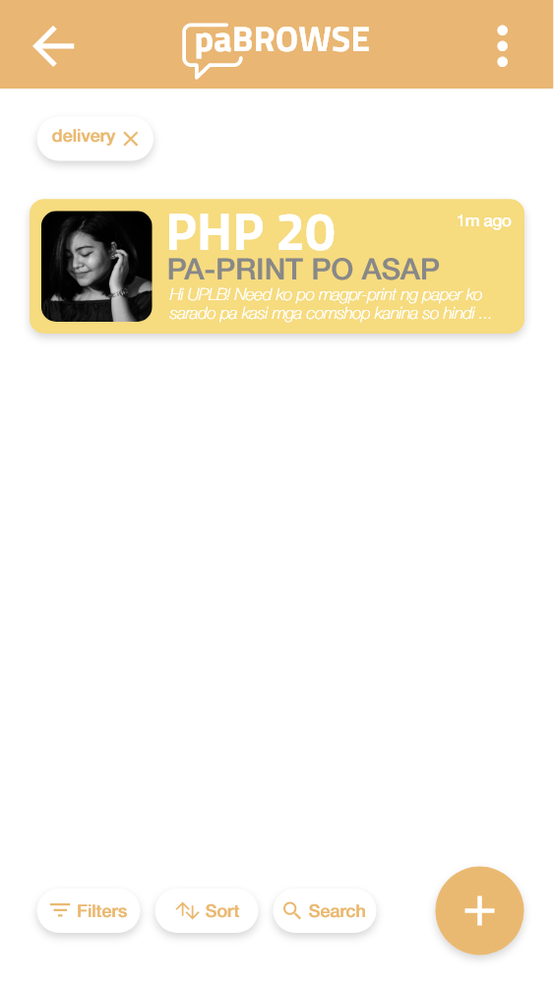
Browse Errands
This allows the user, who is looking for an errand, to search, sort, and filter errands.
Notes:
This allows the user, who is looking for an errand, to search, sort, and filter errands. There are initial categories for a user to choose from.
Cleaning
This service includes sweeping and mopping floors, making beds, tidying, bathroom cleaning, vacuuming, surface cleaning, car washing, laundry and ironing, and following the customer instructions.
Delivery
This service includes purchase and pick-up of desired items, groceries, food or beverages, and delivery of the purchased items to a specified location. Quantity of orders needs to be agreed upon between users before purchasing of items.
Officework
This service is on-site and includes inbound and unbound calls, typing and word processing, operating office machines, filing data entry, office inventory and replenishment, running errands, and following the customer instructions. Customer shall provide the materials, tools, and necessary training for the doer to perform the task.
Pet Sitting
This service includes dog sitting, replenishing of pet food and water, walking dogs in permitted areas, cleaning up after dogs, and playtime.
Schoolwork
This service includes tutoring, editing and proofreading papers, transcribing, editing videos, designing posters, participating in focus group discussions, interviews, or surveys, statistical analysis and the likes. Customer shall provide the materials, tools, and necessary training for the doer to perform the task.
The default sorting algorithm is the most recently posted errand first. Also, there is an in-app search bar that will look into the titles and descriptions of available errands and filter them based on the search keyword.

Slide 12
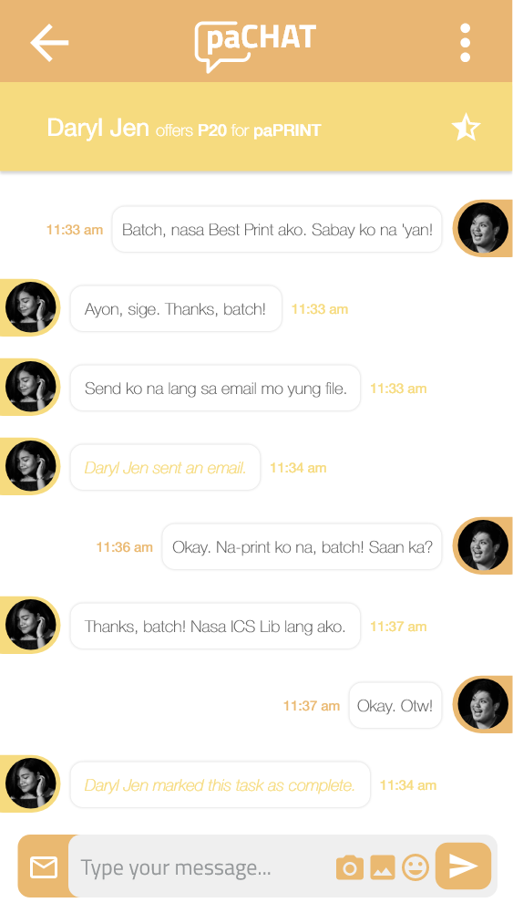
Chat
This allows the users to transact with each other in order to further clarify the scope of selected errand through sending of texts and images.
Notes:
This allows the users to transact with each other in order to further clarify the scope of selected errand through sending of texts and images. Also, push notifications will be added so that users will still receive messages even if they are not in the app.

Slide 13
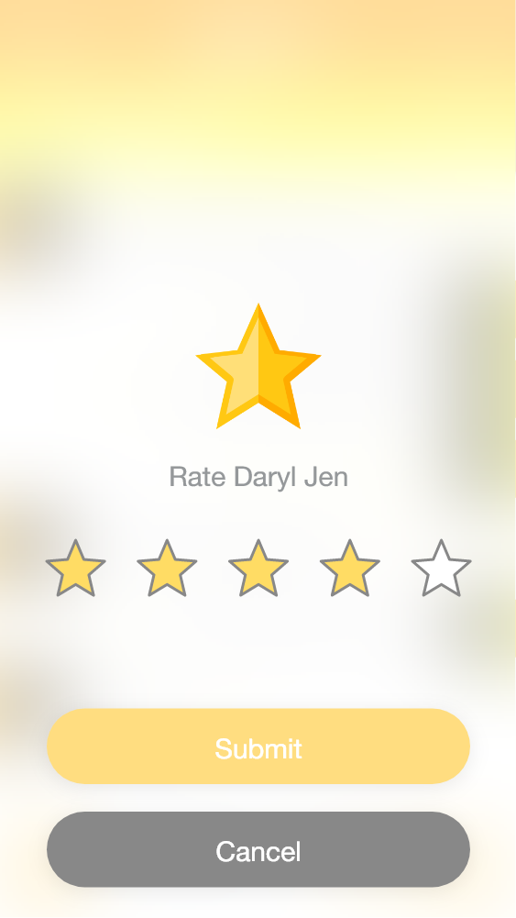
Rate
After an errand is marked as done, you will rate your experience (on a scale of one to five stars) based on the performance of the user who completed the errand and vice versa.
Notes:
After an errand is marked as done, you will rate your experience (on a scale of one to five stars) based on the performance of the user who completed the errand and vice versa. The system will calculate the average based on all the ratings received by the users. Users who have an average rate of less than three will receive constant warnings via push notification. However, once they reached an average rate of less than two, the system will automatically ban them from using the application. They will not be able to log in to the system anymore.

Slide 14
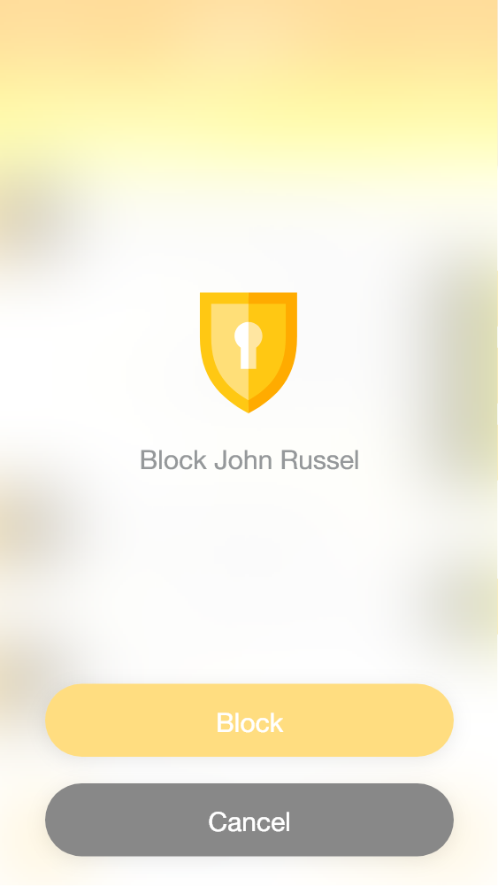
Block
This allows you to block users if you receive unjust treatment from them, including but not limited to, scamming and harassing.
Notes:
This allows you to block users if you receive unjust treatment from them, including but not limited to, scamming and harassing. If you block a user, they cannot see your posted errands and message you. Also, it would terminate any ongoing transaction between you and the user.

Slide 15





Development Process
Notes:
The user interface prototype of the mobile application was made using Adobe XD.
For developing the application, the Flutter SDK and Firebase shall be used along with Visual Studio Code running on the Windows operating system. The application shall be tested by using the Android Studio's Android emulator or by connecting an Android smartphone and previewing the app on the device.
The development of the mobile application shall last for two months and start on the third week of January until the second week of March 2020.

Slide 16



User Testing and Survey
PASABAY
MOBILE USERS
SUS
Google Drive
(at least 25)
Google Forms
Notes:
The System Usability Scale (SUS) shall be used to assess the user experience (UX) of the mobile application. Then, the developer shall ask at least 25 individuals to use and explore all the features of the application.
The installer or the Android Package (APK) for the mobile application shall be available and distributed online through Google Drive. Also, the survey shall be conducted online with the help of Google Forms. The respondents shall install, explore the app, and answer the survey on their own.
The user testing and survey shall last for one month and start on the third week of March until the second week of April 2020.

Slide 18
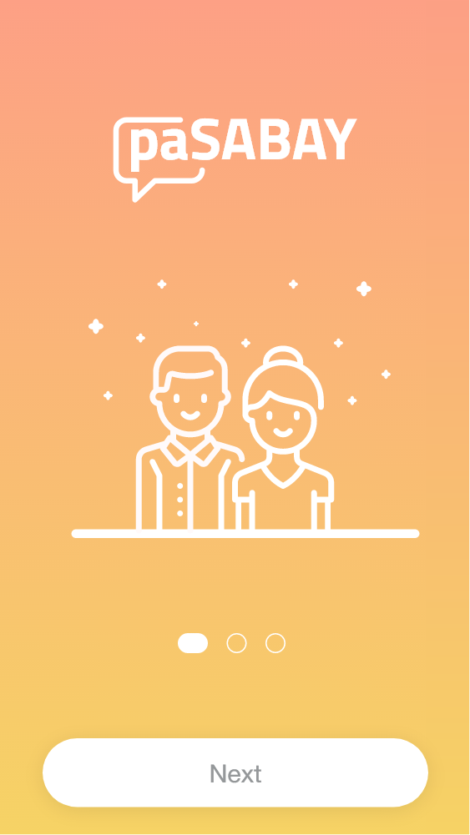
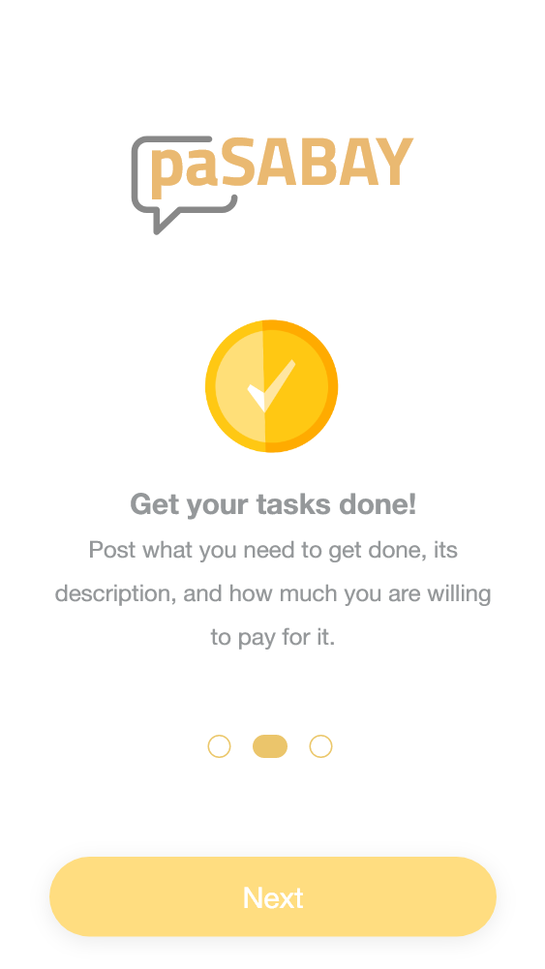
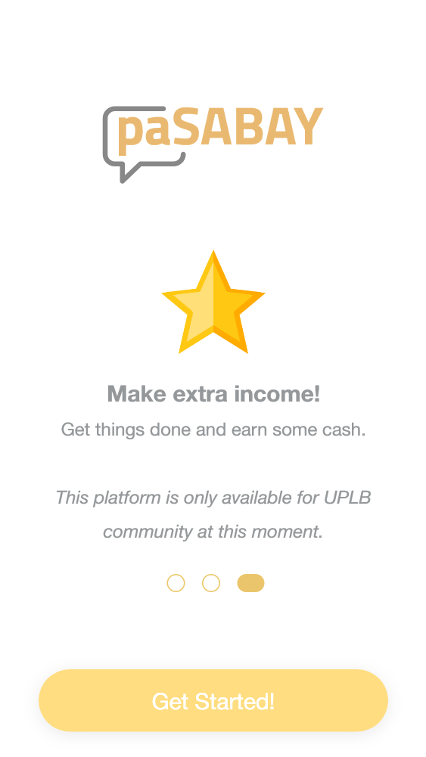

Slide 19
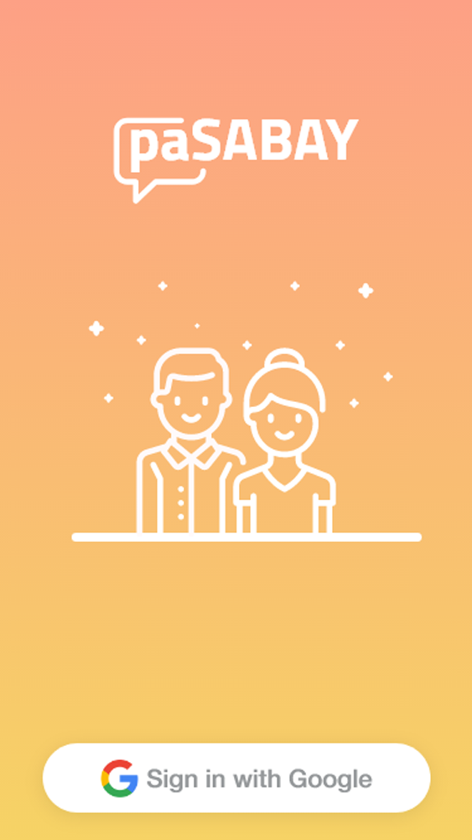
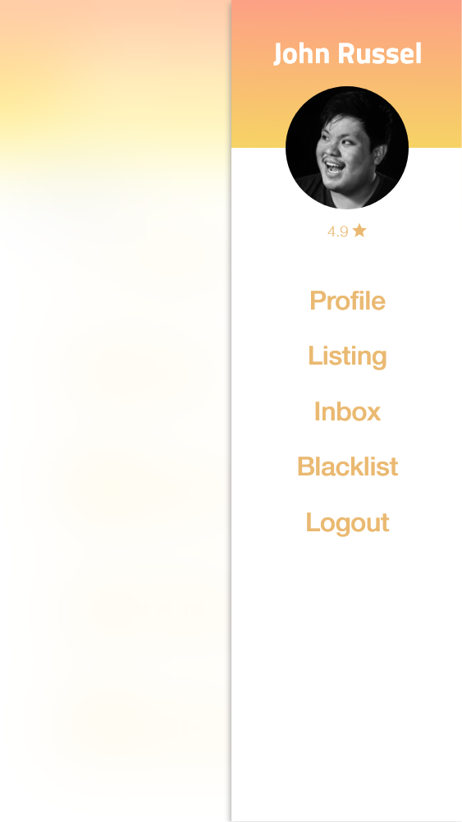

Slide 22
Thank You!

Slide 23
Notes:
Scope and Limitation
The study limits its scope to the creation of a mobile application to the UPLB area only. The test and use of the application are limited solely to UPLB students and employees who have access to their UP Mail accounts. The direct transaction and dealings of the application users are beyond the coverage of the study as it only focuses on creating a standard platform where the users can interact. It shall be published and released for public use and consumption.
Moreover, an application developed in Flutter can work on both Android and iOS. However, the mobile application to be developed will only be tested through Android smartphones due to the lack of macOS platform at hand. Therefore, its compatibility with a tablet and iOS is not guaranteed.

