Slide 1
Delivery Delay Forecasts vs Weather Trends
Smart Logistics Summary - Jermagne

Slide 2
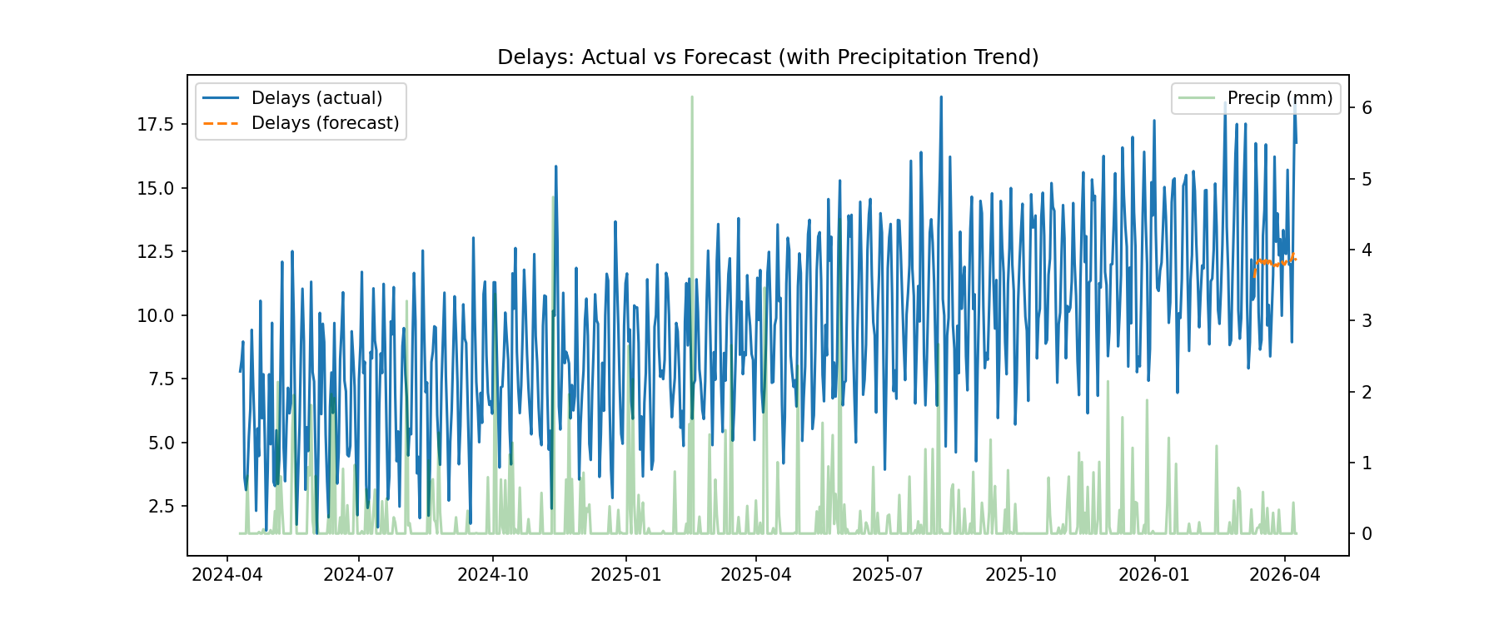
Delays vs Precipitation

