Slide 1
Prevalence:
0.67
0.67

Slide 2
Dynamics:
Habitat Filtering

Slide 3
Dynamics:
Species Interactions

Slide 4
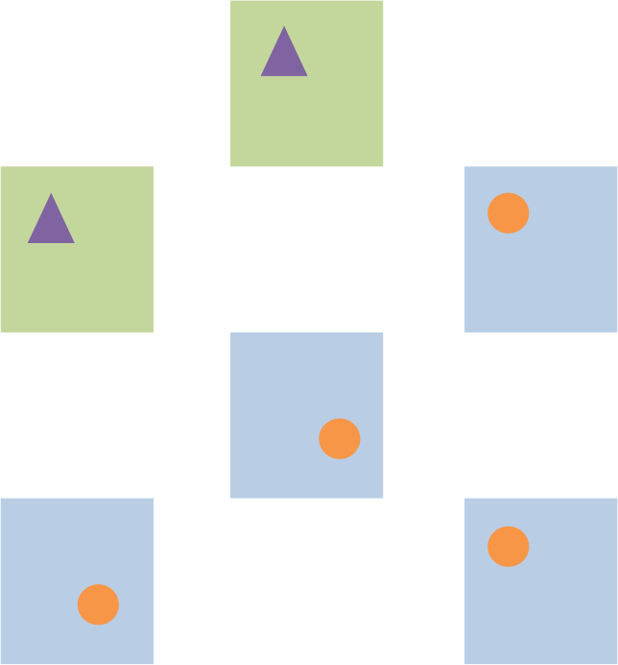
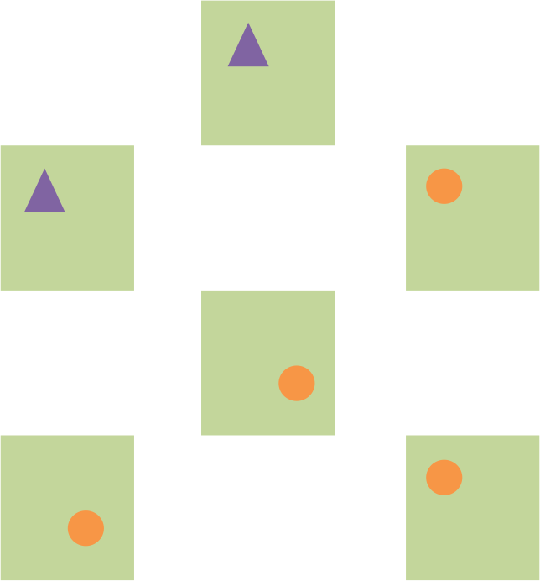
How to disentangle?
Habitat Filtering
Species Interactions

Slide 5
How to disentangle?
Habitat Filtering
Species Interactions
Especially when habitat variability is imperfectly observed

Slide 6
Communities are not static entities.
Dynamics occur over time.

Slide 7
Habitat
1
…
t
t+1
Colonization
Is there a positive effect of on the colonization probability of ?

Slide 8
Habitat
1
…
t
t+1
Extinction
Is there a negative effect of on the persistence probability of ?

Slide 9
Habitat
1
…
…
…
t
t+1
t+2
t+3
Colonization
Extinction
Extinction
Colonization

Slide 10
Habitat
1
…
…
…
Negative species interactions
Habitat
2
…
…
…
t
t+1
t+2
t+3

Slide 11
Habitat
1
…
…
…
Habitat
2
…
…
…
Positive associations among habitat types
(More likely to co-occur in similar habitats)
t
t+1
t+2
t+3
Habitat
3
…
…
…
Habitat
4
…
…
…
t
t+1
t+2
t+3

Slide 12
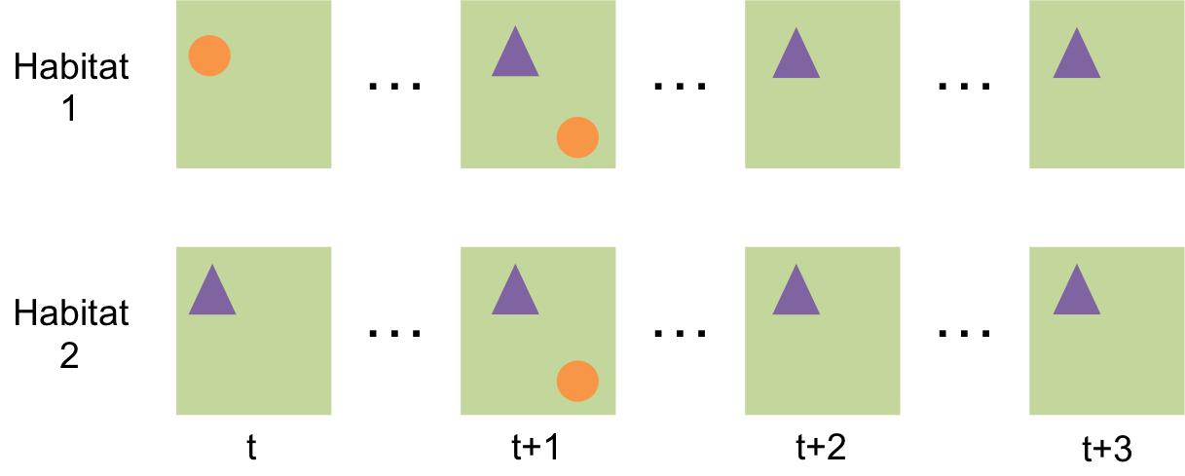
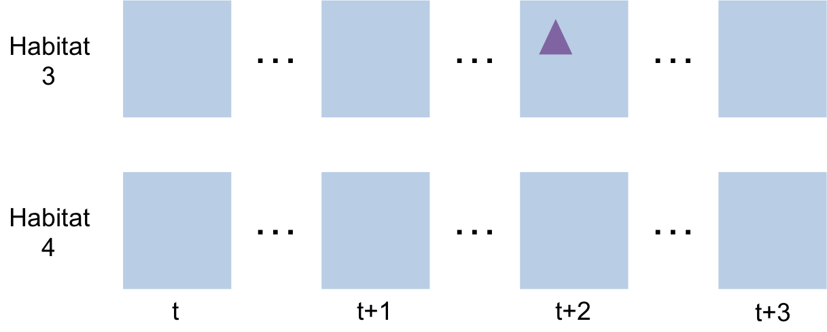
Problem:
Negative species interactions, but positive among-habitat associations can lead to higher observed co-occurrence than expected randomly!
(Perhaps there’s a better way to visualize this?)
Need longitudinal data and models to disentangle patterns and mechanisms!

Slide 13
Habitat
1
…
…
…
t
t+1
t+2
t+3
Questions:
Do species occur in similar habitats?
Do species influence other species’ colonization probabilities?
Do species influence other species’ persistence probabilities?
Are dynamics occurring between time points that are unaccounted for by simple pairwise species effects?

