Slide 1
PowerPoint from R
John Minter

Slide 2
R Markdown
This is an R Markdown presentation. Markdown is a simple formatting syntax for authoring HTML, PDF, and MS Word documents.
When you click the Knit button a document will be generated that includes both content as well as the output of any embedded R code chunks within the document.

Slide 3
Slide with Bullets
Bullet 1
Bullet 2
Bullet 3

Slide 4
Slide with R Output
summary(cars)
speed dist Min. : 4.0 Min. : 2.00 1st Qu.:12.0 1st Qu.: 26.00 Median :15.0 Median : 36.00 Mean :15.4 Mean : 42.98 3rd Qu.:19.0 3rd Qu.: 56.00 Max. :25.0 Max. :120.00

Slide 5
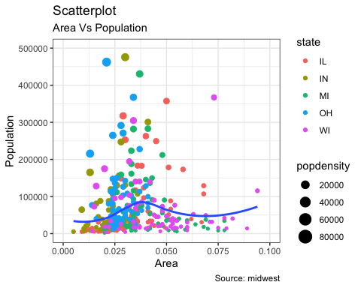
Slide with Plot

