Slide 1

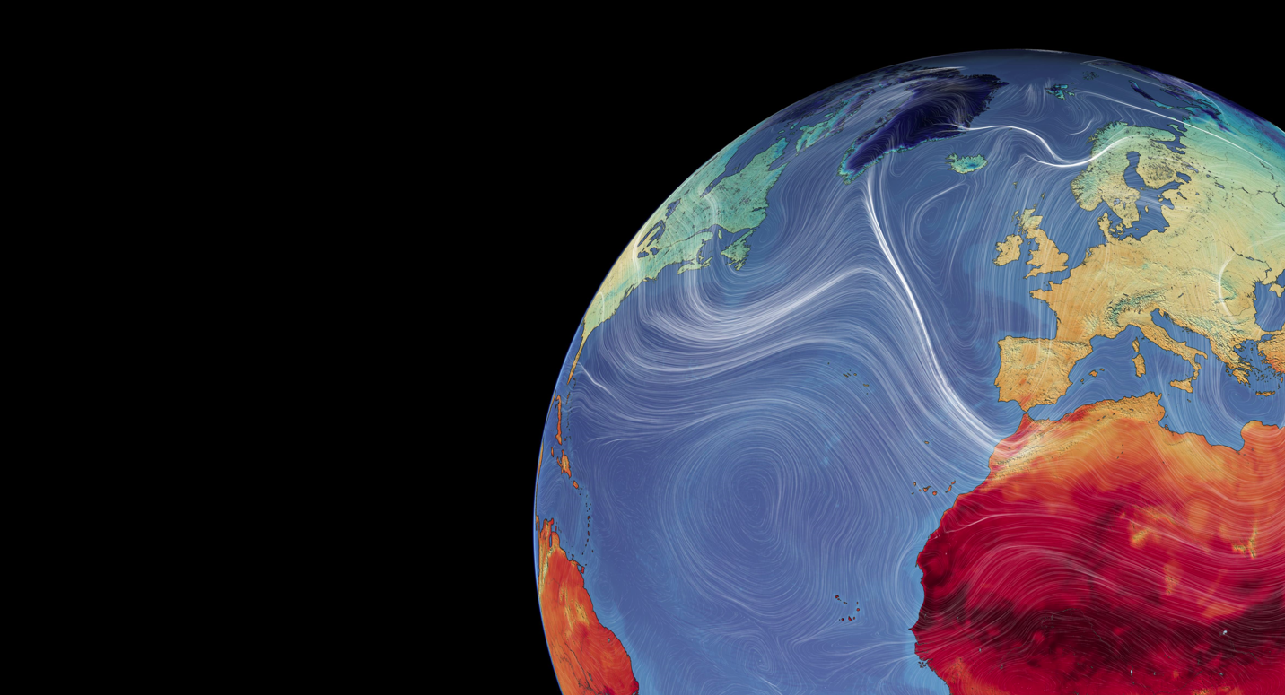
MET OFFICE SCIENCE · CLIMATE–NATURE POLICY
Mapping Climate and Nature indicators and policy opportunities
Jonathan Mosedale; Deborah Hemming

Slide 2

CONTEXT
Climate and nature — why link them?
Two crises, one response
Climate and nature policy increasingly overlap — the two crises share drivers, impacts and solutions.
New instruments are explicitly joined-up, e.g. the CCRA, the Environment Act and the Global Biodiversity Framework.
Met Office climate science increasingly needs to speak to both agendas at once.
Climate
change
Shared
drivers &
solutions
Pressures on Nature
Key policy drivers
Environment Act
Climate Change Act
Climate & Nature Bill
UNFCCC / CBD
Mapping Climate and Nature indicators and policy opportunities

Slide 3
OVERVIEW
Three elements of the approach
1
How data/science informs policy
Quantitative indicators used to monitor and assess policy
Policy
opportunities
2
Understanding the policy landscape
What policy activity is happening and how are different activities related?
3
Defining research fields
Current and potential Met Office research for assessment
Mapping Climate and Nature indicators and policy opportunities
Mapping Climate and Nature indicators and policy opportunities
3

Slide 4
OVERVIEW · EVIDENCE SOURCES
Where the evidence comes from
1
Indicator frameworks
Compiled from public online data and reports
Mapping from
public evidence
2
Policy & organisations
Climate–nature international and UK policy activities and organisations from on-line public sources (eg gov.uk).
3
MO research fields
Defined via public bibliography and reports
Mapping Climate and Nature indicators and policy opportunities

Slide 5
GENERATIVE AI
How generative AI was used
Disclaimer: AI was not a project expectation — it was adopted where it added value.
1
2
3
→
→
Collate & organise
Understand context
Assess relevance
Gathering and structuring information on indicators
Making sense of the policy landscape and its links
Evaluating how research outputs and data products can inform policy
Uninsured AI used outside MO systems · published AI guidance followed · only publicly available information provided to the AI
Mapping Climate and Nature indicators and policy opportunities

Slide 6
HOW IT FITS TOGETHER
Deliverables of the project
1
Data sheets
2
Exploration tools
Indicators, and UK & international policy and organisations — collated to defined protocols.
Indicator and governance dashboards to understand the policy landscape and use of existing indicators.
AI-collated
AI co-created
3
Policy mapping assessments
4
Protocols
Mapping policy applications for actual and potential MO research and data products.
Define data-sheet structure & updating, tool creation, methods, scoring and output formats.
AI-delivered
Human-defined, AI generated
Mapping Climate and Nature indicators and policy opportunities

Slide 7
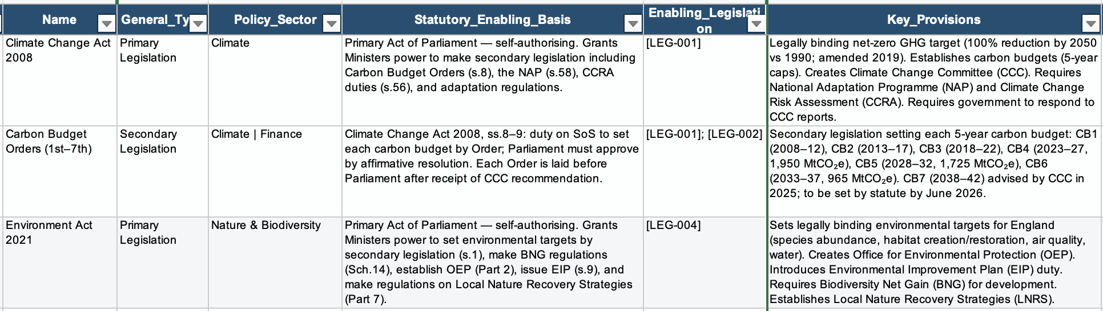
DELIVERABLE 1 · DATA SHEETS
Data sheets: policy & indicators
Compiled data sheets: indicators, and UK & international policy and organisations.
Records collated from public online sources following defined protocols.
The UK policy-governance workbook underpins the assessments.
Mapping Climate and Nature indicators and policy opportunities

Slide 8
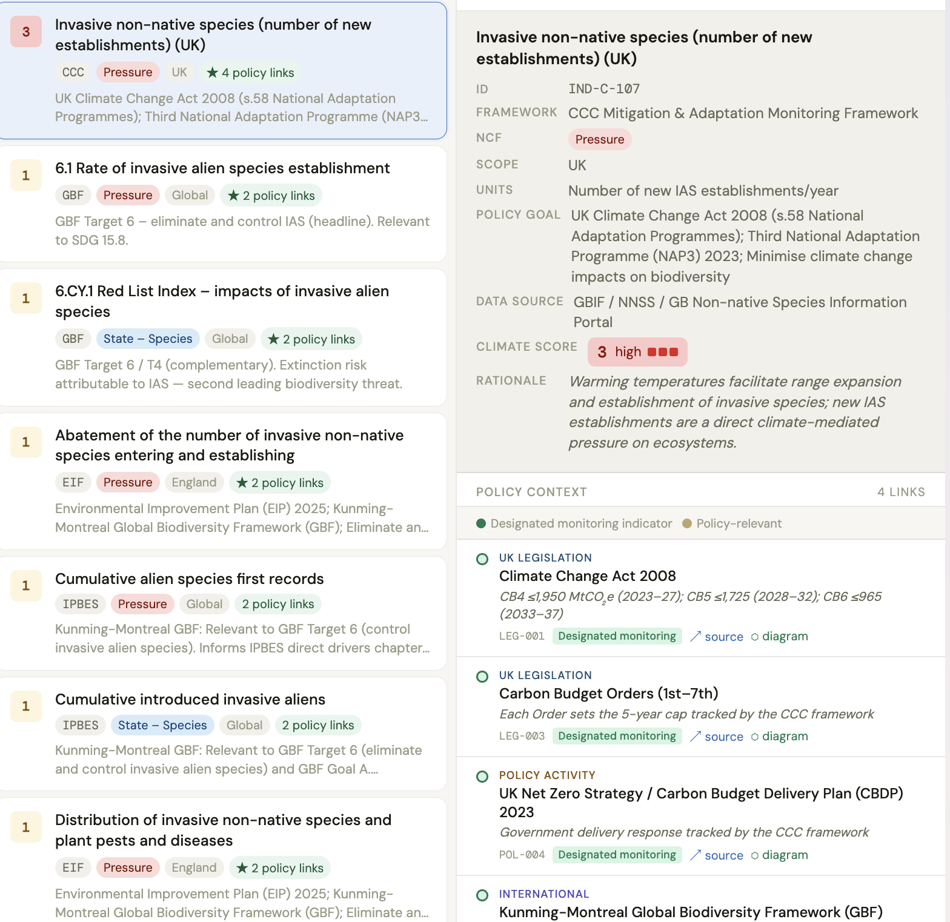
DELIVERABLE 2 · POLICY INDICATORS
Exploring policy indicators
Search for policy indicators and use.
AI methodology scores each indicator for climate relevance.
Covers the main indicator frameworks — EIF, CCC Adaptation, JNCC UK Biodiversity.
Challenge: discriminating between indicators, targets, goals and data products.
Climate relevance score
3 High
2 Med
1 Low
0 None
▶ Open live dashboard
Mapping Climate and Nature indicators and policy opportunities

Slide 9
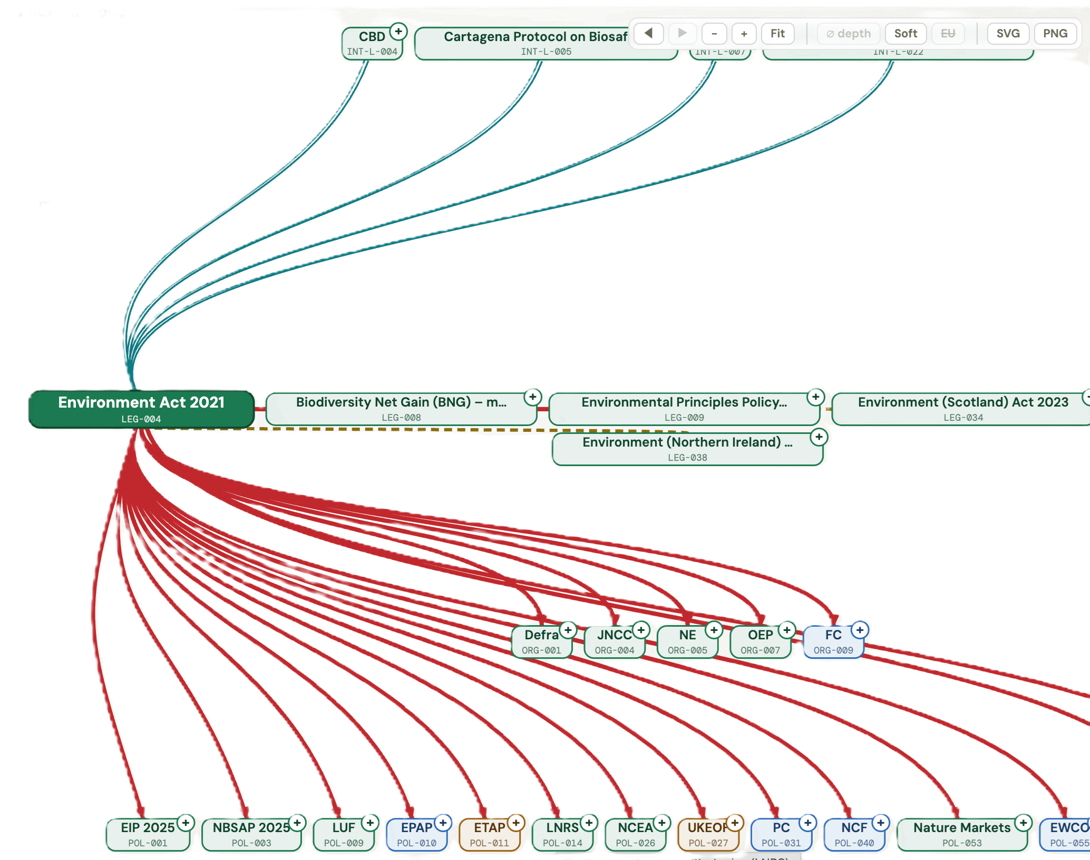
DELIVERABLE 3 · POLICY CONTEXT
Exploring the policy context
Nature & biodiversity policy involves many international and UK initiatives — often tightly interlinked.
Example: the 30×30 international CBD target, adopted into UK legislation and policy.
The tool exposes and provides structure for understanding the complexity of the policy landscape.
Mapping Climate and Nature indicators and policy opportunities

Slide 10
DELIVERABLE 4 · SUMMARY MAPPING ASSESSMENTS
Mapping science to policy
Current links and opportunities
Assess how science informs indicators & policy activities.
1
PUBLIC-DOMAIN
EVIDENCE ONLY
Focused, not exhaustive
Use bibliographies to define research fields, surfacing gaps and opportunities rather than generalising all MO science.
2
Assessments draw only on published Met Office reports and peer-reviewed research — plus targeted public web searches. No internal or unpublished material is shared with the AI.
Public information only
Only publicly available information is ever provided to the AI.
3
Beyond the data sheets
Wider internet searches capture relevant policies not held in the compiled data sheets.
4
Met Office public reports & publications
Mapping Climate and Nature indicators and policy opportunities

Slide 11
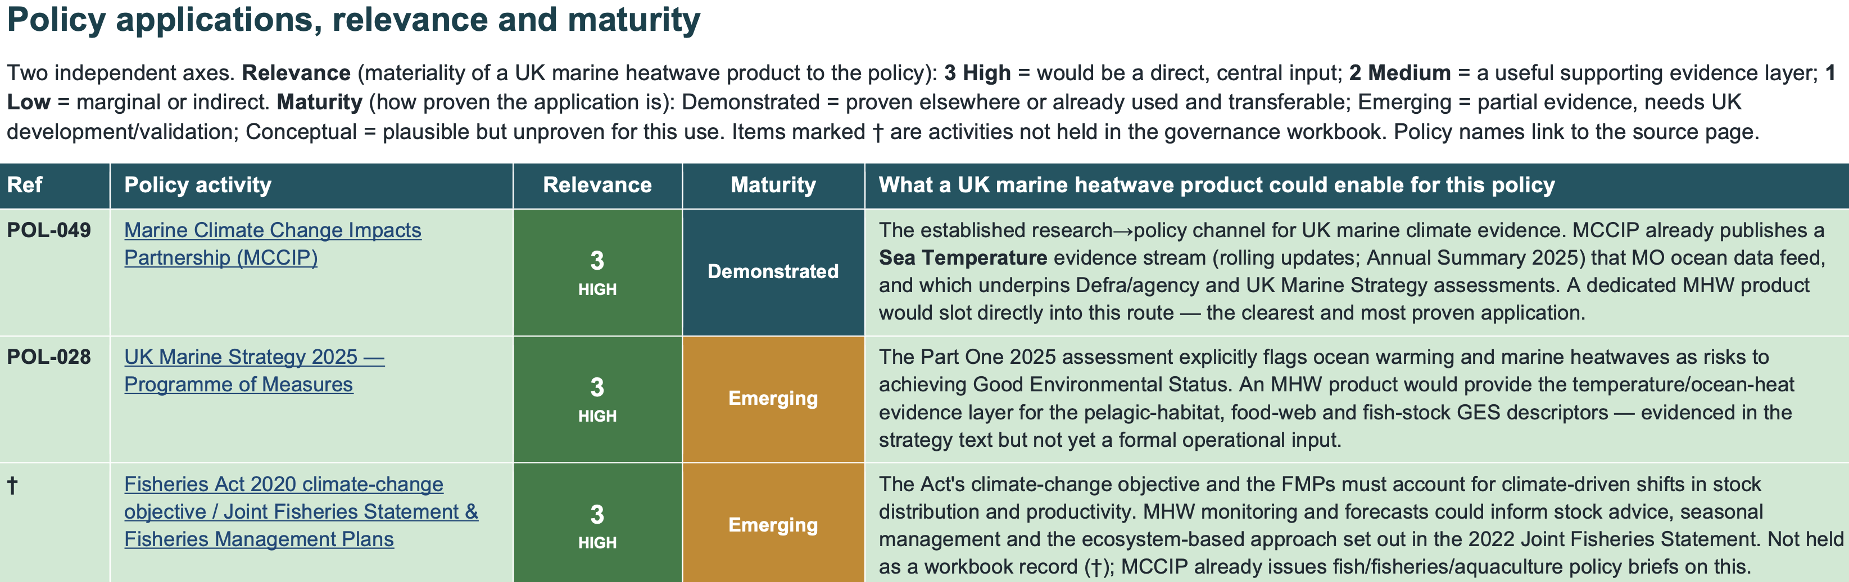
EXAMPLE ASSESSMENT · MARINE HEATWAVES
Ocean temperature & marine heatwaves
Map policy opportunities for a new UK marine-heatwave (MHW) product.
Provided an extensive bibliography (Google Scholar) of international marine-heatwave research.
Other assessments run :
MO Biosecurity research
Land surface temperature product
Daily sunshine product
Mapping Climate and Nature indicators and policy opportunities

Slide 12
DELIVERABLE 5 - PROTOCOLS
Maintaining and updating the tools
Protocols were developed so the outputs can be kept current, not left as a one-off.
1
2
3
Data sheets
Assessments
Interactive tools
Adding and updating indicator, policy and organisation records to a defined structure.
Consistent method, scoring and output formats for each policy-relevance assessment.
Creating and refreshing the HTML indicator and governance dashboards.
Mapping Climate and Nature indicators and policy opportunities

Slide 13
PORTABILITY
Porting to the Met Office workspace
The protocols and compiled data sheets are model-agnostic.
They can be run by alternative AI models inside the Met Office environment — for example Microsoft Copilot.
The value sits in the structured data and protocols, not in any single AI system.
Protocols + data sheets
portable, model-independent
↓
Claude
Copilot
Other LLM
Mapping Climate and Nature indicators and policy opportunities

Slide 14
LESSONS LEARNT and NEXT STEPS
AI benefits:
Next steps:
Compiling online data is a big win
Compiled sheets ensure a minimum policy / indicator context is always considered for further queries.
Deliverables: long-term value for Met Office
Underlying data and protocols offer option of long-term use and maintenance.
Illustrative examples to permanent tools.
AI surprises
AI assessments identified surprising policy opportunities.
How will tools be used?
Needs to inform final development, guidance and maintenance protocols.
Protocols provide standard outputs & ease maintenance
Repeatable steps to update sheets and re-run assessments keep everything current.
Use outputs to inform collaborations with policy teams & nature science experts
Indicator work has informed engagement with Defra biodiversity indicators team and JNCC.
Mapping Climate and Nature indicators and policy opportunities

