Slide 1


MET OFFICE SCIENCE · CLIMATE–NATURE POLICY
Mapping Climate and Nature indicators and policy opportunities
Jonathan Mosedale; Deborah Hemming

Slide 2

OVERVIEW
Three elements of the approach
1
How data/science informs policy
Quantitative indicators used to monitor and assess policy
Policy
opportunities
2
Understanding the policy landscape
What policy activity is happening and how are different activities related?
3
Assessing research fields
Policy applications of current and potential Met Office research
Mapping Climate and Nature indicators and policy opportunities
Mapping Climate and Nature indicators and policy opportunities
3

Slide 3
OVERVIEW · EVIDENCE SOURCES
Where the evidence comes from
1
Indicator frameworks
Compiled from public online data and reports
Mapping from
public evidence
2
Policy activity
Climate–nature international and UK policy activities and organisations from on-line public sources (eg gov.uk).
3
MO research fields
Defined via public bibliography and reports
Mapping Climate and Nature indicators and policy opportunities

Slide 4
GENERATIVE AI
How generative AI was used
Disclaimer: AI was not a project expectation — it was adopted where it added value.
1
2
3
→
→
Collate & organise
Understand context
Assess relevance
Gathering and structuring information on indicators
Making sense of the policy landscape and its links
Evaluating how research outputs and data products can inform policy
Uninsured AI used outside MO systems · published AI guidance followed · only publicly available information provided to the AI
Mapping Climate and Nature indicators and policy opportunities

Slide 5
HOW IT FITS TOGETHER
Deliverables of the project
1
Data sheets
2
Data exploration tools
Indicators, and UK & international policy and organisations — collated to defined protocols.
Indicator and governance html dashboards to understand the policy landscape and use of existing indicators.
AI-collated
AI co-created
3
Policy mapping assessments
4
Protocols
Mapping policy applications for actual and potential MO research and data products.
Define data-sheet structure & updating, tool creation, methods, scoring and output formats.
AI-delivered
Human-defined, AI generated
Mapping Climate and Nature indicators and policy opportunities

Slide 6
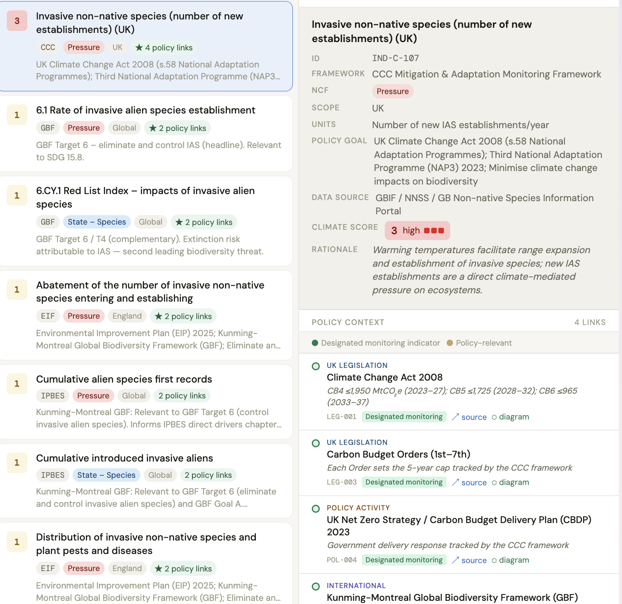
DELIVERABLE 2 · POLICY INDICATORS
Exploring policy indicators
Search for policy indicators and use.
AI methodology scores each indicator for climate relevance.
Covers the main indicator frameworks — EIF, CCC Adaptation, JNCC UK Biodiversity.
Challenge: discriminating between indicators, targets, goals and data products.
Climate relevance score
3 High
2 Med
1 Low
0 None
▶ Open live dashboard
Mapping Climate and Nature indicators and policy opportunities

Slide 7
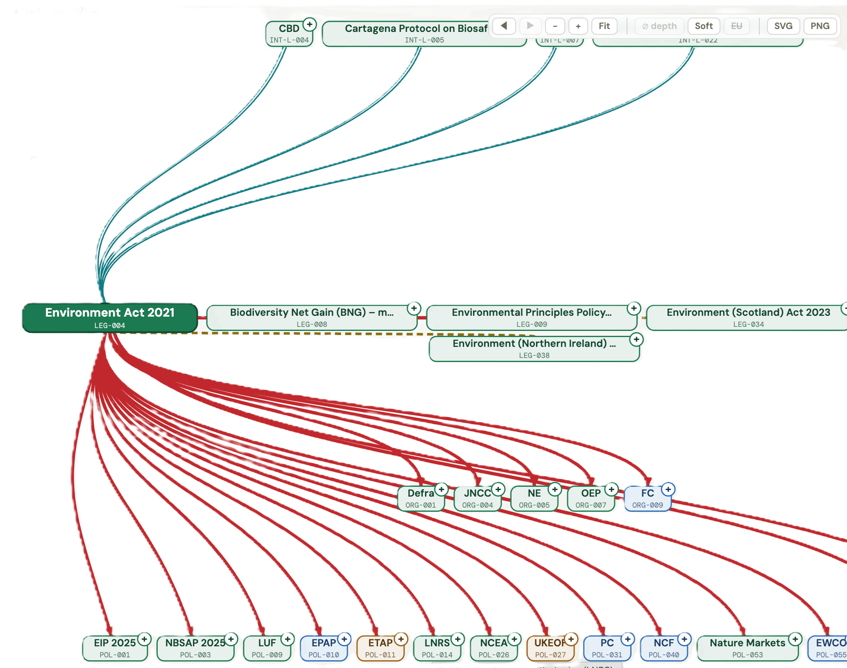
DELIVERABLE 3 · POLICY CONTEXT
Exploring the policy context
Nature & biodiversity policy involves many international and UK initiatives — often tightly interlinked.
Example: the 30×30 international CBD target, adopted into UK legislation and policy.
The tool exposes and provides structure for understanding the complexity of the policy landscape.
Mapping Climate and Nature indicators and policy opportunities

