Slide 1
STANDARDS CONTROL PLANE
Demo overview
What it does · how it's enforced · how it evolves
James Brooke · 2026-04-30 · walk-through draft

Slide 2
WHY THIS EXISTS
Three pains we hit before SCP
Multiple repos · multiple humans · multiple AI agents — each drifting in parallel.
DRIFT
AGENTS INVENTING STANDARDS
NO ENFORCEMENT FLOOR
schema fragmentation
plausible ≠ ours
decisions ≠ enforcement
Each repo's services.yml, waiver shape, vendoring conventions diverged. Reviews argued style, not substance.
Codex / Sonnet / Opus would pick a plausible pattern but not necessarily our pattern. Review caught it; the wasted dispatch didn't.
DECISIONS.md was aspirational — nothing forced a downstream PR to honour it. Governance was retrospective.
The bet: make standards machine-readable + machine-enforceable. Drift collapses; review handles novel substance.

Slide 3
WHAT SCP IS
Three sentences
SCP is a deterministic policy plane.
It exposes "what's allowed" in two flavours: a consult API that agents query before writing code,
and a federation gate that blocks merges after writing code if the result violates a rule.
WHAT SCP OWNS
WHAT SCP DOES NOT OWN
• Source of truth for governance + architecture standards
• Findings store, waivers, scorecards
• Consult interface (humans + agents)
• Federation primitive (reusable workflow downstream pins)
• Multi-agent orchestration → ACC
• Service runtime / auth fabric → Control Tower
• Documentation retrieval → mapp-doc-agent
• The estate itself — SCP plugs in, doesn't replace

Slide 4
ARCHITECTURE
How the pieces fit together.

Slide 5
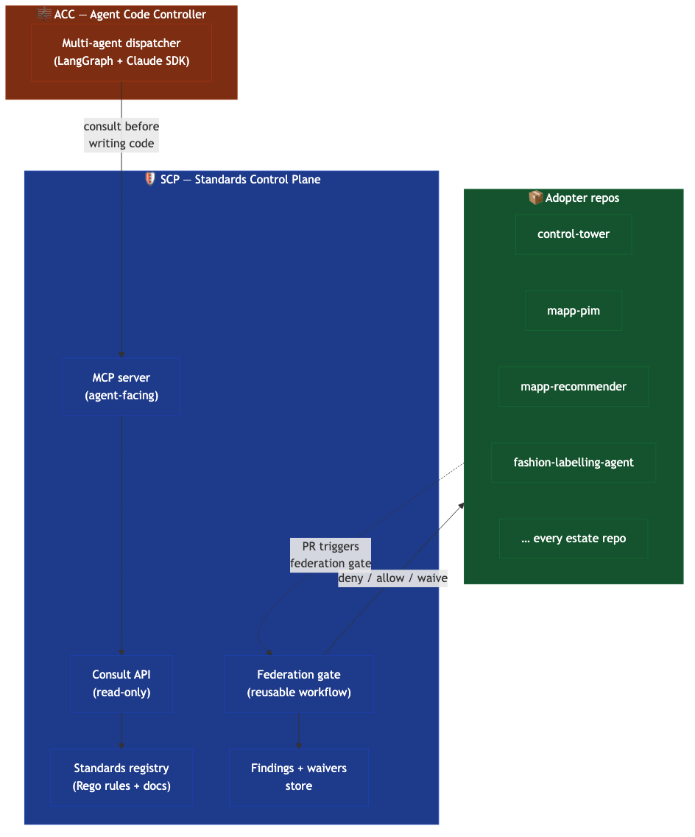
ARCHITECTURE · THREE LAYERS
Policy plane · orchestration plane · adopter plane
SCP plugs into the estate; it doesn't try to be the estate.
SCP sits above ACC (orchestration) and adopter repos (execution). Two protocols out: MCP for agents · reusable-workflow for PRs.

Slide 6
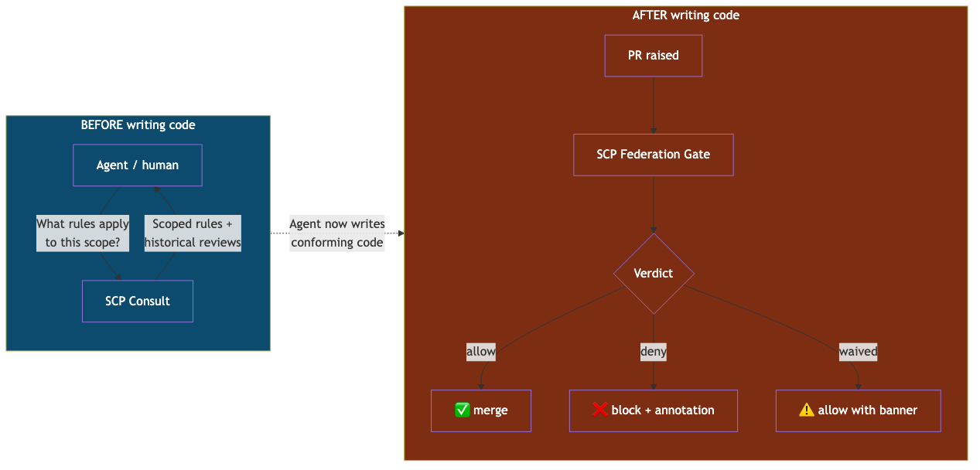
OPERATING MODES
Consult before code · audit after code
Same registry, same rules — one source of truth.
Pre-code consult closes the dispatch-cycle waste; post-code audit catches drift at PR time. Belt + braces.

Slide 7
ENFORCEMENT
The federation primitive — how a PR
actually gets blocked.

Slide 8
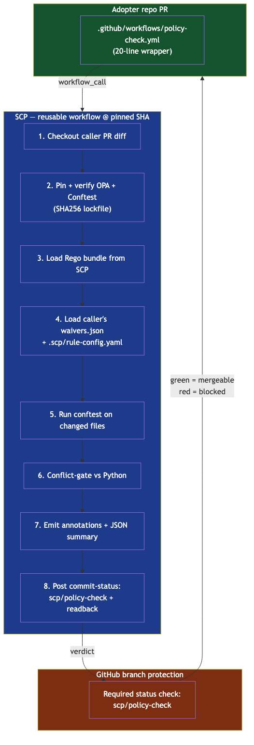
ENFORCEMENT · FEDERATION PRIMITIVE
Reusable workflow + Rego + branch protection
Adopter wrapper is ~20 lines. Pinned by SHA. Renovate cascades the bump.
OPA + Conftest pinned by SHA256. Caller's GITHUB_TOKEN is the ceiling. Break-glass needs three gates — fails closed.

Slide 9
WHAT v1.0.0 ACTUALLY CHECKS
Three rules — deliberately small
The primitive matters more than the rule library. Rules 4–N follow via RFC in v1.1+.
RULE
WHAT IT CHECKS
WHY THIS RULE FIRST
SCP-R-001
services.yml root-shape conforms to SVC-003 auth modes
Auth-contract drift is highest blast radius. WP-SCP-019 froze the schema; this rule enforces it.
SCP-R-002
waivers.json entry schema (approved_by, created_at, expires_at, rule_id ∨ finding_id)
Waivers are the safety valve. If their shape drifts, the safety valve becomes opaque.
SCP-R-003
Vendoring-manifest marker present in package.json / pyproject.toml / go.mod when those change
Marks every adopter as having consciously adopted the SVC-003 contract.
Each rule: structured deny payload · allow + deny fixtures · opa test coverage ≥ 90% · waiver-aware via policies/scp_common.rego

Slide 10
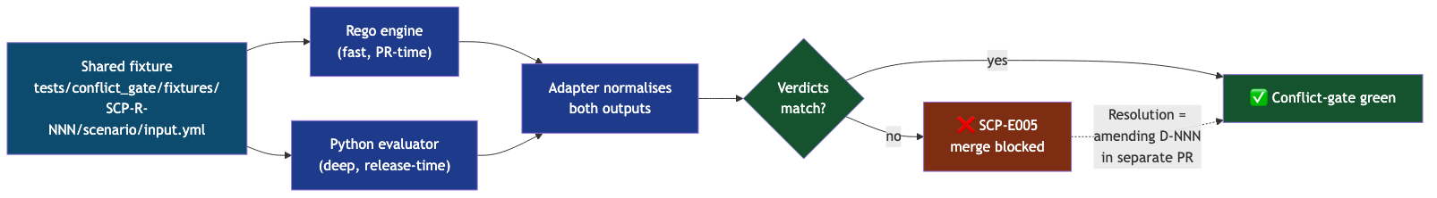
ENFORCEMENT · CONFLICT-GATE
Two engines must agree, or merge is blocked
Architectural insurance against "the rule looks enforced but silently doesn't fire."
Rego = fast PR gate · Python = deep audit. Disagreement → SCP-E005 → amending D-NNN in a separate PR.

Slide 11
AGENTS
The MCP surface — closing the loop
before code is written.

Slide 12
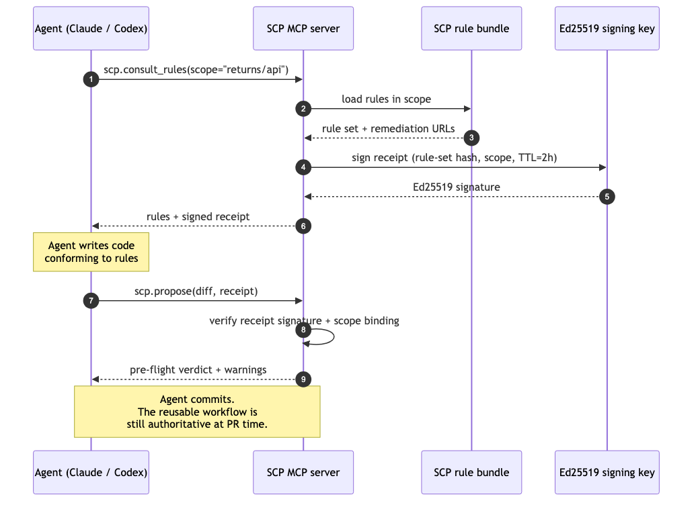
AGENTS · MCP SERVER
Pre-code consult with signed receipts
WHY
• Agent calls scp.consult_rules(scope) before writing code
• Server returns rules + Ed25519-signed receipt (TTL ≤ 2h)
• Receipt binds (rule-set hash, scope, timestamp)
• Pre-flight check via scp.propose(diff, receipt) is advisory
• Reusable workflow at PR time stays authoritative
• Track 2 closed 2026-04-29 (USER-GATE-C signed)

Slide 13
ESTATE
How SCP plugs into the rest
of Brokapps.

Slide 14
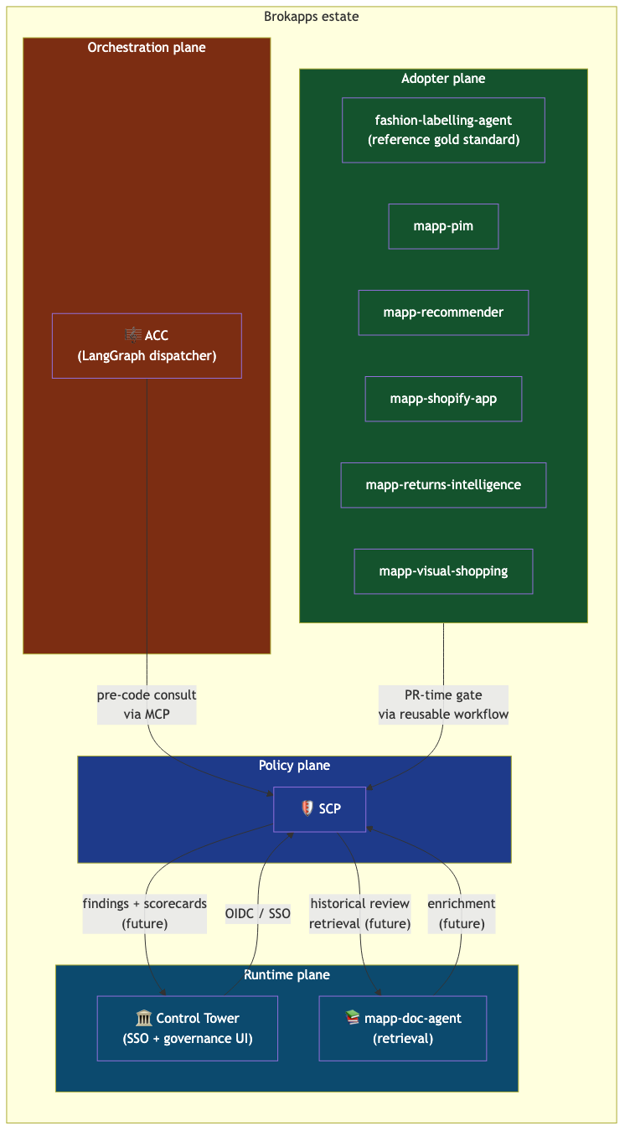
ESTATE · INTEGRATION MAP
Policy plane · orchestration · runtime · adopters
Boundary discipline: SCP doesn't try to be ACC + CT + doc-agent + every repo.
ACC consults pre-code · adopters call the gate at PR time · CT + doc-agent integrate post-Threshold A.

Slide 15
EVOLUTION
How it changes over time —
phases of trust.

Slide 16
HOW IT EVOLVES
Phased rollout — a timeline of trust
Each phase is one mechanism. Build the floor first; optimise on top.
PHASE
WHAT CHANGES
RISK
0 advisory audit
Post-merge audit. Findings logged, no enforcement.
ZERO
1 auth contract
WP-SCP-019. SVC-003 schema frozen. Three modes + one deprecating.
LOW
2 federation primitive
WP-SCP-020. Reusable workflow + Rego bundle + Renovate cascade. SCP self-pilot.
MEDIUM
3 MCP server
WP-SCP-021. Agents consult before writing code. Track 2 closed.
LOW
4 self-gate
020D1 → 020D2. SCP gates its own main. Advisory → required. v1.0.0 cut.
HIGH
5 multi-adopter
FLA pilot first, then estate cascade. Renovate cascades pin-bumps.
MEDIUM
6 scorecards
WP-SCP-023. Cross-repo aggregation, proposal queue, D-NNN indexing.
LOW

Slide 17
THE FINISH LINE
Threshold A — what "actually useful" means
SCP gates itself on its own main · 3 rules enforcing · conflict-gate green · v1.0.0 cut.
✅ DONE
⏳ AHEAD
020A plan + D-022/D-023
020K adopter onboarding + ADOPT-005
020B reusable workflow (PR #36)
020D1 self-dogfood wrapper (advisory)
020B.1 workflow-selftest harness (PR #38)
020H.1 v1.0.0-rc.1 + observability emit
020B.2 scripts/scp-policy-check (PR #41)
020E.a pre-protection canary
020C 3 starter Rego rules (PR #49)
🛑 USER-GATE-A0 advisory→required signoff
020C.1 waiver-aware + conflict-gate (PR #52)
020D2 required-status-check + cut v1.0.0
020J tag-protection + signed-commits (PR #53)
🛑 USER-GATE-A Threshold A signoff

Slide 18
WHERE WE ARE TODAY
Programmes + active PRs
Snapshot: 2026-04-30 morning, post-020J apply.
PROGRAMME
STATE
TRACK
WP-SCP-019 — Service Auth Contract
✅ closed 2026-04-20
—
WP-SCP-020 — Federation Primitive
🔄 in flight (~60% slices)
Track 1
WP-SCP-021 — MCP Server
✅ landed 2026-04-29
Track 2
WP-SCP-022 — Implementation Programme
🔄 orchestrator for 020 + 021
Meta
LIVE INFRA (today)
• main has required_signatures: true (020J landed this morning)
• Tag-protection ruleset on v* — no force-push, no deletion, no re-pointing
• 3 Rego rules under policies/, reusable workflow at .github/workflows/policy-check.yml
• MCP server at src/standards_control_plane/mcp/, Ed25519 signing key under .scp/keys/

Slide 19
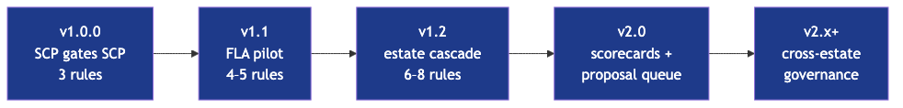
POST-v1.0.0 ROADMAP
v1.x → v2.x — what comes after self-gating
Each version adds capability without breaking adopters. Pin-bump via Renovate is the upgrade path.
v1.1: FLA pilot · v1.2: estate cascade · v2.0: scorecards + proposal queue · v2.x: cross-estate governance.

Slide 20
WHY THIS IS WORTH DOING
Benefits — three audiences
Estate · operator · future agents and humans.
FOR THE ESTATE
FOR THE OPERATOR
FOR FUTURE AGENTS
• Drift collapses — every repo held to the same schema
• Agents stop inventing — every dispatch starts with "what's allowed?"
• Review handles novel substance, not boilerplate
• Governance becomes reproducible — policies/ is a git tree
• Single source of truth, NOT single point of failure
• Renovate cascades pin-bumps automatically
• Bus-factor-1 acknowledged explicitly (quarterly review cadence)
• Conflict-gate is structural insurance
• Standards evolve, never deprecate suddenly (RFC + 1-release window)
• Receipt-bound consults are auditable forensic trails
• Machine-readable rules = pre-code conformance
• MCP server is advisory; gate is authoritative — belt + braces

Slide 21
REFERENCE
Where to dig deeper
docs/decks/SCP-overview-2026-04-30.md
the markdown source of truth for this deck
docs/plans/WP-SCP-020-policy-federation-primitive.md
federation primitive design, slice-by-slice
docs/plans/WP-SCP-021-scp-as-mcp-server.md
MCP server design + receipt model
docs/plans/WP-SCP-022-implementation-programme-plan.md
how 020 + 021 are sequenced + gate-by-gate roadmap
docs/adoption/ADOPT-001-project-onboarding.md
the single onboarding brief for adopter repos
docs/integrations/conflict-gate.md
conflict-gate adapter doctrine
docs/security/branch-protection.md
020J configured-state docs + verify + revert
docs/DECISIONS.md
every amending D-NNN decision row
policies/README.md
rule template + 7-step contributor checklist
STATUS.md
at-a-glance Threshold A progress + active PRs

