Slide 1
PH290: Predicting parkinson’s disease with smartphone data
Jin Rou New
28 Apr 2015

Slide 2
Aim
To use the data collected from 16 smartphone users to distinguish Parkinson's Disease (PD) patients from healthy controls
9 of the 16 users are PD patients at varying stages of the disease
The smartphone data includes audio, accelorometry, compass, ambient light, proximity, battery level and GPS data.

Slide 3
Data processing
The data: organized into about 7000 compressed folders each containing a set of csv and log files
The steps: Wrote a bash shell script to programmatically
Decompress zip files
Concatenate csv files of each type of smartphone data for each user
Discard the log files and non-accelerometry data

Slide 4
Feature Engineering
Aggregated accelerometry data by the hour by taking the mean of the time samples for every variable
Challenge here is to balance having too much noise with little aggregation if and having too little data with too much aggregation
Discarded hourly windows with less than 5 seconds of data
Took the root mean square of the 3 channels for all variables, since the x, y and z axes were measured with respect to the phone's orientation, which cannot be deduced based on the accelerometer data alone

Slide 5
Feature Engineering
The resulting data set has 4615 observations and 8 features aside from the class (PD vs Control) for the 16 users
average hourly mean acceleration
acceleration standard deviation
acceleration absolute deviation
acceleration maximum deviation,
power spectral density (PSD) for 1Hz, 3Hz, 6Hz and 10Hz bands
All features are combined across all x, y and z axes (using root mean square)

Slide 6
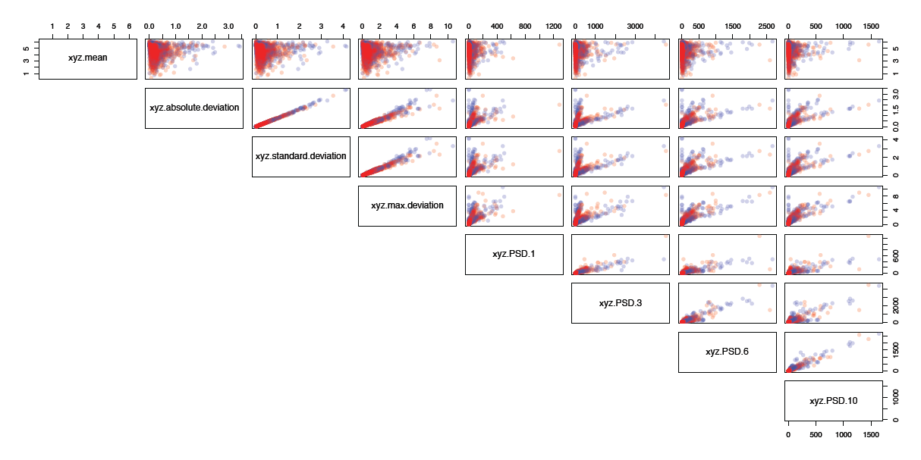
Feature Engineering

Slide 7
Methods
Two-step process
1. Four classification methods were applied and tested to classify all hourly data points:
Linear Discriminant Analysis
Quadratic Discriminant Analysis
Support Vector Machine
Random Forest
2. Results were summarized for each user:
Proportion of of data points of a user predicted to have the PD class = Probability that the user has PD
If this probability > 0.5, the user is predicted to have PD

Slide 8
Results
Method performance was assessed using leave-one (user)-out cross validation error
The first three classifiers performed poorly, predicting the test/left-out user to have PD in all 16 cases
However, the random forest had superior performance with 100% prediction accuracy

Slide 9
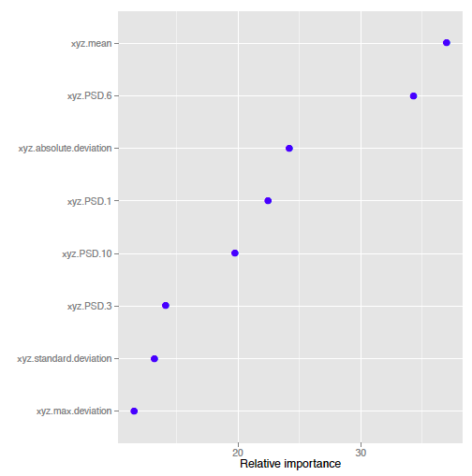
Results
Finally, I applied RF to the full data set
Variable importance plot show that the average hourly mean acceleration and PSD in the 6Hz band seem to be the most important variables

Slide 10
Method Benchmarking
My proposed method performed as well as Brunato et al.’s method, despite its comparative simplicity and its use of only the accelerometer data
A fair comparison of my method and the other two winning methods could not be made as different metrics were used, however, it does appear to be superior given the high prediction accuracy

Slide 11
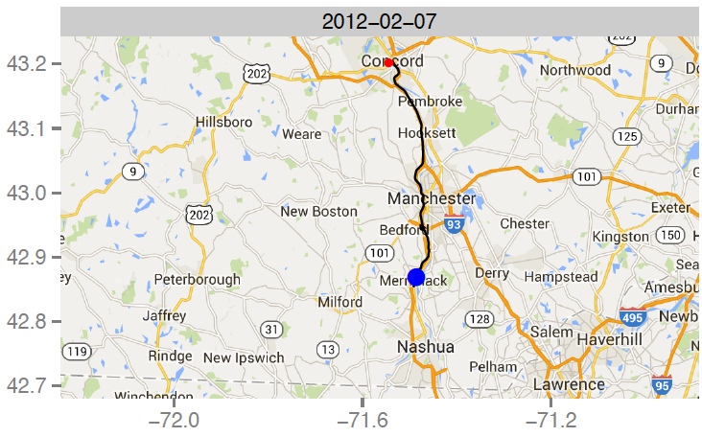
Additional analysis
How much can be gleaned from GPS data of smartphone users?

Slide 12
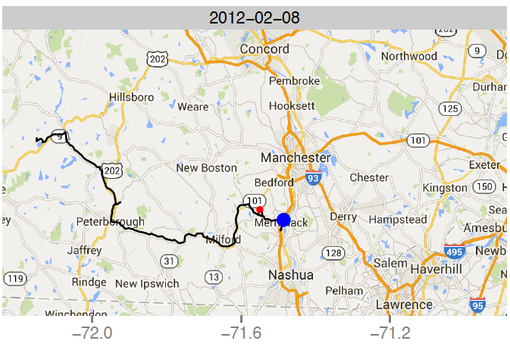
Additional analysis
How much can be gleaned from GPS data of smartphone users?

Slide 13
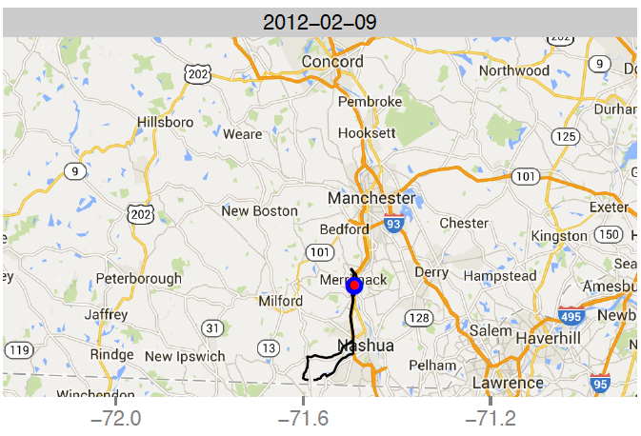
Additional analysis
How much can be gleaned from GPS data of smartphone users?

Slide 14
Additional analysis
Possible to determine from GPS data the user’s
home
daily movement patterns and travel patterns
time spent at each location
mode of transport (e.g. car vs bicycle vs public bus/subway)
whether the user is a PD patient or a healthy control (the hypothesis being that someone with PD is likely to move around less).
could not be generalized as there were many confounding variables such as age and occupation

Slide 15
Discussion
While initial results of my proposed method show a lot of potential, more training and testing on data from a larger study group of smartphone users is needed to assess if the results can indeed be generalized to a larger population
It would be interesting to explore if there is any medical basis for the importance of the variable PSD in the 6Hz band
The GPS data analysis raises important ethical questions and privacy concerns for the use and analysis of smartphone data as too much information aside from those for the study aims is revealed. How can judicious use of GPS data be regulated, or how can GPS data be appropriately anonymized/hashed?

