Slide 1
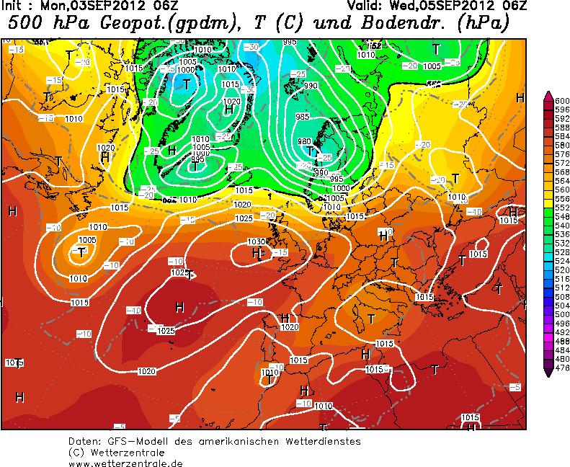
Weather Prediction Visualization
Jeroen Hofman
Computational Science

