Slide 1


EMPIRICAL DATA FOR REAL NETWORKS
Pathlenght
Clustering
Degree Distr.
P(k) ~ k^{-γ}
Regular network
P(k)=δ(k-k_{d})
Erdos-
Renyi
Watts-
Strogatz
Exponential
Barabasi-Albert
P(k) ~ k^{-γ}
Network Science: Evolving Network Models February 14, 2011
Notes:
As we can see, the BA model gets approximatelly right the small world effect, the degree distribution. When it comes to the clustering coefficient, the bad news is that it still decreases with the system size. The good news, is that it decreases slower that the ER prediction. Most important, however, the real difference is this: the model is really a modeling platform, that can be adjusted to the properties of real networks– we will see that in fact it can generate a finite, system size independnet clustering coefficient, if our main goal is to do just that.

Slide 2

Class 4: It’s a Small World After All
Dr. Baruch Barzel
Network Science: Small World February 2, 2011

Slide 3
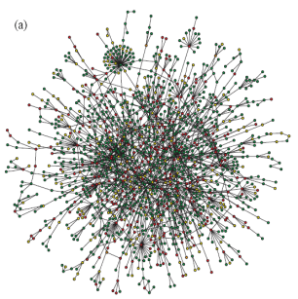
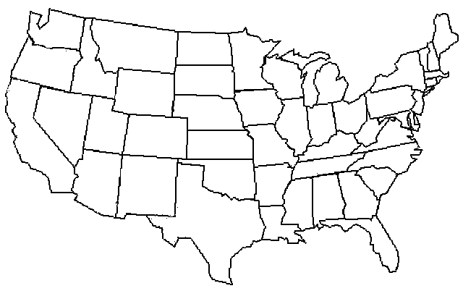
Milgram’s Six Degrees
The first chain letters
The destination: Boston, Massachusetts
Starting Points: Omaha, Nebraska & Wichita, Kansas
SIX DEGREES
Travers and Milgram, Sociometry 32,425 (1969)

Slide 4
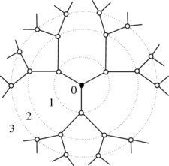

The Exploding Volume of Networks
The secret behind the small world effect –
Looking at the network volume

Slide 5
The Exploding Volume of Networks
The secret behind the small world effect –
Looking at the network volume
Polynomial growth

Slide 6
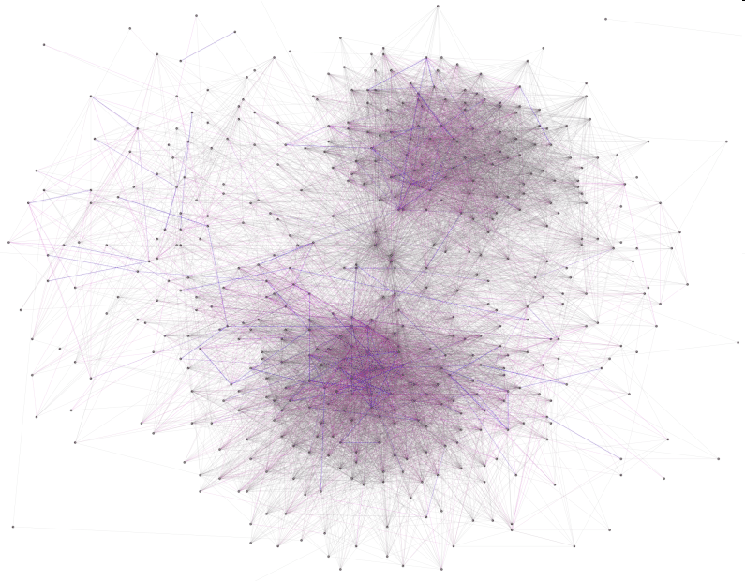
Clustering vs. Randomness
A network can be a small world as long as clustering can be ignored
Where should we place the social network?
Clustered
Random

Slide 7
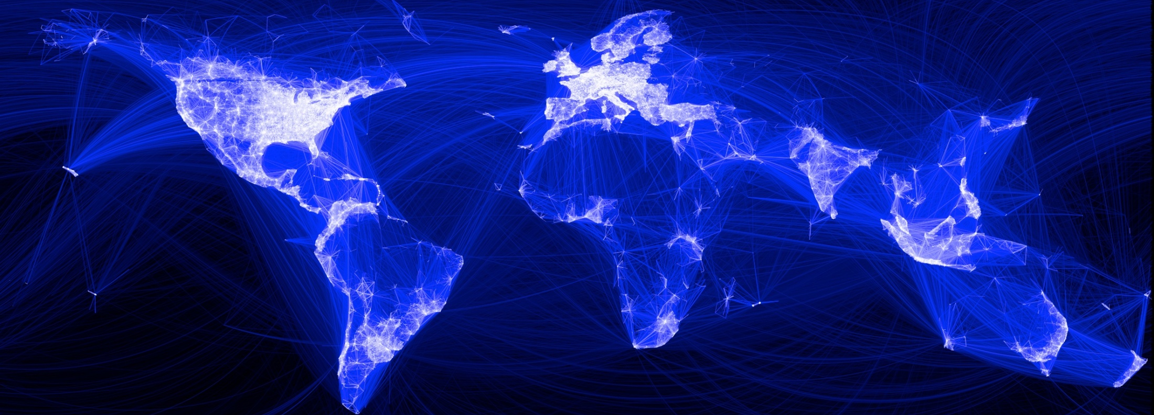
Watts Going on with Social Networks
Could a network which is so strongly locally structured be at the same time a small world?

Slide 8
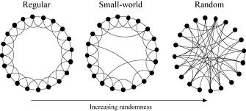
Watts Going on with Social Networks
The solution is to merge structure and randomness
The Watts Strogatz Model:
Start with a lattice network.
For every edge rewire with a probability β.
Watts and Strogatz, Nature 393,409 (1998)

Slide 9
Watts Going on with Social Networks
The solution is to merge structure and randomness
For
Watts and Strogatz, Nature 393,409 (1998)

Slide 10

Watts Going on with Social Networks
The solution is to merge structure and randomness
Watts and Strogatz, Nature 393,409 (1998)

Slide 11
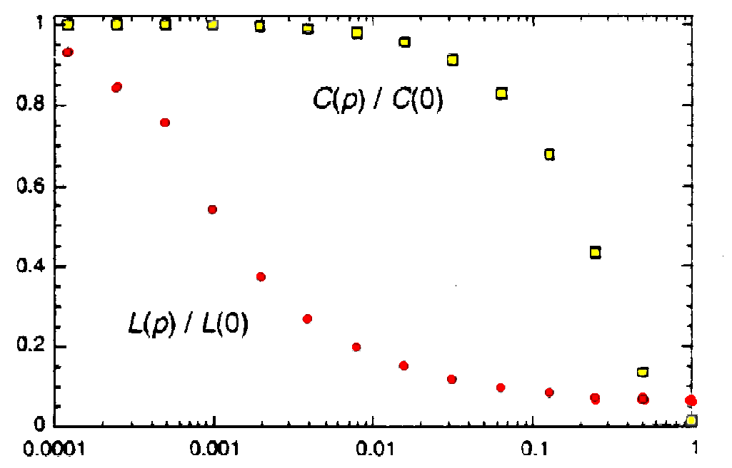
Watts Going on with Social Networks
The solution is to merge structure and randomness
The Watts Strogatz Model:
It takes a lot of randomness to ruin the clustering, but a very small amount to overcome locality
Watts and Strogatz, Nature 393,409 (1998)

Slide 12
Class 7: Scale-Free Property
Prof. Albert-László Barabási
Dr. Baruch Barzel, Dr. Mauro Martino
Network Science: Scale-Free Property February 7, 2011

Slide 13
Regular network
Empirical data for real networks
Pathlenght
Clustering
Degree Distr.
P(k) ~ k^{-γ}
P(k)=δ(k-k_{d})
Erdos-
Renyi
Watts-
Strogatz
Exponential
Network Science: Random Graphs January 31, 2011
Notes:
As a universal feature, they do well in clustering and the path lenghts. However, they all fail in the degree distribution. Hence we need models the fix that problem. As will see, this is not a trivial feature– many properties of real networks are determined primarily by the degree distribution.

Slide 14
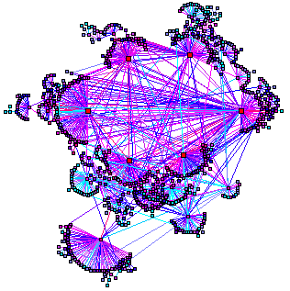
WORLD WIDE WEB
Nodes: WWW documents Links: URL links
Over 3 billion documents
ROBOT: collects all URL’s found in a document and follows them recursively
Expected
P(k) ~ k^{-γ}
Found
R. Albert, H. Jeong, A-L Barabasi, Nature, 401 130 (1999).
Network Science: Scale-Free Property February 7, 2011

Slide 15
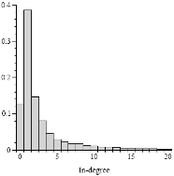
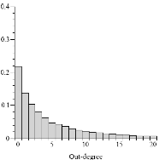
Degree distribution of the WWW
Expected
P(k) ~ k^{-γ}
Found
R. Albert, H. Jeong, A-L Barabasi, Nature, 401 130 (1999).
Network Science: Scale-Free Property February 7, 2011

Slide 16
The difference between a power law and an exponential distribution
1
0.6
0.2
20
40
60
80
100
Above a certain x value, the power law is always higher than the exponential.
Network Science: Scale-Free Property February 7, 2011
Notes:
There appears to be little difference between them at the first look. Yet. There is some quite relevant different: the at high degrees the power law curve is always higher than the exponential.

Slide 17
The difference between a power law and an exponential distribution
This difference is particularly obvious if we plot them on a log vertical scale: for large x there are orders of magnitude differences between the two functions.
0
1
2
3
10
10
10
10
10
0
10
-1
10
-2
10
-3
loglog
semilog
10
-4
Network Science: Scale-Free Property February 7, 2011

Slide 18
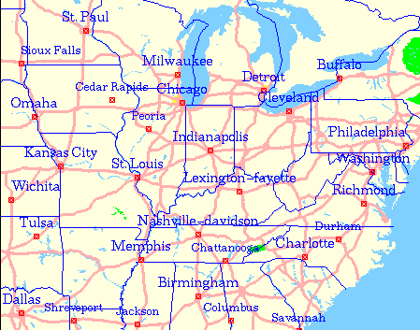
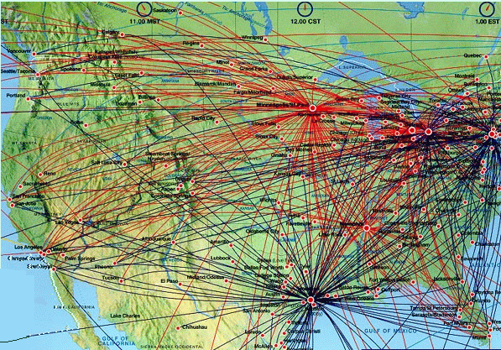
What does the difference mean? Visual representation.
Nodes: WWW documents Links: URL links
Exponential Network
Over 3 billion documents
ROBOT: collects all URL’s found in a document and follows them recursively
Expected
P(k) ~ k^{-γ}
Scale-free Network
Found
R. Albert, H. Jeong, A-L Barabasi, Nature, 401 130 (1999).
Network Science: Scale-Free Property February 7, 2011

Slide 19
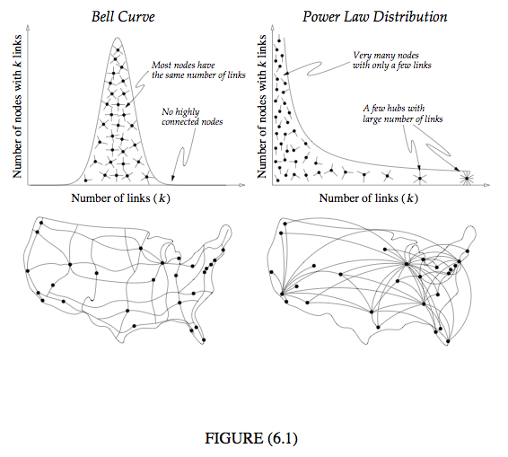
WORLD WIDE WEB
Network Science: Scale-Free Property February 7, 2011
Notes:
There appears to be little difference between them at the first look. Yet. There is some quite relevant different: the at high degrees the power law curve is always higher than the exponential.

Slide 20
Scale-free networks: Definition
Definition:
Networks with a power law tail in their degree distribution are called
‘scale-free networks’
Slides after Dante R. Chialvo
Network Science: Scale-Free Property February 7, 2011
Slides after Dante R. Chialvo
Notes:
There appears to be little difference between them at the first look. Yet. There is some quite relevant different: the at high degrees the power law curve is always higher than the exponential.

Slide 21
DISTANCES IN RANDOM GRAPHS
Random graphs tend to have a tree-like topology with almost constant node degrees.
nr. of first neighbors:
nr. of second neighbors:
nr. of neighbours at distance d:
estimate maximum distance:
Network Science: Random Graphs January 31, 2011

Slide 22
Distances in scale-free networks
DISTANCES IN SCALE-FREE NETWORKS
Size of the biggest hub is of order O(N). Most nodes can be connected within two layers of it, thus the average path length will be independent of the system size.
The average path length increases slower than logarithmically. In a random network all nodes have comparable degree, thus most paths will have comparable length. In a scale-free network the vast majority of the path go through the few high degree hubs, reducing the distances between nodes.
Some key models produce γ=3, so the result is of particular importance for them. This was first derived by Bollobas and collaborators for the network diameter in the context of a dynamical model, but it holds for the average path length as well.
The second moment of the distribution is finite, thus in many ways the network behaves as a random network. Hence the average path length follows the result that we derived for the random network model earlier.
Small World
Cohen, Havlin Phys. Rev. Lett. 90, 58701(2003); Cohen, Havlin and ben-Avraham, in Handbook of Graphs and Networks, Eds. Bornholdt and Shuster (Willy-VCH, NY, 2002) Chap. 4; Confirmed also by: Dorogovtsev et al (2002), Chung and Lu (2002); (Bollobas, Riordan, 2002; Bollobas, 1985; Newman, 2001

Slide 23
SUMMARY OF THE BEHAVIOR OF SCALE-FREE NETWORKS
γ^{collab}
γ^{metab}
γ^{intern}
γ^{synonyms}
γ^{w}_{in}
γ^{w}_{out}
γ^{actor}
γ^{cita}
γ^{sex}
γ=1
γ=2
γ=3
<k²> diverges
<k²> finite
<k> diverges
<k> finite
Ultra small world behavior
Small world
Regime full of anomalies…
The scale-free behavior is relevant
Behaves like a random network
Network Science: Scale-Free Property February 7, 2011

Slide 24
SUMMARY OF THE BEHAVIOR OF SCALE-FREE NETWORKS
γ^{collab}
γ^{metab}
γ^{intern}
γ^{synonyms}
γ^{w}_{in}
γ^{w}_{out}
γ^{actor}
γ^{cita}
γ^{sex}
γ=1
γ=2
γ=3
<k²> diverges
<k²> finite
Regime full of anomalies…
The scale-free behavior is relevant
Behaves like a random network
Why are most exponents in this regime?
Network Science: Scale-Free Property February 7, 2011

Slide 25
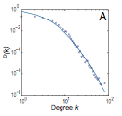

Why don’t we see networks with exponents in the range of γ=4,5,6, etc?
In order to document a scale-free networks, we need 2-3 orders of magnitude scaling. That is, K_{max}~ 10³
However, that constrains on the system size we require to document it.
For example, to measure an exponent γ=5,we need to maximum degree a system size of the order of
Mobile Call Network
N=4.6x10⁶
γ=8.4
Onella et al. PNAS 2007

Slide 26
Class 7: Evolving Network Models
Prof. Albert-László Barabási
Dr. Baruch Barzel, Dr. Mauro Martino
Network Science: Evolving Network Models February 14, 2011

Slide 27
Empirical findings for real networks
P(k) ~ k^{-γ}
Small World:
distances scale
logarithmically with the network size
Clustered:
clustering coefficient does not depend on network size.
Scale-free:
The degrees follow a power-laws distribution.
Network Science: Evolving Network Models February 14, 2011

Slide 28
BA MODEL - Preferential Attachment
Where will the new node link to?
ER, WS models: choose randomly.
PREFERENTIAL ATTACHMENT:
the probability that a node connects to a node with k links is proportional to k.
New nodes prefer to link to highly connected nodes.
Barabási & Albert, Science 286, 509 (1999)
Network Science: Evolving Network Models February 14, 2011

Slide 29
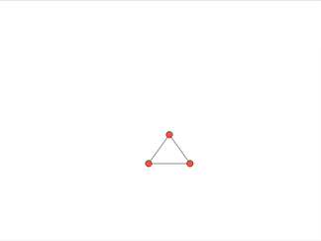
BA MODEL - Origin of SF networks: Growth and preferential attachment
(1) Networks continuously expand by the addition of new nodes
GROWTH:
add a new node with m links
WWW : addition of new documents
PREFERENTIAL ATTACHMENT:
the probability that a node connects to a node with k links is proportional to k.
(2) New nodes prefer to link to highly connected nodes.
WWW : linking to well known sites
P(k) ~k⁻³
Barabási & Albert, Science 286, 509 (1999)
Network Science: Evolving Network Models February 14, 2011

Slide 30
Regular network
EMPIRICAL DATA FOR REAL NETWORKS
Pathlenght
Clustering
Degree Distr.
P(k) ~ k^{-γ}
P(k)=δ(k-k_{d})
Erdos-
Renyi
Watts-
Strogatz
Exponential
Barabasi-Albert
P(k) ~ k^{-γ}
Network Science: Evolving Network Models February 14, 2011
Notes:
As a universal feature, they do well in clustering and the path lenghts. However, they all fail in the degree distribution. Hence we need models the fix that problem. As will see, this is not a trivial feature– many properties of real networks are determined primarily by the degree distribution.

Slide 31
Distances in scale-free networks
DISTANCES IN SCALE-FREE NETWORKS
Size of the biggest hub is of order O(N). Most nodes can be connected within two layers of it, thus the average path length will be independent of the system size.
The average path length increases slower than logarithmically. In a random network all nodes have comparable degree, thus most paths will have comparable length. In a scale-free network the vast majority of the path go through the few high degree hubs, reducing the distances between nodes.
Some key models produce γ=3, so the result is of particular importance for them. This was first derived by Bollobas and collaborators for the network diameter in the context of a dynamical model, but it holds for the average path length as well.
The second moment of the distribution is finite, thus in many ways the network behaves as a random network. Hence the average path length follows the result that we derived for the random network model earlier.
Small World
Cohen, Havlin Phys. Rev. Lett. 90, 58701(2003); Cohen, Havlin and ben-Avraham, in Handbook of Graphs and Networks, Eds. Bornholdt and Shuster (Willy-VCH, NY, 2002) Chap. 4; Confirmed also by: Dorogovtsev et al (2002), Chung and Lu (2002); (Bollobas, Riordan, 2002; Bollobas, 1985; Newman, 2001

Slide 32
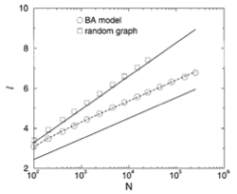

PATH LENGTHS IN THE BA MODEL
Bollobas, Riordan, 2002
Network Science: Evolving Network Models February 14, 2011

Slide 33
SUMMARY: PROPERTIES OF THE BA MODEL
Nr. of nodes:
Nr. of links:
Average degree:
Degree dynamics
Degree distribution:
Average Path Length:
Clustering Coefficient:
β: dynamical exponent
γ: degree exponent
The network grows, but the degree distribution is stationary.
Network Science: Evolving Network Models February 14, 2011

Slide 34
EVOLVING NETWORK MODELS
The BA model is only a minimal model.
Makes the simplest assumptions necessary for a sf network to emerge:
linear growth
linear preferential attachment
Does not capture
variations in the shape of the degree distribution
variations in the degree exponent
the size-independent clustering coefficient
Hypothesis:
The BA model can be adapted to describe most features of real networks.
We need to incorporate mechanisms that are known to take place in real networks: addition of links without new nodes, link rewiring, link removal; node removal, constraints or optimization
Network Science: Evolving Network Models February 14, 2011

Slide 35
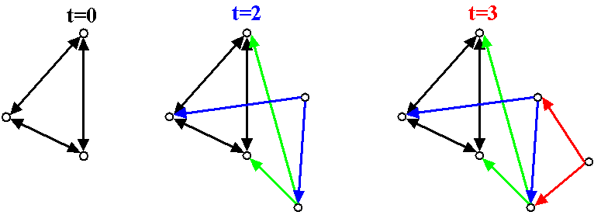
(the simplest way to change the degree exponent)
BA ALGORITHM WITH DIRECTED EDGES
Undirected BA network:
Directed BA network:
β=1: dynamical exponent
γ_{in}=2: degree exponent; P(k_{out})=δ(k_{out}-m)
Undirected BA: β=1/2; γ=3
Network Science: Evolving Network Models February 14, 2011
γ = 3
A.-L.Barabási, R. Albert and H. Jeong, Physica A 272, 173 (1999)

Slide 36
EXTENDED MODEL: Other ways to change the exponent
Extended Model
prob. p : internal links
prob. q : link deletion
prob. 1-p-q : add node
P(k) ~ (k+κ(p,q,m))^{-γ(p,q,m)}
γ ∈ [1,∞)
Network Science: Evolving Network Models February 14, 2011
Notes:
It also

Slide 37
EXTENDED MODEL: Small-k cutoff
P(k) ~ (k+κ(p,q,m))^{-γ(p,q,m)} γ ∈ [1,∞)
Extended Model
prob. p : internal links
prob. q : link deletion
prob. 1-p-q : add node
→Predicts a small-k cutoff!!!
a correct model should predict all aspects of the degree distribution, not only the degree exponent.
Degree exponent is a continuous function of p,q, m
p=0.937
m=1
κ = 31.68
γ = 3.07
Actor network
Network Science: Evolving Network Models February 14, 2011
Notes:
It also

Slide 38
THE LAST PROBLEM: HIGH, SYSTEM-SIZE INDEPENDENT C(N)
Pathlenght
Clustering
Degree Distr.
P(k) ~ k^{-γ}
Regular network
P(k)=δ(k-k_{d})
Erdos-
Renyi
Watts-
Strogatz
Exponential
Barabasi-Albert
P(k) ~ k^{-γ}
Network Science: Evolving Network Models February 14, 2011
Notes:
As we can see, the BA model gets approximatelly right the small world effect, the degree distribution. When it comes to the clustering coefficient, the bad news is that it still decreases with the system size. The good news, is that it decreases slower that the ER prediction. Most important, however, the real difference is this: the model is really a modeling platform, that can be adjusted to the properties of real networks– we will see that in fact it can generate a finite, system size independnet clustering coefficient, if our main goal is to do just that.

Slide 39
LESSONS LEARNED: evolving network models
There is no universal exponent characterizing all networks.
Growth and preferential attachment are responsible for the emergence of the scale-free property.
The origins of the preferential attachment is system-dependent.
Modeling real networks:
identify the microscopic processes that take place in the system
measure their frequency from real data
develop dynamical models that capture these
processes.
5. If the model is correct, it should correctly predict not only the degree exponent, but both small and large k-cutoffs.
Network Science: Evolving Network Models February 14, 2011

Slide 40
The end
Network Science: Evolving Network Models February 14, 2011

