Slide 1
High Paying Jobs in the Finance Sector and their Relationship with Educational Investment
Group 4: Jack O’Connor, Michael Zheng, and Tyler Panfil

Slide 2
Explain the Datasets
Census Finance and Insurance Summary Statistics https://www.census.gov/data/tables/2017/econ/economic-census/naics-sector-52.html
School Data
https://www.census.gov/data/tables/2017/econ/school-finances/secondary-education-finance.html
Kaggle School Data
https://www.kaggle.com/noriuk/us-education-datasets-unification-project?select=states_all_extended.csv

Slide 3
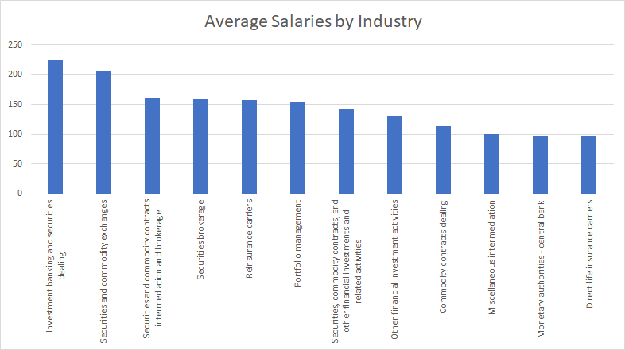
Which industries have the highest salaries?
Investment banking and securities dealing ($223,619 average salary)
Securities and commodity exchanges ($205,300 average salary)
Securities and commodity contracts intermediation and brokerage ($160,014 average salary)

Slide 4
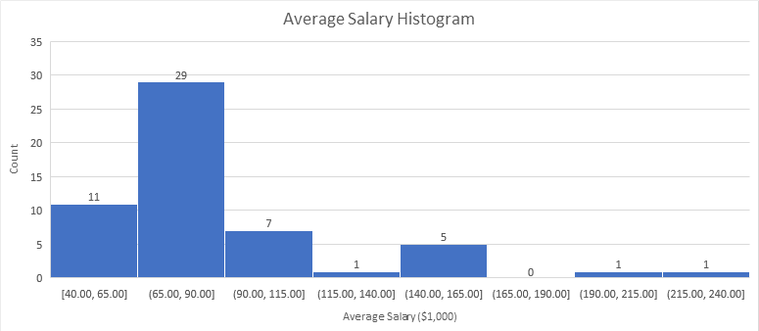
Distribution of Average Salaries

Slide 5
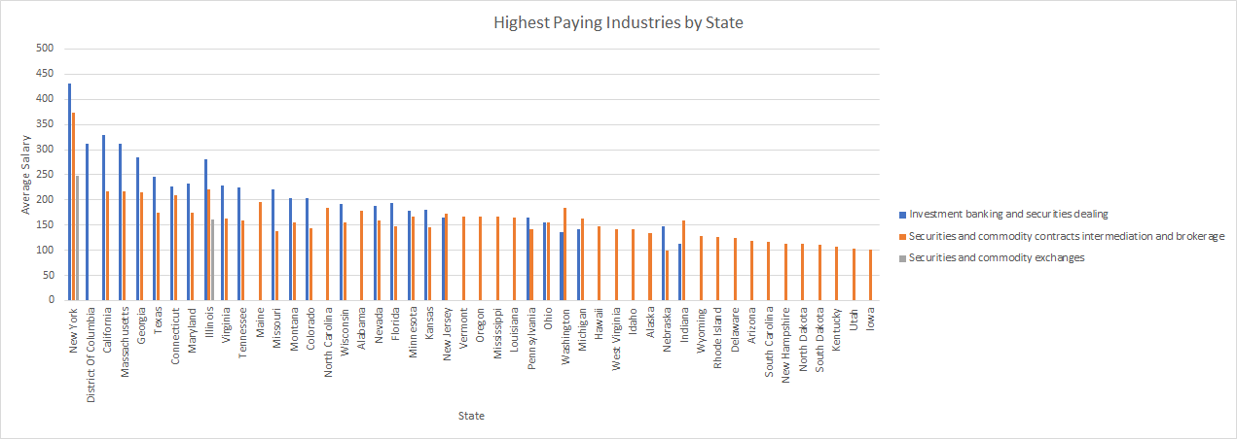
Which states have the highest salaries for the three top paying industries?

Slide 6
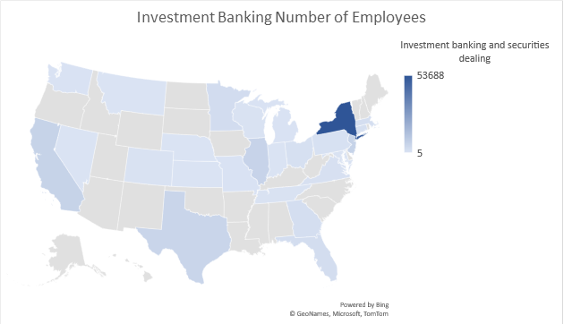
Where are the jobs in the high paying industries?

Slide 7
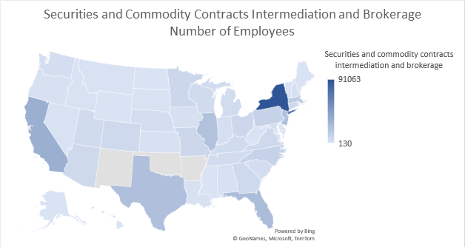
Securities and Commodity Contracts Intermediation and Brokerage

Slide 8
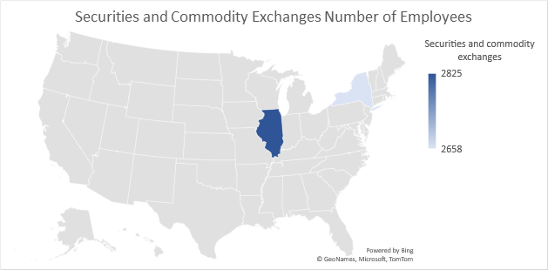
Securities and Commodity Exchanges

Slide 9
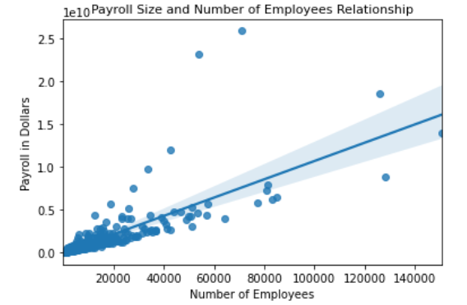
Multivariate ML Prediction for Industry Payroll
Prediction of Industry Payroll
Each Dot Represents a State and Industry in the Financial Sector resulting in about 1000 dots in this graph
Only 2 significant predictive variables
Number of Employees was the most important variable
The 2nd most important variable was Company Revenue
NY- Investment banking and securities dealing
NY- Portfolio management
Notes:
Add: use some blank space to indicate what the outliers are. Use text and arrows pointing to points far from the line.

Slide 10
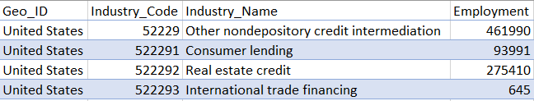
Lost Census Data
Census Data breaks down into more granular industry categories
The less granular data is not replaced
More granular data is simply placed on the lower row
This effectively duplicates the data in a different levels of granularity
Notes:
The Census groups data together with different Geo_IDs like the United States, or California with different sectors. Then these sectors are split into more granular sectors. Unfortunately, Census data doesn’t get rid of the less granular data in favor of the more granular data, but rather stacks them on top of each other, thus duplicating the data at 2 different levels of granularity. As you can see in the excel cells I am using for my example, we have the Sector Name “Other Nondespository Credit Intermediation” with an employment of 461,990. The next 3 rows are just more granular breakdowns of “Other Nondespository Credit Intermediation” thus the employment is accounted for twice. However we discovered that the employment summation of these 3 rows did not equal the sector that they were derived from. In fact we noticed this occurred often when Census data was broken down into more granular sectors. This led us to conclude that when they were being broken down into more granular sectors, data was often lost.

Slide 11
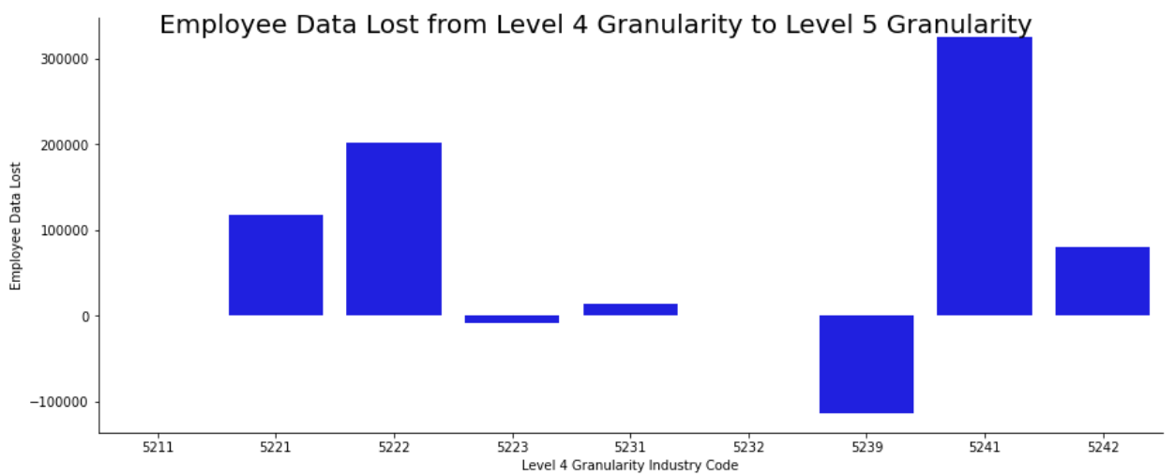
Lost Census Data- Continued

Slide 12
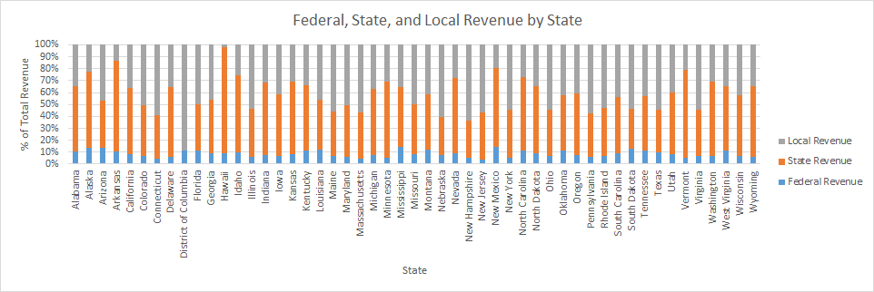
States’ total education revenue broken down by Federal, State, and Local revenue

Slide 13
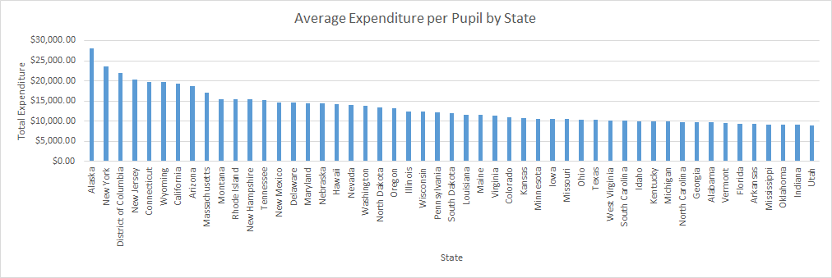
Which states spend the most on primary and secondary education per pupil?
States with Highest Incomes:
New York
California
Texas
Illinois
DC

Slide 14
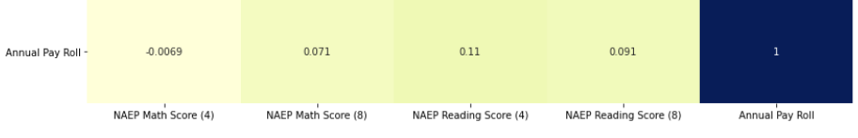
Is there a relationship between how a state’s primary education performance, and a state’s financial sector payroll?
Census Finance & Insurance Summary Statistics:
Annual Payroll: annual payroll of a state’s financial sector industry
LEFT JOINED (Primary/Foreign Key = GEO_TTL/STATE) w/
Kaggle School Data:
NAEP Math Score 4: Average score of a state’s fourth graders on the NAEP Math exam.
NAEP Math Score 8: Average score of a state’s eighth graders on the NAEP Math exam.
NAEP Reading Score 4: Average score of a state’s eighth graders on the NAEP Reading exam.
NAEP Reading Score 8: Average score of a state’s eighth graders on the NAEP Reading exam.
Notes:
Introduction:
In order to determine whether there is a relationship between how well a state’s students perform in school and the state’s financial sector’s payroll, we ran a correlation matrix between the sample variables payroll, NAEP Math Score 4 &8, and NAEP Reading Score 4 & 8.
Each sample used to generate the correlation matrix corresponds to a state’s financial sector industry.
The variable Annual Payroll is from the Finance and Insurance Industry Summary Statistics data set. It includes information about the annual payroll of a state’s financial sector industry.
The NAEP Test Score variables were obtained from kaggle’s us-education dataset .It includes information about the average result of a state’s fourth and eighth graders’ performance on the National Assessment of Educational Progress test.
Observation:
Take Away:
Transition:

Slide 15
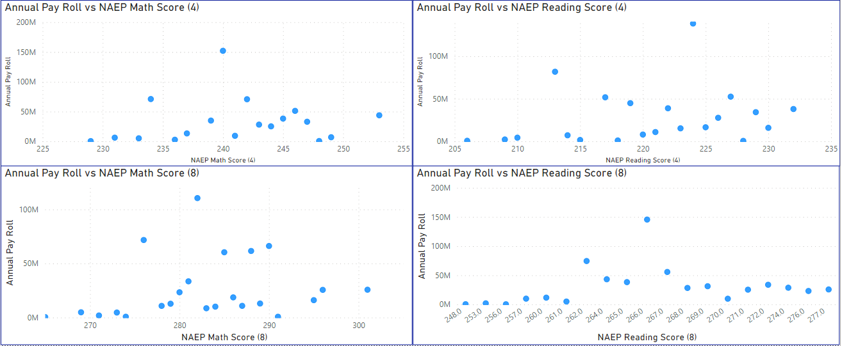
As exam scores increase, annual payroll does not change based on a predictable pattern.
Outliers alongs the Annual Pay Roll axis are from samples belonging to California, New York, and Texas.
Notes:
Be careful to explain since this is complex
Introduction:
Observation:
Take Away:
Transition:

Slide 16
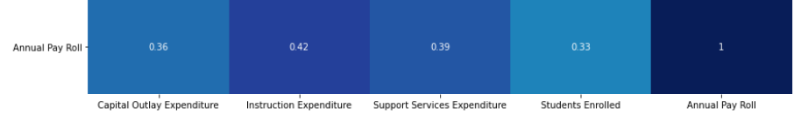
Is there a relationship between a state’s primary education expenditure, and a state’s financial sector payroll?
Census Finance & Insurance Summary Statistics:
Annual Payroll: annual payroll of a state’s financial sector industry
LEFT JOINED (Primary/Foreign Key = GEO_TTL/STATE) w/
Kaggle School Data:
Support Services Expenditure
Instruction Expenditure
Capital Outlay Expenditure
Students Enrolled
Notes:
The top left is so dark it takes away from the fact that these correlations are much more significant than the last matrix showed. Maybe don’t show the top 4X4 grid?
Introduction:
Observation:
Take Away:
Transition:

Slide 17
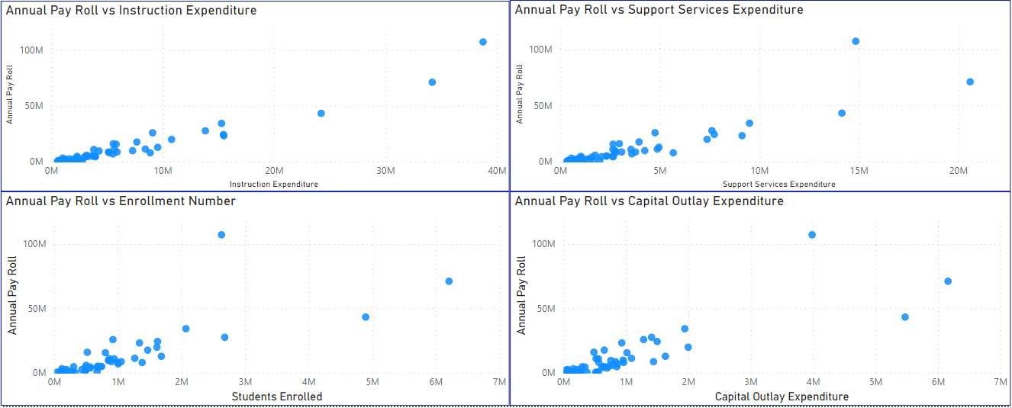
As exam scores increase, annual payroll increases.
Outliers alongs the Annual Pay Roll axis are from samples belonging to California, New York, and Texas.
Notes:
Maybe not necessary to show rows of data at top.
Introduction:
Observation:
Take Away:
Transition:

Slide 18
Areas of further study
For further analysis on the impact of education on the finance & insurance sector:
Acquire academic performance and expenditure data for higher education, specifically business colleges.
For a more detailed analysis of the finance & insurance sector:
Acquire employee level data such as average age, number of years of experience, college degree obtained, etc.

Slide 19
Thank you!
Questions?

