Slide 1


Missing Migrant Dataset
Kristen Logue, Robert Eason, Jack O’Connor, Jaci Willoughby
Syracuse University iSchool
IST 687 – Data Analytics
Winter 2019

Slide 2
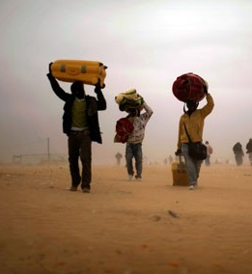
Objective
Our goal is to answer four questions:
What are the most dangerous routes?
What are the most common ways migrants die?
Is it possible to predict deaths in the future?
What can be done to prevent deaths in the future?
To do this we:
Cleaned the data to prepare the dataset for further analysis.
Found and coded attributes of each region, route and death using linear regression.
Created various charts to illustrate these results.
Made predictions of future deaths that allowed us to develop actionable insights.

Slide 3
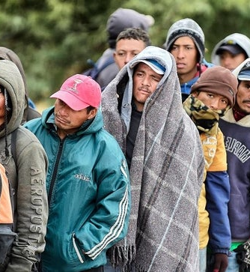
Data Set Description
The Missing Migrant Dataset was derived from information gathered by The Missing Migrant Program beginning October of 2013. The dataset tracks the deaths of migrants and refugees who have gone missing along worldwide migration routes. The Missing Migrant Project has since become a recognized and valuable resource of information for Governments and Media outlets all over the world.
The data is gathered from a variety of sources and organizations, depending on the location of the migration route. Information has been shared by the Coast Guard, Medical Examiners, Media Sources and from interviews with surviving immigrants.
The International Organization for Migration (IMO) defines a migrant as any person who is moving or has moved across an international border or within a State away from his/her habitual place of residence, regardless of
(1) the person’s legal status;
(2) whether the movement is voluntary or involuntary;
(3) what the causes for the movement are; or
(4) what the length of the stay is.
The Data Set counts migrants who have died or gone missing at the external borders of states, or in the process of migration towards an international destination. It does not include deaths that occur in immigration detention facilities, during deportation, or after forced return to a migrant’s homeland.

Slide 4
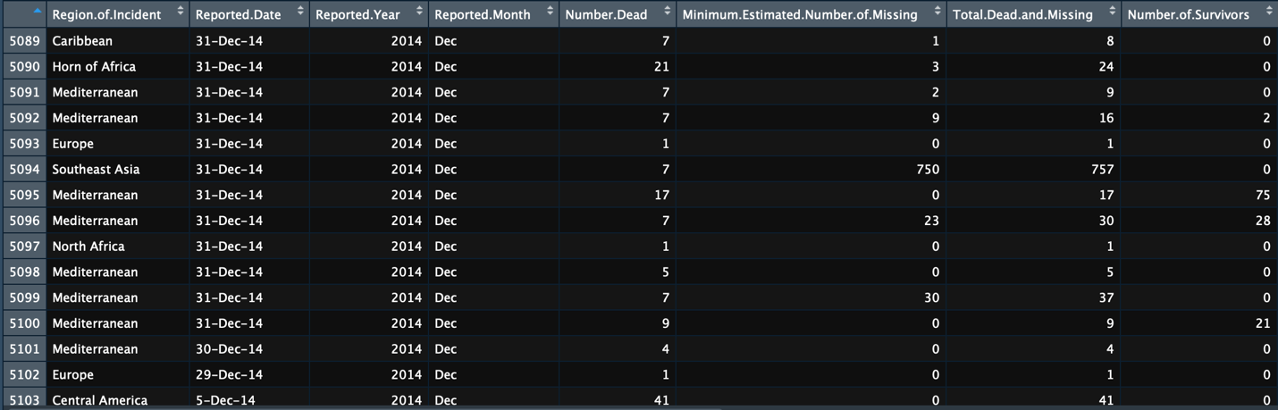
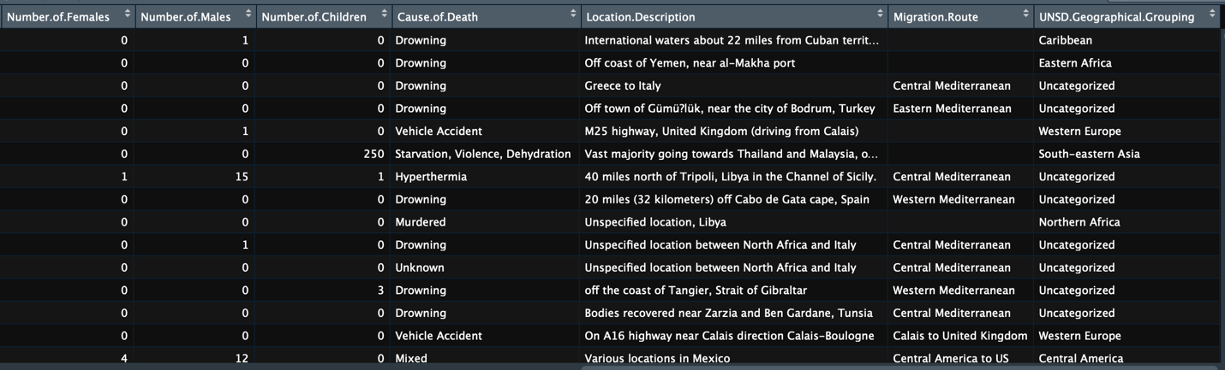
Data Cleaning
library(readxl)
# READ IN DATA
miss_mig <- read_excel("Syracuse/IST687/Project/Missing_Migrants_Dataset_2019OCT
0.xlsx")
View(miss_mig)
# SORT BY VECTOR NAME [Z] THEN [X]
miss_mig[with(miss_mig, order(miss_mig$`Reported Year`, miss_mig$`Reported Month`, miss_mig$`Region of Incident`)),]
# USE MEAN TO REPLACE NA GROUPING BY REGION OF INCIDENT
library(tidyverse)
new_df <- miss_mig %>% group_by('Region of Incident') %>%
mutate_all(funs(ifelse(is.na(.), mean(., na.rm = TRUE),.)))
# REPLACE ALL OTHER NA'S WITH 0 (ZEROES)
miss_mig[is.na(miss_mig)] <- 0
# REMOVE UNUSED COLUMNS
miss_mig_cln <- miss_mig[-c(14,15,18,20)]
miss_mig_cln
Steps:
Read in data from excel to R Markdown
Sort data by vector name
Replace NA’s with zeros
Remove irrelevant columns

Slide 5
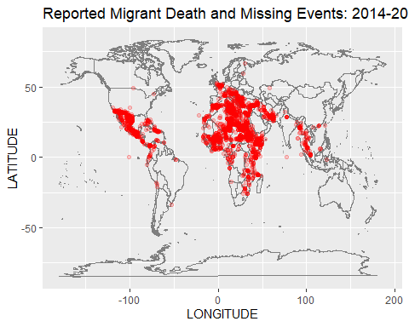
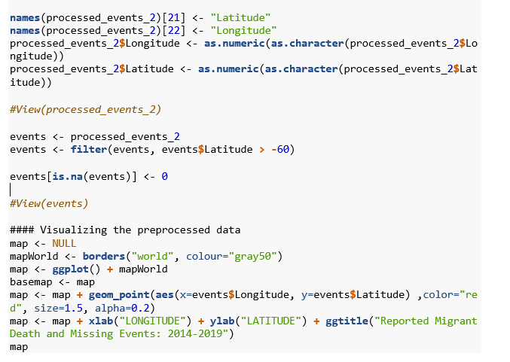
The Most Dangerous Routes: Visual Representation
Q1
This visual representation of migrant deaths reported shows high concentrations in the Mediterranean, North Africa and Sub-Saharan Africa.

Slide 6
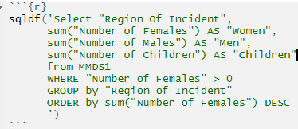
Missing or Dead Migrant Totals
Q1
Migration Route | Women | Men | Children | Total # of Dead or Unknown
Mediterranean | 811 | 962 | 408 | 18,995
North Africa | 265 | 122 | 106 | 4,461
Sub-Saharan Africa | 207 | 63 | 71 | 2,241
Southeast Asia | 150 | 83 | 89 | 2,227
US-Mexico Border | 97 | 22 | 13 | 1,832
Horn of Africa | 70 | 113 | 37 | 1,182
Middle East | 60 | 23 | 40 | 666
Central America | 39 | 48 | 17 | 621
Caribbean | 38 | 42 | 5 | 491
Europe | 35 | 68 | 17 | 490
South Asia | 18 | 6 | 5 | 289
South America | 13 | 8 | 2 | 99
East Asia | 1 | 2 | 0 | 52
Central Asia | 0 | 0 | 0 | 31
North America | 1 | 0 | 0 | 2
Based on total dead or missing the most dangerous routes are the Mediterranean, North Africa and Sub-Saharan Africa.

Slide 7
Missing or Dead Migrant Percentages
Migration Route | % Dead & Missing
Mediterranean | 31%
North Africa | 82%
US-Mexico Border | 89%
Southeast Asia | 73%
Sub-Saharan Africa | 64%
Horn of Africa | 37%
Central America | 32%
Caribbean | 62%
Middle East | 45%
Europe | 57%
South Asia | 83%
South America | 61%
Central Asia | 91%
East Asia | 56%
North America | 100%
Q1
library (formattable)
MMDS1 <- sqldf('Select "Region Of Incident",
sum("Total Dead and Missing") AS "Dead and Missing",
sum("Number of Survivors") AS "Survivors"
from MMDS
WHERE "Total Dead and Missing" > 0
GROUP by "Region of Incident"
ORDER by sum("Total Dead and Missing") DESC')
MMDS1
MMDS1$"Total Migrants" <- MMDS1$`Dead and Missing` + MMDS1$`Survivors`
MMDS1$"DMpercent" <- MMDS1$'Dead and Missing'/MMDS1$'Total Migrants'
MMDS1$"DMpercent" <- percent(MMDS1$"DMpercent")
order(MMDS1$DMpercent)
MMDS1
Based on percentages of dead or missing the most dangerous routes are North-America, US-Mexico Border and Central Asia.

Slide 8
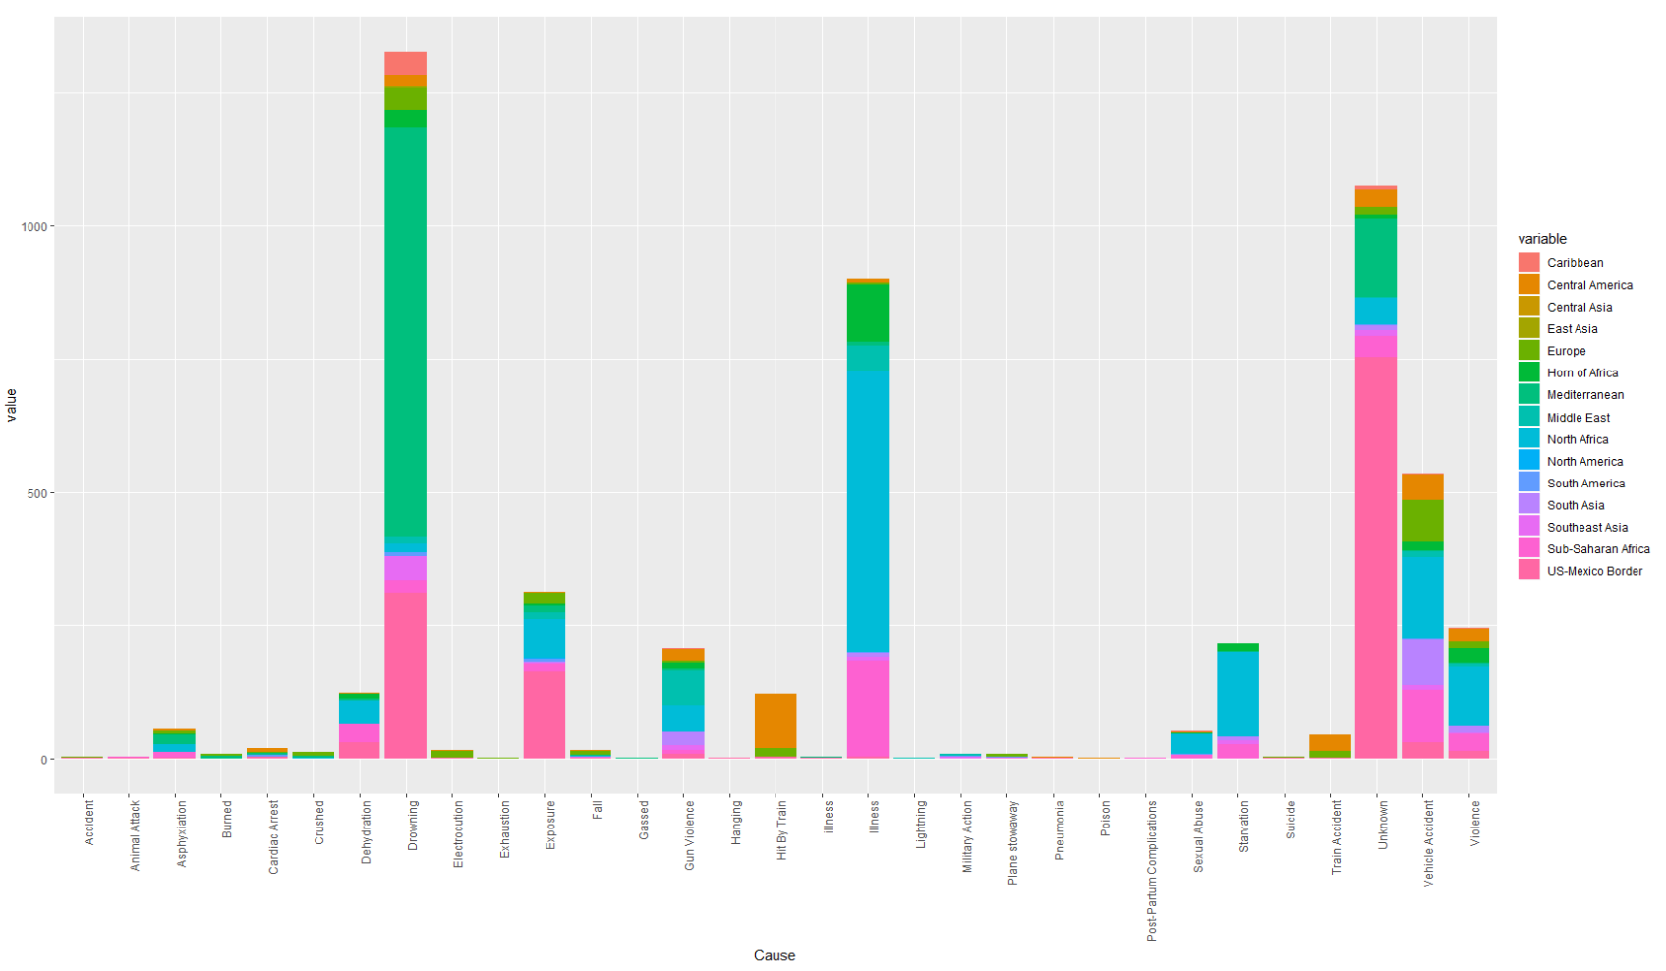
Circumstances Surrounding Deaths on Each Route
Q2
Drowning is the number one cause of death, followed by unknown causes, then illness that went untreated.

Slide 9
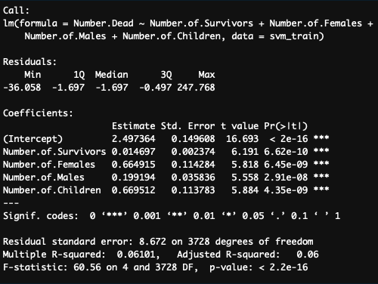
Predicting Future Deaths: Linear Model
Q3
# CLEAN THE DATA
svm_data <- subset(missing_mig, select = c(“Region.of.Incident”, “Reported.Date”, “Number.Dead”, “Minimum.Estimated.Number.of.Missing”, “Number.of.Survivors”, “Number.of.Females”, “Number.of.Males”, “Number.of.Children”,
“Cause.of.Death”, “Migration.Route”))
# BUILD A LINEAR MODEL
lin.mod <- lm(formula = Number.Dead ~ Number.of.Survivors” + Number.of.Females + Number.of.Males + Number.of.Children , data = svm_data)
Summary(lin.mod)
A linear model was run including only the data on number dead, their sex and age, and number of survivors. The P values are low for each of the independent variables, but the adjusted R^2 proves that the inputs do not explain the outputs. Only 6% of the variance in the output variable is explained by variance in the inputs. The variables included in this model are only the statistically significant variables.

Slide 10
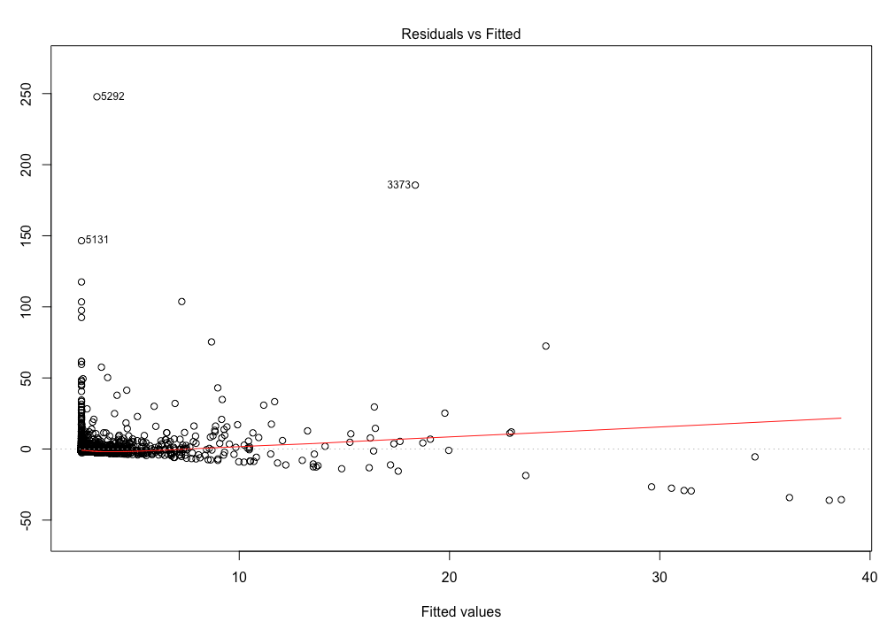
Predicting Future Deaths: Linear Residual Plot
Q3
plot(lin.mod) #cycle thorough plots for residual plot
Since our data on the number of migrant deaths was heavily concentrated between 1 and 10 with several outliers it was difficult to develop a useful linear model.

Slide 11
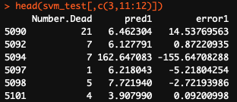
Predicting Future Deaths: SVM Model
Q3
# DIVIDE ROWS INTO TRAINING SETS
nrows <- nrow(svm_data)
sample_size <- round(nrows * .70)
training_index <- sample(1:nrows, size = sample_size, replace = FALSE)
svm_train <- svm_data[training_index, ]
svm_test <- svm_data[-training_index, ]
# TRAIN MODEL
library(kernlab)
ksvm_model <- ksvm(Number.Dead ~ ., data = svm_train, type = “eps_svr”, kernel = “vanilladot”) #Training error = .823517
pred1 <- predict(ksvm_model, newdata = svm_test)
svm_test$pred1 <- pred1
svm_test$error <- svm_test$Number.Dead – svm_test$pred1
The SVM model is not very accurate at predicting number of deaths. In some instances the prediction is very close, but in others the error is high..

Slide 12
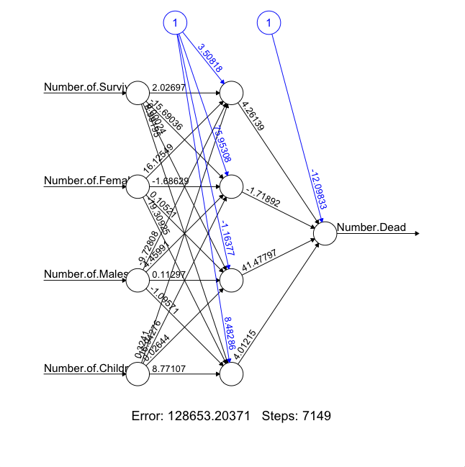
Predicting Future Deaths: Neural Network
Q3
library(neuralnet)
neural_network <- neuralnet(Number.Dead ~ Number.of.Survivors” + Number.of.Females + Number.of.Males + Number.of.Children, data = svm_train, hidden = 4, rep = 1, lifesign = “minimal”, linear.output = TRUE, threshold = 2)
The neural network is not any better at predicting number of deaths than the other models. The error on the neural network is high and offers little in prediction efficacy.

Slide 13
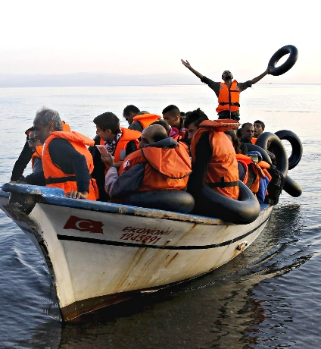
Conclusion: Preventing Deaths
Q4
Suggesting alternative routes
The most dangerous routes, based on migrant death percentages, are through North-America, US-Mexico Border and Central Asia. These routes should be avoided. Providing information on alternative routes to migrants would save lives.
Providing quick rescue efforts
The most migrant deaths occur on routes through the Mediterranean, North Africa and Sub-Saharan Africa. There is a very high volume of people using these route, so having a higher concentration of medical professionals is the key to keeping migrants safe.
Dispatching the correct medical professionals
The number one cause of death of migrants is drowning. Routes like the Mediterranean, which is on water, should concentrate on protecting those traveling at sea and have the supplies to launch rescue missions for boats. Routes through Central Asia, North Africa and Sub-Saharan Africa have a lot of migrant deaths through untreated illness. In those places it would be more beneficial to have accessible hospitals and to spread information to migrants on where they are.

